Slide 1
Neural Networks

Slide 2
Neural Networks
Neural Networks are a type of non-linear or non-parametric (i.e. makes no assumptions about distribution) model
There are many different “variants” of neural network designed for specific tasks, but all are based on the same fundamental model structure
Neural networks are behind most modern applications of AI

Slide 3
Neural Networks
Neural Networks are a type of regression model
They’re usually depicted using a special notation of interconnected “nodes” arranged in “layers”
The number of layers describes the “depth” of the model, leading to the term “deep learning” being used to describe their use

Slide 4
Regression Models (a review)
Linear models, such as linear regression and logistic regression, can learn linear relationships in data.
y = mx + b
Test Score
Study Time

Slide 5
Going Deeper into Model Fitting
Test Score
Study Time

Slide 6
Going Deeper into Model Fitting
Test Score
Study Time

Slide 7
Going Deeper into Model Fitting
error
Test Score
Study Time

Slide 8
Going Deeper into Model Fitting
Squared error
error
Test Score
m
Study Time

Slide 9
Going Deeper into Model Fitting
Squared error
Test Score
m
Study Time

Slide 10
Going Deeper into Model Fitting
Squared error
Test Score
m
Study Time

Slide 11
Going Deeper into Model Fitting
Squared error
Test Score
m
Study Time

Slide 12
Going Deeper into Model Fitting
Squared error
Test Score
m
Study Time

Slide 13
Going Deeper into Model Fitting
Squared error
Test Score
m
Study Time

Slide 14
Going Deeper into Model Fitting
Squared error
Test Score
m
Study Time

Slide 15
Going Deeper into Model Fitting
Squared error
Test Score
m
We can set the derivative of our cost function (squared error) to 0 and then solve for our coefficient (m)
Study Time

Slide 16
Regression Models (a review)
y = mx + b

Slide 17
Regression Models (a review)
y = wx + b

Slide 18
Regression Models (a review)
y = w₀x₀ + w₁x₁ + b(1)

Slide 19
Regression Models (a review)
w₀
y = w₀x₀ + w₁x₁ + b(1)
w₁
b
Linear Regression

Slide 20
Regression Models (a review)
w₀
y = a(w₀x₀ + w₁x₁ + b(1))
w₁
b
Where a() is a logit function
Logistic Regression

Slide 21
Neural Networks
W_{2,3}
W_{3,3}
W_{0,0}
b₀
W_{1,0}
b₁
W_{0,1}
W_{1,1}

Slide 22
Multi Layer Perceptrons

Slide 23
Perceptrons
Neural Networks were designed after a simplified version of a neuron in the brain.
A perceptron is a single “node” that sums several weighted inputs and applies an activation function.
w₀
w₁
$$∑$$
sum
activation
w₂

Slide 24
Activation Functions
Identity (i.e. no activation)
Sigmoid
Tanh
Linear Rectifier (Relu)
Softmax
w₀
w₁
$$∑$$
sum
activation
w₂

Slide 25
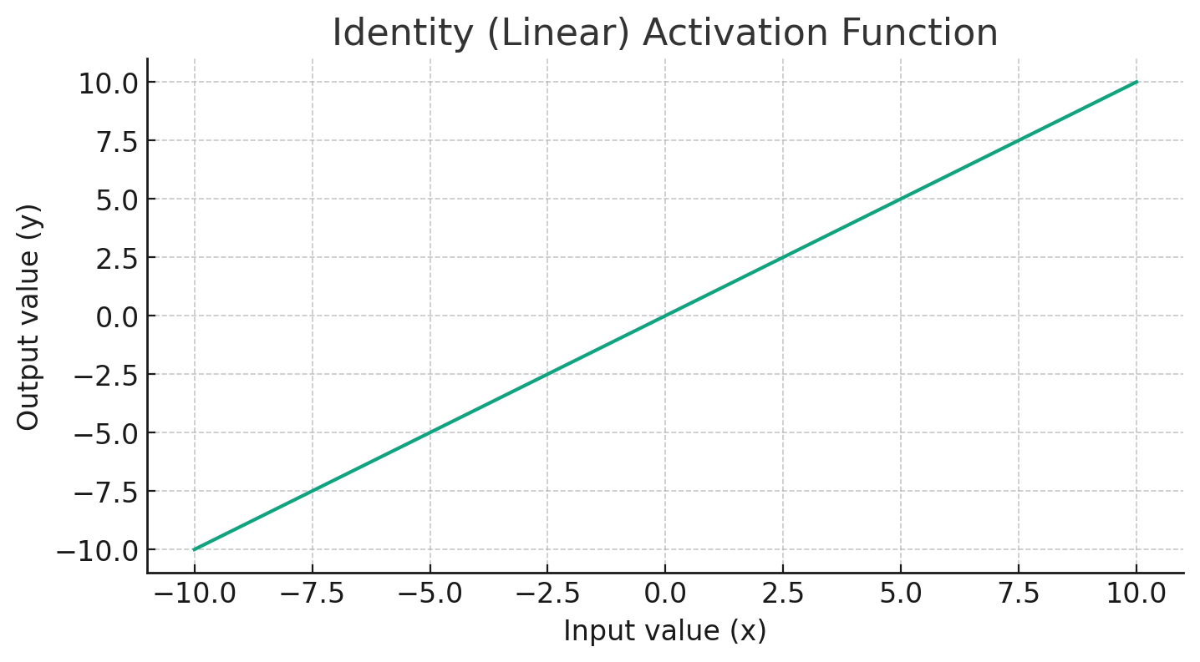
Activation Functions
Identity (i.e. no activation)
Sigmoid
Tanh
Linear Rectifier (Relu)
Softmax

Slide 26
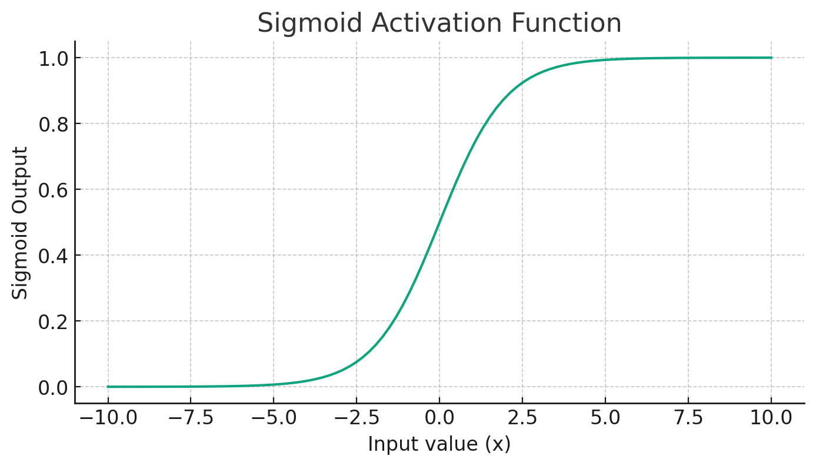
Activation Functions
Identity (i.e. no activation)
Sigmoid
Tanh
Linear Rectifier (Relu)
Softmax

Slide 27
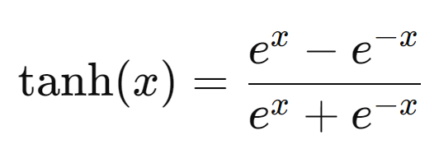
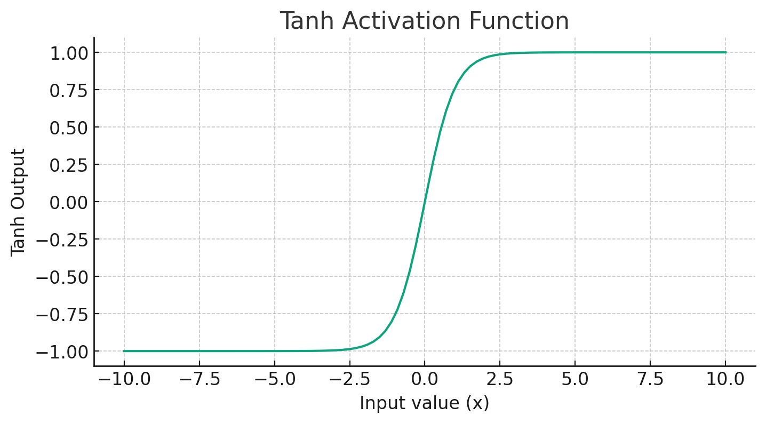
Activation Functions
Identity (i.e. no activation)
Sigmoid
Tanh
Linear Rectifier (Relu)
Softmax

Slide 28
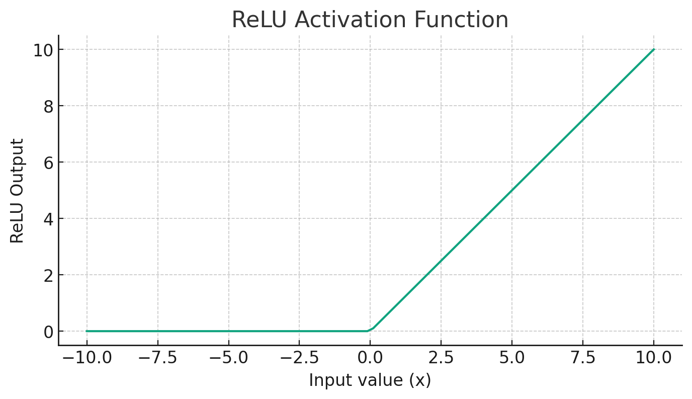
Activation Functions
Identity (i.e. no activation)
Sigmoid
Tanh
Linear Rectifier (Relu)
Softmax

Slide 29
Activation Functions
Identity (i.e. no activation)
Sigmoid
Tanh
Linear Rectifier (Relu)
Softmax
Outputs sum to 1
W_{0,0}
b₀
W_{1,0}
b₁
W_{0,1}
W_{1,1}

Slide 30
Neural Networks
W_{2,3}
W_{3,3}
W_{0,0}
b₀
W_{1,0}
b₁
W_{0,1}
W_{1,1}

Slide 31
Neural Networks
Output Layer
Flow of data
W_{2,3}
W_{3,3}
Hidden Layer
W_{0,0}
b₀
W_{1,0}
b₁
W_{0,1}
W_{1,1}
Input Layer

Slide 32
Neural Networks
Output Layer
Flow of data
W_{2,3}
W_{3,3}
Hidden Layer
W_{0,0}
b₀
W_{1,0}
b₁
W_{0,1}
W_{1,1}
Input Layer

Slide 33
Neural Networks
W_{2,3}
W_{3,3}
W_{0,0}
b₀
W_{1,0}
b₁
W_{0,1}
W_{1,1}

Slide 34
Neural Networks
W_{2,3}
W_{3,3}
W_{0,0}
b₀
W_{1,0}
b₁
W_{0,1}
W_{1,1}

Slide 35
Neural Networks
Output Layer
W_{2,3}
W_{3,3}
Hidden Layer
Learns how to construct features in the hidden layer
W_{0,0}
b₀
W_{1,0}
b₁
W_{0,1}
W_{1,1}
Input Layer

Slide 36
Neural Networks
Output Layer
Uses those features to predict your dependent variable
W_{2,3}
W_{3,3}
Hidden Layer
Learns how to construct features in the hidden layer
W_{0,0}
b₀
W_{1,0}
b₁
W_{0,1}
W_{1,1}
Input Layer

Slide 37
Feature Vectors and Model Training

Slide 38
Hidden Layer
The hidden layer of a neural network can learn features that represent the inputs.
Although uninterpretable, they represent an aggregation of data from lower layers of the network
Output Layer
W_{2,3}
W_{3,3}
Hidden Layer
W_{0,0}
b₀
W_{1,0}
b₁
W_{0,1}
W_{1,1}
Input Layer

Slide 39
Hidden Layer
The output layer produces a prediction, but sometimes we also care about the output of the hidden layer
We can “remove” the output layer to extract the outputs of the hidden layer as a set of “embedded” features
Output Layer
W_{2,3}
W_{3,3}
Hidden Layer
W_{0,0}
b₀
W_{1,0}
b₁
W_{0,1}
W_{1,1}
Input Layer

Slide 40
Hidden Layer
When a hidden layer is smaller than the previous layer, we can incorporate dimensionality reduction in our model
Output Layer
W_{2,3}
W_{3,3}
Hidden Layer
W_{0,0}
b₀
W_{1,0}
b₁
W_{0,1}
W_{1,1}
Input Layer

Slide 41
Autoencoders
Autoencoders are a special type of neural network used for unsupervised learning
The input values are used as output labels to allow the model to learn a reduced set of representative features
Mathematically equivalent to PCA when using an identity activation function
Output Layer
Hidden Layer
W_{0,0}
b₀
W_{1,0}
b₁
W_{0,1}
W_{1,1}
Input Layer

Slide 42
Model Training
Neural Networks are trained by making small iterative adjustments to weights based on model error
Output Layer
W_{2,3}
W_{3,3}
Hidden Layer
W_{0,0}
b₀
W_{1,0}
b₁
W_{0,1}
W_{1,1}
Input Layer

Slide 43
Model Training
Squared error
Test Score
m
Study Time

Slide 44
Model Training
Squared error
w

Slide 45
Model Training
Squared error
w

Slide 46
Model Training
Squared error
w

Slide 47
Model Training
Squared error
w

Slide 48
Model Training
Squared error
w

Slide 49
Model Training
This adjustment is called the learning rate
Most modern implementations use an adaptive learning rate
The model is trained over multiple epochs, or cycles through the training data
Output Layer
W_{2,3}
W_{3,3}
Hidden Layer
W_{0,0}
b₀
W_{1,0}
b₁
W_{0,1}
W_{1,1}
Input Layer

Slide 50
Model Training
Weights are updated based on performance on a batch of training samples.
Error is determined by a cost or loss function
Cross Entropy
Mean Squared Error
Output Layer
W_{2,3}
W_{3,3}
Hidden Layer
W_{0,0}
b₀
W_{1,0}
b₁
W_{0,1}
W_{1,1}
Input Layer

Slide 51
Hyperparameters
Number of layers
The type of each layer
Number of nodes per layer
Activation function for each layer
The learning rate
The optimization method
The cost function
The batch size
Number of epochs
Output Layer
W_{2,3}
W_{3,3}
Hidden Layer
W_{0,0}
b₀
W_{1,0}
b₁
W_{0,1}
W_{1,1}
Input Layer

Slide 52
Hyperparameters
Number of layers
The type of each layer
Number of nodes per layer
Activation function for each layer
The learning rate
The optimization method
The cost function
The batch size
Number of epochs
Output Layer
W_{2,3}
W_{3,3}
Hidden Layer
W_{0,0}
b₀
W_{1,0}
b₁
W_{0,1}
W_{1,1}
Input Layer

Slide 53
Hyperparameters
Number of layers
The type of each layer
Number of nodes per layer
Activation function for each layer
The learning rate
The optimization method
The cost function
The batch size
Number of epochs
Output Layer
W_{2,3}
W_{3,3}
Hidden Layer
W_{0,0}
b₀
W_{1,0}
b₁
W_{0,1}
W_{1,1}
Input Layer

Slide 54
Hyperparameters
Number of layers
The type of each layer
Number of nodes per layer
Activation function for each layer
The learning rate
The optimization method
The cost function
The batch size
Number of epochs
Output Layer
W_{2,3}
W_{3,3}
Hidden Layer
W_{0,0}
b₀
W_{1,0}
b₁
W_{0,1}
W_{1,1}
Input Layer

Slide 55
Hyperparameters
Number of layers
The type of each layer
Number of nodes per layer
Activation function for each layer
The learning rate
The optimization method
The cost function
The batch size
Number of epochs
*The method for iteratively updating weights
Adam: Adaptive gradient decent with momentum

Slide 56
Hyperparameters
Number of layers
The type of each layer
Number of nodes per layer
Activation function for each layer
The learning rate
The optimization method
The cost function
The batch size
Number of epochs
Early Stopping:
Create a validation set
Train the model and continually test it on the validation set
Find the point where the model’s performance begins to “plateau” (where it’s degree of improvement falls below a set threshold) and stop training

Slide 57
Overfitting
Test Score
Study Time

Slide 58
Overfitting
Test Score
Study Time

Slide 59
Overfitting
*Overfitting can be identified by observing the difference between training prediction error and test prediction error
Test Score
Study Time

Slide 60
Recurrent Neural Networks

Slide 61
Representing Sequential Data
Assignment 1: 0 0 0 1 0 1 1 1

Slide 62
Representing Sequential Data
Aggregate features can be informative, but it is often the case that we want to represent changes over time.
A previous module explained one potential solution by splitting data temporally
Example: Change in correctness
Assignment 1: 0 0 0 1 0 1 1 1
Early Performance
Later Performance
=.25
=.75

Slide 63
Representing Sequential Data
Aggregate features can be informative, but it is often the case that we want to represent changes over time.
A previous module explained one potential solution by splitting data temporally
Example: Change in correctness
Assignment 1: 0 0 0 1 0 1 1 1
Early Performance
Later Performance
=.25
=.75
Performance Improvement = Later – Early = 0.5

Slide 64
Recurrent Neural Nets
Y
Y
H₄
H₃
H₂
H₁
X₁
X₂
X₃
1

Slide 65
Recurrent Neural Nets
Y
Y
H₄
H₃
H₂
H₁
X₁
X₂
X₃
1
Time Step 1

Slide 66
Recurrent Neural Nets
Y
Y
Y
Y
H₄
H₄
H₃
H₃
H₂
H₂
H₁
H₁
X₁
X₂
X₃
1
X₁
X₂
X₃
1
Time Step 1
Time Step 2

Slide 67
Recurrent Neural Nets
Y
Y
Y
Y
H₄
H₄
H₃
H₃
H₂
H₂
H₁
H₁
X₁
X₂
X₃
1
X₁
X₂
X₃
1
Time Step T-1
Time Step T

Slide 68
Recurrent Neural Nets
Y
Y
H₄
H₃
H₂
H₁
X₁
X₂
X₃
1
Time Step 1
Image from http://dprogrammer.org/rnn-lstm-gru

Slide 69
Recurrent Neural Nets
Y
Y
H₄
H₃
H₂
H₁
X₁
X₂
X₃
1
Time Step 1
Image from http://dprogrammer.org/rnn-lstm-gru

Slide 70
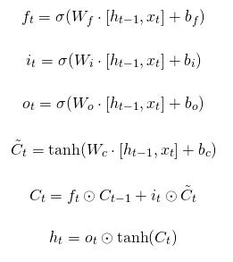
Parts of an LSTM
Image from http://dprogrammer.org/rnn-lstm-gru

Slide 71
Parts of an LSTM
How much of my aggregated memory should I forget
How much of the new information should I add to my aggregated memory
How should I combine the new information with my aggregated memory to pass onward
Image from http://dprogrammer.org/rnn-lstm-gru

Slide 72
Parts of an LSTM
How much of my aggregated memory should I forget
How much of the new information should I add to my aggregated memory
How should I combine the new information with my aggregated memory to pass onward
Image from http://dprogrammer.org/rnn-lstm-gru

Slide 73
Parts of an LSTM
How much of my aggregated memory should I forget
How much of the new information should I add to my aggregated memory
How should I combine the new information with my aggregated memory to pass onward
Image from http://dprogrammer.org/rnn-lstm-gru

Slide 74
Training Recurrent Models
Y
Y
Y
Y
H₄
H₄
H₃
H₃
H₂
H₂
H₁
H₁
X₁
X₂
X₃
1
X₁
X₂
X₃
1
Time Step 1
Time Step 2

Slide 75
Training Recurrent Models
Assignment 1: 0 0 0 1 0 1 1 1
Assignment 2: 0 0 1 0 0 1 0 0 0 1 1 0 1 1 1

Slide 76
Training Recurrent Models
Assignment 1: 0 0 0 0 0 0 0 0 0 0 1 0 1 1 1
Assignment 2: 0 0 1 0 0 1 0 0 0 1 1 0 1 1 1

Slide 77
Training Recurrent Models
Assignment 1: 0 0 0 0 0 0 0 0 0 0 1 0 1 1 1
Mask 1: 0 0 0 0 0 0 0 1 1 1 1 1 1 1 1
Assignment 2: 0 0 1 0 0 1 0 0 0 1 1 0 1 1 1
Mask 2: 1 1 1 1 1 1 1 1 1 1 1 1 1 1 1

Slide 78
Training Recurrent Models
[0, 1.2, 1]
[0, 3.4, 0]
[0, 0.7, 2]
[1, 5.2, 1]
[0, 3.1, 0]
[0, 2.1, 1]
[1, 2.6, 0]
[1, 2.6, 0]
[1, 2.3, 3]
[1, 3.7, 0]
Assignment 1
Assignment 2

Slide 79
Convolutional Neural Networks

Slide 80
Image Data
Assignment 1: 0 0 0 1 0 1 1 1
Assignment 2: 0 0 1 0 0 1 0 0 0 1 1 0 1 1 1

Slide 81
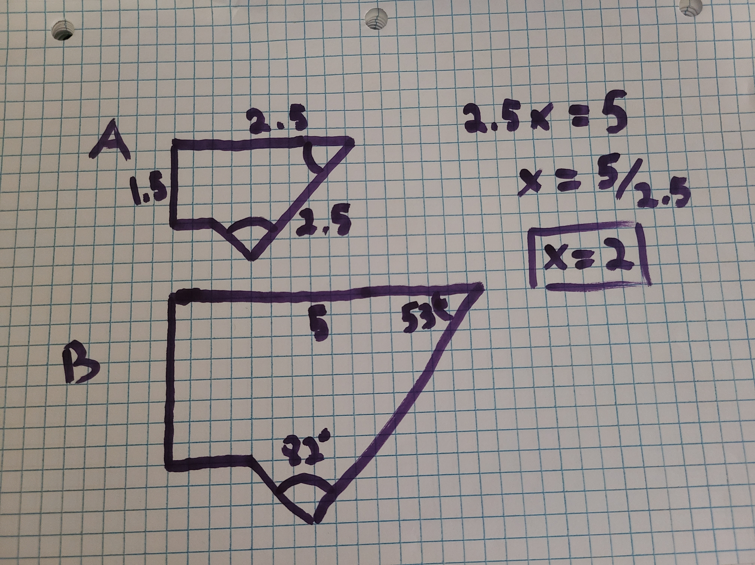
Image Data

Slide 82
Pixels

Slide 83
Pixels
Pixels are represented as a set of 3 color “channels”
[Red, Green, Blue]

Slide 84
Pixels
Pixels are represented as a set of 3 color “channels”
*An additional “alpha” channel is also common to represent pixel transparency
[Red, Green, Blue]

Slide 85
Pixels
Pixels are represented as a set of 3 color “channels”
[Red, Green, Blue]
*Each color is represented as an integer value ranging from 0 – 255
[60, 38, 63]

Slide 86
Pixels
Pixels are represented as a set of 3 color “channels”
[Red, Green, Blue]
*Each color is represented as an integer value ranging from 0 – 255
*These values are also sometimes represented as a decimal ( value/255 )
[60, 38, 63]

Slide 87
Pixels
Pixels are represented as a set of 3 color “channels”
[0, 0, 0]
[75, 75, 75]
[150, 150, 150]
[255, 255, 255]

Slide 88
Convolutional Neural Networks
Most modern image processing methods rely on the application of deep learning models
Convolutional Neural Networks are a special type of deep learning model that learns sets of features from spatial data
CNNs utilize alternating Convolutional layers and Pooling layers within the network

Slide 89
Template Matching
Output Layer
W_{2,3}
W_{3,3}
Hidden Layer
2
template
W_{0,0}
b₀
W_{1,0}
b₁
W_{0,1}
W_{1,1}
Input Layer
image

Slide 90
Template Matching
Template Matching involves comparing an image to a set of pre-determined templates
The template is systematically moved throughout the image and a distance is calculated at each point
The method can then return the point(s) with the smallest difference
2
template
image

Slide 91
Template Matching
Template Matching involves comparing an image to a set of pre-determined templates
The template is systematically moved throughout the image and a distance is calculated at each point
The method can then return the point(s) with the smallest difference
2
2
template
image

Slide 92
Template Matching
Template Matching involves comparing an image to a set of pre-determined templates
The template is systematically moved throughout the image and a distance is calculated at each point
The method can then return the point(s) with the smallest difference
2
2
template
image

Slide 93
Template Matching
Template Matching involves comparing an image to a set of pre-determined templates
The template is systematically moved throughout the image and a distance is calculated at each point
The method can then return the point(s) with the smallest difference
2
2
template
image

Slide 94
Template Matching
Template Matching involves comparing an image to a set of pre-determined templates
The template is systematically moved throughout the image and a distance is calculated at each point
The method can then return the point(s) with the smallest difference
2
2
template
image

Slide 95
Template Matching
Template Matching involves comparing an image to a set of pre-determined templates
The template is systematically moved throughout the image and a distance is calculated at each point
The method can then return the point(s) with the smallest difference
2
template
image

Slide 96
Convolutions

Slide 97
Convolutions

Slide 98
Convolutions

Slide 99
Convolutions

Slide 100
Convolutions

Slide 101
Convolutions

Slide 102
Convolutions

Slide 103
Convolutions

Slide 104
Convolutions

Slide 105
Convolutions

Slide 106
Convolutions

Slide 107
Convolutions

Slide 108
Convolutional Neural Networks
[60, 38, 63]
Images from https://medium.com/@fenjiro/face-id-deep-learning-for-face-recognition-324b50d916d1

Slide 109
Convolutional Neural Networks
[60, 38, 63]
Images from https://medium.com/@fenjiro/face-id-deep-learning-for-face-recognition-324b50d916d1

Slide 110
Convolutional Neural Networks
[60, 38, 63]
Images from https://medium.com/@fenjiro/face-id-deep-learning-for-face-recognition-324b50d916d1

Slide 111
Convolutional Neural Networks
[60, 38, 63]
Images from https://medium.com/@fenjiro/face-id-deep-learning-for-face-recognition-324b50d916d1

Slide 112
Convolutional Neural Networks
[60, 38, 63]
Images from https://medium.com/@fenjiro/face-id-deep-learning-for-face-recognition-324b50d916d1

Slide 113
Convolutional Neural Networks
[60, 38, 63]
Images from https://medium.com/@fenjiro/face-id-deep-learning-for-face-recognition-324b50d916d1

Slide 114
Convolutional Neural Networks
[60, 38, 63]
Images from https://medium.com/@fenjiro/face-id-deep-learning-for-face-recognition-324b50d916d1

Slide 115
Video Features
Video data adds a temporal element to image analyses
Videos are made of many images that are played in a sequence with a synchronized audio track
We can apply the same principle concepts to analyze video as we do for image data, but need to then just incorporate temporal methods
Most modern methods will combine a Recurrent Deep Learning model with a Convolutional model to represent changes in pixel information over time

