Slide 1
Prediction Modeling and Evaluation Metrics

Slide 2
Prediction Modeling

Slide 3
Models of Data
When we “analyze data,” we use various methods to examine the relationships that exist within that data
Statistical models used to analyze data typically fall into one of two categories:
Supervised Learning
Unsupervised Learning
Where approaches that utilize both types of model are then described as
Semi-supervised learning

Slide 4
Supervised Learning
Supervised learning examines relationships between one or more variables and a target variable
The target variable is referred to as the dependent variable or label while the others are referred to as independent variables, covariates, predictors, and features
The terms “independent variables,” “covariates,” and “predictors” often used interchangeably, but there are subtle differences between these
Terms such as “features” or “variables” are typically used in a more generalized manner

Slide 5
Common Research Questions answered by prediction modeling: How well can we predict [future event]? How well can we detect [something that has happened]? What are the features that are most predictive of [something of interest]? What is the relationship between [feature] and [outcome], accounting for [other features]?

Slide 6
Common Research Questions answered by prediction modeling: How well can we predict [future event]? How well can we detect [something that has happened]? What are the features that are most predictive of [something of interest]? What is the relationship between [feature] and [outcome], accounting for [other features]?

Slide 7
How well can we predict [future event]?
How well can we predict student test scores?
How well can we predict students’ college enrollment?
How well can we predict student dropout?
How well can we predict a student’s next problem correctness?

Slide 8
Common Research Questions answered by prediction modeling: How well can we predict [future event]? How well can we detect [something that has happened]? What are the features that are most predictive of [something of interest]? What is the relationship between [feature] and [outcome], accounting for [other features]?

Slide 9
How well can we detect [something that has happened]?
How well can we detect students who are struggling?
How well can we detect student frustration?
How well can we detect whether the student knows a concept?
How well can we detect when learning occurs?
Learning might have happened here

Slide 10
Common Research Questions answered by prediction modeling: How well can we predict [future event]? How well can we detect [something that has happened]? What are the features that are most predictive of [something of interest]? What is the relationship between [feature] and [outcome], accounting for [other features]?

Slide 11
What are the features that are most predictive of [something of interest]?
What features are most predictive of student dropout?
What features are most predictive of college enrollment?
What features are most predictive of student test scores?
What features are most predictive of model error?

Slide 12
Common Research Questions answered by prediction modeling: How well can we predict [future event]? How well can we detect [something that has happened]? What are the features that are most predictive of [something of interest]? What is the relationship between [feature] and [outcome], accounting for [other features]?

Slide 13
What is the relationship between [feature] and [outcome], accounting for [other features]?
What is the relationship between a learning intervention and test scores, accounting for prior knowledge?
What is the relationship between study time and test scores, accounting for the studying method?

Slide 14
Measuring Relationships
We often want to examine how two variables are correlated or even causally linked

Slide 15
Measuring Relationships
We often want to examine how two variables are correlated or even causally linked
We may extend this to examine how multiple independent variables relate to a single target variable

Slide 16
Measuring Relationships
We often want to examine how two variables are correlated or even causally linked
It is rare for two variables to share a relationship that is not in some way influenced by other variables or factors.

Slide 17
Measuring Relationships
We often want to examine how two variables are correlated or even causally linked
It is rare for two variables to share a relationship that is not in some way influenced by other variables or factors.
Supervised learning methods allow us to examine individual relationships while controlling for (or accounting for) other relationships that might confuse or confound our understanding that relationship

Slide 18
Terminology Recap
Dependent Variable – the target variable; an outcome of interest that we care about. Sometimes called the “label”
Independent Variable – another variable or set of variables for which we want to examine the relationship with the dependent variable
Covariate – a variable or set of variables that we think may also relate with the dependent variable that we want to “control for” in our analysis
Predictor – a variable or set of variables (independent variables and covariates) that are used to predict the dependent variable
Confounding Variable – a variable or set of variables that influences both an independent variable (or predictor) and the dependent variable

Slide 19
Introduction to Different Types of Data

Slide 20
Numeric and Non-numeric Types
Non-Numeric*
Non-Numeric
Numeric
Numeric
*Identifiers often look numeric, but just represent ways of distinguishing one entity from another

Slide 21
Types of Data
Nominal
Ordinal / Discrete
Continuous
Ratio

Slide 22
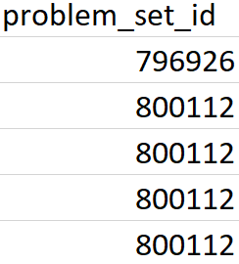
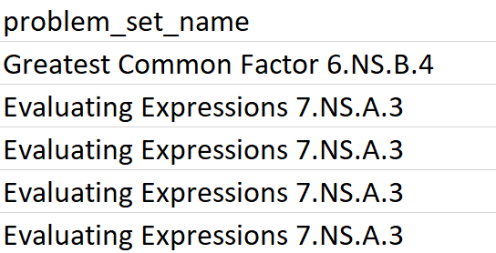
Nominal Data
Nominal / Categorical Data
Text data
Identifiers

Slide 23
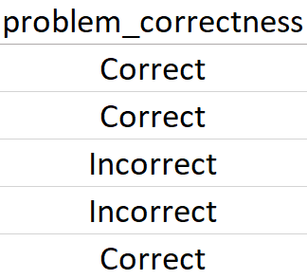
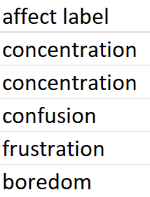
Nominal Data
Nominal / Categorical Data
When there are 2 categories: binary or binomial data
When there are more than 2 categories: multinomial data

Slide 24
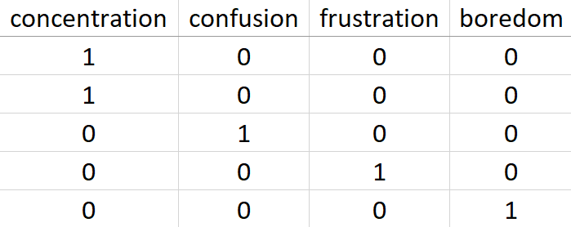
Nominal Data
Nominal / Categorical Data
Multinomial data can be converted into multiple binary features using 1-hot encoding*
*Sometimes also referred to as dummy coding

Slide 25
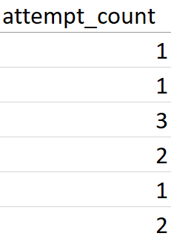
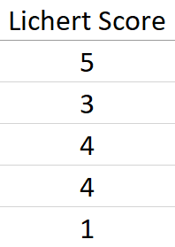
Ordinal Data
Ordered Data
Counts
Rankings
Integer Scores

Slide 26
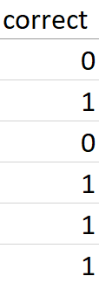
Ordinal Data
Binary Data can also be considered ordinal
Ordinal Data can sometimes be treated as Nominal

Slide 27
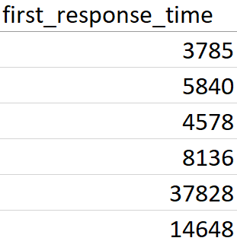
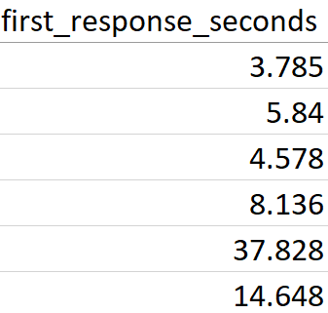
Continuous Data
Numeric Data (Often decimal-valued)
Measurements
Time-based features

Slide 28
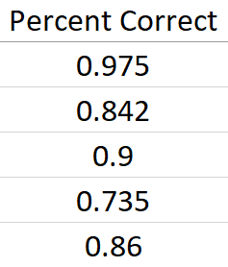
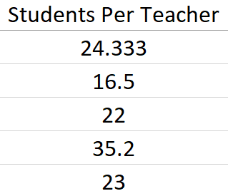
Ratio Data
Numeric Data (Often percentages)
A special case of Continuous Data
Percentage
Fractions

Slide 29
Transforming Data
“Median Split”
Is the value greater than or equal to the median? (0.86)
Ratio/Continuous
Ordinal/Nominal

Slide 30
Transforming Data
“Binning”
Does the value fall within a set boundary?
Ratio/Continuous
Ordinal/Nominal

Slide 31
Transforming Data
Ordinal
Re-Labeling
Ranking / Median Split
Nominal
Median Split
Ratio/Continuous

Slide 32
Linear Models

Slide 33
What is a model?
A mathematic representation that describes the relationships between two or more variables
They quantitatively describe the structure of a measure or construct through data
Using historic examples, we can fit or train a model to learn the structure of relationships in the data.

Slide 34
Linear Models
Linear models, such as linear regression and logistic regression, can learn linear relationships in data.
Test Score
Study Time

Slide 35
Linear Models
Linear models, such as linear regression and logistic regression, can learn linear relationships in data.
Test Score
Study Time

Slide 36
Linear Models
Linear models, such as linear regression and logistic regression, can learn linear relationships in data.
Test Score
Study Time

Slide 37
Linear Models
Linear models, such as linear regression and logistic regression, can learn linear relationships in data.
Test Score
Study Time

Slide 38
Linear Models
Linear models, such as linear regression and logistic regression, can learn linear relationships in data.
Test Score
Study Time

Slide 39
Linear Models
Linear models, such as linear regression and logistic regression, can learn linear relationships in data.
Test Score
Study Time

Slide 40
Linear Models
Linear models, such as linear regression and logistic regression, can learn linear relationships in data.
y = mx + b
Test Score
Study Time

Slide 41
Linear Models
Linear models, such as linear regression and logistic regression, can learn linear relationships in data.
y = mx + b
Test Score
Study Time

Slide 42
Linear Models
Linear models, such as linear regression and logistic regression, can learn linear relationships in data.
y = 0.4x + b
Test Score
For every one unit increase of study time, we tend to see 0.4 points higher scores on the test
Study Time

Slide 43
Linear Models
Linear Regression fits a line to the data
Logistic Regression is applied to binomial data
Finds where categories are “linearly separable”
Test Score
Study Time

Slide 44
Linear Models
Logistic Regression is applied to binomial data
Finds where categories are “linearly separable”
High
Test Score
Low
Study Time

Slide 45
Linear Models
Logistic Regression is applied to binomial data
Finds where categories are “linearly separable”
High
Test Score
Low
Study Time

Slide 46
Linear Models
Logistic Regression is applied to binomial data
Finds where categories are “linearly separable”
High
Test Score
Low
Study Time

Slide 47
Linear Models
Logistic Regression is applied to binomial data
Finds where categories are “linearly separable”
High
Test Score
y = logit(mx + b)
Low
Study Time

Slide 48
Assumptions
Linear and Logistic Regression makes several assumptions about the data:
There is a linear relationship between the predictors and dependent variables

Slide 49
Assumptions
Linear and Logistic Regression makes several assumptions about the data:
There is a linear relationship between the predictors and dependent variables
Test Score
Study Time

Slide 50
Assumptions
Linear and Logistic Regression makes several assumptions about the data:
There is a linear relationship between the predictors and dependent variables
Test Score
Study Time

Slide 51
Assumptions
Linear and Logistic Regression makes several assumptions about the data:
There is a linear relationship between the predictors and dependent variables
*Underfitting*
Test Score
Study Time

Slide 52
Assumptions
Linear and Logistic Regression makes several assumptions about the data:
There is a linear relationship between the predictors and dependent variables
The independent variables are independent (not correlated)
Multicollinearity

Slide 53
Assumptions
Linear and Logistic Regression makes several assumptions about the data:
There is a linear relationship between the predictors and dependent variables
The independent variables are independent (not correlated)
Multicollinearity
Lasso and Ridge Regression are special types of linear regression that helps to account for collinear features

Slide 54
Prediction Modeling and Evaluation Metrics

Slide 55
Model Evaluation
Identifiers
Label(s)
Dataset
Model Features

Slide 56
Model Evaluation
Identifiers
Model Features
Label(s)
Dataset

Slide 57
Model Evaluation
Identifiers
Model Features
Label(s)
Identifiers
Model Features
Dataset
Future Data

Slide 58
Model Evaluation
Identifiers
Model Features
Label(s)
Training Set
Test/Holdout Set
Dataset

Slide 59
Model Evaluation
How well does our model perform on previously-unseen samples?
Step 1: Train a model using the features and labels of the training set
Step 2: Apply the model using the features in the test set to produce a set of predictions
Step 3: Compare the test set predictions to the actual test set labels

Slide 60
Model Evaluation
It is important that you do not make decisions based on the holdout set
You shouldn’t “peek” at your holdout to make changes to your model
Training Set
Test Set

Slide 61
Model Evaluation
Your training set is sometimes called a “sandbox” set – you can “play” with your model parameters all you like.
You can split your training set into two sets to emulate the testing process, creating a validation set
Training Set
Used for training and model exploration
Validation Set
Test Set
A pure holdout set

Slide 62
Cross Validation
A simple train/test split has a notable weakness:
Your test set may not be representative of the larger set/population
Differences in subpopulations
Different label proportions
The existence/lack of outliers
Training Set
Test Set

Slide 63
Cross Validation
K-Fold Cross Validation
Data Set

Slide 64
Cross Validation
K-Fold Cross Validation
Step 1: Divide your data into K “folds”
- K can be any number, though 5 or 10 are most common
Fold 1
Fold 2
Fold 3
Fold 4
Fold 5
Example: 5-fold Cross Validation

Slide 65
Cross Validation
K-Fold Cross Validation
Step 1: Divide your data into K “folds”
- K can be any number, though 5 or 10 are most common
Fold 1
Fold 2
Step 2: Train a model using all but one of the folds
- The remaining fold acts as a holdout set
Training Set
Fold 3
Fold 4
Fold 5
Test Set
Example: 5-fold Cross Validation

Slide 66
Cross Validation
K-Fold Cross Validation
Step 1: Divide your data into K “folds”
- K can be any number, though 5 or 10 are most common
Fold 1
Fold 2
Step 2: Train a model using all but one of the folds
- The remaining fold acts as a holdout set
Training Set
Fold 3
Fold 4
Step 3: Evaluate the model on the remaining fold
Fold 5
Test Set
Example: 5-fold Cross Validation

Slide 67
Cross Validation
K-Fold Cross Validation
Step 1: Divide your data into K “folds”
- K can be any number, though 5 or 10 are most common
Fold 1
Fold 2
Training Set
Step 2: Train a model using all but one of the folds
- The remaining fold acts as a holdout set
Fold 3
Fold 4
Test Set
Step 3: Evaluate the model on the remaining fold
Fold 5
Training Set
Example: 5-fold Cross Validation
Step 4+: Repeat the process with each fold as the holdout

Slide 68
Cross Validation
K-Fold Cross Validation
Step 1: Divide your data into K “folds”
- K can be any number, though 5 or 10 are most common
Fold 1
Fold 2
Training Set
Step 2: Train a model using all but one of the folds
- The remaining fold acts as a holdout set
Fold 3
Test Set
Fold 4
Step 3: Evaluate the model on the remaining fold
Training Set
Fold 5
Example: 5-fold Cross Validation
Step 4+: Repeat the process with each fold as the holdout

Slide 69
Cross Validation
K-Fold Cross Validation
Step 1: Divide your data into K “folds”
- K can be any number, though 5 or 10 are most common
When finished, you’ll have K sets of evaluation metrics
Take an average of these to find the overall model performance
Step 2: Train a model using all but one of the folds
- The remaining fold acts as a holdout set
Step 3: Evaluate the model on the remaining fold
Step 4+: Repeat the process with each fold as the holdout

Slide 70
Cross Validation
Special Cases:
Leave-one-out Cross Validation: Cross validation is conducted where K equals the number of samples in the dataset.
- Often considered the most robust approach, but is computationally expensive.
Stratified Cross Validation: Samples are grouped to maintain similar data distributions within each fold.
Group-Level Cross Validation: Data is folded such that no data from a specified group exists across multiple folds
- “student-level” cross validation ensures that each student’s data is contained within a single fold

Slide 71
Cross Validation
Student-Level Cross Validation
Without Student-Level Cross Validation:
How well does our model perform on previously-unseen samples from the same students in our training set?
With Student-Level Cross Validation:
How well does our model perform on data from previously-unseen students?

Slide 72
Evaluation Metrics

Slide 73
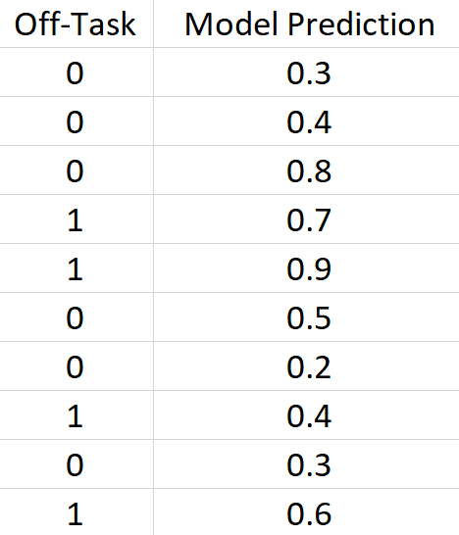
How do we know if our model is “good”?
There are different ways to measure how well a model is able to make predictions

Slide 74
How do we know if our model is “good”?
There are different ways to measure how well a model is able to make predictions
Actual
Predicted

Slide 75
How do we know if our model is “good”?
There are different ways to measure how well a model is able to make predictions
Actual
Predicted
A.K.A:
Y
Label
Class
Dependent
A.K.A:
Ŷ (“Y hat”)
P
Estimate
Probability

Slide 76
Types of Metrics
There are numerous metrics that are common in different contexts
Metrics that use the continuous-valued predictions/probabilities
Measure aspects of error and model fit
Can reveal aspects of model confidence
Metrics that use rounded predictions or “classifications”
Measure how well the model is able to make decisions and distinctions

Slide 77
Metrics
Error
Mean Absolute Error
Squared Error
Root Mean Squared Error (RMSE)
Spearman’s Rho
R²
Accuracy
Precision
Recall
F1 Score
Cohen’s Kappa
Area Under the Receiver Operating Characteristic Curve (AUC)

Slide 78
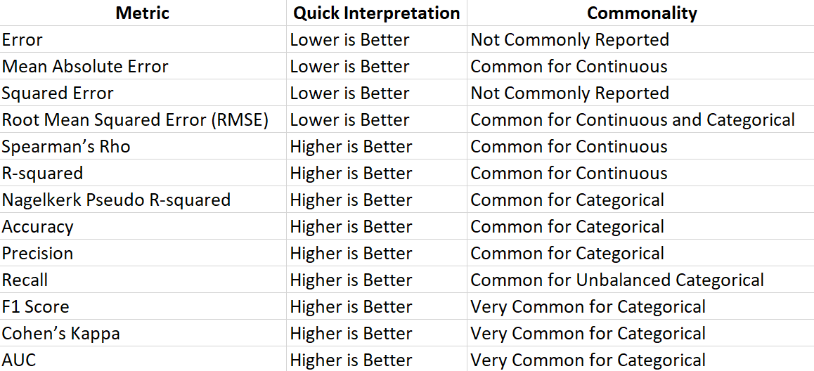
Metrics
Reference Guide
Error
Mean Absolute Error
Squared Error
Root Mean Squared Error (RMSE)
Spearman’s Rho
R²
Accuracy
Precision
Recall
F1 Score
Cohen’s Kappa
Area Under the Receiver Operating Characteristic Curve (AUC)

Slide 79
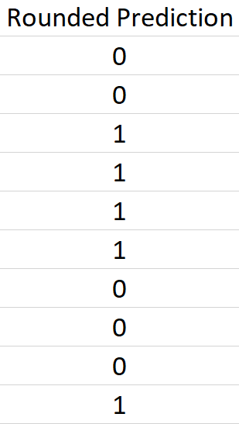
Accuracy (for categorical labels)
Accuracy is among the easiest to understand measures
Can be misleading if the proportion of your labels is imbalanced
Round predictions up or down
# matching
Accuracy =
# samples

Slide 80
Root Mean Squared Error
RMSE is a measure of error which disregards whether a model over- or under-predicts
Common for continuous labels
Sometimes used as a secondary-metric for categorical labels
Can act as a measure of model confidence
SE= $(actual −predicted$)²
MSE= $Mean(SE$)
RMSE= SquareRoot$(MSE$)

Slide 81
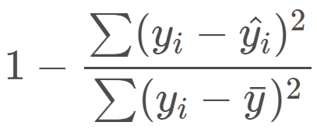
R²
“R-squared” a.k.a the “coefficient of determination”
Used to describe the model’s “goodness of fit”
R² =
It is effectively the percent of variance in the dependent variable that is explained by the model
Example: an R² of 0.8 means that your model explains 80% of your outcome, meaning there is some set of features that are not included in your model that accounts for 20% of what your outcome is measuring.

Slide 82
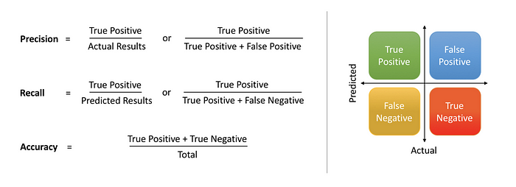
Precision and Recall
Observe the “true-positive”, “false-positive”, and “false-negative” rates
Precision and Recall are especially useful for measuring how well your model classifies a rarely-occurring label (like high school dropout) while considering false-positive rates
https://medium.com/@shrutisaxena0617/precision-vs-recall-386cf9f89488

Slide 83
Cohen’s Kappa
A measure of inter-rater reliability or “agreement”
Often used to determine if two observers agree on a classifying an observed construct or behavior
Improves upon simple accuracy by recognizing that a model might get some predictions right by just randomly guessing
A measure of “agreement above chance”

Slide 84
Cohen’s Kappa
2 * (TP * TN – FN * FP)
K =
(TP + FP) * (FP + TN) + (TP + FN) * (FN + TN)
Actual
1
0
1
TP
FN
A value of 0 means the model does no better than random guessing
A value of 1 means the model is in perfect agreement with the label
A value of -1 means the model is in perfect disagreement with the label (likely an error due to mislabeling)
Predicted
0
FP
TN

Slide 85
Cohen’s Kappa
2 * (TP * TN – FN * FP)
K =
(TP + FP) * (FP + TN) + (TP + FN) * (FN + TN)
Actual
1
0
1
TP
FN
A value of 0 means the model does no better than random guessing
A value of 1 means the model is in perfect agreement with the label
A value of -1 means the model is in perfect disagreement with the label (likely an error due to mislabeling)
Predicted
0
FP
TN

Slide 86
AUC
Area Under the Receiver Operating Characteristic Curve
Brace yourselves, this sounds more complicated than it really is!

Slide 87
AUC
Area Under the Receiver Operating Characteristic Curve
Used only for binary prediction tasks
Variations exist for multi-class classification
Most metrics have required us to round our predictions up or down
0.5 is usually used as a rounding threshold, but may not be optimal when we have unbalanced labels
AUC allows us to know how well our models perform regardless of what we choose as a rounding threshold

Slide 88
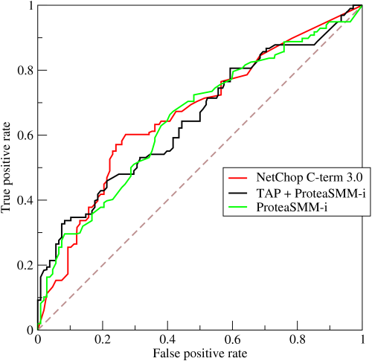
AUC
Traditionally, AUC is defined by looking at the “ROC” curve produced by the true-positive and false-positive rates
https://en.wikipedia.org/wiki/Receiver_operating_characteristic#/media/File:Roccurves.png

Slide 89
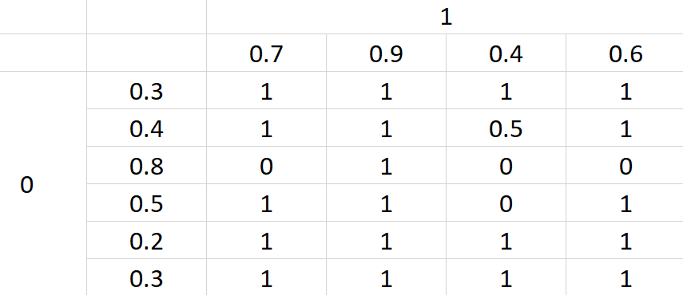
AUC
We hope our model predicts higher values for the samples…
AUC is the probability that a prediction for a positive label (1) is higher than a prediction for a negative label (0)

Slide 90
AUC
We hope our model predicts higher values for the samples…
AUC is the probability that a prediction for a positive label (1) is higher than a prediction for a negative label (0)

Slide 91
AUC
We hope our model predicts higher values for the samples…
AUC is the probability that a prediction for a positive label (1) is higher than a prediction for a negative label (0)

Slide 92
AUC
We hope our model predicts higher values for the samples…
AUC is the probability that a prediction for a positive label (1) is higher than a prediction for a negative label (0)
Is 0.7 greater than 0.3?

Slide 93
AUC
We hope our model predicts higher values for the samples…
AUC is the probability that a prediction for a positive label (1) is higher than a prediction for a negative label (0)

Slide 94
AUC
We hope our model predicts higher values for the samples…
AUC is the probability that a prediction for a positive label (1) is higher than a prediction for a negative label (0)
AUC = 0.81

Slide 95
AUC
Higher values are better
AUC is bounded between 0 and 1, with 0.5 indicating performance no better than random chance
Practically, AUC is usually between 0.5 and 1 unless a modeling error was made

Slide 96
Choosing Metrics
It is usually best to report multiple complementary metrics to describe different dimensions of model performance
AUC, Cohen’s Kappa, RMSE, and Recall
RMSE, R², and Spearman’s Rho
Example- For Categorical Labels:
Example- For Continuous Labels:
Note: these metrics are what I typically choose to report but can depend greatly on the context

Slide 97
Baselines of Comparison

Slide 98
Why Baselines?
If we want to know how “good” our models are, we often need something to compare them to
Best Option: Compare your models to the previous “best” model

Slide 99
Why Baselines?
If we want to know how “good” our models are, we often need something to compare them to
Best Option: Compare your models to the previous best model
But what if we’re the first to build a model predicting [something]?
But what if others have predicted [something] in a different context or system?

Slide 100
Strawman Comparisons
A “strawman” comparison is one that is easily beaten

Slide 101
Strawman Comparisons
A “strawman” comparison is one that is easily beaten
If your “fancy” model can’t beat the simplest approach, did it actually learn anything useful?

Slide 102
Majority Class
Step 1: Find the most frequent label in your training set
Step 2: Predict that label for all samples of your test set

Slide 103
Majority Class
Example: In a dataset, 15% of the examples are labeled as “off-task” – most examples are NOT off-task
The off-task majority class model would predict 0 for all examples of the test set

Slide 104
“Average” Model
Step 1: Find the average of each binary label in your training set
Step 2: Predict that value as the probability for all samples of your test set

Slide 105
“Average” Model
Example: In a dataset, 15% of the examples are labeled as “off-task”
The off-task “Average” model would predict 0.15 for all examples of the test set

Slide 106
Evaluation
The majority class and average models predict the same value for all test samples (but may differ across folds of a cross validation)
AUC will equal 0.5
Kappa will equal 0
Accuracy will equal 85%

Slide 107
Evaluation
Example: In a hypothetical dataset of students, 98% students graduated, 2% dropped out of school
Let’s say we want to build a dropout detector
What would the majority class model predict?

Slide 108
Evaluation
Example: In a hypothetical dataset of students, 98% students graduated, 2% dropped out of school
Let’s say we want to build a dropout detector
What would the majority class model predict?
The model would predict 0 for all students (not dropout)

Slide 109
Evaluation
Example: In a hypothetical dataset of students, 98% students graduated, 2% dropped out of school
Let’s say we want to build a dropout detector
What would the Accuracy of the Majority Class model be?

Slide 110
Evaluation
Example: In a hypothetical dataset of students, 98% students graduated, 2% dropped out of school
Let’s say we want to build a dropout detector
What would the Accuracy of the Majority Class model be?
98% Accuracy

Slide 111
Evaluation
Example: In a hypothetical dataset of students, 98% students graduated, 2% dropped out of school
Let’s say we want to build a dropout detector
What would the Accuracy of the Majority Class model be?
If a logistic regression model gets 97% Accuracy, is this good?
98% Accuracy

Slide 112
“Good” Models
“Good” models perform well and have utility
Majority Class: 98% Accuracy
(Performs better, but has no utility)
Logistic Regression: 97% Accuracy

Slide 113
“Good” Models
“Good” models perform well and have utility
Majority Class: 98% Accuracy, Recall = 0%
Logistic Regression: 97% Accuracy, Recall = 25%

Slide 114
More Modeling Methods

Slide 115
Linear Models
Linear models, such as linear regression and logistic regression, can learn linear relationships in data.
y = mx + b
Test Score
Study Time

Slide 116
Decision Trees

Slide 117
Decision Trees
Decision Trees (DT) are a type of non-linear or non-parametric (i.e. makes no assumptions about distribution) model
A DT model finds the most predictive features and identifies “split points” that optimally divide samples into smaller sub-groups, forming a tree-like data structure

Slide 118
Decision Trees
Example:
Test Score
Study Time

Slide 119
Decision Trees
Example:
Test Score
Study Time

Slide 120
Decision Trees
Example:
Test Score
Study Time

Slide 121
Decision Trees
Example:
Study Time
<10 min
>10 min
G₁
Test Score
Study Time
<1 hour
>1 hour
G₂
G₃
Study Time

Slide 122
Decision Trees
Features and split points are determined based on how distinctive the resulting groups are
A number of methods are commonly used:
Information gain
Gini index
Gain ratio
The most important features are found at the “root” or top of the tree

Slide 123
Decision Trees
Decision trees can be “pruned” to help reduce the complexity of the model
Common parameters can be set:
Minimum Leaf Size: the smallest number of samples allowable to result in any split
Maximum Height: the largest number of allowable splits
Split method/criteria: the method and thresholds for splitting data (often very dependent on the context of the data)
Study Time
<10 min
>10 min
G₁
Study Time
<1 hour
>1 hour
G₂
G₃

Slide 124
Naïve Bayes

Slide 125
Bayes Theorem
P(B | A) x P(A)
P(A | B) =
P(B)

Slide 126
Bayes Theorem
P(B | A) x P(A)
P(A | B) =
P(B)
A: The student gets a high score on the test
B: The student studied

Slide 127
Bayes Theorem
The probability that a student gets a high score, given that the student studied
P(B | A) x P(A)
P(A | B) =
P(B)
A: The student gets a high score on the test
B: The student studied

Slide 128
Bayes Theorem
What is the probability of [something], given some set of features, accounting for both the likelihood of [something] happening regardless of those features and how often we see correlations between those features and [something]

Slide 129
Naïve Bayes
Uses Bayes Theorem to measure probabilistic relationships between features and a classification label
P(B | A) x P(A)
P(A | B) =
P(B)

Slide 130
Support Vector Machines

Slide 131
Support Vector Machines (SVM)
Hours of Sleep
Legend
Study Time
High Score
Low Score

Slide 132
Support Vector Machines (SVM)
Hours of Sleep
Legend
Study Time
High Score
Low Score

Slide 133
Support Vector Machines (SVM)
Hours of Sleep
Legend
Study Time
High Score
Low Score

Slide 134
Support Vector Machines (SVM)
Hours of Sleep
Legend
Study Time
High Score
Low Score

Slide 135
Support Vector Machines (SVM)
Hours of Sleep
Legend
Study Time
High Score
Low Score

Slide 136
Support Vector Machines (SVM)
Hours of Sleep
Legend
Study Time
High Score
Low Score

Slide 137
Support Vector Machines (SVM)
Hours of Sleep
Legend
Study Time
High Score
Low Score

Slide 138
Support Vector Machines (SVM)
Finds the boundary of the label cluster and draws a “support vector”
Hours of Sleep
Legend
Study Time
High Score
Low Score

Slide 139
Support Vector Machines (SVM)
Hours of Sleep
Legend
Study Time
High Score
Low Score

Slide 140
Support Vector Machines (SVM)
Finds the boundaries between clusters of labels
Uses cross-validation internally to identify boundaries and clusters to optimize the trade-offs of misclassification
Hours of Sleep
Study Time

