Slide 1
Data Science Methods for Digital Learning Platforms Certificate
Week 1

Slide 2
Welcome!
We’re excited to welcome you to the certificate in Data Science Methods for Digital Learning Platforms
Mission: provide learners with hands-on experience in understanding and applying a range of intermediate and advanced data science methods on real digital learning platform datasets, as well as space to develop your professional identity in equity-oriented data science.

Slide 3
Welcome!
Over the last 15 years, the educational data mining and learning analytics communities have developed a range of algorithms tailored to the data and R&D goals of digital learning platforms. The Data Science Methods for Digital Learning Platforms certificate will provide you with a breadth and depth of skills that expand beyond existing courses of its length in data science or education more generally.

Slide 4
Where you already are
We have carefully hand-picked the best applicants to the program
Looking at career interests, past experiences, and preparation
Your cohort are the best and brightest and we’re honored to be teaching you

Slide 5
Where we hope you’ll be at the end
Prepare to become an education researcher capable of leveraging large-scale data using data science methods to augment education quality using digital learning platforms.

Slide 6
Digital Learning Platforms
A recent explosion of digital learning platforms being used at scale in K-12 and undergraduate learning in the USA
Richer and richer interactions

Slide 7
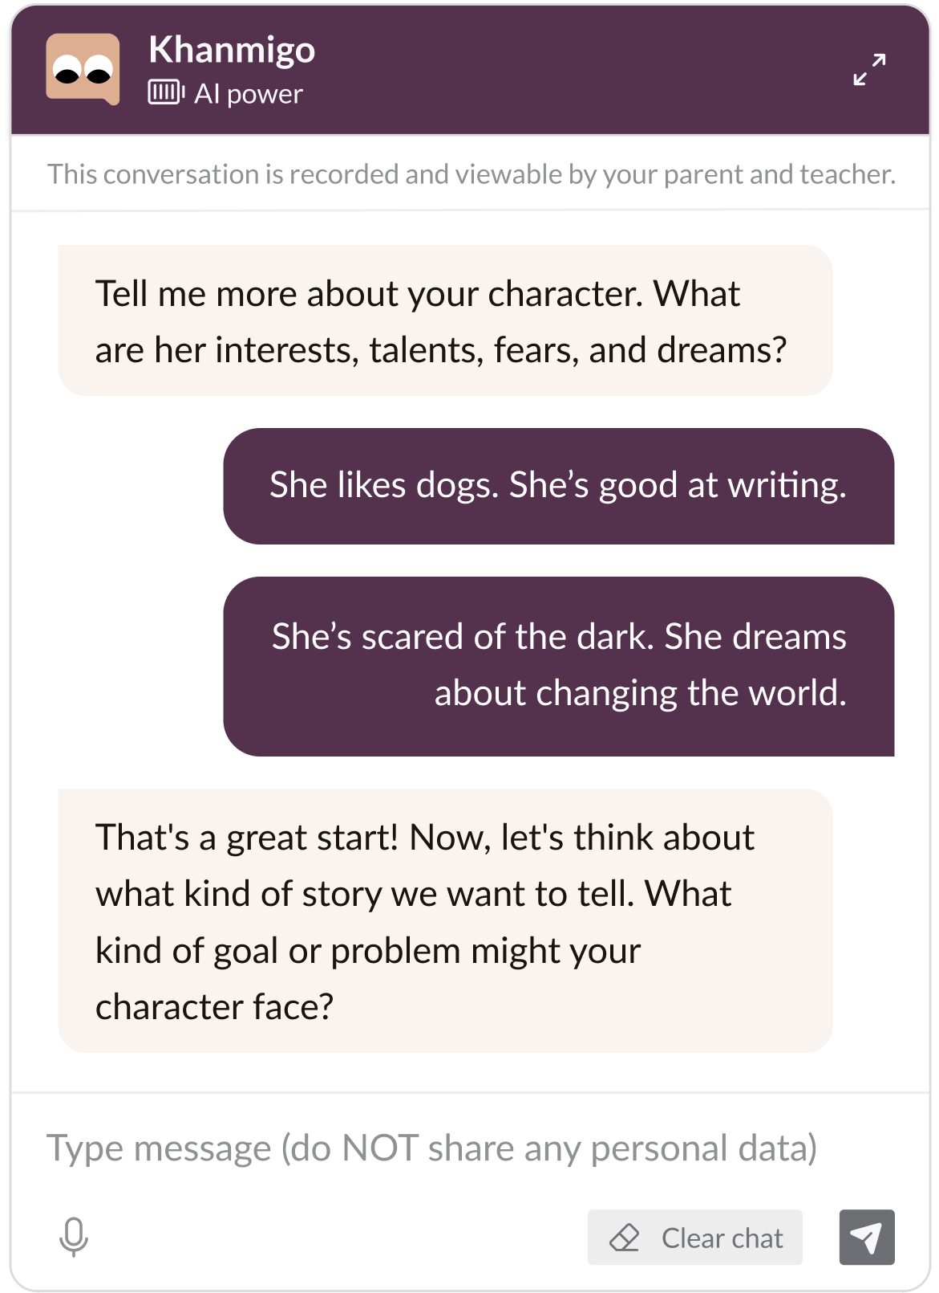
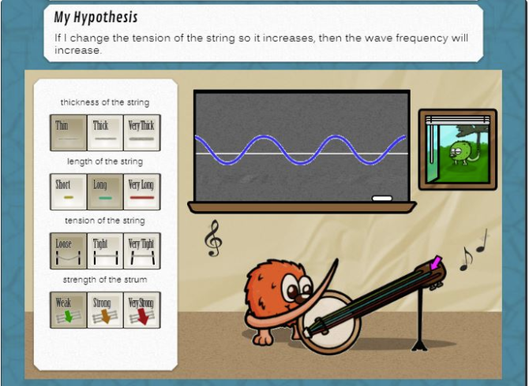
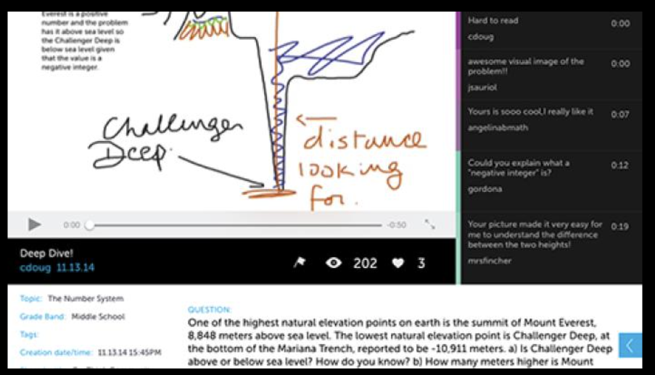

Slide 8
Data Science Methods
In this certificate, you’ll learn a range of different methods involving data science/learning analytics/educational data mining

Slide 9
Data Science and Statistics
Closely-allied fields
Sometimes subtle differences in what the same terminology means
We’ll try to flag these for those of you with statistics background

Slide 10
Data Science and Statistics
Especially with digital learning platforms, we are often dealing with large quantities of data (debatably “big” data)
Many traditional statistical paradigms break down at this size
Everything comes up statistically significant, even with tiny effect sizes
Some stats tools are just too slow with this much data
Many of the concerns of statistics still very relevant
Many of the methods drawn from statistics
Porous boundaries between fields

Slide 11
Two communities
International Educational Data Mining Society
First event: EDM workshop in 2005 (at AAAI)
First conference: EDM2008
Publishing JEDM since 2009
Society for Learning Analytics Research
First conference: LAK2011
Journal of Learning Analytics (founded 2012)

Slide 12
Two communities
Joint goal of exploring the “big data” now available on learners and learning
To promote
New scientific discoveries & to advance learning sciences
Better assessment of learners along multiple dimensions
Cognitive, meta-cognitive, emotional, social, etc.
Better real-time support for learners
Adaptive learning systems
Actionable information for teachers and other school personnel

Slide 13
Types of EDM/LA method (Baker & Siemens, 2014, 2022; building off of Baker & Yacef, 2009)
Prediction
Classification
Regression
Latent Knowledge Estimation
Sequential Classifiers
Structure Discovery
Clustering
Factor Analysis
Domain Structure Discovery
Network Analysis
Epistemic Network Analysis
Relationship mining
Association rule mining
Correlation mining
Sequential pattern mining
Causal data mining
Visualization
Discovery with models

Slide 14
Prediction
Develop a model which can infer a single aspect of the data (predicted variable) from some combination of other aspects of the data (predictor variables)
Which students are off-task?
Which students will fail the class?

Slide 15
Structure Discovery
Find structure and patterns in the data that emerge “naturally”
No specific target or predictor variable

Slide 16
Relationship Mining
Discover relationships between variables in a data set with many variables

Slide 17
Discovery with Models
Pre-existing model (developed with EDM prediction methods… or clustering… or knowledge engineering)
Applied to data and used as a component in another analysis

Slide 18
Types of EDM/LA method (Baker & Siemens, 2014, 2022; building off of Baker & Yacef, 2009)
Prediction
Classification
Regression
Latent Knowledge Estimation
Sequential Classifiers
Structure Discovery
Clustering
Factor Analysis
Domain Structure Discovery
Network Analysis
Epistemic Network Analysis
Relationship mining
Association rule mining
Correlation mining
Sequential pattern mining
Causal data mining
Visualization
Discovery with models

Slide 19
Topics/Weeks
Introduction, Challenges, and Framework
Prediction Modeling and Metrics
Feature Extraction and Feature Engineering
Neural Networks and Deep Learning
Data Visualization
Ethics, Equity, and Algorithmic Bias
Data Management and Database Access
Knowledge Graphs
Knowledge Tracing
Data and Measurement Validity
Cluster Analysis
Network Analysis
Sequential Pattern Mining and Temporal Analysis
Causal Reasoning
Natural Language Processing
Transformer and Foundation Models

Slide 20
Taught by experts from around the country
Topics/Weeks
Introduction, Challenges, and Framework
Prediction Modeling and Metrics
Feature Extraction and Feature Engineering
Neural Networks and Deep Learning
Data Visualization
Ethics, Equity, and Algorithmic Bias
Data Management and Database Access
Knowledge Graphs
Knowledge Tracing
Data and Measurement Validity
Cluster Analysis
Network Analysis
Sequential Pattern Mining and Temporal Analysis
Causal Reasoning
Natural Language Processing
Transformer and Foundation Models

Slide 21
A Fast-Moving Area
Rapid advancements in methods
Particularly very recently with the emergence and improvement in Large Language Models and other forms of Generative AI

Slide 22
The next weeks…
Videos (please watch the videos!)
Scaffolded Hands-on Learning Tasks
Discussion Forums moderated by week’s expert
Reflective Journals
“Ask me Anything” sessions with each expert

Slide 23
The next weeks…
Videos (please watch the videos!)
Scaffolded Hands-on Learning Tasks
Discussion Forums moderated by week’s expert
Reflective Journals
“Ask me Anything” sessions with each expert
Surveys to track how we’re doing (totally optional, but please answer these)

Slide 24
This week is a warm-up week
Activities will focus on getting to know us and each other
And making sure you’re ready to do the activities of future weeks
It will get a little more intense in the weeks to come
But don’t stress out – we are here to help!

Slide 25
Again, welcome!
We’re extremely glad to have you here!

