Slide 1
Week 2 Video 1
Detector Confidence

Slide 2
Classification
There is something you want to predict (“the label”)
The thing you want to predict is categorical

Slide 3
It can be useful to know yes or no

Slide 4
It can be useful to know yes or no
The detector says you don’t have Ptarmigan’s Disease!

Slide 5
It can be useful to know yes or no
But it’s even more useful to know how certain the prediction is

Slide 6
It can be useful to know yes or no
But it’s even more useful to know how certain the prediction is
The detector says there is a 50.1% chance that you don’t have Ptarmigan’s disease!

Slide 7
Uses of detector confidence

Slide 8
Uses of detector confidence
Gradated intervention
Give a strong intervention if confidence over 60%
Give no intervention if confidence under 60%
Give “fail-soft” intervention if confidence 40-60%

Slide 9
Uses of detector confidence
Decisions about strength of intervention can be made based on cost-benefit analysis
What is the cost of an incorrectly applied intervention?
What is the benefit of a correctly applied intervention?

Slide 10
Example
An incorrectly applied intervention will cost the student 1 minute
Each minute the student typically will learn 0.05% of course content
A correctly applied intervention will result in the student learning 0.03% more course content than they would have learned otherwise

Slide 11
Expected Value of Intervention
0.03*Confidence – 0.05 * (1-Confidence)

Slide 12
Adding a second intervention
0.05*Confidence – 0.08 * (1-Confidence)

Slide 13
Intervention cut-points
STRONGER
FAIL SOFT

Slide 14
Alternative approach
Cost-sensitive classification
You tell the algorithm that false positives and false negatives have a different cost
For instance, fitting a model to try to minimize an adjusted RMSE that weights FP and FN differently
Rather than just RMSE
In this case, you are adjusting the predictions themselves rather than your decision thresholds
Can be applied to most modern classification algorithms

Slide 15
Uses of detector confidence

Slide 16
Uses of detector confidence
Discovery with models analyses
When you use this model in further analyses
We’ll discuss this later in the course
Big idea: keep all of your information around

Slide 17
Confidence can be “lumpy”
For example, a tree might only give you confidences
100%, 66.67%, 50%, 2.22%
This isn’t a problem per-se
But some implementations of standard metrics (like AUC ROC) can behave oddly in this case
We’ll discuss this later this week
Common in simpler, earlier-generation classifiers

Slide 18
Confidence
Almost always a good idea to use it when it’s available
Not all metrics use it, we’ll discuss this later this week

Slide 19
Confidence about your confidence?
Recent methods make it possible to estimate the variance/SD around a confidence value, and 95% confidence intervals around a prediction (Gal & Ghahramani, 2015; Hu & Rangwala, 2019)
Not widely used as of this writing, but there are many cases where this could be useful

Slide 20
Risk Ratio
A good way of analyzing the impact of specific predictors on your prediction

Slide 21
Risk Ratio
Used with binary predictors
Take predictor P
$$RR=\frac{Probability when P=1}{Probability when P=0}$$

Slide 22
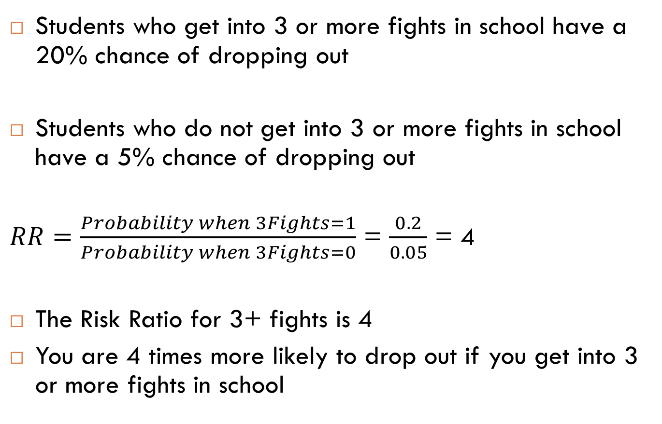
Risk Ratio: Example
Students who get into 3 or more fights in school have a 20% chance of dropping out
Students who do not get into 3 or more fights in school have a 5% chance of dropping out
$RR=\frac{Probability when 3Fights=1}{Probability when 3Fights=0}$ = $\frac{0.2}{0.05}$ = 4
The Risk Ratio for 3+ fights is 4
You are 4 times more likely to drop out if you get into 3 or more fights in school

Slide 23
Risk Ratio: Notes
You can turn numerical predictors into binary predictors with a threshold
Like our last example!
Clear way to communicate the effects of a variable on your predicted outcome

Slide 24
Next lecture
Diagnostic metrics part 1

