Slide 1
Week 2 Video 3
Diagnostic Metrics

Slide 2
Different Methods, Different Measures
Today we’ll continue our focus on classifiers
Later this week we’ll discuss regressors
And other methods will get worked in later in the course

Slide 3
Last class
We discussed accuracy and Kappa
Today, we’ll discuss additional metrics for assessing classifier goodness

Slide 4
ROC
Receiver-Operating Characteristic Curve

Slide 5
ROC
You are predicting something which has two values
Correct/Incorrect
Gaming the System/not Gaming the System
Dropout/Not Dropout

Slide 6
ROC
Your prediction model outputs a probability or other real value
How good is your prediction model?

Slide 7
Example
PREDICTION TRUTH
0.1 0
0.7 1
0.44 0
0.4 0
0.8 1
0.55 0
0.2 0
0.1 0
0.09 0
0.19 0
0.51 1
0.14 0
0.95 1
0.3 0

Slide 8
ROC
Take any number and use it as a cut-off
Some number of predictions (maybe 0) will then be classified as 1’s
The rest (maybe 0) will be classified as 0’s

Slide 9
Threshold = 0.5
PREDICTION TRUTH
0.1 0
0.7 1
0.44 0
0.4 0
0.8 1
0.55 0
0.2 0
0.1 0
0.09 0
0.19 0
0.51 1
0.14 0
0.95 1
0.3 0

Slide 10
Threshold = 0.6
PREDICTION TRUTH
0.1 0
0.7 1
0.44 0
0.4 0
0.8 1
0.55 0
0.2 0
0.1 0
0.09 0
0.19 0
0.51 1
0.14 0
0.95 1
0.3 0

Slide 11
Four possibilities
True positive
False positive
True negative
False negative

Slide 12
Threshold = 0.6
PREDICTION TRUTH
0.1 0 TRUE NEGATIVE
0.7 1 TRUE POSITIVE
0.44 0 TRUE NEGATIVE
0.4 0 TRUE NEGATIVE
0.8 1 TRUE POSITIVE
0.55 0 TRUE NEGATIVE
0.2 0 TRUE NEGATIVE
0.1 0 TRUE NEGATIVE
0.09 0 TRUE NEGATIVE
0.19 0 TRUE NEGATIVE
0.51 1 FALSE NEGATIVE
0.14 0 TRUE NEGATIVE
0.95 1 TRUE POSITIVE
0.3 0 TRUE NEGATIVE

Slide 13
Threshold = 0.5
PREDICTION TRUTH
0.1 0 TRUE NEGATIVE
0.7 1 TRUE POSITIVE
0.44 0 TRUE NEGATIVE
0.4 0 TRUE NEGATIVE
0.8 1 TRUE POSITIVE
0.55 0 FALSE POSITIVE
0.2 0 TRUE NEGATIVE
0.1 0 TRUE NEGATIVE
0.09 0 TRUE NEGATIVE
0.19 0 TRUE NEGATIVE
0.51 1 TRUE POSITIVE
0.14 0 TRUE NEGATIVE
0.95 1 TRUE POSITIVE
0.3 0 TRUE NEGATIVE

Slide 14
Threshold = 0.99
PREDICTION TRUTH
0.1 0 TRUE NEGATIVE
0.7 1 FALSE NEGATIVE
0.44 0 TRUE NEGATIVE
0.4 0 TRUE NEGATIVE
0.8 1 FALSE NEGATIVE
0.55 0 TRUE NEGATIVE
0.2 0 TRUE NEGATIVE
0.1 0 TRUE NEGATIVE
0.09 0 TRUE NEGATIVE
0.19 0 TRUE NEGATIVE
0.51 1 FALSE NEGATIVE
0.14 0 TRUE NEGATIVE
0.95 1 FALSE NEGATIVE
0.3 0 TRUE NEGATIVE

Slide 15
ROC curve
X axis = Percent false positives (versus true negatives)
False positives to the right
Y axis = Percent true positives (versus false negatives)
True positives going up

Slide 16
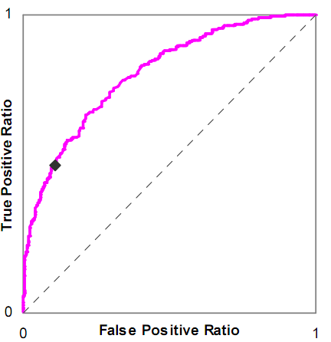
Example

Slide 17
Is this a good model or a bad model?

Slide 18
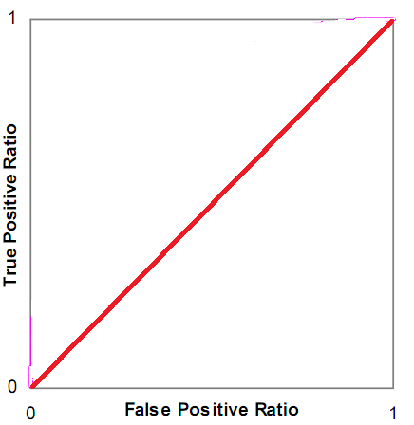
Chance model

Slide 19
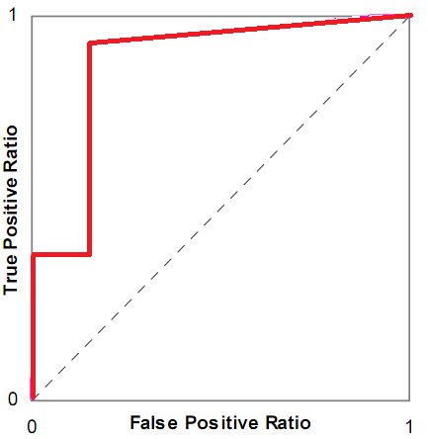
Good model (but note stair steps)

Slide 20
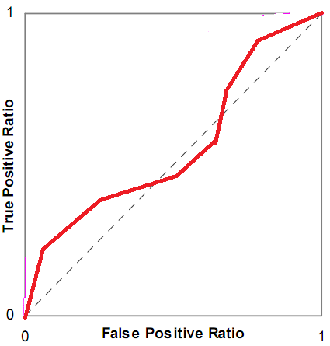
Poor model

Slide 21
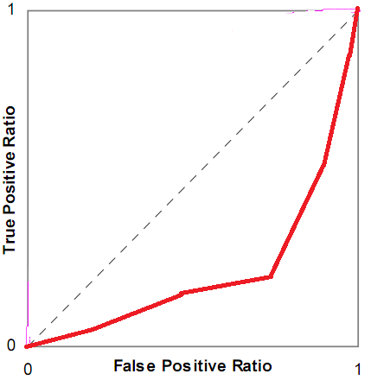
So bad it’s good

Slide 22
AUC ROC
Also called AUC, and historically A’
The area under the ROC curve

Slide 23
AUC
Is mathematically equivalent to the Wilcoxon statistic (Hanley & McNeil, 1982)
The probability that if the model is given an example from each category, it will accurately identify which is which

Slide 24
AUC
Equivalence to Wilcoxon is useful
It means that you can compute statistical tests for
Whether two AUC values are significantly different
Same data set or different data sets!
Whether an AUC value is significantly different than chance

Slide 25
AUC
Equivalence to Wilcoxon is useful
It means that you can compute statistical tests for
Whether two AUC values are significantly different
Same data set or different data sets!
Whether an AUC value is significantly different than chance

Slide 26
AUC
Tests you can use
If sample is big (Hanley & McNeil, 1982)
For details see previous editions of this MOOC
If sample is small or big (DeLong et al., 1988)
Both tests ignore
Non-independence within students (Baker et al., 2008)
Interrelationships between models (Demler et al., 2012)
These papers (and others) introduce complex approaches to dealing with these problems, tread carefully

Slide 27
Notes
Not really a good way to compute AUC for 3 or more categories
There are methods, but the semantics change somewhat

Slide 28
More Caution
The implementations of AUC still remain buggy in many data mining and statistical packages in 2022
But it works in sci-kit learn
And there is a correct package for r called auctestr
If you use other tools, see my webpage for a command-line and GUI implementation of AUC http://www.upenn.edu/learninganalytics/ryanbaker/edmtools.html

Slide 29
AUC and Kappa

Slide 30
AUC and Kappa
AUC
more difficult to compute
only works for two categories (without complicated extensions)
meaning is invariant across data sets (AUC=0.6 is always better than AUC=0.55)
very easy to interpret statistically

Slide 31
AUC
AUC values are almost always higher than Kappa values
AUC takes confidence into account

Slide 32
Precision and Recall
Precision = TP
TP + FP
Recall = TP
TP + FN

Slide 33
What do these mean?
Precision = The probability that a data point classified as true is actually true
Recall = The probability that a data point that is actually true is classified as true

Slide 34
Terminology
FP = False Positive = Type 1 error
FN = False Negative = Type 2 error

Slide 35
Precision-Recall Curves
Show trade-off between precision and recall for all possible decision thresholds
Usually better to look at this than the precision and recall the machine learning package gives you initially

Slide 36
F1
Harmonic mean of precision and recall
2 * precision * recall precision + recall
Preferred by some as an alternative to Kappa

Slide 37
Some notes
(Jeni et al., 2013) finds evidence that AUC is more robust to skewed distributions than Kappa and also several other metrics
(Dhanani et al., 2014) finds evidence that models selected with RMSE (which we’ll talk about next time) come closer to true parameter values than AUC
(Pelanek, 2017) argues that AUC only pays attention to relative differences between models and that absolute differences matter too

Slide 38
Next lecture
Metrics for regressors

