Slide 1
Week 2 Video 4
Metrics for Regressors

Slide 2
Metrics for Regressors
Linear Correlation
MAE/RMSE
Information Criteria

Slide 3
Linear correlation (Pearson’s correlation)
r(A,B) =
When A’s value changes, does B change in the same direction?
Assumes a linear relationship

Slide 4
What is a “good correlation”?
1.0 – perfect
0.0 – none
-1.0 – perfectly negatively correlated
In between – depends on the field

Slide 5
What is a “good correlation”?
1.0 – perfect
0.0 – none
-1.0 – perfectly negatively correlated
In between – depends on the field
In physics – correlation of 0.8 is weak!
In education – correlation of 0.3 is good

Slide 6
Why are small correlations OK in education?
Lots and lots of factors contribute to just about any dependent measure

Slide 7
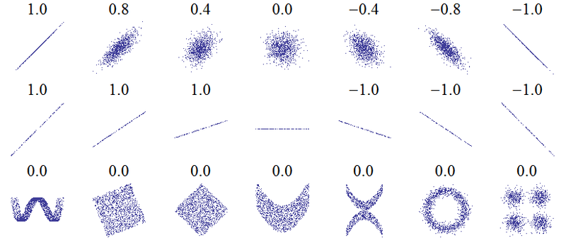
Examples of correlation values
From Denis Boigelot, available on Wikipedia

Slide 8
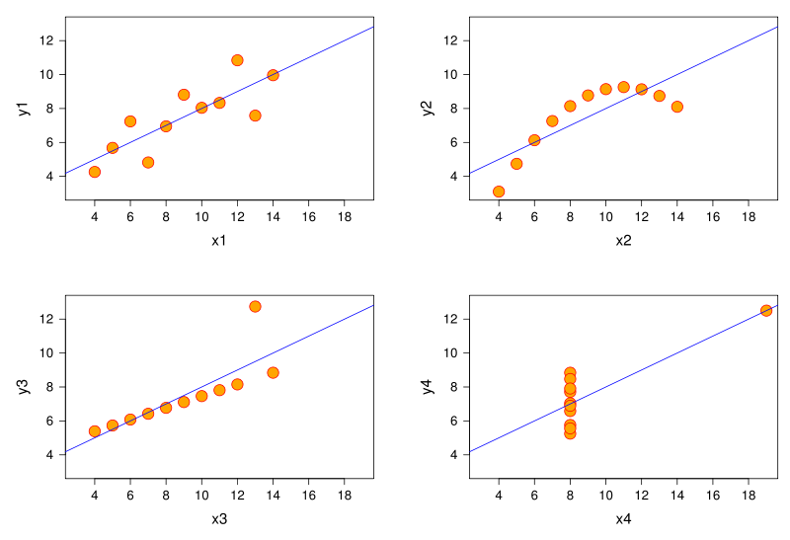
Same correlation, different functions
Anscombe’s Quartet

Slide 9
r²
The correlation, squared
Also a measure of what percentage of variance in dependent measure is explained by a model
If you are predicting A with B,C,D,E
r² is often used as the measure of model goodness rather than r (depends on the community)

Slide 10
Spearman’s Correlation (ρ)
Rank correlation
Turn each variable into ranks
1 = highest value, 2 = 2nd highest value, 3 = 3rd highest value, and so on
Then compute Pearson’s correlation
(There’s actually an easier formula, but not relevant here)

Slide 11
Spearman’s Correlation (ρ)
Interpreted exactly the same way as Pearson’s correlation
1.0 – perfect
0.0 – none
-1.0 – perfectly negatively correlated

Slide 12
Why use Spearman’s Correlation (ρ)?
More robust to outliers
Determines how monotonic a relationship is, not how linear it is

Slide 13
RMSE/MAE

Slide 14
Mean Absolute Error
Average of
Absolute value (actual value minus predicted value)

Slide 15
Root Mean Squared Error (RMSE)
Square Root of average of
(actual value minus predicted value)²

Slide 16
MAE vs. RMSE
MAE tells you the average amount to which the predictions deviate from the actual values
Very interpretable
RMSE can be interpreted the same way (mostly) but penalizes large deviation more than small deviation

Slide 17
However
RMSE is largely preferred to MAE
The example to follow is courtesy of Radek Pelanek, Masaryk University

Slide 18
Radek’s Example
Take a student who makes correct responses 70% of the time
And two models
Model A predicts 70% correctness
Model B predicts 100% correctness

Slide 19
In other words
70% of the time the student gets it right
Response = 1
30% of the time the student gets it wrong
Response = 0
Model A Prediction = 0.7
Model B Prediction = 1.0
Which of these seems more reasonable?

Slide 20
MAE
70% of the time the student gets it right
Response = 1
Model A (0.7) Absolute Error = 0.3
Model B (1.0) Absolute Error = 0
30% of the time the student gets it wrong
Response = 0
Model A (0.7) Absolute Error = 0.7
Model B (1.0) Absolute Error = 1

Slide 21
MAE
Model A
(0.7)(0.3)+(0.3)(0.7)
0.21+0.21
0.42
Model B
(0.7)(0)+(0.3)(1)
0+0.3
0.3

Slide 22
MAE
Model A
(0.7)(0.3)+(0.3)(0.7)
0.21+0.21
0.42
Model B is better, according to MAE
(0.7)(0)+(0.3)(1)
0+0.3
0.3

Slide 23
Do you believe it?
Model A
(0.7)(0.3)+(0.3)(0.7)
0.21+0.21
0.42
Model B is better, according to MAE
(0.7)(0)+(0.3)(1)
0+0.3
0.3

Slide 24
RMSE
70% of the time the student gets it right
Response = 1
Model A (0.7) Squared Error = 0.09
Model B (1.0) Squared Error = 0
30% of the time the student gets it wrong
Response = 0
Model A (0.7) Squared Error = 0.49
Model B (1.0) Squared Error = 1

Slide 25
RMSE
Model A
(0.7)(0.09)+(0.3)(0.49)
0.063+0.147
0.21
Model B
(0.7)(0)+(0.3)(1)
0+0.3
0.3

Slide 26
RMSE
Model A is better, according to RMSE.
(0.7)(0.09)+(0.3)(0.49)
0.063+0.147
0.21
Model B
(0.7)(0)+(0.3)(1)
0+0.3
0.3

Slide 27
RMSE
Model A is better, according to RMSE. Does this seem more reasonable?
(0.7)(0.09)+(0.3)(0.49)
0.063+0.147
0.21
Model B
(0.7)(0)+(0.3)(1)
0+0.3
0.3

Slide 28
Note
Low RMSE is good
High Correlation is good

Slide 29
What does it mean?
Low RMSE/MAE, High Correlation = Good model
High RMSE/MAE, Low Correlation = Bad model

Slide 30
What does it mean?
High RMSE/MAE, High Correlation = Model goes in the right direction, but is systematically biased
A model that says that adults are taller than children
But that adults are 8 feet tall, and children are 6 feet tall

Slide 31
What does it mean?
Low RMSE/MAE, Low Correlation = Model values are in the right range, but model doesn’t capture relative change
Particularly common if there’s not much variation in data

Slide 32
Information Criteria

Slide 33
BiC
Bayesian Information Criterion (Raftery, 1995)
Makes trade-off between goodness of fit and flexibility of fit (number of parameters)
Formula for linear regression
BiC’ = n log (1- r²) + p log n
n is number of students, p is number of variables

Slide 34
BiC’
Values over 0: worse than expected given number of variables
Values under 0: better than expected given number of variables
Can be used to understand significance of difference between models (Raftery, 1995)

Slide 35
BiC
Said to be statistically equivalent to k-fold cross-validation for optimal k
The derivation is… somewhat complex
BiC is easier to compute than cross-validation, but different formulas must be used for different modeling frameworks
No BiC formula available for many modeling frameworks

Slide 36
AIC
Alternative to BiC
Stands for
An Information Criterion (Akaike, 1971)
Akaike’s Information Criterion (Akaike, 1974)
Makes slightly different trade-off between goodness of fit and flexibility of fit (number of parameters)

Slide 37
AIC
Said to be statistically equivalent to Leave-Out-One-Cross-Validation

Slide 38
AIC or BIC: Which one should you use?
<shrug>

Slide 39
All the metrics: Which one should you use?
“The idea of looking for a single best measure to choose between classifiers is wrongheaded.” – Powers (2012)

Slide 40
Next Lecture
Cross-validation and over-fitting

