Slide 1
Week 3 Video 3
Feature Engineering

Slide 2
Feature Engineering

Slide 3
Feature Engineering
Up until this point in the class, we’ve talked about building and validating prediction models
Models that infer a predicted variable from predictor variables

Slide 4
Where the Predicted Variable Comes From
A couple lectures ago, we went into a little more detail about where the predicted variable can come from

Slide 5
Where the Predictor Variables Come From
Where do the predictor variables come from?
Do they fall out of the sky?
Do they come from the Office for Predictor Variables in Washington, DC?

Slide 6
Feature Engineering
The art of creating predictor variables
A major topic in its own right

Slide 7
Why is it important?
Feature engineering is the least well-studied part of the process of developing prediction models
But it’s arguably the most important part
Your model will never be any good if your features (predictors) aren’t very good

Slide 8
Why is it important?
It is an art, it is human-driven design
It involves lore rather than well-known and validated principles
It is hard!

Slide 9
The Big Idea
How can we take the voluminous, ill-formed, and yet under-specified data that we now have in education
And shape it into a reasonable set of variables
In an efficient, effective, and predictive way?

Slide 10
Or to put it another way
We want features that are effective

Slide 11
Or to put it another way
We want features that are effective
But also not tautological

Slide 12
Examples
Predicting final course grade from the grades on all the assignments and tests…
Predicting that students who have engaged in violence will engage in violence
Predicting that students who stop participating in a course are likely to drop out…

Slide 13
That said…
One person’s silly tautology is another person’s meaningful finding

Slide 14
A process in its own right
Brainstorming features
Deciding what features to create
Creating the features
Studying the impact of features on model goodness
Iterating on features if useful
Go to 3 (or 1)

Slide 15
Brainstorming Features
Can be more or less formal

Slide 16
IDEO tips for Brainstorming
1. Defer judgment
2. Encourage wild ideas
3. Build on the ideas of others
4. Stay focused on the topic
5. One conversation at a time
6. Be visual
7. Go for quantity
http://www.openideo.com/fieldnotes/openideo-team-notes/seven-tips-on-better-brainstorming

Slide 17
Brainstorming Features
Good to have both EDM/LAK experts and domain experts in the room
Domain experts:
People who understand the literature in the area (if any)
People who have conducted classroom observations relevant to the construct you’re interested in
People who have taught relevant to the construct you’re interested in

Slide 18
Building on the Ideas of Others
Doesn’t just have to be people nearby
There’s a huge literature out there of features people have tried and what has worked, or failed to work, for a range of problems
Read papers from researchers working on similar problems, and see what you can use
Some folks have also tried crowd-sourcing (Veeramacheneni et al., 2014)

Slide 19
Brainstorming Features
On hard projects, my research group often meets as a team over pizza and beer to brainstorm
On easier projects, one person brainstorms solo
And then often discusses their features with another person, who offers further suggestions

Slide 20
Deciding what features to create
There is never infinite time
A trade-off between the effort to create a feature and how likely it is to be useful
“How likely it is to be useful” – the best you can do is to
Look at whether similar features have been useful for similar problems
Use your best intuition
Worth biasing in favor of features that are different than anything else you’ve tried before
Explores a different part of the space

Slide 21
Creating features
Excel – Really good for prototyping features, has fallen out of fashion
See past versions of this MOOC for detailed info on how to use Excel for this
Jupyter Notebook – Allows quick prototyping and iteration with code, just a little bit harder to see what you’re doing than Excel
Distillation Code – The scalable solution… but harder to check yourself or explore

Slide 22
Some useful types of features
Average, min, max, stdev
Total counts
Counts-so-far
Counts-last-n-actions
Differentiating first and subsequent attempts
Ratios between events of interest
Cut-off based features

Slide 23
Some useful types of features
Percentages of action type so far
Percentages of time spent per action/location/KC/etc.
Did event of interest ever occur for student?
Times-so-far
Comparing earlier behaviors to later behaviors through caching

Slide 24
Some features
Standard deviations above or below the mean (aka unitization)
Several means and standard deviations you can take
Across students in any situation
Across students in same situation
Across same student in different situations so far

Slide 25
Feature Iteration
Sometimes when a feature looks like it might be good
It’s worth iterating on that feature, trying close variants to see if they do better

Slide 26
Example
You have a feature “slow actions after hints” (cf. Shih, Koedinger, & Scheines, 2008)
You define “slow action” as an action taking over 20 seconds
What if 30 seconds is a better cut-off?

Slide 27
Details of features matter
For example, the same feature can have different impact depending on context

Slide 28
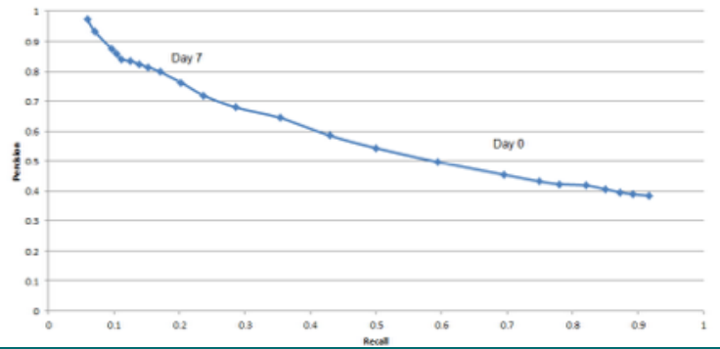
(Baker et al., 2015)
Whether a student has opened their e-textbook predicts whether they fail the course
But with totally different precision and recall on the first day of the class versus the 7th day of the class

Slide 29
A few thoughts

Slide 30
Does feature engineering over-fit?
It can
Which is why it’s useful to remember
The true test of a model is whether it works on entirely unseen data
If you iterate a lot and use cross-validated goodness
Then the true test of your model will be either a held-out data set or newly-collected data later on

Slide 31
Feature Engineering
Your features come from somewhere
You can take a standard set of variables or pre-existing variables
No question it’s faster
But thinking about your variables is likely to lead to better models
Actually evidence for this, see (Sao Pedro et al., 2012)

Slide 32
Next Lecture
Automated feature generation and selection

