Slide 1
Week 5 Video 2
Relationship Mining
Causal Mining

Slide 2
Causal Data Mining
These slides developed in partnership with Stephen Fancsali, Carnegie Learning, Inc.

Slide 3
Causal Data Mining
Distinct from prediction or correlation mining
The goal is not to figure out what predicts X,
or to figure out what is correlated to X,
but instead…

Slide 4
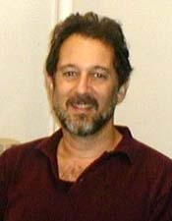
Causal Data Mining
find causal relationships in data.
A causes B
Examples from Scheines (2007):
What features of student behavior cause learning?
What will happen when we make everyone take a reading quiz before each class?
What will happen when we program our tutor to intervene to give hints after an error?

Slide 5
Causal Data Mining
Use graphs to represent causal structure
Frequently directed graphs without cycles
(Bayesian networks – see week 4 slides)
Nodes represent variables
(Directed) edges represent causal relationships

Slide 6
Causal Data Mining
Algorithms infer (classes of) causal graphs that explain dependencies in observed data
From observed data alone, often cannot infer a unique causal graph.

Slide 7
Finding Causal Structure
Easy to determine if you intervene
Some experiments are impossible, too expensive, unethical, etc.
Can you determine this from purely correlational data?
Spirtes, Glymour, and Scheines say: sometimes, yes!

Slide 8
Example
Is repeatedly retrying quizzes harmful?
Does repeatedly retrying quizzes cause decreased learning?
Suppose an investigator notices that repeatedly retrying quizzes and exam score are negatively associated (i.e., correlated).

Slide 9
Causal Graphs
A direct causal relationship could explain this correlation…
Retry quiz

Slide 10
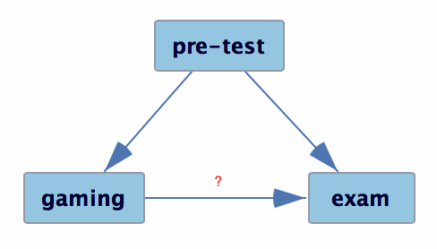
Causal Graphs
or the correlation of retry quiz and exam might arise from a common cause, e.g., prior knowledge.
(or both!)
Retry quiz

Slide 11
Causal Graphs
Suppose that when we control for pre-test, the correlation of retry quiz & exam disappears.
E.g., the partial correlation is not significantly different from zero.

Slide 12
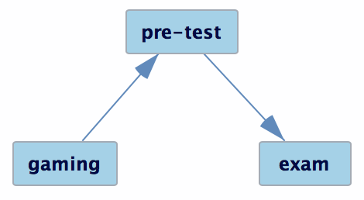
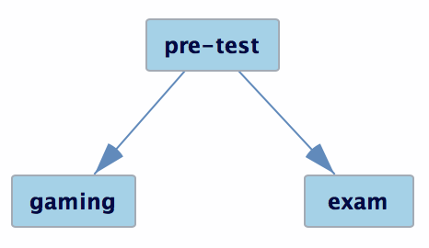
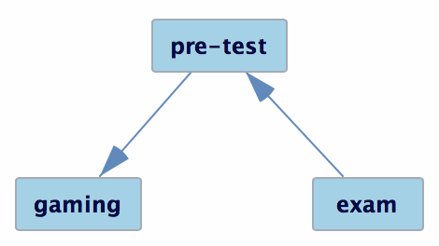
Causal Graphs
Three causal graphs can explain this conditional independence equally well…
Retry quiz
Retry quiz
Retry quiz

Slide 13
Causal Graphs
but only one is compatible with background knowledge
pre-test is prior to behavior in a tutor and a final exam.
Retry quiz

Slide 14
Big idea
Infer class of graphs that can represent the full pattern of such (in)dependencies among measured variables.

Slide 15
Causal Data Mining
TETRAD is a key software package used to study this
http://www.phil.cmu.edu/projects/tetrad/

Slide 16
TETRAD
Implements multiple algorithms for inferring causal structure from data
Different algorithms are applicable given particular assumptions.

Slide 17
Assumptions guide algorithm choice
Are there unmeasured common causes?
Linear relationships between variables?
Are underlying dynamics acyclic or cyclic?
Distribution of variables: Gaussian vs. non-Gaussian
See TETRAD User Guide for detailed discussion….

Slide 18
Math & Assumptions
See
Scheines, R., Spirtes, P., Glymour, C., Meek, C., Richardson, T. (1998) The TETRAD Project: Constraint Based Aids to Causal Model Specification. Multivariate Behavioral Research, 33 (1), 65-117.
Glymour, C. (2001) The Mind’s Arrows

Slide 19
Examples in EDM

Slide 20
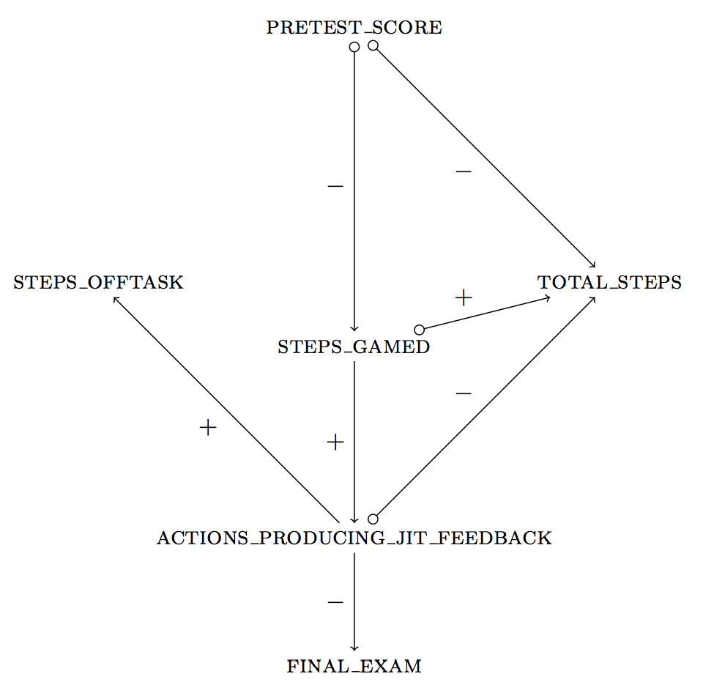
Fancsali (2013) Example
This example uses an algorithm that allows for
unmeasured common causes of measured
variables. pretest_score → total_steps can signify
(1) pretest_score is a cause of total_steps;
(2) pretest_score & total_steps share a
common cause;
(3) both!

Slide 21
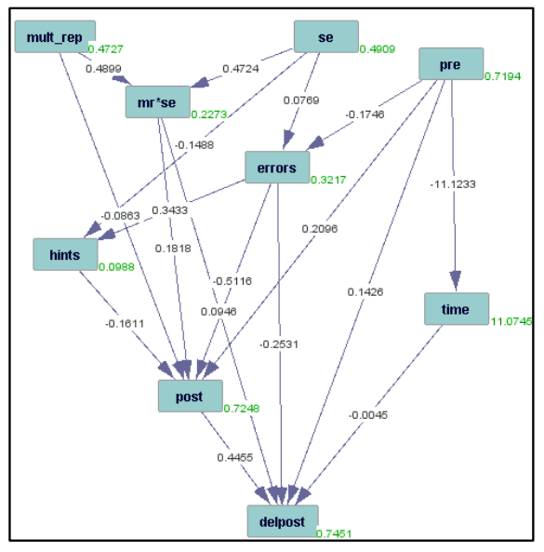
Rau & Scheines (2012)

Slide 22
Rau & Scheines (2012)

Slide 23
Rau & Scheines (2012)

Slide 24
Rai et al. (2011)

Slide 25
Rai et al. (2011)

Slide 26
Rai et al. (2011)

Slide 27
Wait, what?

Slide 28
Solution
Use domain knowledge to constrain search.
The future can’t cause the past.
cf. example of pre-test being prior to retry quiz & exam.

Slide 29
Result

Slide 30
Important
Important to use causal modeling algorithms correctly!
Which assumptions are reasonable?
The future can’t cause the past
Except in movies

Slide 31
Important
Are variables good proxies for what we intend to study (especially if “latent”)?
Suppose pre-test isn’t an appropriate measure of prior knowledge.
pre-test might not “screen off” retry quiz & exam, so we might still think that retry quiz causes decreased learning (exam).
Retry quiz

Slide 32
Causal Modeling
A powerful tool
But needs to be used carefully!

Slide 33
Another Type of Causal Inference
Making causal inferences from quasi-experimental data
i.e. Figuring out ways to treat a quasi-experiment as if it were an experiment
A very big area in its own right
More statistics than machine learning/data mining, so I won’t discuss in detail

Slide 34
Next lecture
Association rule mining

