Slide 1
Week 5 Video 3
Relationship Mining
Association Rule Mining

Slide 2
Association Rule Mining
Try to automatically find simple if-then rules within the data set

Slide 3
Example
Famous (and fake) example:
People who buy more diapers buy more beer
If person X buys diapers,
Person X buys beer
Conclusion: put expensive beer next to the diapers

Slide 4
Interpretation #1
Guys are sent to the grocery store to buy diapers, they want to have a drink down at the pub, but they buy beer to get drunk at home instead

Slide 5
Interpretation #2
There’s just no time to go to the bathroom during a major drinking bout

Slide 6
Serious Issue
Association rules imply causality by their if-then nature
But causality can go either direction

Slide 7
If-conditions can be more complex
If person X buys diapers, and person X is male, and it is after 7pm, then person Y buys beer

Slide 8
Then-conditions can also be more complex
If person X buys diapers, and person X is male, and it is after 7pm, then person Y buys beer and tortilla chips and salsa
Can be harder to use, sometimes eliminated from consideration

Slide 9
Useful for…
Generating hypotheses to study further
Finding unexpected connections
Is there a surprisingly ineffective instructor or math problem?
Are there e-learning resources that tend to be selected together?

Slide 10
Association Rule Mining
Find rules
Evaluate rules

Slide 11
Association Rule Mining
Find rules
Evaluate rules

Slide 12
Rule Evaluation
What would make a rule “good”?

Slide 13
Rule Evaluation
Support/Coverage
Confidence
“Interestingness”

Slide 14
Support/Coverage
Number of data points that fit the rule, divided by the total number of data points
(Variant: just the number of data points that fit the rule)

Slide 15
Example
Rule: If a student took Advanced Data Mining, the student took Intro Statistics
Support/coverage?
Took Adv. DM | Took Intro Stat.
1 | 1
0 | 1
0 | 1
0 | 1
0 | 1
0 | 1
1 | 0
1 | 0
1 | 0
1 | 0
1 | 1

Slide 16
Example
Rule: If a student took Advanced Data Mining, the student took Intro Statistics
Support/coverage?
2/11= 0.1818
Took Adv. DM | Took Intro Stat.
1 | 1
0 | 1
0 | 1
0 | 1
0 | 1
0 | 1
1 | 0
1 | 0
1 | 0
1 | 0
1 | 1

Slide 17
Confidence
Number of data points that fit the rule, divided by the number of data points that fit the rule’s IF condition
Equivalent to precision in classification
Also referred to as accuracy, just to make things confusing
NOT equivalent to accuracy in classification

Slide 18
Example
Rule: If a student took Advanced Data Mining, the student took Intro Statistics
Confidence?
Took Adv. DM | Took Intro Stat.
1 | 1
0 | 1
0 | 1
0 | 1
0 | 1
0 | 1
1 | 0
1 | 0
1 | 0
1 | 0
1 | 1

Slide 19
Example
Rule: If a student took Advanced Data Mining, the student took Intro Statistics
Confidence?
2/6 = 0.33
Took Adv. DM | Took Intro Stat.
1 | 1
0 | 1
0 | 1
0 | 1
0 | 1
0 | 1
1 | 0
1 | 0
1 | 0
1 | 0
1 | 1

Slide 20
Important Note
Implementations of Association Rule Mining sometimes differ based on whether the values for support and confidence (and other metrics)
Are calculated based on exact cases
Or some other grouping variable (sometimes called “customer” in specific packages)
Notes:
New slide June 2015!

Slide 21
For example
Let’s say you are looking at whether boredom follows frustration
If Frustrated at time N, Then Bored at time N+1
Frustrated Time N | Bored Time N+1
0 | 0
0 | 0
0 | 0
0 | 0
0 | 0
0 | 1
1 | 1
1 | 1
1 | 1
1 | 0
1 | 1
Notes:
New slide June 2015!

Slide 22
For example
If you just calculate it this way,
Confidence = 4/5
Frustrated Time N | Bored Time N+1
0 | 0
0 | 0
0 | 0
0 | 0
0 | 0
0 | 1
1 | 1
1 | 1
1 | 1
1 | 0
1 | 1
Notes:
New slide June 2015!

Slide 23
For example
But if you treat student as your “customer” grouping variable
Then whole rule applies for A, C
And IF applies for A, C
So confidence = 1
Student | Frustrated Time N | Bored Time N+1
A | 0 | 0
B | 0 | 0
C | 0 | 0
A | 0 | 0
B | 0 | 0
C | 0 | 1
A | 1 | 1
C | 1 | 1
C | 1 | 1
A | 1 | 0
C | 1 | 1
Notes:
New slide June 2015!

Slide 24
Arbitrary Cut-offs
The association rule mining community differs from most other methodological communities by acknowledging that cut-offs for support and confidence are arbitrary
Researchers typically adjust them to find a desirable number of rules to investigate, ordering from best-to-worst…
Rather than arbitrarily saying that all rules over a certain cut-off are “good”

Slide 25
Other Metrics
Support and confidence aren’t enough
Why not?

Slide 26
Why not?
Possible to generate large numbers of trivial associations
Students who took a course took its prerequisites (AUTHORS REDACTED, 2009)
Students who do poorly on the exams fail the course (AUTHOR REDACTED, 2009)

Slide 27
Interestingness

Slide 28
Interestingness
Not quite what it sounds like
Typically defined as measures other than support and confidence
Rather than an actual measure of the novelty or usefulness of the discovery
Notes:
Edited slide June 2015

Slide 29
Potential Interestingness Measures
Cosine
P(A^B)
sqrt(P(A)*P(B))
Measures co-occurrence
Merceron & Yacef (2008) note that it is easy to interpret (numbers closer to 1 than 0 are better; over 0.65 is desirable)

Slide 30
Example
Rule: If a student took BDEMOOC, the student published EDM paper
Cosine?
P(A^B)
sqrt(P(A)*P(B))
(0.4)/sqrt(0.5*0.5) = 0.8
Took BDEMOOC | Published EDM Paper
1 | 1
0 | 1
0 | 0
0 | 0
0 | 0
0 | 0
1 | 1
1 | 1
1 | 0
1 | 1

Slide 31
Potential Interestingness Measures
Lift
Confidence(A->B) P(A^B)
P(B) P(A)*P(B)
Measures whether data points that have both A and B are more common than would be expected from the base rate of each
Merceron & Yacef (2008) note that it is easy to interpret (lift over 1 indicates stronger association)
=

Slide 32
Example
Rule: If a student took BDEMOOC, the student published EDM paper
Lift?
P(A^B)
P(A)*P(B)
(0.4)/(0.5*0.5) = 1.6
Took BDEMOOC | Published EDM Paper
1 | 1
0 | 1
0 | 0
0 | 0
0 | 0
0 | 0
1 | 1
1 | 1
1 | 0
1 | 1

Slide 33
Merceron & Yacef recommendation
Rules with high cosine or high lift should be considered interesting

Slide 34
Other Interestingness measures (Tan, Kumar, & Srivastava, 2002)

Slide 35
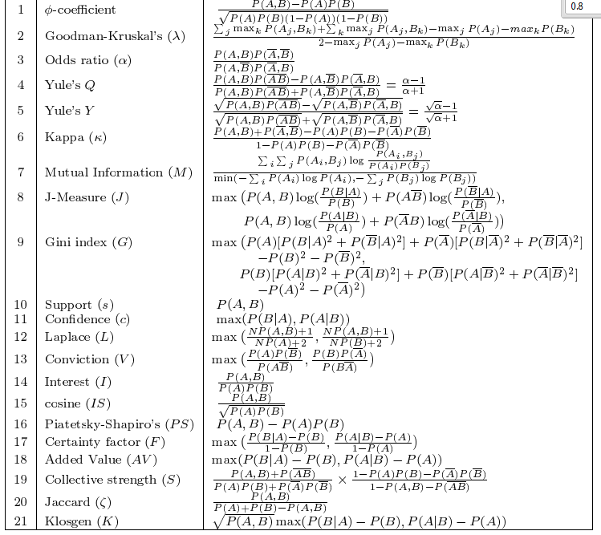

Slide 36
Worth drawing your attention to
Jaccard
P(A^B)
P(A)+P(B)- P(A^B)
Measures the relative degree to which having A and B together is more likely than having either A or B but not both
Notes:
New slide June 2015!

Slide 37
Other idea for selection
Select rules based both on interestingness and based on being different from other rules already selected (e.g., involve different operators)

Slide 38
Alternate approach (Bazaldua et al., 2014)
Compared “interestingness” measures to human judgments about how interesting the rules were
They found that Jaccard and Cosine were the best single predictors
And that Lift had predictive power independent of them
But they also found that the correlations between [Jaccard and Cosine] and [human ratings of interestingness] were negative
For Cosine, opposite of prediction in Merceron & Yacef!
Notes:
New slide June 2015!

Slide 39
Association Rule Mining
Find rules
Evaluate rules

Slide 40
The Apriori algorithm (Agrawal et al., 1996)
Generate frequent itemset
Generate rules from frequent itemset

Slide 41
Generate Frequent Itemset
Generate all single items, take those with support over threshold – {i1}
Generate all pairs of items from items in {i1}, take those with support over threshold – {i2}
Generate all triplets of items from items in {i2}, take those with support over threshold – {i3}
And so on…
Then form joint itemset of all itemsets

Slide 42
Generate Rules From Frequent Itemset
Given a frequent itemset, take all items with at least two components
Generate rules from these items
E.g. {A,B,C,D} leads to {A,B,C}->D, {A,B,D}->C, {A,B}->{C,D}, etc. etc.
Eliminate rules with confidence below threshold

Slide 43
Finally
Rank the resulting rules using your interest measures

Slide 44
Other Algorithms
Typically differ primarily in terms of style of search for rules

Slide 45
Variant on association rules
Negative association rules (Brin et al., 1997)
What doesn’t go together? (especially if probability suggests that two things should go together)
People who buy diapers don’t buy car wax, even though 30-year old males buy both?
People who take advanced data mining don’t take hierarchical linear models, even though everyone who takes either has advanced math?
Students who game the system don’t go off-task?

Slide 46
Next lecture
Sequential Pattern Mining

