Slide 1
Week 7 Video 4
Clustering Examples

Slide 2
Bowers (2010)
Looked at student grades from kindergarten through high school
Used HAC clustering to group students

Slide 3
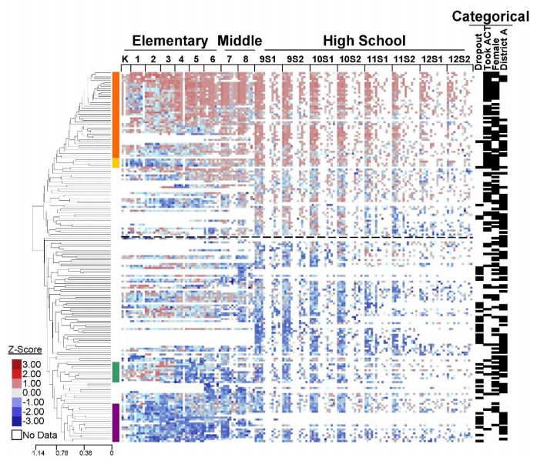
Good grades = red
Bad grades = blue

Slide 4
Took ACT cluster
Dropout cluster

Slide 5
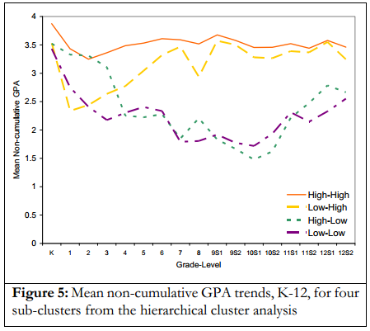
Four sub-clusters

Slide 6
Bowers (2010)
There is a distinct group of students who did well until third or fourth grade and then started doing much poorer
These students were more likely to drop out of high school than students who did poorly from the start!
Hypothesis: Switch from “learning to read” to “reading to learn”
This switch was known, but perhaps not how big an impact it has…

Slide 7
Amershi & Conati (2009)
Split students by their behaviors in an exploratory learning environment where students explore AI algorithms by stepping through the algorithm and making alternate execution choices in real time
Then looked at learning outcomes

Slide 8
Amershi & Conati (2009)
Three groups
Two low learning
One high learning

Slide 9
Amershi & Conati (2009)
Students with lower learning (both groups) tended to move through the environment faster, and did not pause to reflect after moves
Failure to Self-Explain

Slide 10
Amershi & Conati (2009)
The two groups of students with lower learning differed in other aspects
Amount of pause after back-tracking
Degree to which students adjusted graph
But this (apparently) did not affect learning – both groups had poor learning

Slide 11
Beal, Qu, & Lee (2006)
Clustered students in terms of five behaviors in an intelligent tutor
Solved problem correctly in over 10 seconds
Produced incorrect answer in over 10 seconds; then solved correctly in over 10 seconds
Answered in under 10 seconds
Clicked on hints in under 10 seconds per hint
Paused for over 10 seconds on hints

Slide 12
Resultant Clusters
Lots of fast responses; also lots of viewing hints after making an incorrect response
Read lots of help
Answered problems accurately without using help

Slide 13
General Point
Were these results surprising?
Not necessarily surprising that some students make lots of fast responses and ask for help after making an incorrect response
A faster way to get a model of this phenomenon than conducting field observations and developing a prediction model
But the resultant model is by nature somewhat less validated

Slide 14
General Point
The greatest power of clustering (in my opinion) is to discover completely unknown patterns
Clustering is most useful in areas where you don’t know very much…

Slide 15
Next lecture
Factor Analysis

