Slide 1
Week 6 Video 6
Knowledge Inference: Q-Matrix

Slide 2
What is the Q-Matrix?
A table
Where rows are items
And columns are skills
(Tatsuoka, 1983; Barnes, 2005)
Also called a KC [knowledge component] Model
Or a skill-item mapping

Slide 3
What is the Q-Matrix? (Tatsuoka, 1983; Barnes, 2005)
 | Skill1 | Skill2 | Skill3 | Skill4
Item1 | 1 | 0 | 0 | 0
Item2 | 1 | 1 | 0 | 0
Item3 | 1 | 0 | 1 | 0
Item4 | 0 | 0 | 0 | 1
Item5 | 0 | 0 | 1 | 1
Item6 | 0 | 1 | 0 | 0

Slide 4
Example
 | Add | Subtract | Multiply | Divide
7 + 3 + 2 | 1 | 0 | 0 | 0
7 + 3 - 2 | 1 | 1 | 0 | 0
(7 + 3) * 2 | 1 | 0 | 1 | 0
7 / 3 / 2 | 0 | 0 | 0 | 1
7 * 3 / 2 | 0 | 0 | 1 | 1
7 - 3 - 2 | 0 | 1 | 0 | 0

Slide 5
How do we get a skill-item mapping?
Automatic model discovery
Hand-development and refinement
Hybrid approaches

Slide 6
How do we get a skill-item mapping?
Automatic model discovery
Hand-development and refinement
Hybrid approaches

Slide 7
Automated Model Discovery
Learn the mapping between items and skills solely from data

Slide 8
Initial algorithm
Hill-climbing based method (Barnes, Bitzer, & Vouk, 2005)

Slide 9
More common approach lately
Non-negative matrix factorization (Desmarais, 2011)
Can be combined! (Picones et al., 2022)

Slide 10
First question
How many skills should we use?
This is determined empirically
Try 1 skill
Try 1 more skill than previous model (e.g. 2,3,4,5…)
Does the new model do better than the previous model? If so, go to step 2. If not, quit and use the previous model.

Slide 11
How do we know if one Q-matrix is better than another
Several definitions

Slide 12
Barnes et al.’s definition
Better models have the property that if a student knows skill X
And item 1 and item 2 both have skill X
Then a student who gets item 1 right will be more likely to get item 2 right
And item 1 wrong → item 2 wrong
And item 2 right → item 1 right
And item 2 wrong → item 1 wrong

Slide 13
Barnes et al.’s definition
Given a skill-item mapping, you can predict, for each combination of skills whether a student should get each item correct or not
A model’s degree of error is based on how many item-student pairs the prediction gets wrong

Slide 14
And forward from there
You can compare models with different numbers of skills using BIC or AIC or cross-validation (Effenberger et al., 2020)

Slide 15
Subtlety
Is skill conjunctive? (as in Barnes)
You need all relevant skills to get an item right
Or is it compensatory? (Pardos et al., 2008)
Any relevant skill leads to getting an item right

Slide 16
Assumption
Barnes’s approach and NNMF (and most approaches to q-matrix discovery) assume no learning

Slide 17
Alternate Test of Model Goodness
Look at student improvement over time
Fit a model like PFA or BKT from Week 4, and see how well it fits data, given the skill-item mapping
No point to doing this with DKT-family, since they either skip or fit their own q-matrix!
Liu & Koedinger (2017); Effenberger et al. (2020); Picones et al. (2022) give examples

Slide 18
How do we get a Q-Matrix?
Automatic model discovery
Hand-development and refinement
Hybrid approaches

Slide 19
Hand Development and Refinement
The original way that Q-Matrices were created
A domain expert creates the Q-Matrix using knowledge engineering

Slide 20
Hand Development and Refinement
What kind of data can we use to guide refinement?
Some slides adapted from a talk in my class by John Stamper

Slide 21
Strategies for Q-Matrix Refinement
Try to smooth learning curves
Look for skills with no apparent learning
Look for problems with unexpected error rates

Slide 22
Tool for doing this
Pittsburgh Science of Learning Center DataShop
https://pslcdatashop.web.cmu.edu/
Notes:
Slides after this have been removed

Slide 23
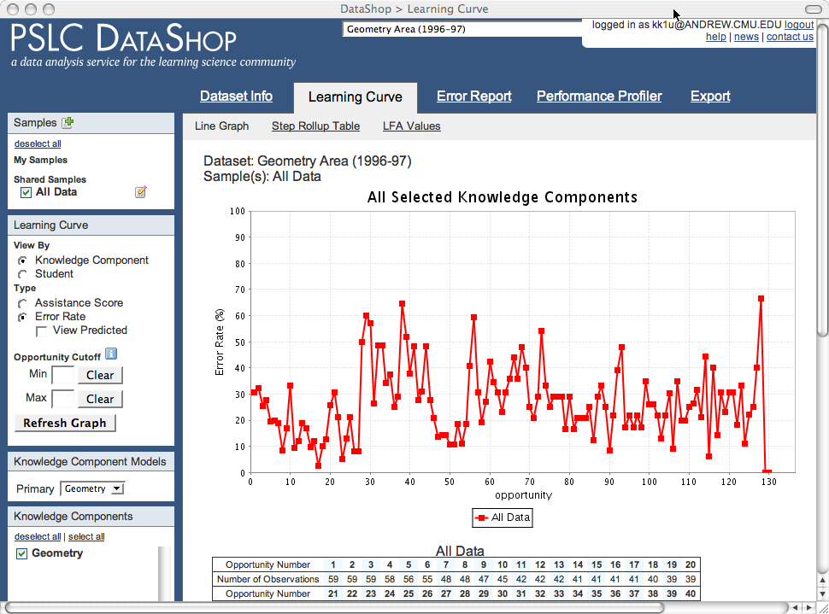
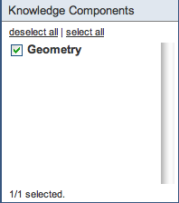
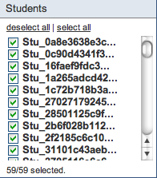
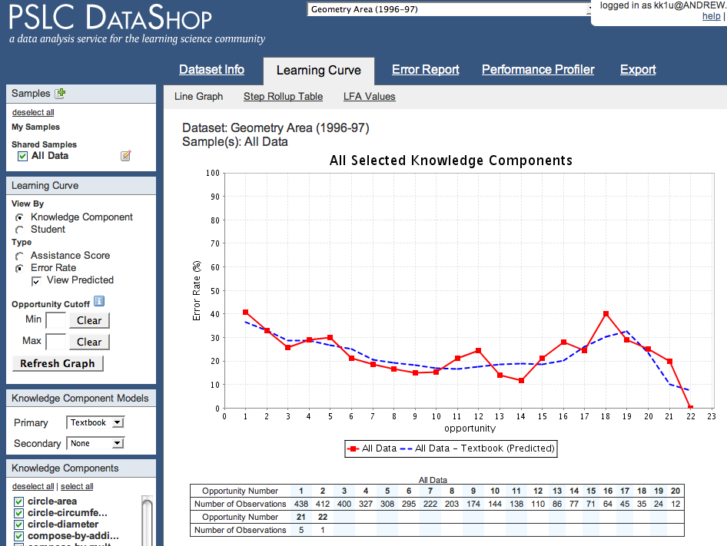
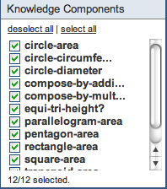
Possible to look at learning curves for different skill models (we will discuss this more in a future lecture)
If you treat Geometry Area as a single skill,
Not a smooth learning curve.
But if you split it into 12 skills
(Rise in error rate because weaker students get assigned more problems)
You get a smooth learning curve.
Notes:
Modified slide; re-record

Slide 24
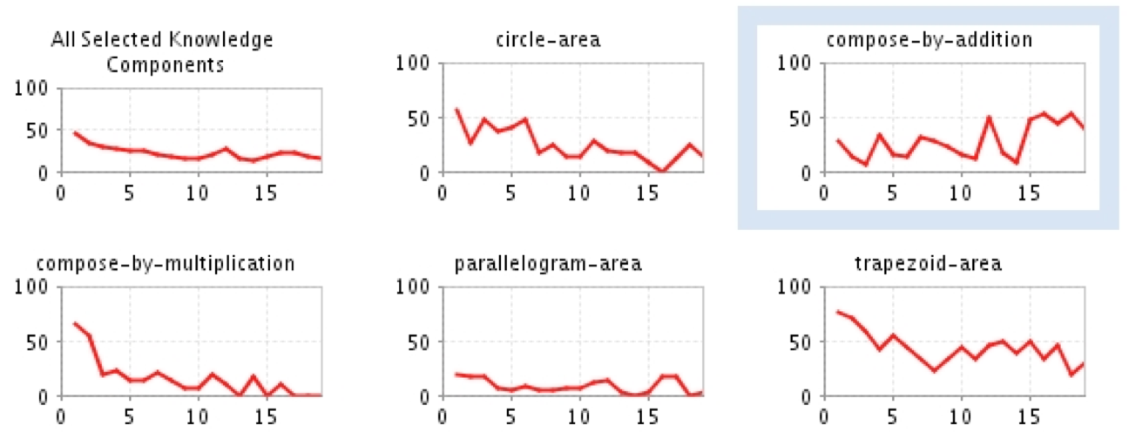
You can inspect curves for individual skills
Many curves show a reasonable decline (e.g. less errors over time)
Some do not => Opportunity to improve model!
Notes:
Re-record

Slide 25
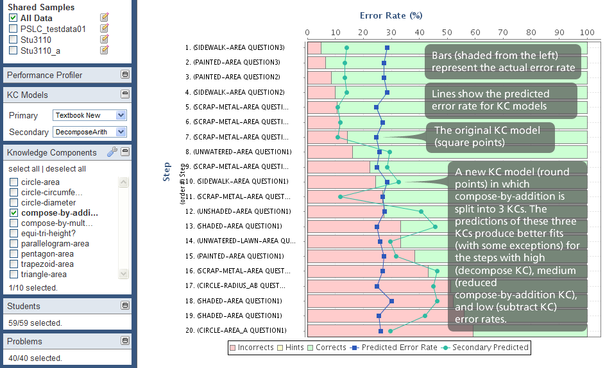
Also look for problems with unexpected error rates
Notes:
Re-record

Slide 26
DataShop can apply model for you!
Applies a mathematical model called LFA (similar to PFA) to data
Can give AIC and BIC goodness measures for different skill-item mappings
Notes:
Re-record

Slide 27
Next Up
Knowledge Structure Inference: Hybrid Approaches and Models with Prerequisites and Hierarchy
Notes:
Re-record

