Slide 1
Week 6 Video 8
Visualization
Learning Curves

Slide 2
Learning Curves
One of the most important visualizations in education, particularly for studying knowledge models
Worth going into a little more depth

Slide 3
The Classic Learning Curve

Slide 4
Assumptions
The student is practicing the same skill several times in (approximately) the same fashion
Completing a physics problem set
Reading the same word in several stories
Learning to complete an assembly line procedure
Early application! (Crossman, 1959)

Slide 5
Assumptions
Similar methods and considerations apply to situations where the student is recalling the same knowledge several times

Slide 6
Assumptions
We have some way to measure student performance over time
Speed or accuracy

Slide 7
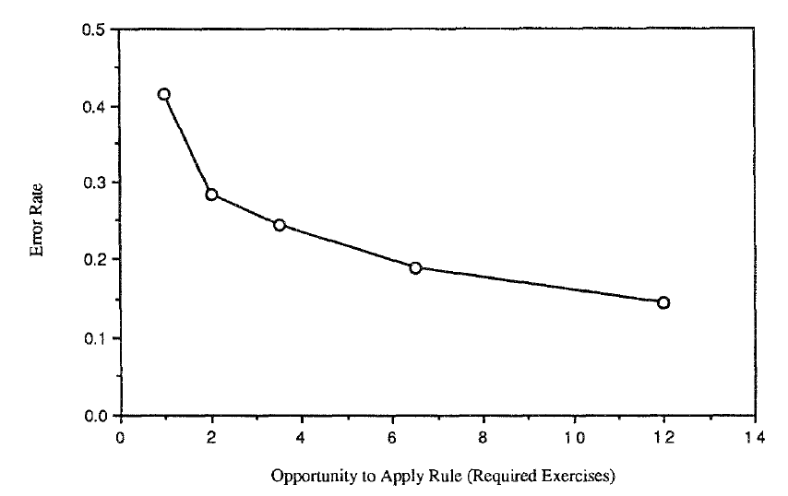
Learning LISP programming in the LISP Tutor (Corbett & Anderson, 1995)

Slide 8
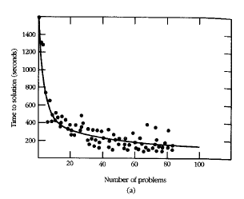
Learning in Cognitive Tutor Geometry (Ritter et al., 2007)

Slide 9
A certain characteristic pattern

Slide 10
Power Law of Learning*
Performance (both speed and accuracy) improves with a power function
* -- May actually be an exponential function rather than a power function (Heathcote, Brown, & Mewhort, 2000)

Slide 11
Called Power Law
Because speed and accuracy both follow a power curve
Radical improvement at first which slows over time towards an asymptote
Passing the asymptote usually involves developing entirely new strategy

Slide 12
Passing the Asymptote
Famous example: Fosbury Flop
http://www.youtube.com/watch?v=Id4W6VA0uLc

Slide 13
Power Law of Learning proven to apply across many domains
Simple domains
Pressing correct button on stimulus
Complex problem-solving domains
Math
Programming
Real-world domains
Cigar-making in factories (Crossman, 1959)

Slide 14
Real-world data
Are rarely perfectly smooth…
(At least not without hundreds of students or more)

Slide 15
Example from a minute ago

Slide 16
Making inference from learning curves

Slide 17
Making inference from learning curves
Via visual inspection of the curve form

Slide 18
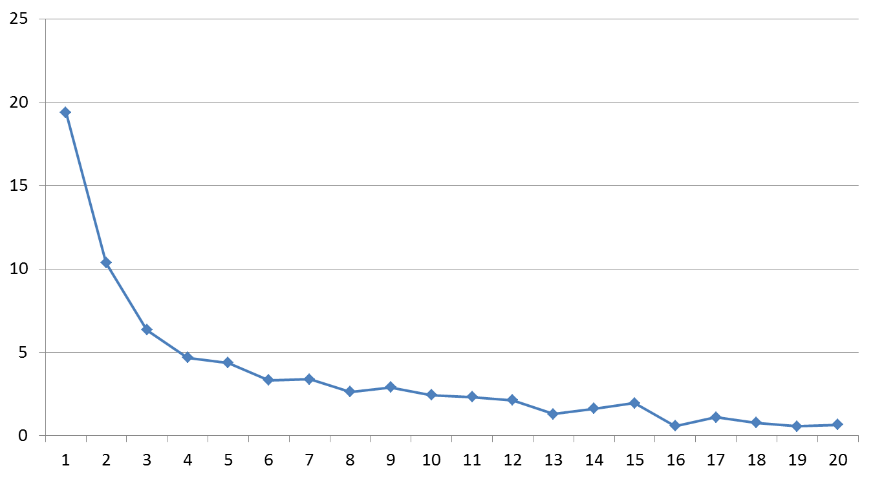
“Normal learning”

Slide 19
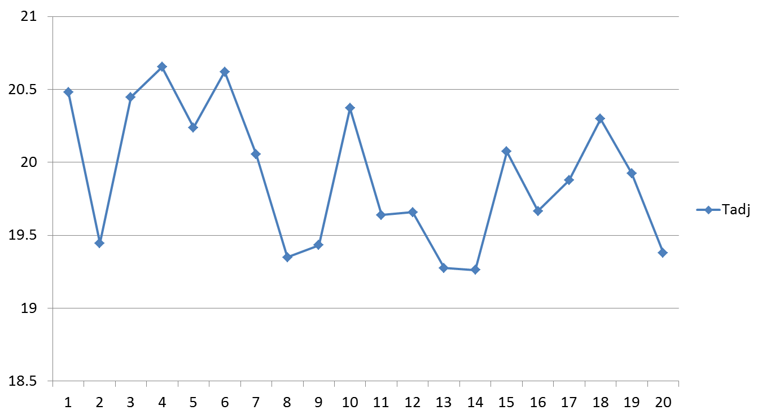
No learning going on

Slide 20
What might this graph mean?

Slide 21
Insert Pause-Continue Quiz Here

Slide 22
Student has already learned skill for the most part

Slide 23
What might this graph mean?

Slide 24
Insert Pause-Continue Quiz Here

Slide 25
Student learned a new strategy and “broke through” the asymptote

Slide 26
What might this graph mean?

Slide 27
Insert Pause-Continue Quiz Here4

Slide 28
Two skills treated as the same skill (Corbett & Anderson, 1995)

Slide 29
Uses
To understand how (and whether) a skill is being learned across students

Slide 30
Uses
To study and refine item-skill mappings in educational software
As discussed earlier this week, Pittsburgh Science of Learning Center DataShop (Koedinger et al., 2010) is a common tool for doing this

Slide 31
Next week
Advanced Data Sources

