Slide 1
Week 7 Video 2
Foundation Models
Including Text Mining, Part Two

Slide 2
Setting the stage

Slide 3
What do you even call them?
Transformer Models
Foundation Models
Large Language Models
But what about non-language models?

Slide 4
Transformer/Foundation Models
Some examples
BERT, MathBERT, GPT-2, GPT-3, DALL-E 2, StableDiffusion, Github Copilot, …, …

Slide 5
Transformer/Foundation Models
Can predict
Words
Sentences
Pixels
Computer program text
Mathematical equations
Anything?

Slide 6
Transformer/Foundation Models
Can predict
Words
Sentences
Pixels
Computer program text
Mathematical equations
Anything?
And, in a sudden light-switch transformation, prediction becomes generation

Slide 7
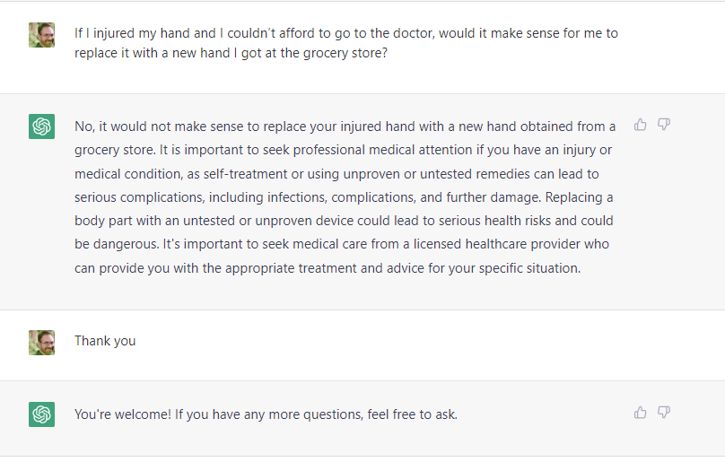
ChatGPT (prompt originally from Kelsey Piper)

Slide 8
AI Dungeon (GPT-2)
You are a friendly blanket. You live in a nice warm house with some nice humans. You like cuddling and keeping people warm. But you don’t want to be a "blanket baby" anymore, so you have decided that it is time for you to leave this place. … > You look for a job as a blanket. You find a job searching for blankets in the classifieds. You start reading the ads. Most of them are for low paying menial jobs, but you find three that look interesting. > You read the best ad. You find the best job listed: WANTED: One blanket for sleeping on the cold ground during the night. Must be able to fold yourself into one-third of the blanket's volume. > You call the job ad. … A: The number you have called goes through to the "Blanket Museum“ where a robotic voice informs you that the number you have called is not in their phone book.

Slide 9
AI Dungeon (GPT-2)
… > You go inside museum. You walk into the museum and see a robotic voice greet you. "Hello, and welcome to the Blanket Museum!" it says. > You say "I want a job" A: You are asked some questions and then fitted for a security uniform, just like in the movies. You are given a tour of the museum and the exhibits. > You put on security uniform. > You fold yourself. You find that you can easily turn the security uniform into a small blanket. You spend the rest of your life working at the museum. Every day you spend your time looking after the exhibits and cleaning the building. YOU HAVE DIED

Slide 10
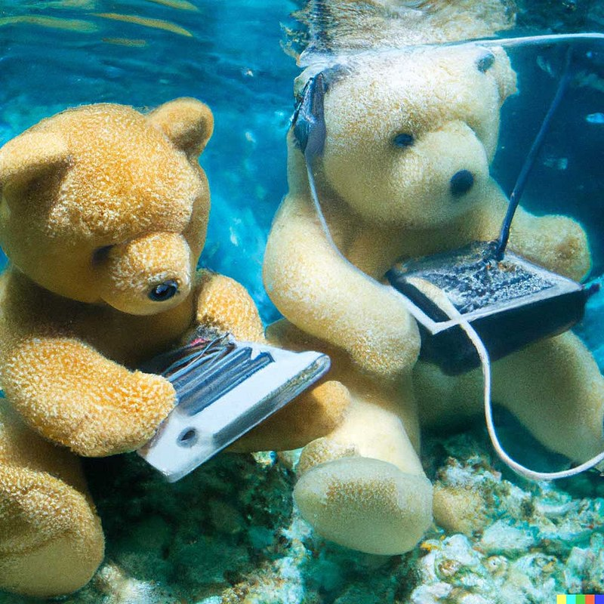
DALL-E 2
"Teddy bears working on new AI research underwater with 1990s technology"

Slide 11
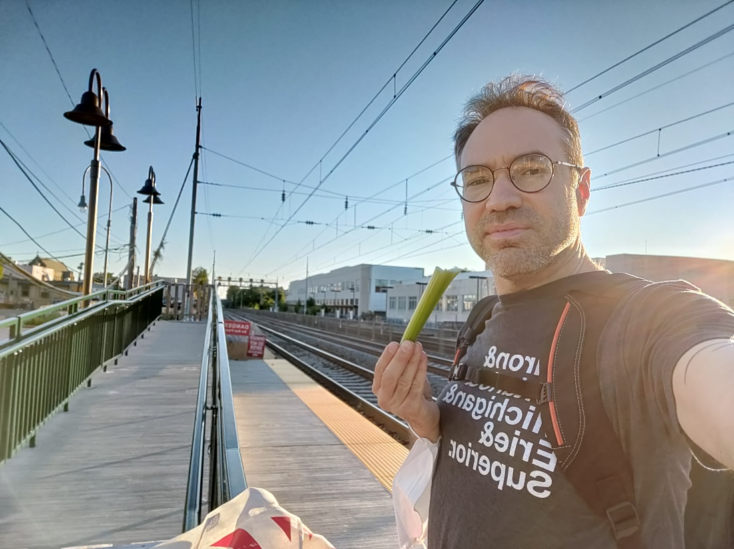
DALL-E 2
“Sticking thumb out to hitchhike”

Slide 12
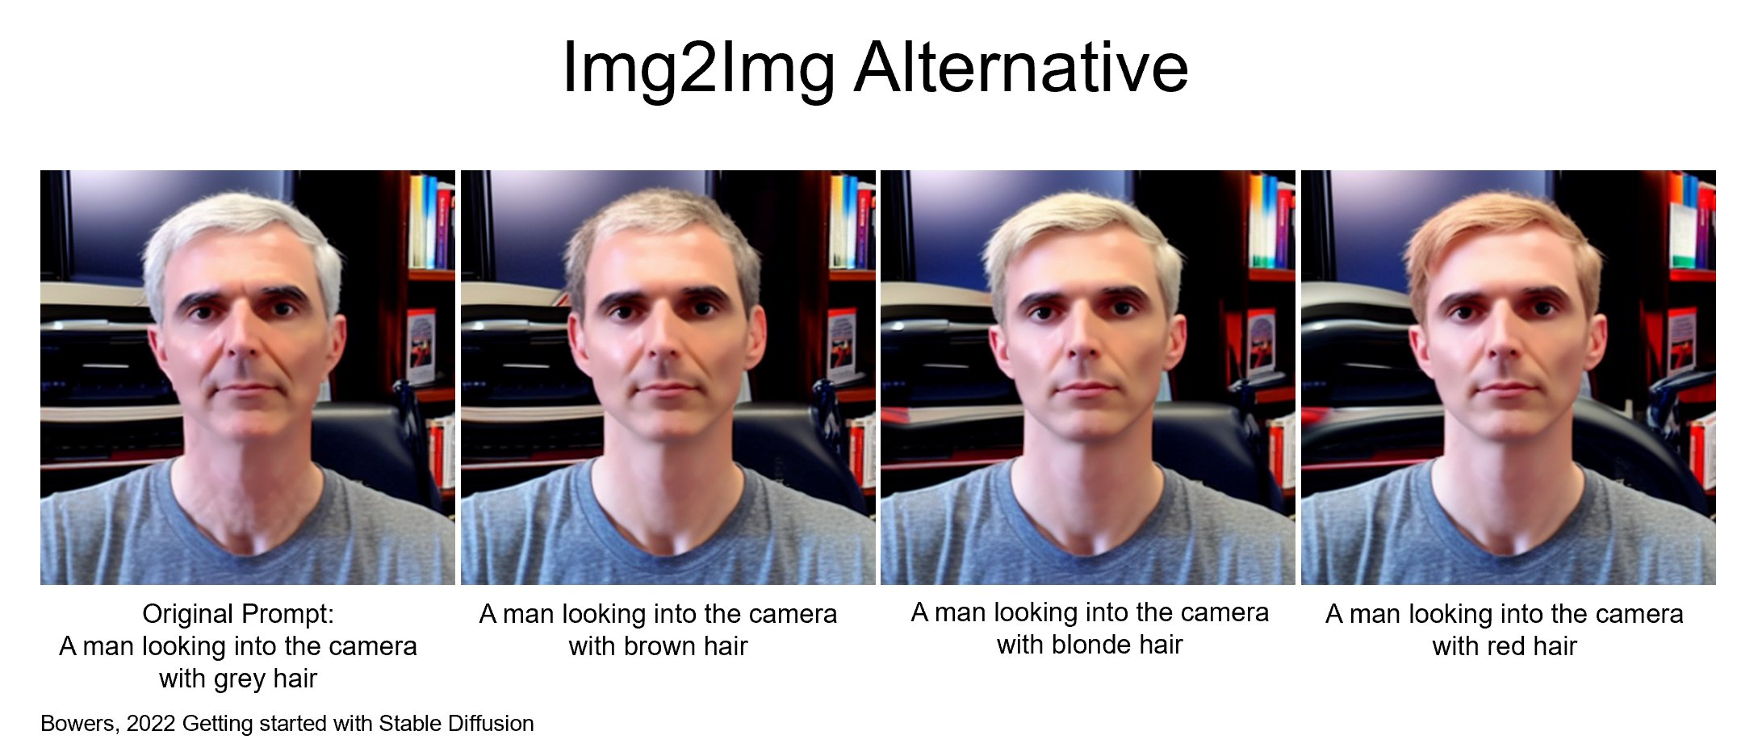
Stable Diffusion
Open-source alternative to DALL-E 2 with several variants
More powerful and easier to customize
Significantly harder to set up and keep running

Slide 13
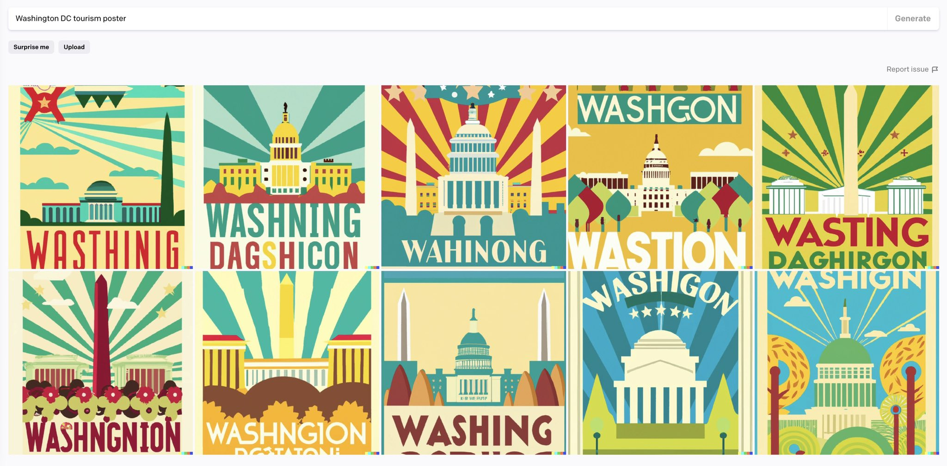
Text and image generation: not quite together yet (Randall Munro)

Slide 14
Large Language Models
Based on text embeddings
Represent text as feature vector (example from Neelakantan et al., 2022)

Slide 15
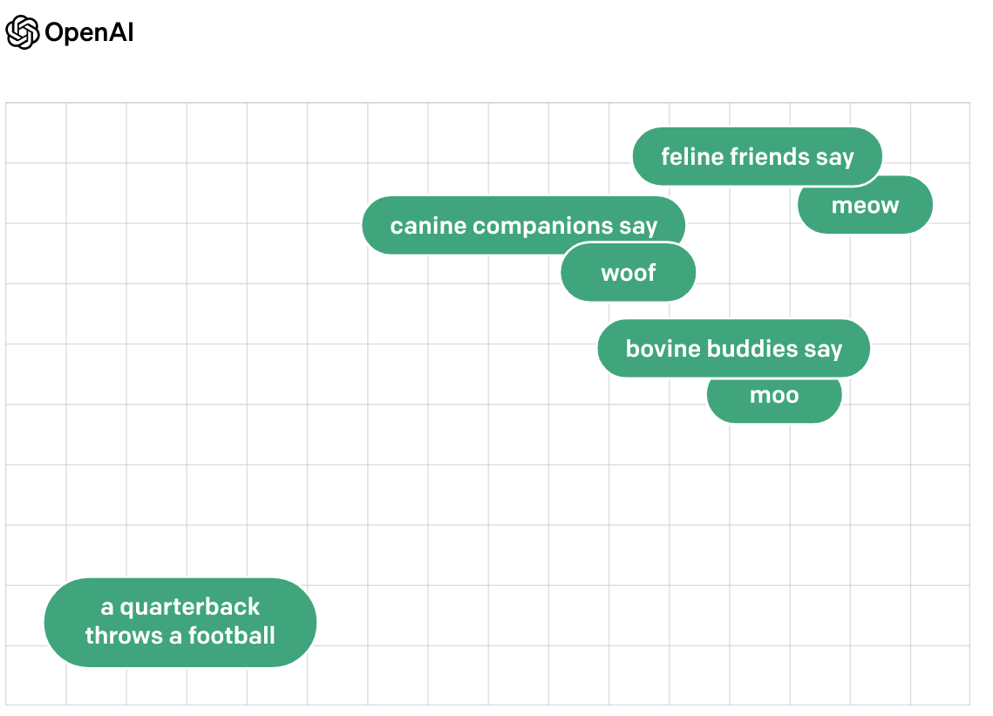
(example from Neelakantan et al., 2022)

Slide 16
If you want to generate embedding for your own use…
Universal Sentence Encoder (Cer et al., 2018)

Slide 17
If you want to just generate predicted text
Including assessing text
GPT-3/ChatGPT is the current best option

Slide 18
Prediction becomes Generation…

Slide 19
And Machine Learning Becomes Prompt Engineering

Slide 20
And Machine Learning Becomes Prompt Engineering
Write a summary of how GPT works
Write a summary of how GPT works, for a 5th grader, written at a 5th grade reading level
Write a summary of how GPT works, written for a PhD in Machine Learning who has not read a research paper since 2017.
Write a summary of how GPT works, written for a highly-intelligent person who knows essentially nothing about artificial intelligence.
Ryan Baker is an Ivy League professor of Machine Learning. He is explaining to a general audience how GPT works. He says, “

Slide 21
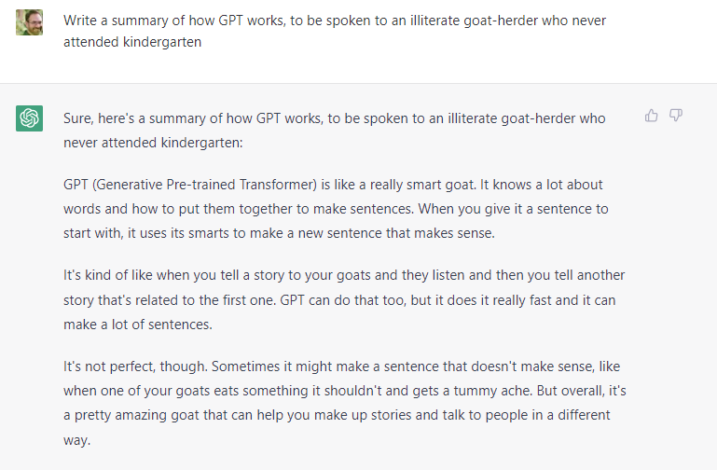
And Machine Learning Becomes Prompt Engineering

Slide 22
Two types of prompts
Request prompts (ChatGPT)
Completion prompts (GPT3)

Slide 23
A sample of things you can ask for
How to write a Python program for a specific goal
A simple example sentence involving a specific word in a different language
A translation of any language
Grammatical correction, simplification, clarity improvements, grading level adjustments on a paragraph of text
Summarization of a topic or article
Generate examples of text (synthetic data for signal-boosting in text mining)

Slide 24
Refining Foundation Models
Zero-shot: Just ask model to do something
One-shot: Give one example, ask model to do the same thing
Few-shot: Give several examples, ask model to do the same thing
Fine-tuning: Re-train model with examples

Slide 25
The Elephant in the Room
Why not just replace this class with a class about foundation models?
When they succeed, they succeed spectacularly
But…
They can’t do everything (actually, they don’t do most of the things this class has covered)
When they fail, they fail spectacularly
Not all tools quite as good as these ones (Galactica and Sydney)

Slide 26
Next lecture
Multimodal Learning Analytics

