Slide 1
Week 4 Video 3
Knowledge Inference: Logistic Knowledge Tracing, Performance Factors Analysis

Slide 2
Logistic Knowledge Tracing
A broad framework for knowledge tracing models based on logistic regression (Pavlik et al., 2021)

Slide 3
Performance Factors Analysis
First member of the LKT family that ran in real-time (Pavlik et al., 2009)

Slide 4
PFA
Measures how much latent skill a student has, while they are learning
But expresses it in terms of probability of correctness, the next time the skill is encountered
No direct expression of the amount of latent skill, except this probability of correctness

Slide 5
What is the typical use of PFA?
Assess a student’s knowledge of topic X
Based on a sequence of items that are dichotomously scored
E.g. the student can get a score of 0 or 1 on each item
Where the student can learn on each item, due to help, feedback, scaffolding, etc.

Slide 6
How does PFA differ from BKT?

Slide 7
Key assumptions
Each item may involve multiple latent skills or knowledge components
Different from BKT
Each skill has success learning rate γ and failure learning rate ρ
Different from BKT where learning rate is the same, success or failure

Slide 8
Key assumptions
There is also a difficulty parameter β, but its semantics can vary – more on this later
From these parameters, and the number of successes and failures the student has had on each relevant skill so far, we can compute the probability P(m) that the learner will get the item correct

Slide 9
PFA

Slide 10
PFA

Slide 11
Reasonable Example
γ = 0.2, ρ = 0.1, β = -0.5
Actual | m | P(m)

Slide 12
Reasonable Example
γ = 0.2, ρ = 0.1, β = -0.5
Actual | m | P(m)
 | -0.5 | 0.38

Slide 13
Reasonable Example
γ = 0.2, ρ = 0.1, β = -0.5
Actual | m | P(m)
0 | -0.5 | 0.38
 | -0.5+(0.1*1)

Slide 14
Reasonable Example
γ = 0.2, ρ = 0.1, β = -0.5
Actual | m | P(m)
0 | -0.5 | 0.38
 | -0.5+0.1

Slide 15
Reasonable Example
γ = 0.2, ρ = 0.1, β = -0.5
Actual | m | P(m)
0 | -0.5 | 0.38
 | -0.4 | 0.40

Slide 16
Reasonable Example
γ = 0.2, ρ = 0.1, β = -0.5
Actual | m | P(m)
0 | -0.5 | 0.38
0 | -0.4 | 0.40

Slide 17
Reasonable Example
γ = 0.2, ρ = 0.1, β = -0.5
Actual | m | P(m)
0 | -0.5 | 0.38
0 | -0.4 | 0.40
 | -0.5+(0.1*2)

Slide 18
Reasonable Example
γ = 0.2, ρ = 0.1, β = -0.5
Actual | m | P(m)
0 | -0.5 | 0.38
0 | -0.4 | 0.40
 | -0.5+0.2

Slide 19
Reasonable Example
γ = 0.2, ρ = 0.1, β = -0.5
Actual | m | P(m)
0 | -0.5 | 0.38
0 | -0.4 | 0.40
 | -0.3

Slide 20
Reasonable Example
γ = 0.2, ρ = 0.1, β = -0.5
Actual | m | P(m)
0 | -0.5 | 0.38
0 | -0.4 | 0.40
 | -0.3 | 0.43

Slide 21
Reasonable Example
γ = 0.2, ρ = 0.1, β = -0.5
Actual | m | P(m)
0 | -0.5 | 0.38
0 | -0.4 | 0.40
1 | -0.3 | 0.43

Slide 22
Reasonable Example
γ = 0.2, ρ = 0.1, β = -0.5
Actual | m | P(m)
0 | -0.5 | 0.38
0 | -0.4 | 0.40
1 | -0.3 | 0.43
 | -0.5+(0.1*2)+(0.2*1)

Slide 23
Reasonable Example
γ = 0.2, ρ = 0.1, β = -0.5
Actual | m | P(m)
0 | -0.5 | 0.38
0 | -0.4 | 0.40
1 | -0.3 | 0.43
 | -0.5+0.2+0.2

Slide 24
Reasonable Example
γ = 0.2, ρ = 0.1, β = -0.5
Actual | m | P(m)
0 | -0.5 | 0.38
0 | -0.4 | 0.40
1 | -0.3 | 0.43
 | -0.1 | 0.48

Slide 25
Degeneracy in PFA (Maier et al., 2021)
Three degenerate cases
γ < 0
γ < ρ
γ = ρ = 0

Slide 26
Degeneracy in PFA (Maier et al., 2021)
Three degenerate cases
γ < 0
γ < ρ
γ = ρ = 0
One seemingly degenerate (but not) case
4. ρ > 0
“It is worth noting that a fourth case when ρ > 0 -- is not degenerate, due to the multiple functions the parameters perform in PFA. In this case, the rate of learning the skill may outweigh the evidence of lack of student knowledge that an incorrect answer provides. So long as γ > ρ, a positive ρ is conceptually acceptable.”

Slide 27
Degenerate Example (Case 1)
γ = -0.1, ρ = -0.5, β = -0.5
Actual | m | P(m)
0 | -0.5 | 0.38
0 | -1 | 0.27
1 | -1.5 | 0.18
 | -1.6 | 0.17

Slide 28
Degenerate Example (Case 2)
γ = 0.1, ρ = 0.2, β = -0.5
Actual | m | P(m)
0 | -0.5 | 0.38
0 | -0.3 | 0.43
1 | -0.1 | 0.48
 | 0 | 0.5

Slide 29
Note
Values of ρ below 0 don’t actually mean negative learning
They mean that failure provides more evidence on lack of knowledge
Than the learning opportunity causes improvement
Notes:
Minor edit on this slide

Slide 30
Addressing Degeneracy (Maier et al., 2021)
Simply bound γ and ρ
Does not reduce model performance substantially (just like BKT)
What causes degeneracy?
We’ll come back to this in a minute

Slide 31
Note
Parameters in PFA combine information from correctness with improvement from practice improvement
Makes PFA models a little harder to interpret than BKT

Slide 32
Adjusting β
γ = 0.2, ρ = 0.1, β = -0.5
Actual | m | P(m)
0 | -0.5 | 0.38
0 | -0.4 | 0.40
1 | -0.3 | 0.43
 | -0.1 | 0.48

Slide 33
Adjusting β
γ = 0.2, ρ = 0.1, β = -1.5
Actual | m | P(m)
0 | -1.5 | 0.18
0 | -1.4 | 0.20
1 | -1.3 | 0.21
 | -1.1 | 0.25

Slide 34
Adjusting β
γ = 0.2, ρ = 0.1, β = +3.0
Actual | m | P(m)
0 | 3.0 | 0.953
0 | 3.1 | 0.957
1 | 3.2 | 0.961
 | 3.4 | 0.968

Slide 35
β Parameters
Pavlik proposes three different β Parameters
Item
Item-Type
Skill
Result in different number of parameters
And greater or lesser potential concern about over-fitting

Slide 36
Causes of Degeneracy (Maier et al., 2021)
If β is used at the Skill or Item-Type level
And the learning system moves students from easier to harder items within a “skill”
Then γ < 0.
Also, if items are tagged with multiple skills, shared variance (collinearity) between skills could produce degenerate parameters.

Slide 37
Fitting PFA
Typically Expectation Maximization is used

Slide 38
Expectation Maximization
Starts with initial values for each parameter
Estimates student correctness at each problem step
Estimates params using student correctness estimates
If goodness is substantially better than last time it was estimated, and max iterations has not been reached, go to step 2

Slide 39
Expectation Maximization
EM is vulnerable to local minima
Randomized restart typically used

Slide 40
Is PFA better than BKT?
Approximately equal predictive power across a lot of studies (Pavlik et al., 2009; Gong et al., 2010; Baker et al., 2011; Pardos et al., 2011, 2012)
Different virtues and flaws – choose the one that better fits your goals

Slide 41
Is PFA used in the real world?
Yes, but by far fewer learning systems than BKT
Maier et al. (2021) discuss its use in Reveal Math 1

Slide 42
Using PFA in the real world
One issue in real-world use is handling rare skills, which can impact model inferences on common skills as well
Because PFA is used in cases with items tagged to multiple skills
(Maier et al., 2021) handle this by creating a “catch all” skill for rare skills
Using average parameters from all common skills also works

Slide 43
Final Thoughts on PFA
PFA is a competitor for measuring student skill, which predicts the probability of correctness rather than latent knowledge
Can handle multiple KCs for the same item, a big virtue

Slide 44
Beyond PFA

Slide 45
PFA-Decay (Gong et al., 2011)
Weights actions further back in order less strongly
Adds an evidence decay parameter δ
Substitutes
For the previous summation
Very slightly higher AUC (0.003)

Slide 46
R-PFA (Galyardt & Goldin, 2014)
Weights actions further back in order less strongly
Looks at proportion of success-failure, weighting by distance in order from current action
Adds an evidence decay parameter b
Adds “ghost practices” before current practice to make math work
Substitutes
For the previous summation
A little higher AUC (0.003-0.027) (Pavlik et al., 2021)

Slide 47
LKT (Pavlik et al., 2021)
Creates a general framework for variants of PFA

Slide 48
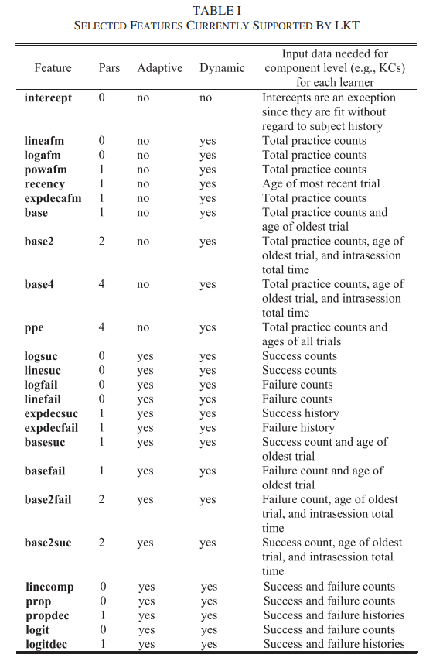

Slide 49
LKT (Pavlik et al., 2021)
Ongoing work on variants to PFA typically frames itself in terms of LKT components (and proposes additional components)
Examples
Fluctuation in response time (Chu & Pavlik, 2023)
Different models of memory decay and spacing effect (Maier et al., 2023)

Slide 50
Next Up
Item Response Theory

