Slide 1
Week 6 Video 3
Advanced Clustering Algorithms

Slide 2
Today…
Multiple advanced algorithms for clustering

Slide 3
Gaussian Mixture Models
Often called EM-based clustering
Kind of a misnomer in my opinion
What distinguishes this algorithm is the kind of clusters it finds
Other patterns can be fit using the Expectation Maximization algorithm
I’ll use the terminology Andrew Moore uses, but note that it’s frequently called EM these days

Slide 4
Gaussian Mixture Models
A centroid and a radius
Fit with the same approach as k-means (some subtleties on process for selecting radius)

Slide 5
Gaussian Mixture Models
Can do fun things like
Overlapping clusters
Explicitly treating points as outliers

Slide 6
+3
0
-3
time
0 1
pknow

Slide 7
Nifty Subtlety
GMM still assigns every point to a cluster, but has a threshold on what’s really considered “in the cluster”
Used during model calculation

Slide 8
+3
0
-3
Mathematically in red cluster, but outside threshold
time
0 1
pknow

Slide 9
Assessment
Can assess with same approaches as before
Distortion
BiC
Plus

Slide 10
Likelihood
(more commonly, log likelihood)
The probability of the data occurring, given the model
Assesses each point’s probability, given the set of clusters, adds it all together

Slide 11
For instance…
+3
0
-3
Very unlikely point
Likely points
Less likely points
time
0 1
pknow

Slide 12
Disadvantages of GMMs
Much slower to create than k-means
Can be overkill for many problems

Slide 13
Spectral Clustering

Slide 14
Spectral Clustering
+3
0
-3
I’m a fair use ghost!
time
0 1
pknow

Slide 15
Spectral Clustering
Conducts dimensionality reduction and clustering simultaneously
Like support vector machines
Mathematically equivalent to K-means clustering on a non-linear dimension-reduced space

Slide 16
Hierarchical Clustering
Clusters can contain sub-clusters

Slide 17
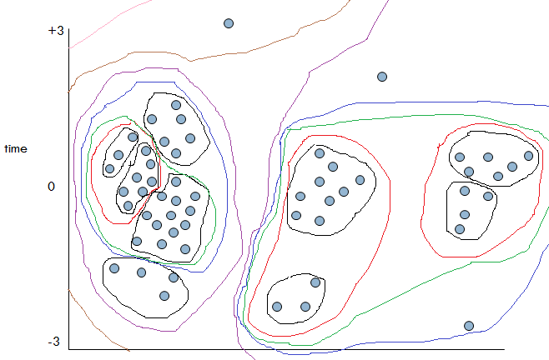

Slide 18
1
2
3
4
5
6
7
8
9
A
B
C
D

Slide 19
Hierarchical Agglommerative Clustering (HAC)
Each data point starts as its own cluster
Two clusters are combined if the resulting fit is better
Continue until no more clusters can be combined

Slide 20
DP-Means clustering
Starts with single point and cluster
Repeatedly adds new point
If point does not fit well with existing clusters, creates a new cluster

Slide 21
Sequence clustering
Clusters sequences rather than individual data points
A variety of algorithms exist to do this

Slide 22
Dynamic Time Warping
A method for calculating difference between sequences when length is not the same
i.e. what if two students have same overall pattern of behavior but don’t take the same time to demonstrate each behavior?
Tries to match each event in one sequence to an event in the other sequence and check if order is consistent

Slide 23
Latent Class Analysis*
* Not technically clustering

Slide 24
Latent Class Analysis
Type of structural equation modeling that groups data points into a latent variable (conceptually similar to a cluster)
Attempts to find data points that are statistically independent of each other, when controlling for group – such that the relationship between the data points is wholly explained by the grouping

Slide 25
Latent Class Analysis
Can conduct statistical analysis of latent classes
Can be used to model changes in membership over time
Requires tons and tons of data
Very slow
Tends to find smaller number of latent classes than cluster analysis

Slide 26
Many types of clustering
Which one you choose depends on what the data looks like
And what kind of patterns you want to find

Slide 27
Next lecture
Clustering – Some examples

