Slide 1
Week 7 Video 2
Generative AI and Large Language Models

Slide 2
Setting the stage

Slide 3
What do you even call them?
Transformer Models
Foundation Models
Large Language Models
But what about non-language models?

Slide 4
Transformer/Foundation Models
Some examples
BERT, MathBERT, GPT-4, Claude, Mistral, LLaMA 2, DALL-E 3, StableDiffusion, Github Copilot, …, …

Slide 5
Transformer/Foundation Models
Can predict
Words
Sentences
Pixels
Computer program text
Mathematical equations
Anything?

Slide 6
Transformer/Foundation Models
Can predict
Words
Sentences
Pixels
Computer program text
Mathematical equations
Anything?
Increasing numbers of models are multimodal, and can handle/output multiple types of data

Slide 7
Transformer/Foundation Models
Can predict
Words
Sentences
Pixels
Computer program text
Mathematical equations
Anything?
And, in a sudden light-switch transformation, prediction became generation

Slide 8
Prediction becomes Generation…

Slide 9
And Machine Learning Becomes Prompt Engineering

Slide 10
And Machine Learning Becomes Prompt Engineering
Write a summary of how GPT works
Write a summary of how GPT works, for a 5th grader, written at a 5th grade reading level
Write a summary of how GPT works, written for a PhD in Machine Learning who has not read a research paper since 2017.
Write a summary of how GPT works, written for a highly-intelligent person who knows essentially nothing about artificial intelligence.
Ryan Baker is an Ivy League professor of Machine Learning. He is explaining to a general audience how GPT works. He says, “

Slide 11
And Machine Learning Becomes Prompt Engineering
Please revise grammar and style of this paragraph for a paper as a scholar without changing the meaning
I am an explanation-generation bot. I am trying to generate compare-contrast explanations for the graph I have chosen. Now I will generate 30 examples. I should make the sentence structures of these examples as various as possible. I should not use words like "while" or "whereas".

Slide 12
Two types of prompts
Request prompts (Chatbot LLMs)
Completion prompts (Non-chatbot LLMs)

Slide 13
Large Language Models
Based on text embeddings
Represent text as feature vector (example from Neelakantan et al., 2022)

Slide 14
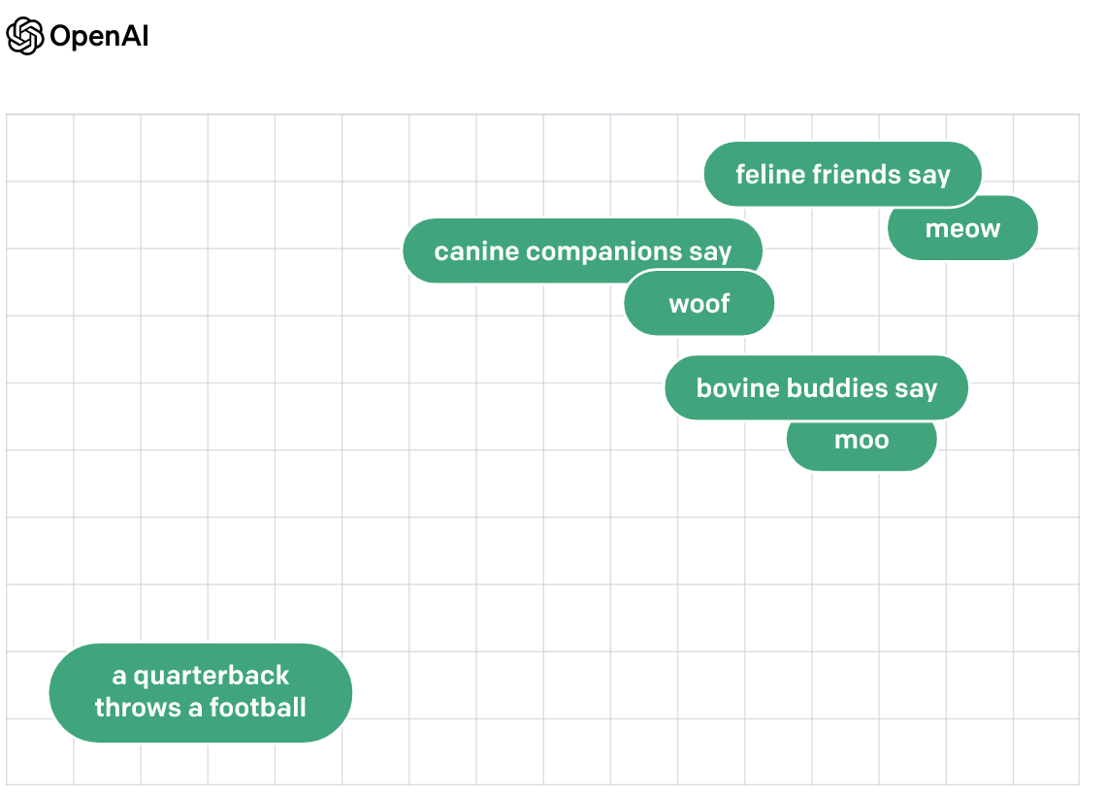
(example from Neelakantan et al., 2022)

Slide 15
Refining Foundation Models
Zero-shot: Just ask model to do something
One-shot: Give one example, ask model to do the same thing
Few-shot: Give several examples, ask model to do the same thing
Fine-tuning: Re-train model with examples

Slide 16
RLHF
Reinforcement Learning with Human Feedback
Giving a model thumbs up-thumbs down feedback on its outputs

Slide 17
The Elephant in the Room
Why not just replace this class with a class about foundation models?
When they succeed, they succeed spectacularly
But…
They can’t do everything (actually, they don’t do most of the things this class has covered)
When they fail, they sometimes fail spectacularly

Slide 18
Fast Moving Space
Right now, it seems like every week a new model comes out, claiming to be the best at something
Growing number of competitors releasing different models, of varying quality

Slide 19
Open Source
Some models are open source
Big advantage in terms of long-term reliability
OpenAI has a habit of completely deprecating older models, and changing base prompts without notice
This has been a nightmare for reproducibility, replicability, and long-term stability of tools built on top of their models

Slide 20
Rest of this week
Deep dives into specific methods for working with LLMs
Prompt Engineering
Using Embeddings
Fine-Tuning
RLHF

Slide 21
Next lecture
Prompt Engineering

