Slide 1
Week 7 Video 3
Prompt Engineering

Slide 2
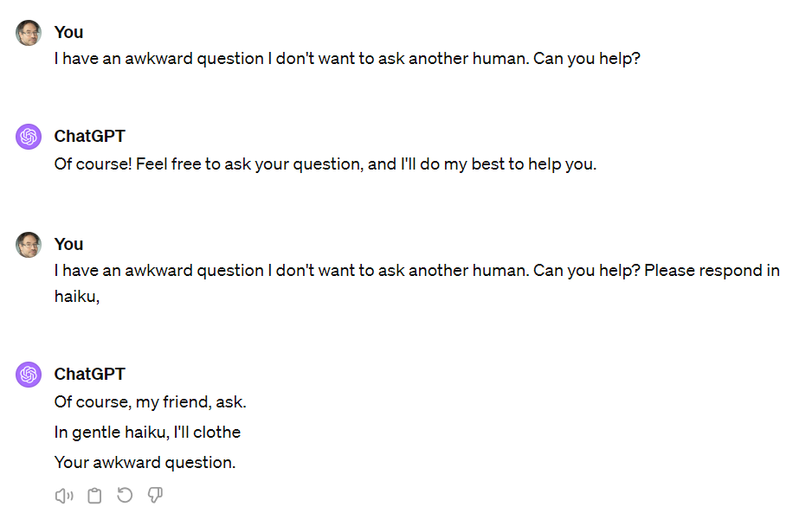
Prompt Engineering
The primary way that most users interact with LLMs

Slide 3
Prompt Engineering (Reprise)
Write a summary of how GPT works
Write a summary of how GPT works, for a 5th grader, written at a 5th grade reading level
Write a summary of how GPT works, written for a PhD in Machine Learning who has not read a research paper since 2017.
Write a summary of how GPT works, written for a highly-intelligent person who knows essentially nothing about artificial intelligence.
Ryan Baker is an Ivy League professor of Machine Learning. He is explaining to a general audience how GPT works. He says, “

Slide 4
Two types of prompts
Request prompts (Chatbot LLMs)
Completion prompts (Non-chatbot LLMs)

Slide 5
Praise-and-prompt
You often get a better response if you tell ChatGPT it’s an expert (and the more expert, the better: use words like “famous”, “award-winning”, or specific institutions)
Doing so makes the answers associated with experts – and the characteristics associated with those answers – the most likely
In general, ChatGPT and other LLMs are good at perspective-taking

Slide 6
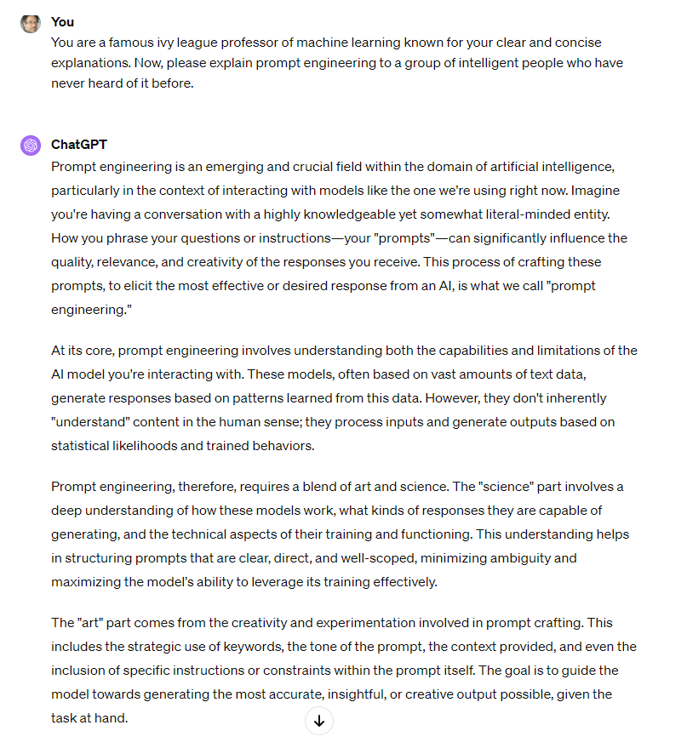

Slide 7
Iteration in Interaction
If you don’t entirely like what it gives you at first, you can correct it, or ask for clarification, or ask for modifications, or ask it to redo

Slide 8
Iteration
Can be an explicit strategy (Barany et al., 2024)
You are a researcher helping develop a qualitative codebook for text data of a math tutor's interactions with students. I will give you the first draft of the codebook, and then the data being coded, in batches. Please help me refine the codes and codebook, focusing on instructional strategies or techniques
[Every 4 data batches]
Please give me a refined codebook, with examples, based on all X batches of data so far

Slide 9
Giving constraints
Let's have a dialogue in Simple Korean. Please use simple words and limit all responses to a maximum of 15 words. You are a friendly neighbor asking my opinion about the president. Please start the conversation.
Write it at the level of a sixth grader.

Slide 10
Reminders of what not to do
Please revise grammar and style of this paragraph for a paper as a scholar without changing the meaning (courtesy of Andres Zambrano)
I want you to act as a Stackoverflow post that helps me to solve a programming assignment in C#. I want you to explain in Polish why this code does not compile. Don’t write solution in the explanation, but focus on meaningful hints… (Pankiewicz et al., 2023)

Slide 11
Tweaking by example
I am an explanation-generation bot. I am trying to generate compare-contrast explanations for the graph I have chosen. Now I will generate 30 examples. I should make the sentence structures of these examples as various as possible. I should not use words like "while" or "whereas". (Slater et al., under review)

Slide 12
Call-outs to published papers
… we want to have deeper contextualization not surface details based on Using Adaptive Learning Technologies to Personalize Instruction to Student Interests: The Impact of Relevant Contexts on Performance and Learning Outcomes… (Yadav et al., 2023)

Slide 13
Chain of Thought Prompting
“Let’s think step by step.”
“Take a deep breath and work on this step by step.” (Yang et al., 2023)

Slide 14
Prompt Chaining
First prompt generates information or plan that is then used in a second prompt

Slide 15
Some current issues
“Averaged reasoning”
Ask them what a specific expert would say, they will give you what a generic expert would say
My Harry Potter adventure with my kids suddenly turned R rated, probably based on GPT reading too much fan fiction
Being too helpful in guessing what you “really want” (because what you asked for is uncommon/rare/weird)

Slide 16
Some current issues
Over-cooperativeness
Sometimes, when you ask it for more detail or explanation, it thinks you are telling it that it is wrong
And it will actually flip its answer
Annoying when using LLM to label or code data

Slide 17
Some current issues
Forgetting over time
Across iterative interaction, LLM can forget original prompt over time
Particularly likely to forget constraints

Slide 18
Some current issues
Unreliability
The same query gets different results
Changes in version happen quietly and change results substantially
It refuses to do innocuous things it used to do
Trying to be safe makes it “too safe”
At one point recently, ChatGPT wouldn’t write a scary story for a child or recommend tourist activities in Philadelphia’s poorest neighborhood

Slide 19
Hallucinations
Making up facts or references
ChatGPT is much better than it used to be
Still a major issue with other LLMs

Slide 20
Just a “Stochastic Parrot”?
These tools create the most probable next word
So, some people refer to them as “stochastic parrots” (e.g. Bender et al., 2021) – which implies no understanding whatsoever
There’s an open debate, but I don’t think that’s quite right…

Slide 21
Just a “Stochastic Parrot”?
There is some model underlying how the most likely next word is produced
Successful prompt engineering depends in part on being able to think like that model
And think of how to make the answer you want become the most probable one

Slide 22
Next lecture
Using Embeddings

