Slide 1
Week 7 Video 4
Using Embeddings with Large Language Models

Slide 2
Today’s Lecture
Thanks to Maciej Pankiewicz, Andres Zambrano, Xiner “Rachel” Liu

Slide 3
Prompt Engineering
As mentioned last lecture, most of the use of LLMs in our field is prompt engineering

Slide 4
Prompt Engineering
But prompt engineering isn’t a particularly optimal way to add information into the LLM’s knowledge base
Sure, you could just append all the info to the beginning of your prompt
Clunky
Expensive
Not always the best results; after a certain scope, can lead to forgetting

Slide 5
Embeddings
An alternative: adding information to the LLM’s knowledge base through embeddings

Slide 6
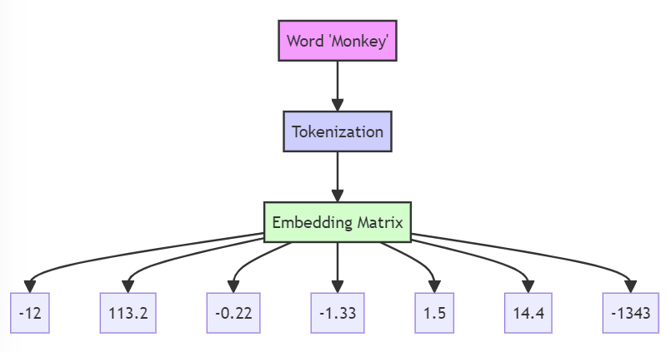
Embeddings
The first step for an LLM to work with text is to convert it to an embedding
A multi-dimensional vector of numbers
Each token in text converted to multi-dimensional vector by a neural network

Slide 7
Embeddings
Each dimension of the multi-dimensional space represents some aspect of the semantic or syntactic properties of the token
Verb
Attitude towards Bananas
Mammal
Valence

Slide 8
Embeddings
Not new to current generation of LLMs
First major embedding approach was Word2Vec (2013), based on a neural network approach but much simpler than GPT’s embeddings

Slide 9
Embeddings
Most LLMs have publicly available tools for transforming tokens into embeddings
You can add those embeddings into the LLM’s knowledge base
A fast way to give the LLM additional information that it treats as its own when you use it

Slide 10
Embeddings
You can store those embeddings locally or embed them into the LLM’s knowledge base
You might want to store them locally in order to search through them and decide which ones you want to add to the LLM’s knowledge base in a specific situation

Slide 11
Many Use Cases in EDM/LA

Slide 12
Providing Key Info
Embeddings can be used to provide key info to LLM for use in generating responses
Example: JeepyTA project at Penn provides past forum responses and grading feedback from instructor to LLM to use as examples

Slide 14
Finding distance between texts
Embeddings can be used to transform text into a representation that can be compared to other text representations in terms of distance
For example, to determine which reference answer a student answer is closest to (Schneider et al., 2023)
Or to cluster mathematics word problems or course descriptions
Or to classify texts into categories (Wang et al., 2023; Surawochet et al., 2024)
Or for outlier detection

Slide 15
Feature generation
Embeddings can be used to transform text into a representation that can be used as features in models predicting other constructs

Slide 16
Embeddings
We can now transform text into very high-quality multi-dimensional representations
LOTS of uses
Not many citation examples yet in EDM/LA, as of this recording
The next edition of this course will have many examples, I’m sure

Slide 17
Next lecture
Using Fine-Tuning

