Slide 1
Week 7 Video 5
Fine-Tuning Large Language Models

Slide 2
Today’s Lecture
Thanks to Maciej Pankiewicz, Andres Zambrano, Xiner “Rachel” Liu

Slide 3
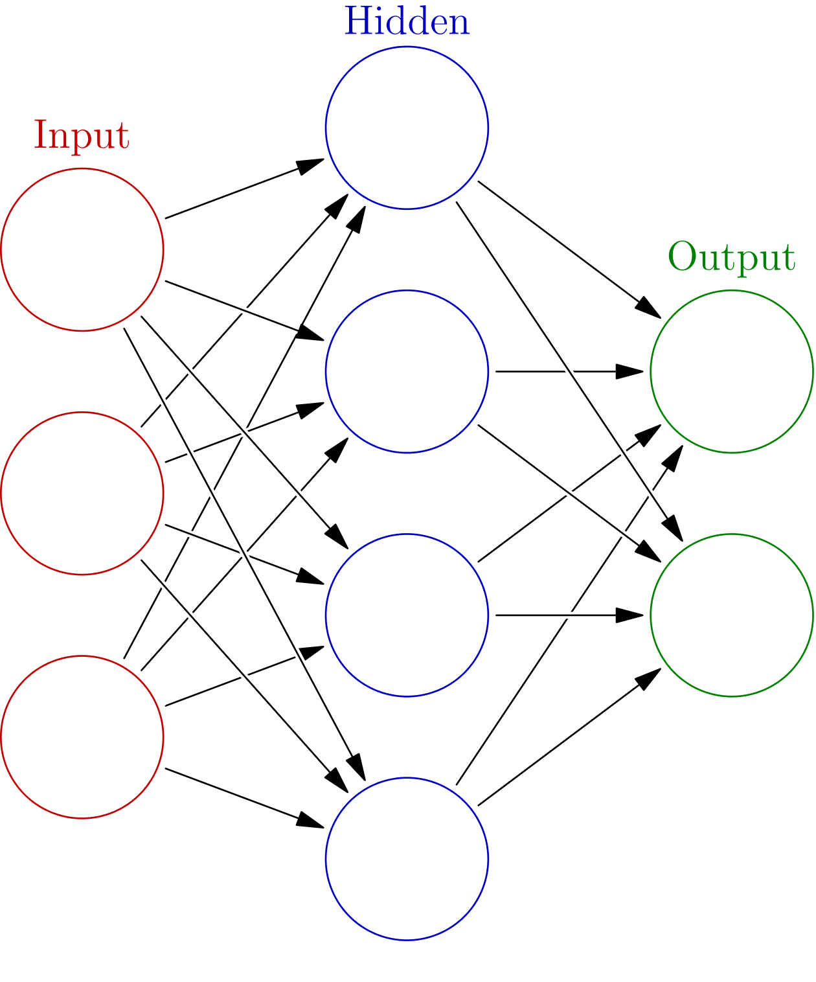
Fine-Tuning
As noted before, LLMs consist of an extremely complex neural network with an input layer, hidden layers, attention mechanisms, and an output layer
Image courtesy of glosser.ca used under Creative Commons Licensing

Slide 4
Fine-Tuning
In fine-tuning, the developer provide additional inputs and outputs, and the neural network is modified to better fit the new data
Modifying the weights of the network to accomplish this

Slide 5
Fine-Tuning
Fine-tuning modifies the weights of this network to better fit a specific data set
According to OpenAI’s website, modifies hidden layer weights, attention mechanism weights, hyperparameter weights, and output layer weights
According to OpenAI can produce clear differences in output for as few as 50 examples
The more data, the better
Evidence of diminishing returns as amount of data increases

Slide 6
Fine-Tuning
Particularly useful if you are sending the same long prompt over and over
Replaces an ongoing cost (repeatedly sending the same long prompt) with a one-time cost (fine-tuning)
Also increases speed (no need to repeatedly process the same long prompt)

Slide 7
Fine-Tuning
A way around deprecation
Once you’ve fine-tuned a model, OpenAI retains it even if the base model is no longer available
WARNING: This is not guaranteed

Slide 8
Use cases
Change style, tone, or format to match examples
If you just need a general change, prompt engineering is usually easier and faster

Slide 9
Use cases
Correct cases where prompting produces incorrect examples
Give it the examples and tell it what to say
With enough examples, it can start to find the pattern underlying where its responses are not what you want

Slide 10
Use cases
Do a task that is hard to explain
Write discussion forum post responses like Ryan Baker (JeepyTA)

Slide 11
Pre-condition
You need to have examples already
Or a process that can generate those examples
Such as showing humans LLM responses and asking them to identify incorrect ones, and suggest a better alternative
Used by Khanmigo (personal communication, Kristen DiCerbo)

Slide 12
Limitations
High initial cost and training time
Locks you into a model version when better ones may become available later
Changes the output, not the knowledge base
If you want the LLM to have additional knowledge, use embeddings

Slide 13
Next up
Week 8: Advanced Topics

