Slide 1
Adaptive Learning Systems
EDUC5183 Summer 2024

Slide 2
Welcome!

Slide 3
Your instructor
Ryan Baker

Slide 4
Your course assistant
Chelsea Porter

Slide 5
Course Goals
More and more education takes place asynchronously and online, but relatively little asynchronous instruction takes advantage of the technological advancements that have taken place in recent decades, replicating traditional models for instruction online.

Slide 6
Course Goals
In this class, you will learn about the pedagogy and technology of adaptive learning systems (often referred to as intelligent tutoring systems), individualized and personalized technology that helps students construct understanding and develop skill.

Slide 7
Course Goals
We will read and reflect on both classic and recent papers on this technology, and study many of the successful examples of adaptive learning systems, both systems that have scaled and systems that have failed to scale.
We will investigate key methods this type of learning leverages, and key pedagogies it affords.

Slide 8
Administrative Stuff
Is everyone signed up for class?
If not, and you want to receive credit, please send me an email
If you ARE signed up for this class, and have NOT gotten email from me yet, also please send me an email

Slide 9
Format
Readings
Video Lectures and Activities
Discussions
AMA Sessions
Projects
Commentary on Projects

Slide 10
How this class is going to work
Watch each week’s videos on the website
Do any interactive activities for the week on the website
Read the readings
Participate in the discussion forums
Participate in the vivi-sd scaffolded group conversations
Attend weekly AMA sessions, ask questions, and discuss the topics
You are also welcome at my office hours
Do the assignments, and post to the forum when you have questions or comments

Slide 11
Course website
https://www.upenn.edu/learninganalytics/ryanbaker/ITS2022/index.html

Slide 12
Class Schedule

Slide 13
Class Schedule
Updated versions will be available on the course webpage

Slide 14
Class Schedule
If any schedule changes happen due to unforeseen circumstances
Online schedule will be kept up-to-date

Slide 15
Readings
https://drive.google.com/drive/folders/1qH8RV6kV6wDsJpxhe60H2symrLWyrILF

Slide 16
Course Discussion Forum
[need link]

Slide 17
Course Discussion Forum
Hand in assignments there
Comment on other students’ assignments there
Discuss the readings and lectures there

Slide 18
Course Discussion Forum
This semester, we will be joined by our LLM-powered TA, JeepyTA
Not just basic GPT-4; we’ve done some fine-tuning
JeepyTA will respond to some of your posts when we aren’t available, and will answer them faster than we can

Slide 19
VIVI-SD Discussions
This semester you will have discussions in VIVI-SD rather than breakout rooms
With your classmates
Organized by “Virtual Ryan”
Starts off and scaffolds your conversations
Not yet as impressive as we hope to make it
This semester’s data will build next semester’s adaptivity
You will have until the due date to schedule and conduct these discussions

Slide 20
VIVI-SD
Please form a VIVI-SD group of 3 and email cfporter@gse.upenn.edu to let her know your group
Do this ASAP
If you don’t know folks on the class, post to the JeepyTA forum
If you still can’t find people to partner with, re-post and tag me

Slide 21
Assignments
System Review
Semester Paper
Let’s take a quick look at each
Any questions?

Slide 22
Assignments
Note that you have to select a topic for your System Review paper really soon
Summer classes have a very condensed schedule compared to Spring/Fall classes
Don’t worry! There aren’t really any wrong choices for your topic (if you stick to the suggested list)

Slide 23
Due Dates
Please try to meet all homework due dates
Given the state of the world these days, I intend to be more flexible than usual on extensions – but please note that the Summer grading schedule is a little unforgiving
Extensions can easily turn into incompletes

Slide 24
Plagiarism and Cheating: Boilerplate Slide
Don’t do it
If you have any questions about what it is, talk to me before you turn in an assignment that involves either of these
University regulations will be followed to the letter

Slide 25
Plagiarism and Cheating: Note
Having said that
I will not be a stickler on use of quotation marks, etc.
Just make sure it’s clear what are your ideas, and what comes from someone else

Slide 26
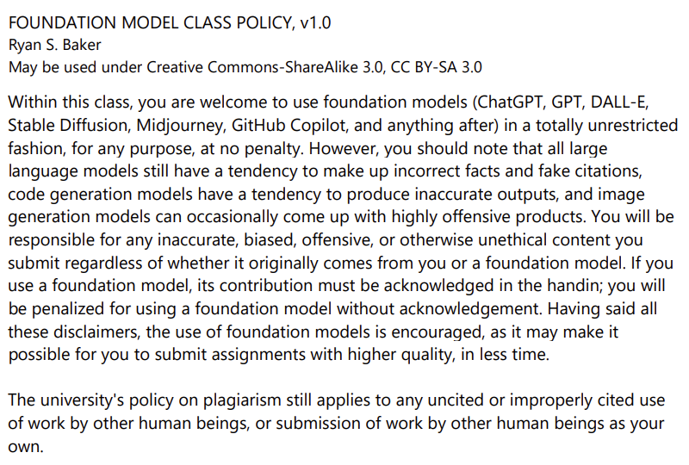

Slide 27
Grading
System Review (25% of grade)
Semester Paper Prospectus (14% of grade)
Semester Paper (25% of grade)
Synchronous Discussions/VIVI-SD (16% of grade)
Other Participation (20% of grade)
Note that posting responses to other students’ assignments is part of your grade for System Review and Semester Paper!

Slide 28
Accommodations for Students with Disabilities
Please email me to set up a meeting so we can best accommodate you

Slide 29
Ways to get in touch with me
Post to the forum
Strongly preferred for all questions that could be of interest to other students; fastest response
Come to office hours
5p-6p Mondays USA Eastern
905-10a Wednesdays USA Eastern
Set up a virtual meeting penn.learninganalytics@gmail.com
Questions on grades or late handins rybaker@upenn.edu
Use the right approach, get a much faster response

Slide 30
Discussion Forums
Before emailing me, if you have a question or comment of general interest for the class
Post to the JeepyTA forum
JeepyTA may have useful thoughts
One of your classmates may have useful thoughts
I will read it faster than my email

Slide 31
Questions
Any questions on the syllabus, schedule, or administrative topics?

Slide 32
Introductions
Please introduce yourselves!
Your name
Your preferred pronoun (completely optional)
What program you’re studying in
What your current job is (if you have one)
Have you ever used or worked on an adaptive learning system before?
Why are adaptive learning systems of interest to you?

Slide 33
Thank you!
I look forward to learning from all of you over the course of this semester!

Slide 34
Questions? Comments?

Slide 35
Upcoming Dates
June 6 Knowledge Tracing and Mastery Learning AMA
June 10 System Review first task due (sign up for learning system)
June 12 VIVI-SD 1 due
June 13 Knowledge Graphs and Prerequisite Tracing AMA
June 19 – VIVI-SD 2 due
June 20 Memory Optimization and Spiraling Review AMA

Slide 36
If you haven’t
Watched week 1 videos
Completed week 1 interactive video
Go ahead and do so
I’ll hang out here

Slide 37
The End

