Slide 1
Adaptive Learning Systems
EDUC5183

Slide 2
Welcome!

Slide 3
Educational Games
A lot of them out there, and more every year

Slide 4
Why is that?
Games are engaging
No kid stands in line all night to get the latest version of AutoTutor or ASSISTments

Slide 5
There are exceptions, of course…
Waiting to buy Aplusix: Algebra Assistant, not Final Fantasy LXXIX: LEGO Call of Mario

Slide 6
Games are fun
And kids play them a lot
It’s often difficult to get adolescents to put hours into studying (or adults)
But these same adolescents often will play computer games for dozens of hours (or hundreds)
(cf. Brown, 2005; Fisher, 2005)

Slide 7
Gamification
“Process of adding game-like elements to something so as to encourage participation”

Slide 8
Gamification
“Process of adding game-like elements to something so as to encourage participation”
“Gamification can be a miraculous way to boost engagement with monotonous tasks at work and beyond, or an over-hyped strategy doomed to fail.” (Milkman, 2021)

Slide 9
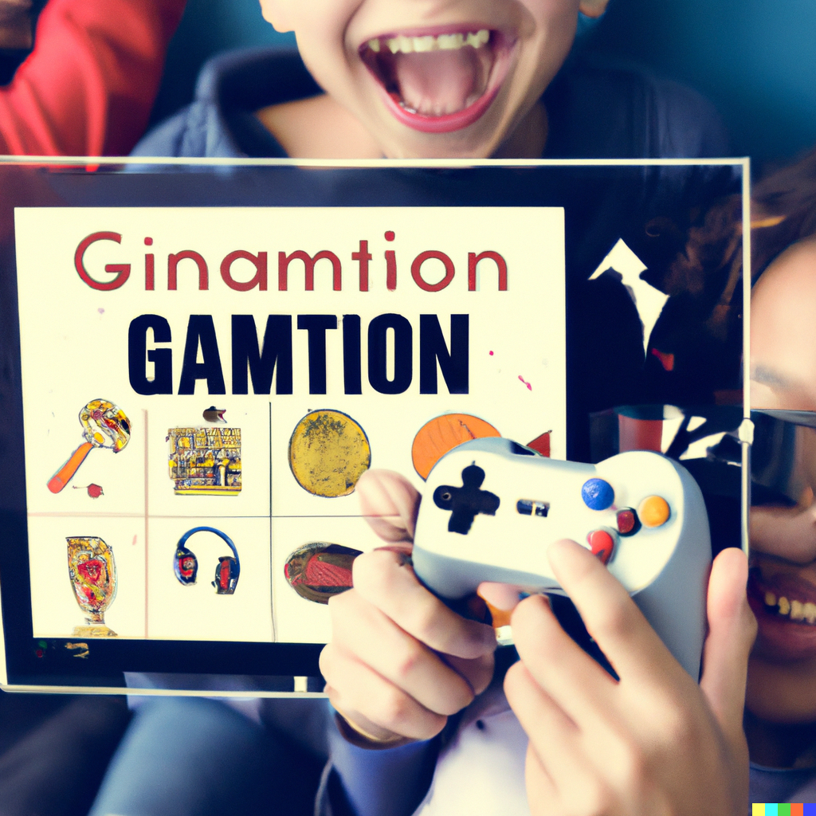
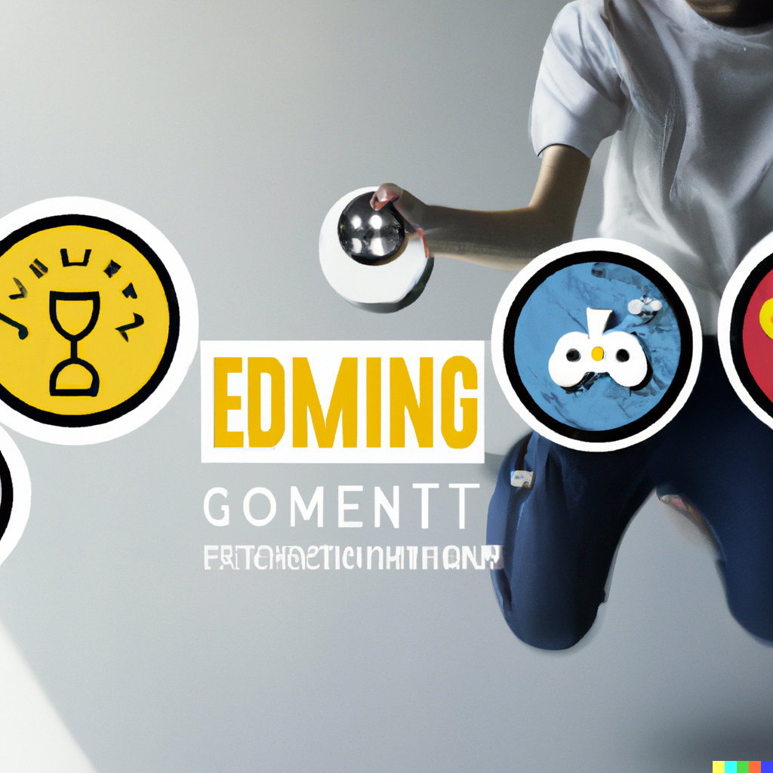
Even DALL-E 2 is Excited By “The Exciting Power of Gamification”

Slide 10
But to others, it’s simply (Bruckman, 1999)

Slide 11
Gamification-Based Rewards Systems
Used in many digital learning platforms
Some successes
Increase motivation and learning (Tahir and Mitrovic, 2020)
More and faster concept completion (Li et al., 2012)
Stronger engagement (Li et al., 2012)
Incentives for desired behaviors (Long and Aleven, 2011)

Slide 12
Gamification-Based Rewards Systems
However, if poorly designed…
Students focus on short-term outcomes rather than long-term (Long and Aleven, 2011)
Adopt behaviors targeted to rewards not learning (Long and Aleven, 2011; Wang et al., 2022)
Reduce long-term intrinsic motivation for learning (Lepper & Greene, 1978)

Slide 13
Gamification Features (Jackson & McNamara, 2013)
Do all of these really seem like gamification?

Slide 14
Gamification Features (Jackson & McNamara, 2013)
Incentives
Not that hard to mess up
“Hidden Cost of Reward” (Lepper & Greene, 1978)
Replicated in games (Long & Aleven, 2014)
Players can be over-responsive to incentives and distorts behavior to earn rewards (Wang et al., 2022)

Slide 15
Gamification Features (Jackson & McNamara, 2013; Kim & Shute, 2015)
Control/Personalization
Not that hard to mess up
Some students spend inordinate amounts of time dressing up their avatars (if you let them) (Feldon & Kafai, 2008)

Slide 16
Gamification Features (Jackson & McNamara, 2013)
Task Difficulty
Not that hard to mess up
If difficulty is too high, players quit – and ideal difficulty for motivation can be lower than expected (Lomas et al., 2013)
Matches findings from behaviorism waaaaay earlier
But ideal difficulty for motivation leads to less learning (Lomas et al., 2013)

Slide 17
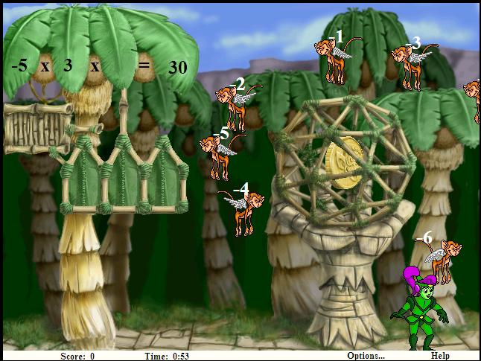
Gamification Features (Malone, 1981)
Extrinsic Fantasy
Fantasy unrelated to game task (Whether or not embedded in core game mechanic)

Slide 18
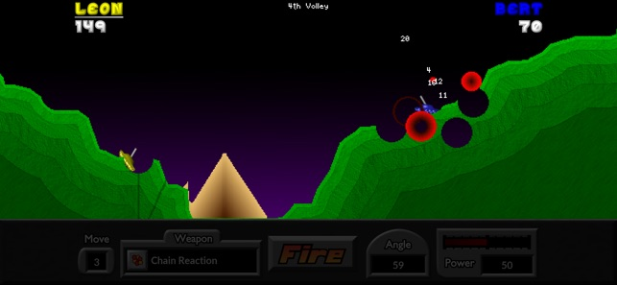
Gamification Features (Malone, 1981)
Intrinsic Fantasy
Fantasy directly related to game task

Slide 19
Gamification Features (Lomas et al., 2017)
Novelty
Operationalized as frequency of changing gaming parameters

Slide 20
Gamification Features (Lomas et al., 2017)
Suspense
How close the player is to losing

Slide 21
Gamification Features (Johnson et al., 2005)
Fish Tanks and Sandboxes
Initially give player version of game with fewer features (Fish Tank) or where student can’t lose (Sandboxes)

Slide 22
Gamification Features (Wouters & van Oostendrop, 2017)
Narrative

Slide 23
Gamification Features (Wouters & van Oostendrop, 2017)
Narrative
However, several studies find improved engagement but uncertain learning effect (Wouters & van Oostendrop, 2017)

Slide 24
Anti-Gamification Feature (Mayer et al., 2019)
Prompting player to write self-explanations during gameplay
Leads to better learning
But does the game still feel like a game?

Slide 25
Beyond the game
Several papers find that providing non-game activities relevant to game concepts before or after gameplay improves learning (Mayer et al., 2019)
Maybe less fun-destroying than embedding non-game activities into the game

Slide 26
Key takeaways
Fun is a good thing
Gamification can achieve fun
Gamification can also make things worse if it’s done poorly
And it’s kinda easy to do poorly

Slide 27
The End

