Slide 1
Adaptive Learning Systems
EDUC5183

Slide 2
Welcome!
There’s a lot to cover this week
So I have split this week into 3 videos
ECD
Machine Learning
Natural Language Processing

Slide 3
We continue this week…
With an area that has had considerable interest over the last decade
Tutoring complex behavior

Slide 4
Two steps
Detecting complex behavior
Responding to complex behavior

Slide 5
A Reprise
Let’s connect back to previous lectures
You may remember Cognitive Tutor/MATHia which we’ve seen as an example a few times
Model Tracing determines whether student got problem step right
Knowledge Tracing aggregates across problem steps to assess overall knowledge of skill

Slide 6
We can map this to any assessment of complex behavior
Overall paradigm
Assessment of complex behavior determines whether student got problem step right
Knowledge Tracing aggregates across problem steps to assess overall knowledge of skill

Slide 7
Approaches for Recognizing Complex Behavior
Model tracing (part 1)
ECD (part 1)
ML (part 2) (including NLP – part 3)

Slide 8
Approaches for Recognizing Complex Behavior
Model tracing
ECD
ML (NLP)
Why isn’t Constraint-Based Modeling listed here?

Slide 9
Approaches for Recognizing Complex Behavior
Model tracing
ECD
ML (NLP)
Why isn’t Constraint-Based Modeling listed here?
Because it recognizes when an answer is wrong and why
Not which complex behavior of several is occurring

Slide 10
Model Tracing: Reprise

Slide 11
Production-System Models
Represent performance (and therefore skill) as a set of if-then rules (“productions”)
Can be written in plain English

Slide 12
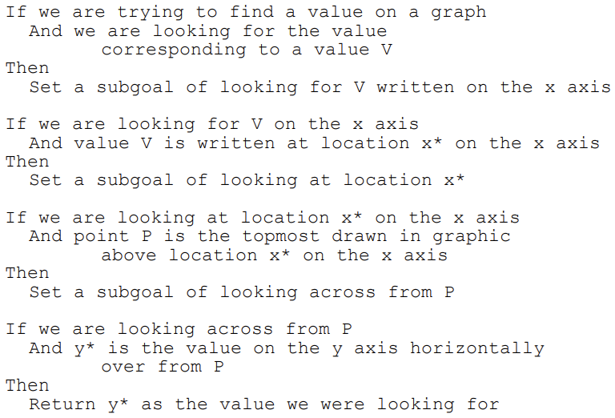
Example (Baker et al., 2001)

Slide 13
Model Tracing: Reprise
Can recognize complex behavior as long as it can be represented by a set of if-then rules
Which is often possible!

Slide 14
Evidence Centered Design (Mislevy et al., 1997)

Slide 15
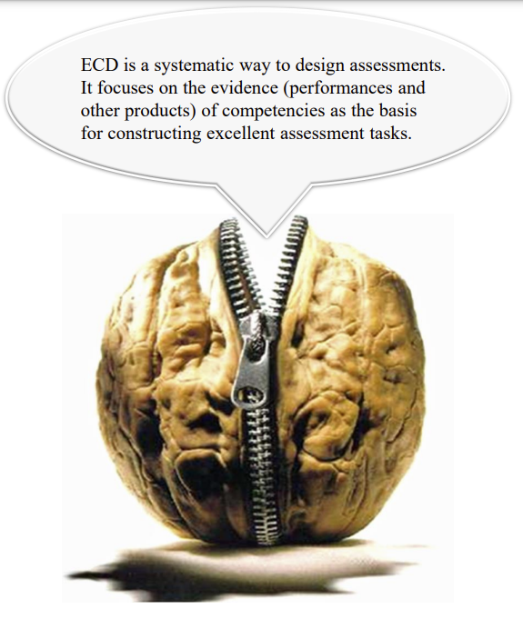
Image from Shute, Kim, Razzouk (n.d.) ECD for Dummies.

Slide 16
ECD
Creates an assessment argument composed of
Competency Model
What collection of knowledge, skills, and other attributes should be assessed?
Evidence Model
What behaviors should reveal different levels of the targeted competencies?
Task Model/Action Model
What tasks/situations can elicit the behaviors that make up the evidence?
Assembly Model
How much evidence is required?

Slide 17
Task Model/Action Model
Task Model is situation that learner interacts with, that provides evidence about competencies
Alternate term Action Model is used when situation is dynamic (as in a simulation or game) and a sequence of actions is required to demonstrated competencies
Situations described in terms of
Presentation format (what student sees)
Work product (what student does)

Slide 18
Evidence Model: two parts
Evidence Rules: Distill observable variables (features) from the work product
Statistical Model: Express a relationship between the evidence and the competencies we want to assess
Statistical model can be as simple as whether one indicator is present/absent, or adding observable variables together, or as complex as a Bayes Net

Slide 19
How ECD is developed
Rationally/prescriptively
Designer designs situation where skill can be demonstrated
Designer determines what evidence rules and statistical model are

Slide 20
ECD: Notes
Used in situations where situation can be developed so that evidence rules and statistical model can be developed by a designer
Not used where situation is too complex for designer to confidently design evidence rules and statistical model

Slide 21
ECD Examples

Slide 22
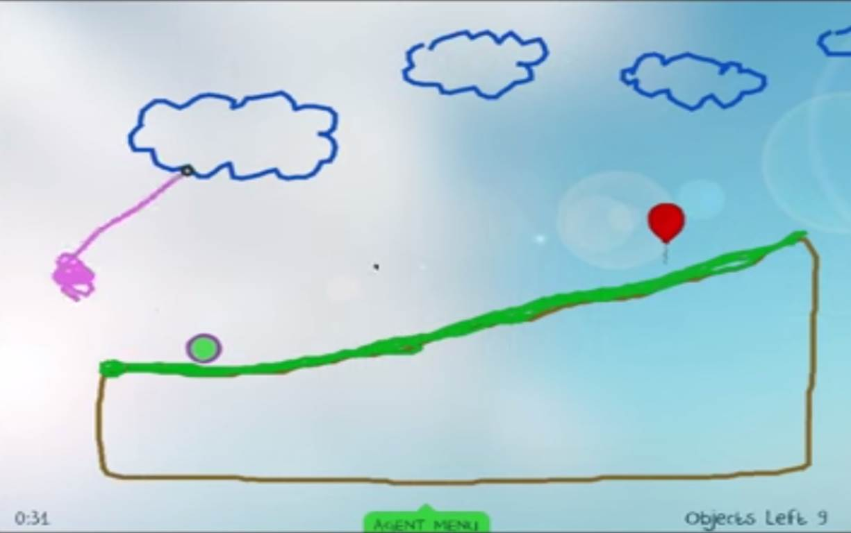
Physics Playground (Kim et al., 2016)
Probably best-known example of ECD in an adaptive learning system

Slide 23
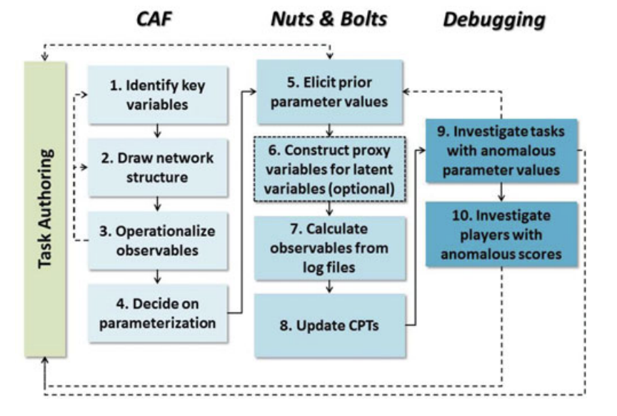
Ten steps to developing model (Kim et al., 2016)

Slide 24
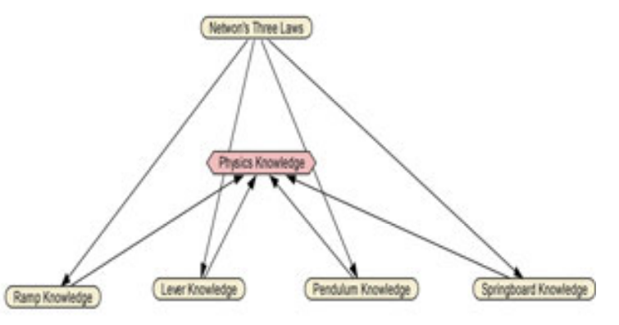
Final competency model (Kim et al., 2016)
Simplification of earlier model that had attempted to further differentiate types of physics knowledge; would have needed too many game levels

Slide 25
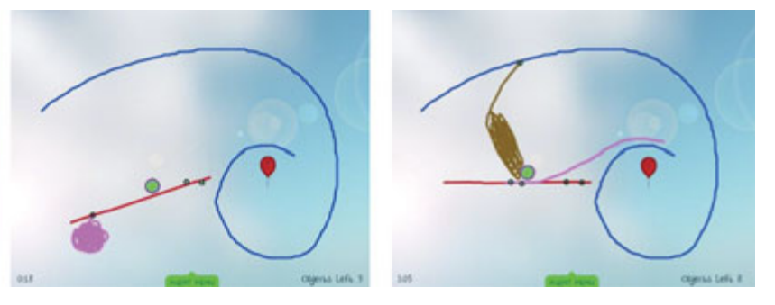
Multiple solutions involving different knowledge
Silver trophy = solved level
Gold trophy = solved level elegantly with minimal objects (requires use of target strategy)

Slide 26
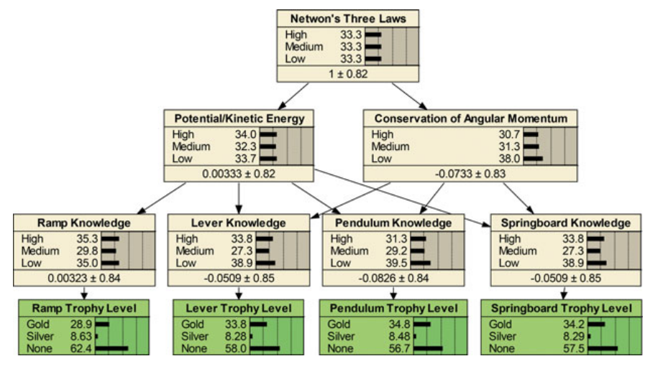
Mapping from evidence to competencies (Kim et al., 2016)

Slide 27
Evidence Identification (Shute & Moore, 2017a)
Built rational “evidence identification” models to identify which strategy used
Used these to distinguish which reason silver trophy obtained for
“For example, pendulums rotate around a single pin, so any drawn object that does this is most likely a pendulum. Ramps tend to be in contact with the ball for a longer period of time. Levers tend to rotate when the ball comes into contact with them. Springboards tend to be connected to other objects with two pins and include a weight—either attached to the springboard or dropped on it and then deleted.”

Slide 28
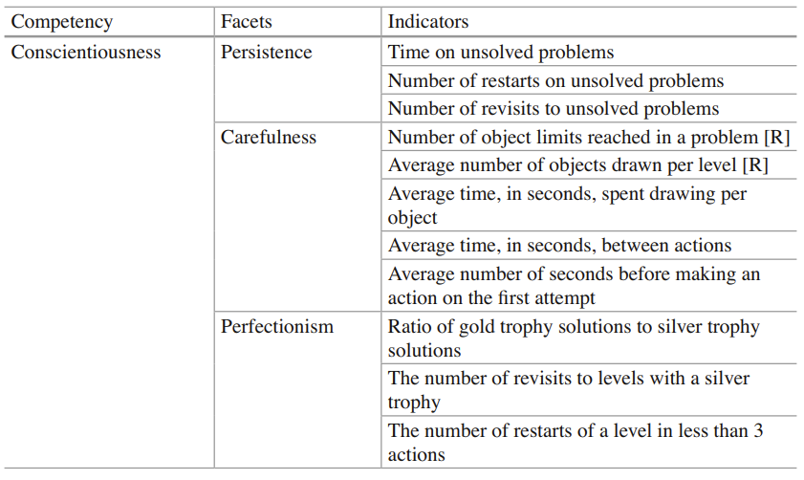
Other uses of ECD in Physics Playground
Conscientiousness (Shute & Moore, 2017b)

Slide 29
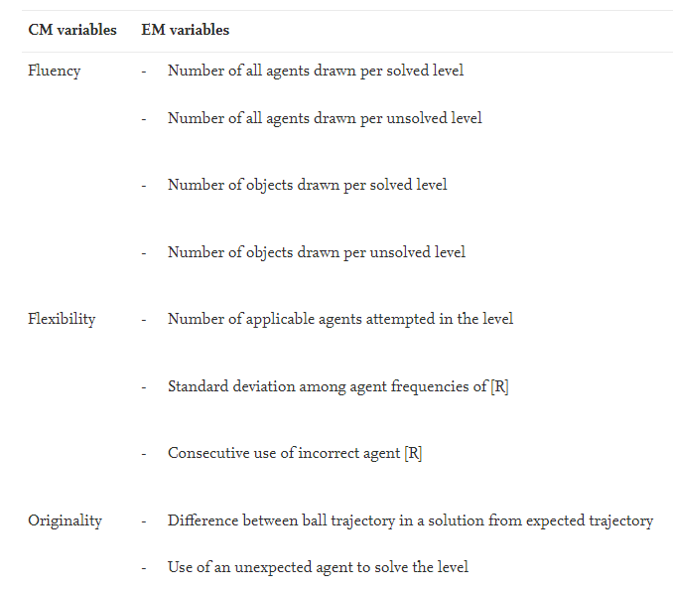
Other uses of ECD in Physics Playground
Creativity (Shute & Rahimi, 2021)

Slide 30
Other uses of ECD in Learning Systems
World of Goo (Shute & Kim, 2012)
Quest to Learn (Shute & Torres, 2012)
Plants versus Zombies (Shute et al., 2015)
Shadowspect (Kim et al., 2019)
CISCO Networking Academy (Behrens et al., 2004)
SimCityEDU (Risconscente et al., 2015)

Slide 31
SimCityEDU

Slide 32
SimCityEDU
Very high-profile collaboration involving ETS, Pearson, GlassLab and a ton of funding
Can ECD be applied to SimCity for assessment?

Slide 33
SimCityEDU: Findings
Yes!

Slide 34
SimCityEDU: Findings
But to make assessment easier, scenarios were designed with very few actions available
These scenarios generally weren’t much fun
Project started with great enthusiasm, ended quietly

Slide 35
ECD Benefits (Shute, Kim, & Razzouk, n.d.)
Transparency: ECD models can be inspected and debated for accountability
Convergency: Can handle lots of types of data
Reusability: Parts of model can be used in different situations (for instance, you can adapt evidence model between tasks)
Flexibility: Can be used for many purposes

Slide 36
ECD Barriers (Shute, Kim, & Razzouk, n.d.)
Over-structuring: Easier to assess if task is very structured, leading designers to structure things too much
SimCityEDU
Cost: A lot of work to get everything in place
Scope: Need to get competency model at right level, or too hard to build
Rubrics: Can be hard to develop rubrics for complex behavior that are not subjective

Slide 37
Final Take-Aways
ECD is a powerful approach for recognizing complex behavior that has been used successfully in several games and learning systems
But when using it, be careful not to focus on assessment to the expense of learning or fun

Slide 38
Reminder: Three Lecture Videos this Week

