Slide 1
Adaptive Learning Systems
EDUC5183

Slide 2
Welcome!

Slide 3
This is video 2 of 3 for this week
We are discussing Tutoring Complex Behavior
Model Tracing (pt 1)
ECD (pt 1)
ML (pt 2) (including NLP – pt 3)

Slide 4
ML
The use of machine learning to determine whether a student’s behavior at a specific time demonstrates a competency

Slide 5
How is ML trained?
Ground truth labels obtained
Algorithm taught to recognize the ground truth labels

Slide 6
How is ground truth obtained for complex behavior?
Text replays
Screen replays
Then human coding
(Quantitative field observations and video of student faces are used to detect affect and disengagement, but not for the type of model we’re discussing today)

Slide 7
Text Replays
Pretty-prints of student interaction behavior from the logs

Slide 8
Examples

Slide 9
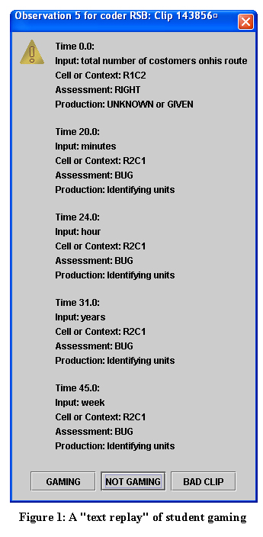

Slide 10
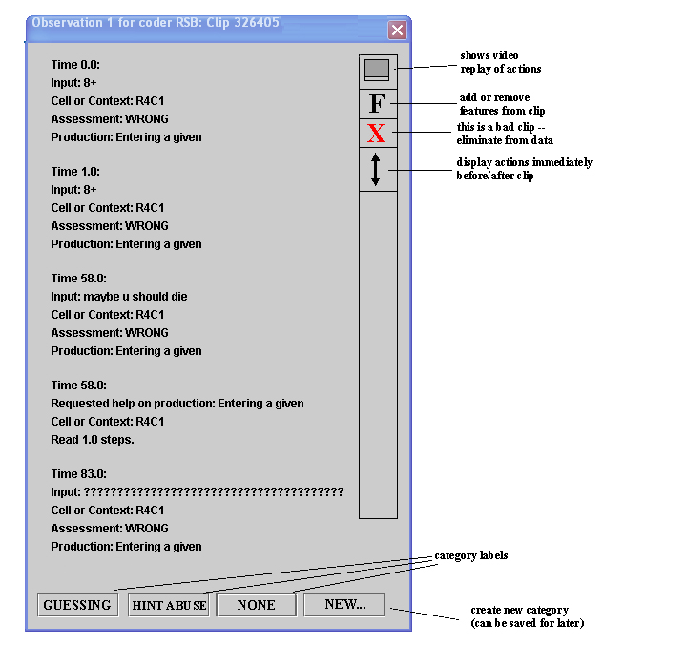

Slide 11
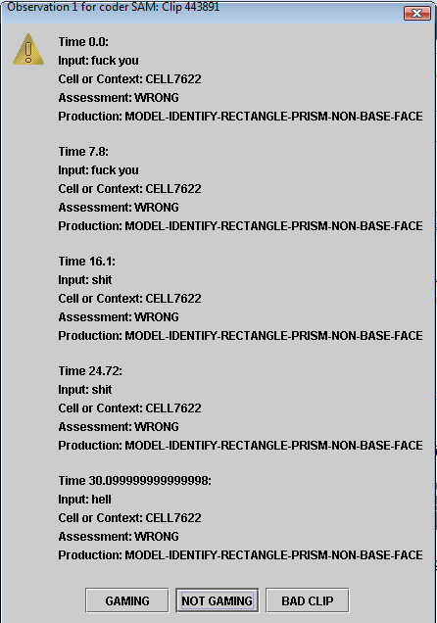

Slide 12
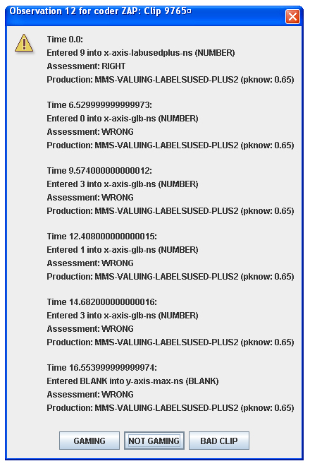

Slide 13
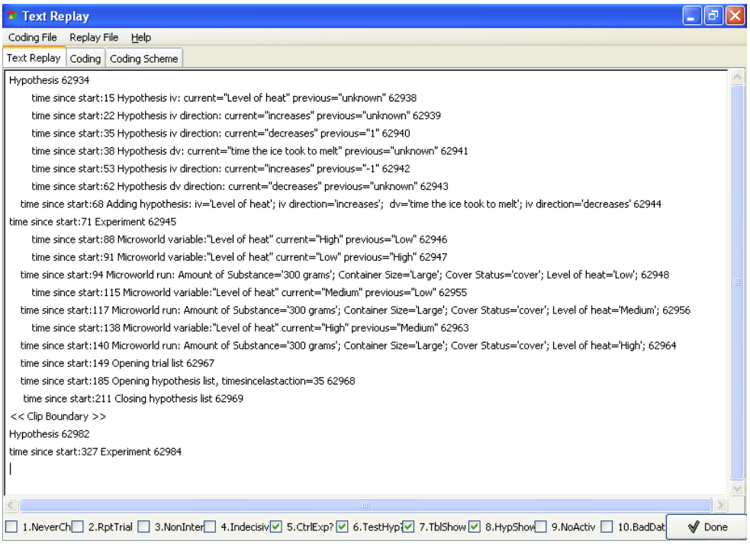

Slide 14
Screen Replays

Slide 15
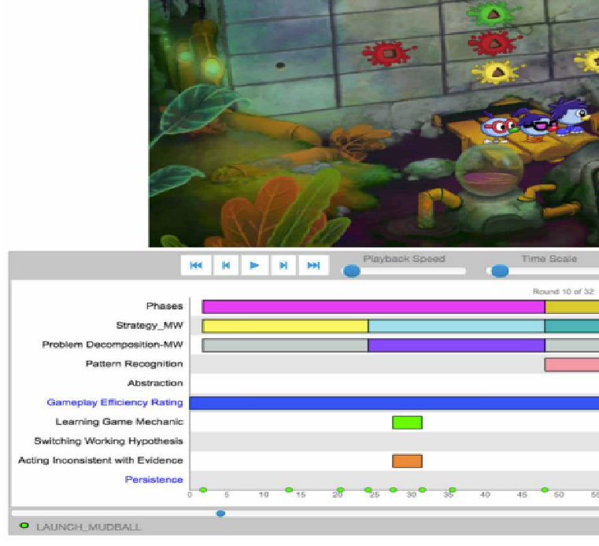
(Rowe et al., 2019,
2021)

Slide 16
Clear trade-offs
Text replays: much faster
Screen replays: higher fidelity, better codes
Some constructs can only be captured through screen replays

Slide 17
Case Study: Inq-ITS
(Sao Pedro et al., 2013)
Slides adapted from Sao Pedro’s dissertation defense

Slide 18
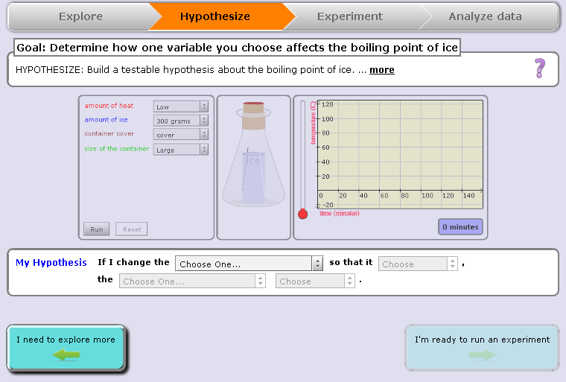
“If I change the amount of ice so that it decreases… the boiling point decreases”
Notes:
(1) Introduce structure first – that we break inquiry down into STAGES. The stages are listed at the top.

Slide 19
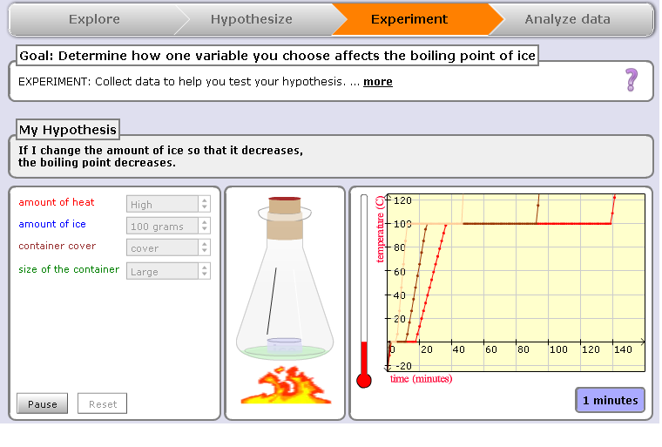

Slide 20
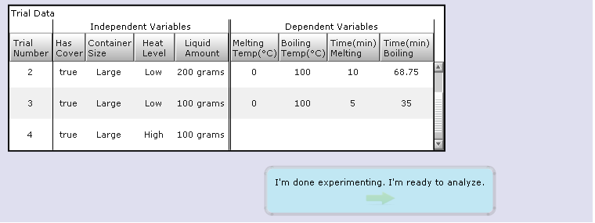

Slide 21
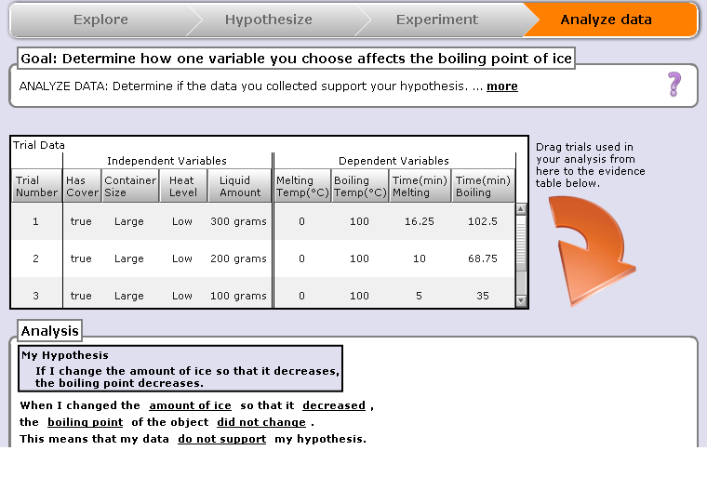

Slide 22
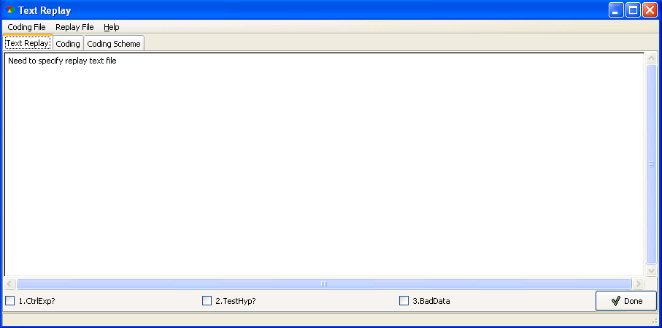
Hypothesis
time since start: 0 Hypothesis iv: current=“Level of heat” previous=“unknown”
time since start: 2 Hypothesis iv direction: current=“increases” previous=“unknown”
time since start: 6 Hypothesis dv: current=“time the ice took to melt” previous=“unknown”
time since start: 8 Hypothesis dv direction: current=“decreases” previous=“unknown”
time since start: 12 Adding hypothesis: iv=“Level of heat” iv direction=“increases”
dv=“time the ice took to melt” dv direction=“decreases”
time since start: 16 Experiment
time since start: 22 Variable change: “Level of heat” current=“High” previous=“Low”
time since start: 23 Run: Level of heat=“High”, Cover=“Off”, Container Size=“Small”, …
time since start: 27 Reset Experiment
time since start: 30 Variable change: “Level of heat” current=“Med” previous=“High”
time since start: 32 Run Experiment: Level of heat=“Med”
time since start: 51 Reset Experiment
time since start: 52 Run: Level of heat=“Med”, Cover=“Off”, Container Size=“Small”, …
<<Clip Boundary>>
Text Replay Tagging:
Inter-Rater Reliability (between human coders)
Designing Controlled Experiments: κ = .69
Testing Stated Hypotheses: κ = 1.00
Notes:
Other detectors = gaming the system
Just don’t forget to say that this is just one example of student work. In some cases students ran several trials and engaged in a wide variety (variation) of data collections.

Slide 23

Build and Validate Detectors
Remove Features
Build Model
X
X
Training
?
Inter-correlated
r >= .6
J48 Decision Trees
Test
Six-fold cross-validation by student
Training
Tagged Clips
Test
Notes:
This algorithm was chosen based on previous successes in generating behavior detectors using text replays (Baker & de Carvalho, 2008; Baker, Mitrovic & Mathews, 2010).

Slide 24
Features Used
(Sao Pedro et al., 2012)
Selected by domain experts for relevance
All actions count
Total run count
Complete run count
Num variable changes made when designing experiments
Num changes to variables associated with stated hypotheses when designing experiments
Adjacent and pairwise controlled experiments counts (both with and without considering repeats)
Pairwise and adjacent repeat trials counts
The number of simulation pauses

Slide 25
Algorithm Used: J48 Decision Trees
Classical Machine Learning algorithm
Predicted human labels from combination of features

Slide 26
Integrating Evidence
Each time a student completes a simulation, performance is evaluated as to whether it reflects the two skills
Evidence aggregated across simulations into a mastery estimate using BKT

Slide 27
Generalizability of Detection
Predicts inquiry performance in real-world tasks (San Pedro et al., 2013) and across learning domains (San Pedro et al., 2014)
  Between physics topics
  Between physics and biology

Slide 28
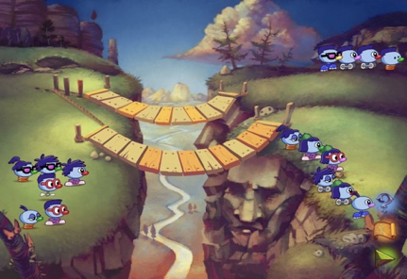
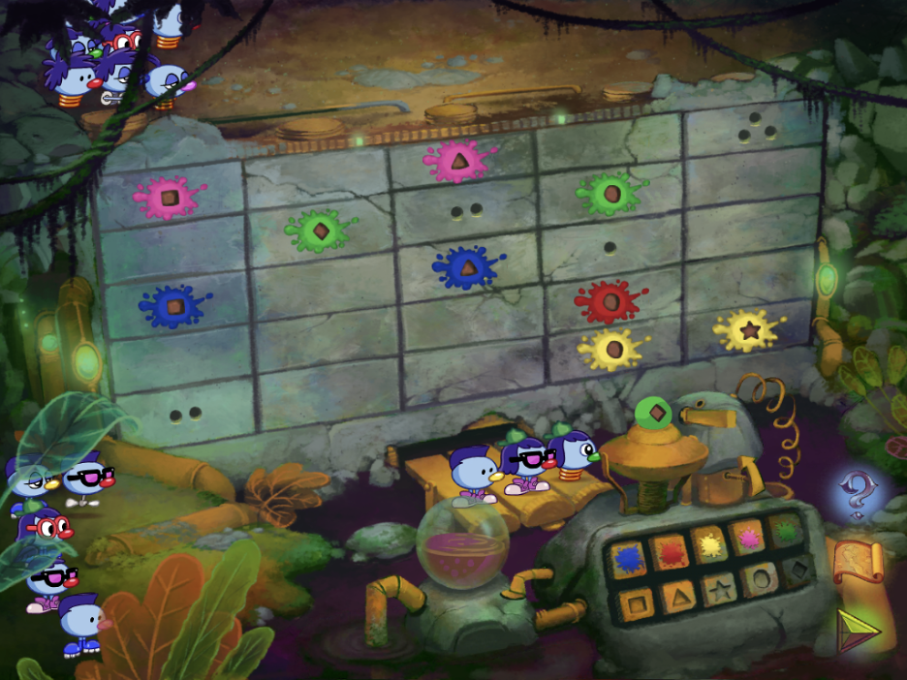
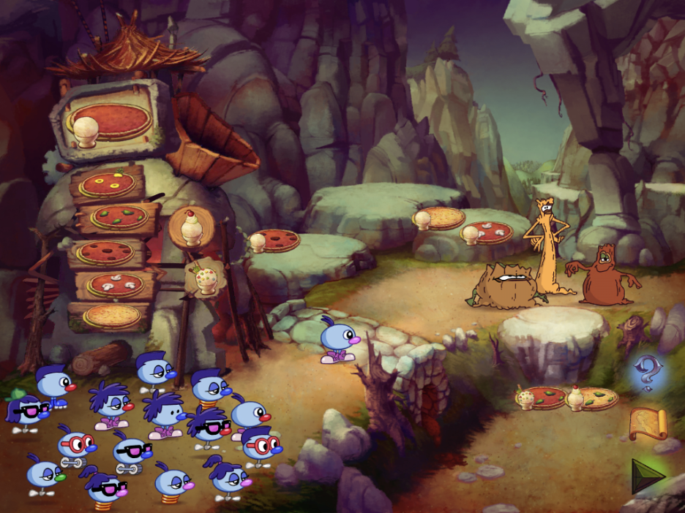
Case Study: Zoombinis
(Rowe et al., 2019, 2021)
Pizza Pass
Allergic Cliffs
Mudball Wall

Slide 29
Computational Thinking
“The conceptual foundation required to solve problems effectively and efficiently (i.e., algorithmically, with or without the assistance of computers) with solutions that are reusable in different contexts” (Shute, Sun, & Asbell-Clarke, 2017).
“CT is often described as a set of thinking practices that may include: problem decomposition, abstraction, algorithmic thinking, conditional logic, recursive thinking, and debugging.” (Asbell-Clarke et al., 2020)

Slide 30
Computational Thinking:
Constructs Studied
Problem Decomposition: reducing the complexity of a problem by breaking it into smaller, more manageable parts.
Pattern Recognition: seeing trends and groupings in a collection of objects, tasks, or information.
Abstraction: generalizing from observed patterns and making general rules or classifications about objects, tasks, or information by discerning relevant from irrelevant information.
Algorithm Design: establishing reusable procedures that solve sets of problems.

Slide 31
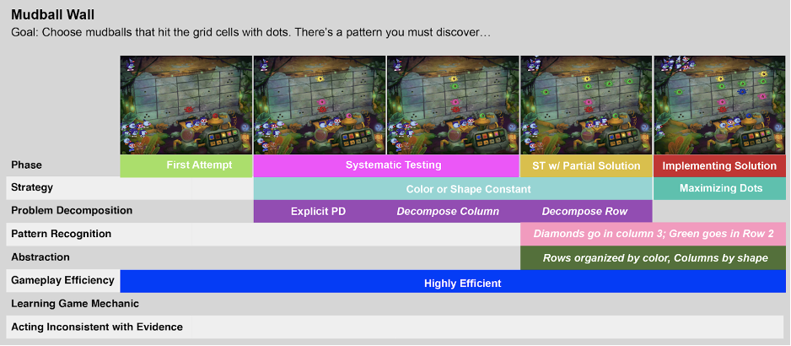
Hand Labeling: Video Coding
Interrater reliability over 0.7 for all constructs
Notes:
This is an overview of labeling of the Mudball puzzle using the Data Arcade tool.
For each puzzle, two researchers labeled all rounds of gameplay except the first round.

Slide 32
Detector Development
Feature engineering → classic machine learning algorithm approach

Slide 33
Detector Development
74-113 features created for each puzzle
  Based on past feature engineering experience on team, ideas from domain experts
  41 features common across all puzzles
Feature values were aggregated at the round level when detecting gameplay efficiency and strategies

Slide 34
Category | Example Feature | Feature Rationale
Pizza Pass, Mudball Wall, and Allergic Cliffs
Overall Gameplay: These features describe general aspects of a student’s play such as the outcome of each round (all Zoombinis through, Some Zoombinis through, no Zoombinis through, Quit) | Number of Zoombinis ejected from the puzzle | Zoombinis being ejected from the puzzle is a significant sign play is not going well.
Topping Futzes (Pizza Pass only): Switches toppings before the pizza is delivered to the troll. | Number of futzes since last pizza | More futzing may indicate that the player is unsure about their next move.
Mudball Duplicates (Mudball Wall only): These features capture the extent to which learners throw similar mudballs at the wall | Current consecutive number of duplicate mudballs | Duplicate mudballs are wasted resources because no new information is gained. This suggests players may not understand the game mechanic.
Zoombini Timing (Allergic Cliffs only): These features describe the speed with which learners select Zoombinis to cross the bridges. | Time since the last unsuccessful Zoombini. | More time since the last unsuccessful Zoombini may indicate if players have figured out the underlying rule

Slide 35
Detector Development
Separate detectors built for each CT category in Pizza Pass, Mudball Wall, and Allergic Cliffs
Tried multiple classic ML algorithms; took best performing for each model
  W-J48
  W-JRip
  Linear regression with a step function
  Naive Bayes

Slide 36
Other Uses of this Paradigm
Impulse (Rowe et al., 2014)
RumbleBlocks (Harpstead et al., 2015)
Progenitor X (Owen et al., 2016)
CueThink (Zhang et al., 2021)

Slide 37
Integrating into KT
Quite easy
ECD typically provides [0,1] outputs – can be integrated into KT just like traditional items
ML typically provides {0,1} probabilities – easy to integrate into KT with simple extensions (Sao Pedro et al., 2013)

Slide 38
Scaffolding Complex Behavior

Slide 39
Inq-ITS

Slide 40
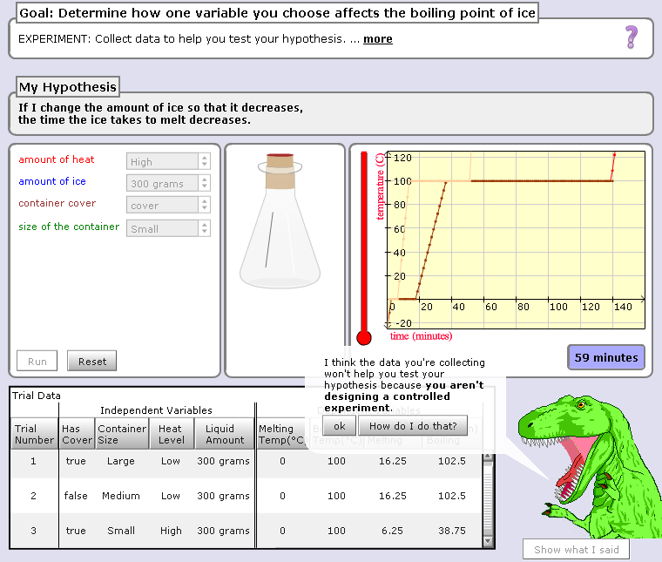

Slide 41
Hey, are you just playing with the buttons? Take your learning seriously or I will eat you!!!

Slide 42
Result
Significantly better performance (Sao Pedro et al., 2013; Gobert et al., 2018)
Transferred to other topics (Li et al., 2019)

Slide 43
Deep Thought
(Stamper et al., 2013)
Logic proof tutor
Modeling approach a bit different, but scaffolding relevant

Slide 44
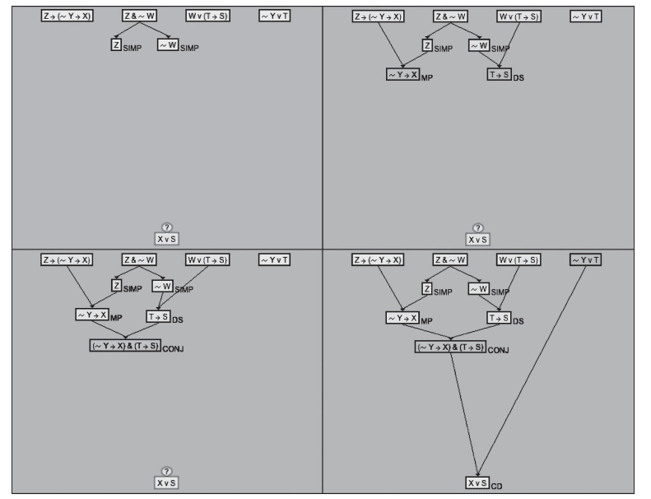

Slide 45
Deep Thought
(Stamper et al., 2013)
Logic proof tutor
Recommended next action to students based on previous actions
  By students who had eventually solved proof
  That were same as current student’s process so far

Slide 46
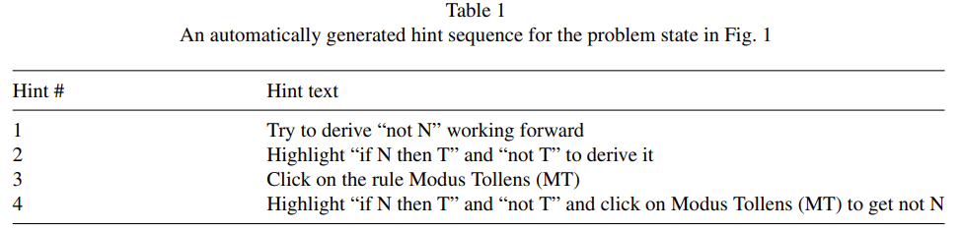
Example of Hint

Slide 47
Deep Thought
(Stamper et al., 2013)
Led to better post-test score and better course grade
Also reduced quitting behavior

Slide 48
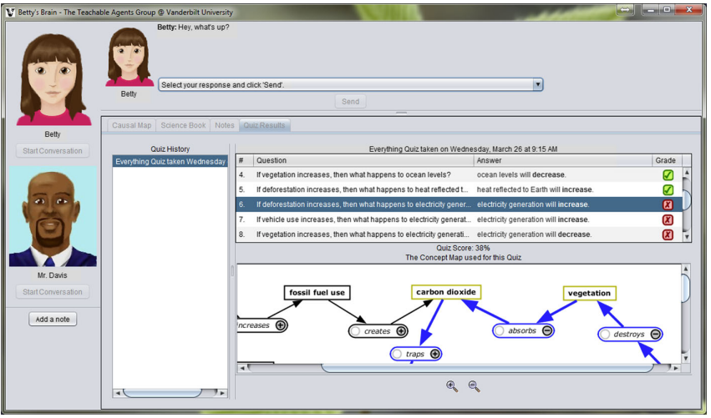
Betty’s Brain

Slide 49
Mr. Davis
(Leelawong et al., 2008)
Provides feedback when student provides incorrect answers or when student demonstrates poor SRL strategy

Slide 50
Mr. Davis
(Leelawong et al., 2008)
“Betty, to do well on this quiz you must understand the causal relationships that make up the chain of events that happen in the river. A chain of direct relationships produces a chain of events. Paying attention in class leads to better understanding and better understanding produces better grades is an example of a chain of events.
Betty, below is a part of the chain of events you need to know to answer the quiz 2 questions correctly. Your tutor will have to figure out how to use these hints to teach you with the concept map, but you can help your tutor by giving explanations for your answers to the quiz questions. Remember it is a good idea for your tutor to get an explanation from you for the first question on this quiz. Check back here after you take the quiz again for more parts of the chain.
Fish live in the river, and while they help algae by exhaling carbon dioxide, algae also depend on fish and macroinvertebrates in another way. Fish make their waste in the river, and this waste plays an important role in the interdependence between fish and algae.
Also, don't forget to look at the resources if you need more information.”

Slide 51
Physics Playground
(Bainbridge et al., 2021)
When student demonstrates they do not know a competency, system provides video
  Showing related puzzle
  Providing narration
https://www.youtube.com/watch?v=aHP8Ex0HaBY

Slide 52
Physics Playground
(Bainbridge et al., 2021)
Led to better performance on far transfer test
But, oddly, not on near transfer test

Slide 53
These examples are very different from each other

Slide 54
Huge Space of Potential Interventions

Slide 55
Huge Space of Potential Interventions
Stealth interventions that change learner experience in subtle ways
Reports to student or instructor
Hints and messages
Videos
Embodied behaviors by agents
Many more

Slide 56
Final Take-Aways
Machine Learning can be used to recognize complex student behaviors
First, humans label a lot of data; then, machine learning learns to emulate human judgments
Text replays and screen replays can be used to collect those labels
To learn more about how the ML works, take 6191 (if you haven’t done so already)

Slide 57
One more lecture video this week

