Slide 1
Adaptive Learning Systems
EDUC5183

Slide 2
Welcome!
To the first of this week’s 3 videos
Meta-cognition
Self-regulated learning
Engagement

Slide 3
This week…
Discussing key factors determining whether an ALS will work
The student’s ability to self-regulate their learning (next video)
And think about their thinking and learning (metacognition) (this video)
And their engagement during that learning (third video)

Slide 4
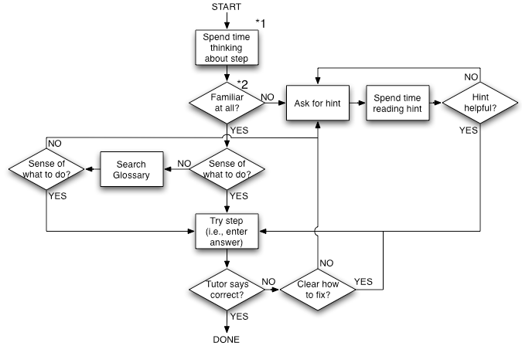
We’ve already talked about
Aleven’s help-seeking model

Slide 5
Aleven’s Help-Seeking Model
Captures a relatively narrow span of SRL behavior
Particularly relevant in the system he was studying, Cognitive Tutor (now Mathia)

Slide 6
Self-Regulated Learning
Depends on metacognition

Slide 7
Meta-cognition
Cognition about cognition

Slide 8
Components of meta-cognition (according to Flavell, 1979)
Meta-cognitive knowledge – knowledge about your tasks/goals/actions/experiences, or about someone else’s
Meta-cognitive experiences – conscious cognitive or affective experiences that accompany thinking
Meta-cognitive strategies – strategies for accomplishing cognitive objectives (expressed in Flavell as separate goals and strategies)

Slide 9
Potential modifications
Meta-cognitive knowledge – knowledge about your tasks/goals/actions/experiences, or about someone else’s

Slide 10
Potential modifications
Meta-cognitive experiences – conscious cognitive or affective experiences that accompany thinking
Caution: What Flavell meant by affect is generally not the same thing I’ll talk about in the next video

Slide 11
Potential modifications
Meta-cognitive skills – abilities for accomplishing meta-cognitive objectives

Slide 12
Key Meta-cognitive Experiences
Feeling of Knowing (FOK)
Judgment of Learning (JOL)
Also referred to as Metamemory Experiences
Metamemory is “the study of what people know and understand about their own memory and memorial processes” (Benjamin et al., 1998)

Slide 13
Feeling of Knowing (Hart, 1965)
When you feel that you know something
You may or may not actually know it
You may or may not actually be able to retrieve it, even if you do know it

Slide 14
Feeling of Knowing
“What is produced through a solution of hydrogen fluoride in water?”

Slide 15
Feeling of Knowing
“Oh, man, it’s on the tip of my tongue.”

Slide 16
Feeling of Knowing
“Spit it out quick! That’s Hydrofluoric Acid!”

Slide 17
Feeling of Knowing
“FOK!”

Slide 18
Feeling of Knowing
Thought to be a special case of the retrieval process; even if retrieval fails, enough related knowledge is activated to lead the subject to feel he or she knows the material (Koriat, 1993)

Slide 19
Judgment of Learning (JOL)
Judgment of the extent to which a person has learned information (Kimball & Metcalfe, 2003)

Slide 20
Meta-cognitive processes
Another way to look at meta-cognition is that it is a set of processes that interact with all three of these constructs (Paris & Winograd, 1990)
Self-appraisal
Self-monitoring
Self-management/self-regulation

Slide 21
Which Brings us to Self-Regulated Learning

Slide 22
It’s hard to detect
Meta-cognitive knowledge
Meta-cognitive experiences
Self-report
Think-aloud protocols

Slide 23
It’s hard to detect
Meta-cognitive knowledge
Meta-cognitive experiences
Self-report
Think-aloud protocols
(Although some learning systems integrate self-report into ongoing interaction with system)

Slide 24
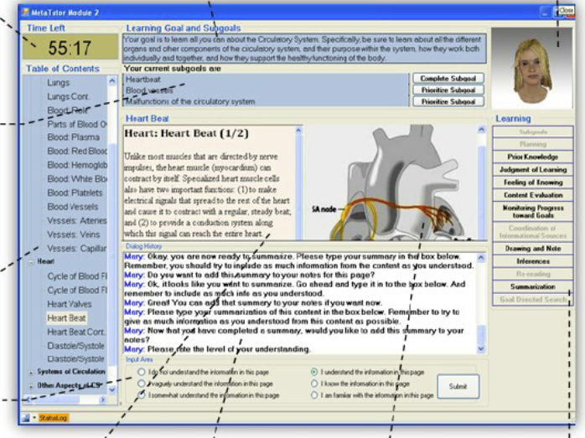
MetaTutor: Integration of Self-Report

Slide 25
So adaptive learning systems
Typically focus on detecting
Metacognitive strategies
Metacognitive skills
Self-regulated learning behaviors
Which we will cover in video 2 this week
See you there!

Slide 26
The End

