Slide 1
Adaptive Learning Systems
EDUC5183

Slide 2
Welcome!
To the third of this week’s videos
Meta-cognition
Self-regulated learning
Engagement

Slide 3
This week
Discussing key factors determining whether an ALS will work
The student’s ability to self-regulate their learning (previous video)
And think about their thinking and learning (metacognition) (previous video)
And their engagement during that learning (this video)

Slide 4
Engagement

Slide 5
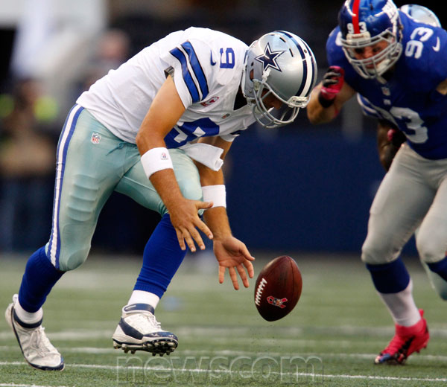
What is engagement?
An “elusive variable” (Corno & Mandinach, 1993)

Slide 6
Engagement
“A student’s active involvement in a learning activity” (Christenson et al., 2012)

Slide 7
Engagement
Several perspectives on engagement in the literature
Fredericks, Blumenfeld, and Paris (2004) refer to
Behavioral engagement – persistence, effort, attention, participation, involvement
Cognitive engagement – cognitive investment in learning, meta-cognition, self-regulated learning
Emotional/affective engagement – emotional reactions to learning situation, including interest, boredom, happiness, anxiety, etc.

Slide 8
Behavioral Engagement
Early work on behavioral engagement tended to focus primarily on whether a student was on-task or off-task (e.g. Carroll, 1963; Lahaderne, 1968; Karweit & Slavin, 1981, 1982)
Work since then has realized that it’s a lot more complex than that (cf. Finn, 1993; Finn et al., 1995; Baker et al., 2004; Ocumpaugh et al., 2016; Li & Rachel Baker, 2016; Fischer et al., 2020)

Slide 9
Behavioral Engagement in Adaptive Learning Systems

Slide 10
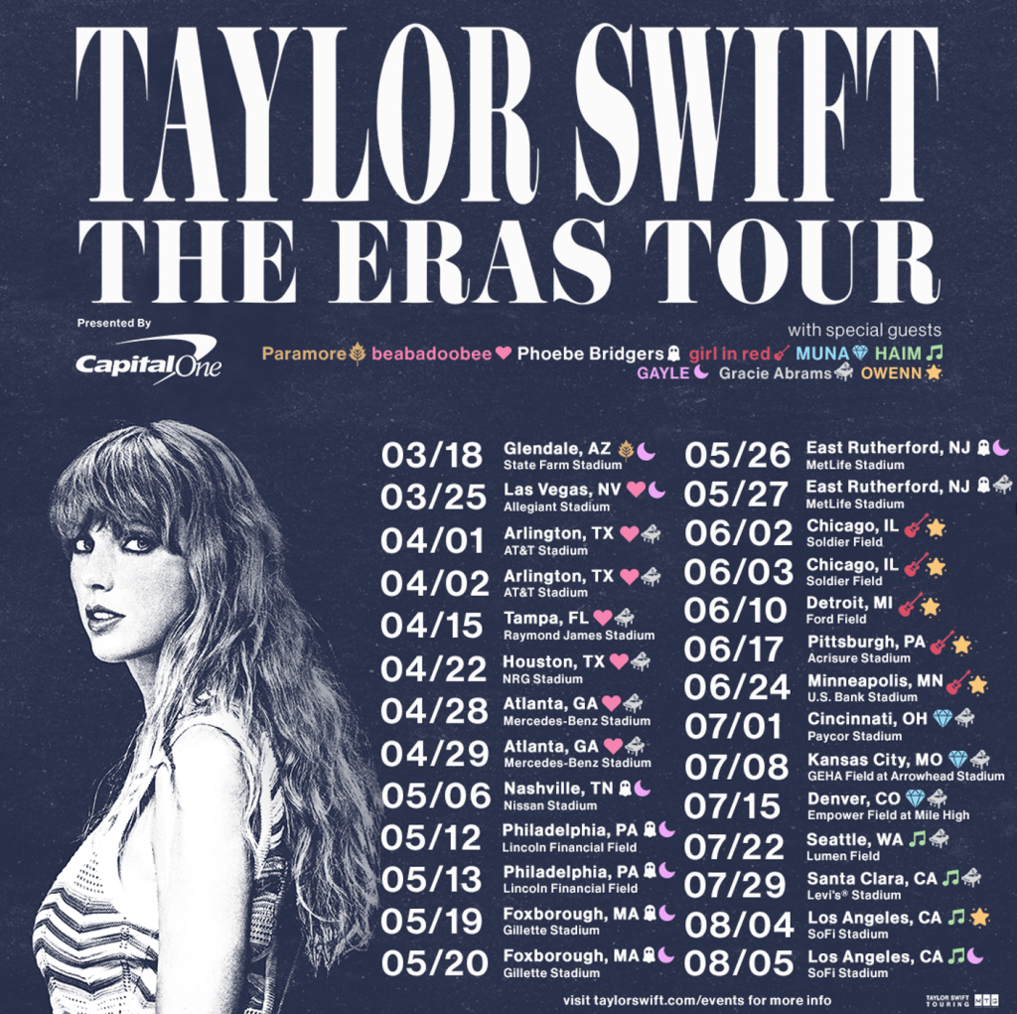
Off-Task Behavior
When a student completely disengages from the learning environment and task to engage in an unrelated behavior.
Examples:
Talking to other student about Taylor Swift

Slide 11
Off-Task Behavior
When a student completely disengages from the learning environment and task to engage in an unrelated behavior.
Examples:
Talking to other student about Taylor Swift
Reading a magazine about Taylor Swift

Slide 12
Off-Task Behavior
When a student completely disengages from the learning environment and task to engage in an unrelated behavior.
Examples:
Talking to other student about Taylor Swift
Reading a magazine about Taylor Swift
Surfing the web to read tweets about Taylor Swift

Slide 13
Off-Task Behavior
When a student completely disengages from the learning environment and task to engage in an unrelated behavior.
Examples:
Talking to other student about Taylor Swift
Reading a magazine about Taylor Swift
Surfing the web to read tweets about Taylor Swift
Playing an online Taylor Swift trivia game

Slide 14
Off-Task Behavior
When a student completely disengages from the learning environment and task to engage in an unrelated behavior.
Examples:
Talking to other student about Taylor Swift
Reading a magazine about Taylor Swift
Surfing the web to read tweets about Taylor Swift
Playing an online Taylor Swift trivia game
Sleeping…

Slide 15
Off-Task Behavior
When a student completely disengages from the learning environment and task to engage in an unrelated behavior.
Examples:
Talking to other student about Taylor Swift
Reading a magazine about Taylor Swift
Surfing the web to read tweets about Taylor Swift
Playing an online Taylor Swift trivia game
Sleeping… and dreaming of Taylor Swift…

Slide 16
Gaming the System
Intentionally misusing educational software to complete problems and advance without learning (Baker et al., 2004)
Systematic guessing
Hint abuse

Slide 17
Careless Errors
Making errors despite knowing the relevant skills or concepts (San Pedro, 2017)

Slide 18
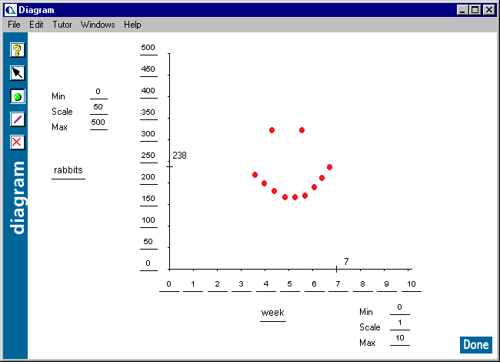
Inexplicable (WTF) Behavior
Student is actively participating in the learning task, but in a fashion not targeted towards successfully completing the task

Slide 19
Behavioral Engagement Matters
Shown repeatedly to be associated with differences in student outcomes (cf. Rumberger & Larson, 1998; Csikszentmihalyi & Schneider, 2001; Baker et al.,2004; Pekrun et al., 2010; San Pedro et al., 2013, 2014; Almeda & Baker, 2020)

Slide 20
Gaming the System associated with
Worse unit tests (Baker et al., 2004; Cocea et al., 2009; Fancsali, 2014)
Worse end-of-year tests (Baker et al., 2004)
Worse standardized exams (Pardos et al., 2014)
Lower probability of college attendance several years later (San Pedro et al., 2013)
Lower probability of STEM job post-college (Almeda & Baker, 2020)

Slide 21
Carelessness associated with
Worse standardized exams (Pardos et al., 2014)
Lower probability of college attendance several years later (San Pedro et al., 2013)
Not associated with poorer learning on unit tests (Baker et al., 2010; Fancsali, 2015)

Slide 22
Off-task behavior associated with
Uncertain/mixed association with poorer standardized exams (Pardos et al., 2014; Kostyuk et al., 2017)
Not associated with poorer performance on end-of-year exams (Baker et al., 2004)
Not associated with lower probability of college attendance (San Pedro et al., 2013)

Slide 23
Off-task behavior in traditional classrooms
Associated with poorer learning outcomes
But weakly and unstably
(See reviews in Karweit & Slavin, 1981, 1982; Goodman, 1990; Godwin et al., 2016)
Still not understood why relationship is so variable

Slide 24
Other findings about off-task behavior
Off-Task Behavior can foster positive collaborative relationships (cf. Goldman, 1996; cf. Barron, 2003; Kreijns, 2008)
E.g. a collaboration strategy
Off-Task Behavior can disrupt boredom (Baker et al., 2011)
E.g. an emotional regulation strategy

Slide 25
Addressing behavioral disengagement
Extensive work has gone into addressing gaming the system in specific, with several approaches improving learner outcomes
Agents that look unhappy when student games and give students more problems on areas they game (Baker et al., 2006)

Slide 26
Embed Scooter.avi (1) here

Slide 27
Addressing behavioral disengagement
Extensive work has gone into addressing gaming the system in specific, with several approaches improving learner outcomes
Explanations between problems of why gaming is problematic (Arroyo et al., 2007; Xia et al., 2020)

Slide 28
Progress Charts (Arroyo et al., 2007)

Slide 29
Addressing behavioral disengagement
Extensive work has gone into addressing gaming the system in specific, with several approaches improving learner outcomes
Combination of meta-cognitive feedback and requiring additional work after gaming (Li et al., 2022)

Slide 30
Addressing behavioral disengagement
Less work on addressing other forms of behavioral disengagement within adaptive learning systems

Slide 31
Affective Engagement

Slide 32
A lot of shifts in theory on affect over the last 20 years
Basic emotions (Ekman, etc.)
Cognitive Appraisal and Emotions (OCC)
Two-dimensional model (Russell)
Academic emotions (Pekrun, D’Mello, Graesser, etc.)
Complexifying academic emotions (Lodge, Bosch)

Slide 33
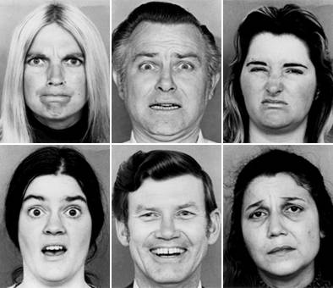
Basic Emotions (Ekman, 1978)

Slide 34
Who are these people?

Slide 35
Does anyone really look like this in real life?

Slide 36
Academic Emotions most common during real-world learning
(Lehman et al., 2008; D’Mello, 2013)

Slide 37
Core academic emotions
Boredom
Frustration
Confusion
Engaged Concentration
positive focused concentration towards the task
related to flow (Csikszentmihalyi, 1990)
Anxiety
Delight

Slide 38
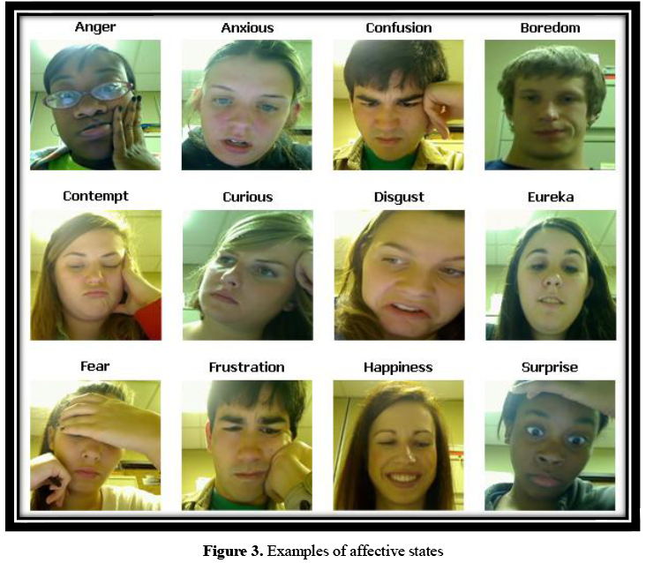
Image courtesy of Sidney D’Mello

Slide 39
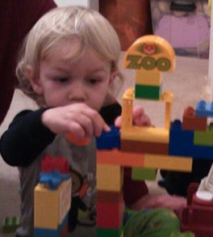
Engaged Concentration

Slide 40
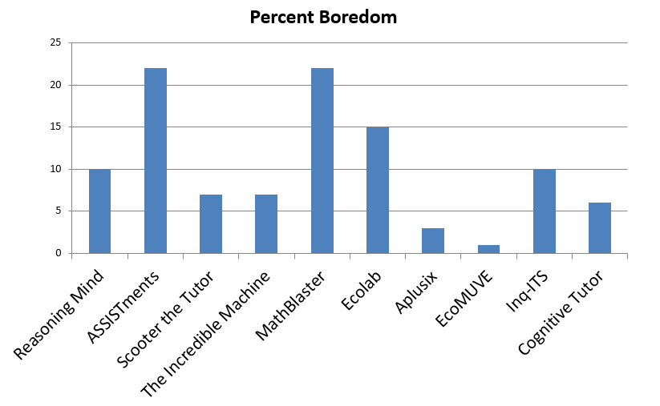
Considerable variation in affective engagement in different learning activities

Slide 41
Affective Engagement matters
Boredom generally associated with worse outcomes, both short-term and long-term (Pekrun et al., 2010; Pardos et al., 2014; San Pedro et al., 2013; Karumbaiah et al., 2022)
Engaged Concentration generally associated with better outcomes, both short-term and long-term (Rodrigo et al., 2009; Pardos et al., 2014; San Pedro et al., 2013; Karumbaiah et al., 2022)

Slide 42
Affective Engagement matters
Relationships between confusion and frustration unstably related to outcomes (see review in Karumbaiah et al., 2022)
Is it resolution? (Lehman et al., 2012; Lodge et al., 2018)
Or is it much more complex? (Cloude et al., under review)

Slide 43
Intervention
A range of intervention strategies, generally with mixed results

Slide 44
AutoTutor (D’Mello et al., 2011)
Affect detection used in lab study to provide “supportive” or “shake-up” messages
Shake-up messages led to better outcomes for successful students
Supportive messages led to better outcomes for less successful students

Slide 45
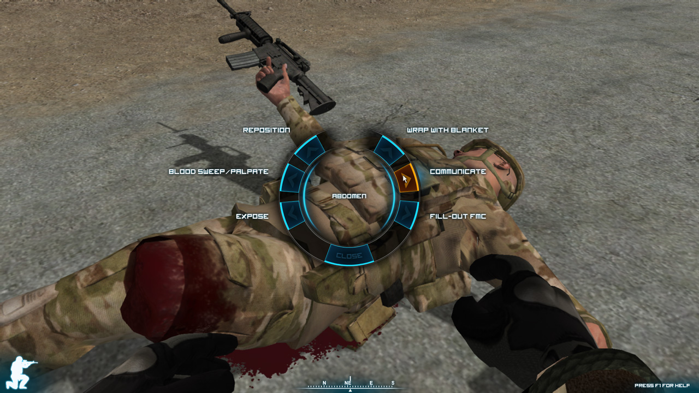
TC3Sim (DeFalco et al., 2018)
Frustration detector used to trigger interventions for military cadets learning medical first responder procedures

Slide 46
TC3Sim (DeFalco et al., 2018)
Social identity intervention led to better learning outcomes “Every single man in this Army plays a vital role, said General Patton. Don’t ever let up. Every man has a job to do and he must do it.”

Slide 47
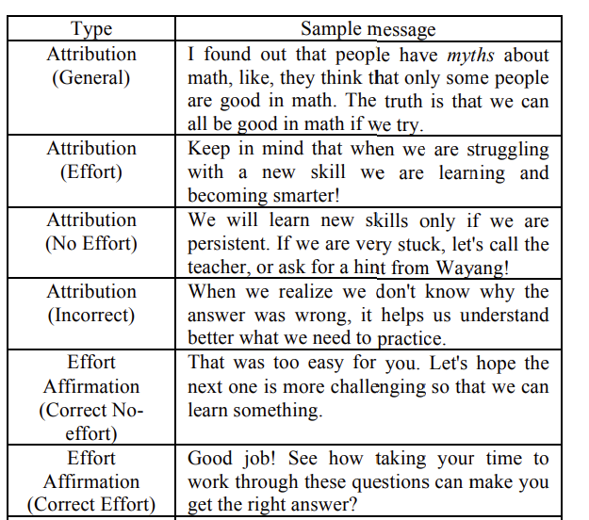
MathSpring (Arroyo et al., 2011)
Agents mirror student affect and provide motivational messages, leading to better learning and less disengagement

Slide 48
Cognitive Engagement

Slide 49
Cognitive Engagement
Most research on Cognitive Engagement in Adaptive Learning Systems ends up just being Self-Regulated Learning
But there has been separated-out research on Mind Wandering

Slide 50
Mind Wandering
A cluster of related behaviors (Christoff et al., 2018)
Intentional
Purposeful thoughts about unrelated tasks
Intentional focus on unrelated tasks
Relaxed thoughts on no specific topic (unrelated to task)
Unintentional
Momentary Distractions
Perseverative Task-Unrelated Thoughts

Slide 51
Mind Wandering
Frequent during learning (30-50% of time!) (Smith et al., 2018; Wammes et al., 2019; Forrin et al., 2021)

Slide 52
Mind Wandering
Negative correlation to learning outcomes (Wong et al., in press)

Slide 53
A 4th type of engagement? (i.e. Reeve & Tseng, 2011)
Agentic engagement -- “students’ constructive contribution into the flow of the instruction they receive”
Do students actively participate in learning activity? (Also see Chi’s ICAP framework)

Slide 54
Detection
All these forms of disengagement can be accurately detected, using either sensors or log data
Many examples, too many to cite here
Log-based detection better for behavioral engagement than affective or cognitive engagement
Still better than chance for affective and cognitive

Slide 55
Detection
Sensor-based approaches usually more accurate but don’t always work (e.g. facial occlusion) (Bosch et al., 2015) and raise privacy and scalability concerns
Ongoing algorithmic bias challenges with sensor-based approaches, which can be addressed through careful effort (Hutt et al., in press)

Slide 56
Key take-aways
Engagement is complex!
Some forms of engagement clearly associated with worse outcomes: gaming the system, mind wandering, boredom
Engagement can be detected and intervened on by adaptive learning systems

Slide 57
The End

