Slide 1
Adaptive Learning Systems
EDUC5183 Summer 2024

Slide 2
Writing Pal (Roscoe & McNamara, 2013; Crossley et al., 2016)
Legitimacy
Non-words
Length
Relevance
Presence of key words
Structure
Number of paragraphs

Slide 3
PEG (Perelman, 2015)
Usage (Grammar Errors)
Articles
Commonly confused words
Preposition errors
Organization & Development
Finding and improving thesis statements
Sufficient number of supporting ideas

Slide 4
WriteToLearn (Foltz & Rosenstein, 2015)
Ideas
Organization
Conventions
Word choice
Sentence fluency

Slide 5
MI Write (Huang & Wilson, 2021) Later version of PEG
Spelling and Grammar
Idea development
Organization
Style
Sentence fluency
Word choice
Conventions

Slide 6
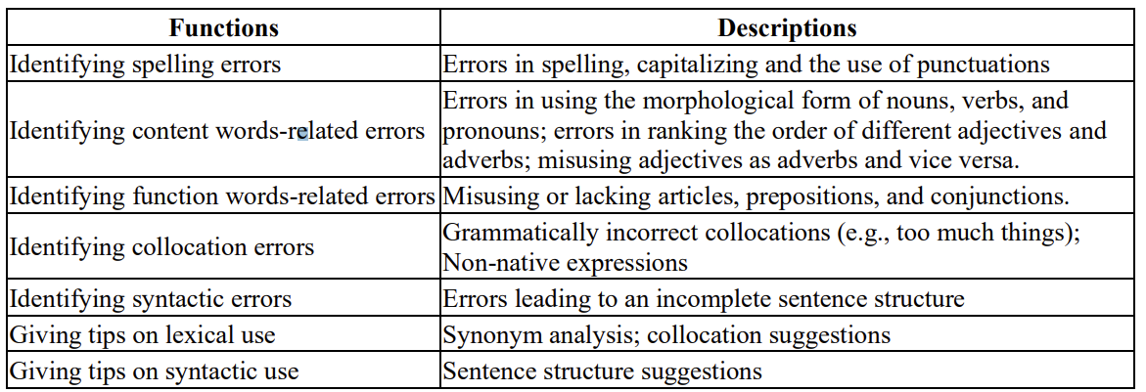
Pigai (Gao, 2021)

