Slide 1
Advanced Methods and Analysis for the Learning and Social Sciences
PSY505 Spring term, 2012
April 25, 2012

Slide 2
Today’s Class
Social Network Analysis

Slide 3
A massive topic…
Necessarily, we will only cover a few of the many analytic metrics and methods in social network analysis

Slide 4
General Principles of Social Network Analysis

Slide 5
General Principles of Social Network Analysis

Slide 6
General Postulates of Social Network Analysis

Slide 7
General Postulates of Social Network Analysis
There are many entities, referred to as nodes or vertices
Nodes have connections to other notes, referred to as ties or links
Nodes can have different types or identities
Links can have different types or identities
Links can have different strenghts

Slide 8
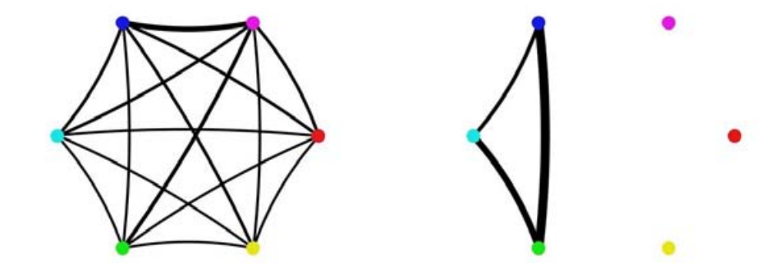
Example (Student work groups – Kay et al., 2006)

Slide 9
Example (Student work groups – Kay et al., 2006)
nodes

Slide 10
Example (Student work groups – Kay et al., 2006)
ties

Slide 11
Example (Student work groups – Kay et al., 2006)
Strong ties
Weak ties

Slide 12
Which student group works together better?

Slide 13
Which is the most collaborative pair?

Slide 14
Who is the most collaborative student?

Slide 15
Types
In a graph of classroom interactions, what different types of nodes could there be?

Slide 16
Types
In a graph of classroom interactions, what different types of nodes could there be?
Teacher
TA
Student
Project Leader
Project Scribe

Slide 17
Types
In a graph of classroom interactions, what different types of links could there be?

Slide 18
Types
In a graph of classroom interactions, what different types of links could there be?
Leadership role (X leads Y)
Working on same learning resource
Helping act
Criticism act
Insult
Note that links can be directed or undirected

Slide 19
Strength
In a graph of classroom interactions, what would make links stronger or weaker?

Slide 20
Strength
In a graph of classroom interactions, what would make links stronger or weaker?
Intensity of act (Examples?)
Frequency of act (Examples?)

Slide 21
Examples
What might be some types of social networks that would be studied in the learning sciences?
What might be some relevant research questions?

Slide 22
Social Network Analysis
Use social network graphs to study the patterns and regularities of the relationships between the nodes

Slide 23
Density
Proportion of possible lines that are actually present in graph
What is the density of these graphs?

Slide 24
Reachability
A node is “reachable” if a path goes from any other node to it
Which nodes are reachable and unreachable?

Slide 25
Geodesic Distance
The number of nodes between one node N and another node M

Slide 26
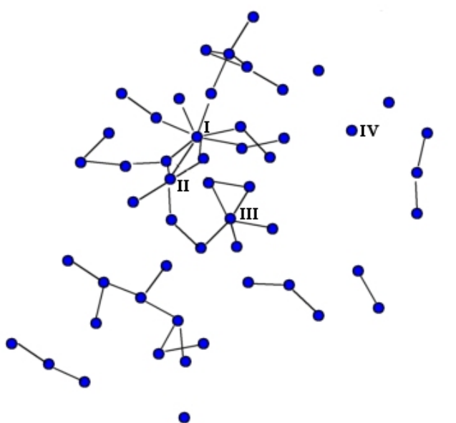
Example (Dawson, 2008)

Slide 27
What is the geodesic distance?

Slide 28
What is the geodesic distance?

Slide 29
What is the geodesic distance?

Slide 30
Geodesic Distance
What might be a use for geodesic distance in educational research?

Slide 31
Flow
How many possible paths are there between node N and node M?

Slide 32
What is the flow?

Slide 33
Flow
What might be a use for flow in educational research?

Slide 34
Centrality
How important is a node within the graph?

Slide 35
Centrality
Four common measures
Degree centrality
Closeness centrality
Betweeness centrality
Eigenvector centrality

Slide 36
Nodal Degree
Number of lines that connect to a node

Slide 37
Which node has the highest nodal degree?

Slide 38
Nodal Degree
Indegree: number of lines that come into a node
How might this be interpreted for some link types you might see in educational data?
Outdegree: number of lines that come out of a node
How might this be interpreted for some link types you might see in educational data?

Slide 39
Closeness
A node N’s closeness is defined as the sum of its distance to other nodes
The most central node in terms of closeness is the node with the lowest value for this metric
Note that strengths can be used as a distance measure for calculating closeness
Higher strength = closer nodes

Slide 40
Which node has highest closeness? (looking solely at number of steps)

Slide 41
Which node has highest closeness? (looking at link strengths)

Slide 42
Betweenness
Betweeness centrality for node N is computed as:
The percent of cases where
For each pair of nodes M and P (which are not N)
The shortest path from M to P passes through N

Slide 43
What is this node’s betweenness

Slide 44
What is this node’s betweenness

Slide 45
What is this node’s betweenness

Slide 46
Betweenness
How might this be interpreted for some link types you might see in educational data?

Slide 47
Eigenvector Centrality
Complex math, but assigns centrality to nodes through recursive process where
More and stronger connections are positive
Connections to nodes with higher eigenvector centrality contribute more than connections to nodes with lower eigenvector centrality

Slide 48
Eigenvector Centrality
What type of applications might this have?

Slide 49
How do these measures differ in meaning?

Slide 50
Reciprocity
What percentage of ties are bi-directional?
Can be computed as number of bi-directional ties over total number of connected pairs

Slide 51
What is the reciprocity?

Slide 52
What could reciprocity tell you?
For educational data

Slide 53
Clique
Sub-set of a network for which all nodes are connected to each other
If there is any node which is connected to all nodes in the clique
Then it is also part of the clique

Slide 54
What are the cliques?

Slide 55
Clique
What could cliques tell you in educational research problems?

Slide 56
N-Clique
Sub-set of a network for which all nodes are connected to each other with a path of geodesic distance of N or less

Slide 57
What are the 2-cliques?

Slide 58
K-plex
Sub-set of a network, of size N, for which all nodes are connected to at least N-K other members of the K-plex

Slide 59
What are the 1-plexes?

Slide 60
Connections between cliques
Can represent key conduits for information
Example from Haythornthwaite (1998)

Slide 61
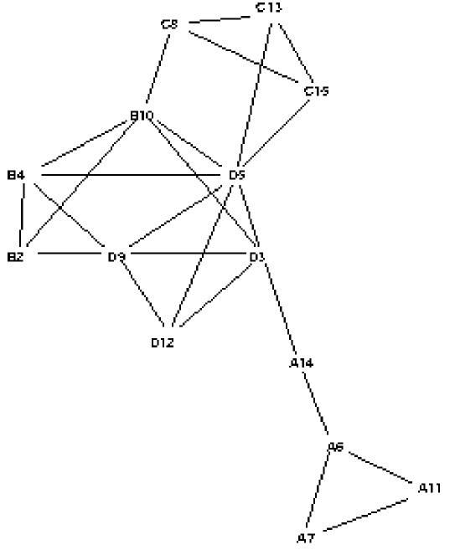
Communication in a class (letters indicate groups)

Slide 62
Comments? Questions?

Slide 63
Case Studies in Uses of Social Network Analysis
(Haythornthwaite, 2001)
(Dawson, 2008)

Slide 64
How?
How did Haythornthwaite and Dawson use social network analysis to learn about collaborative learning?

Slide 65
Haythornthwaite
Analyzed data from four groups from same class over time
Analyzed students’ communication behaviors
Collaborative Work
Exchanging Advice
Socializing
Emotional Support
Analyzing students’ use of communication technologies
Webboard
IRC
Email
NetMeeting
Telephone
Face-to-Face

Slide 66
Dawson
Analyzed student perception of being part of a social community and a learning community, in relation to their centrality (multiple measures)

Slide 67
Other uses?
What are some other uses of social network analysis for learning beyond those we’ve discussed today?

Slide 68
Comments? Questions?

Slide 69
Next Class
Thursday, April 26
3pm-5pm
Campus Center Peterson Room
Frequentist Statistics not Covered in 21st Century Textbooks
Readings
Ferguson, G.A. (1971) Statistical Analysis in Psychology and Education (3rd edition). p. 160-172, 321-346, 390-403.
Assignments Due: None

Slide 70
The End

