Slide 1
Advanced Methods and Analysis for the Learning and Social Sciences
PSY505 Spring term, 2012
February 6, 2012

Slide 2
Today’s Class
Knowledge Structure

Slide 3
Q-Matrix (Tatsuoka, 1983; Barnes, 2005)
 | Skill1 | Skill2 | Skill3 | Skill4
Item1 | 1 | 0 | 0 | 0
Item2 | 1 | 1 | 0 | 0
Item3 | 1 | 0 | 1 | 0
Item4 | 0 | 0 | 0 | 1
Item5 | 0 | 0 | 1 | 1
Item6 | 0 | 1 | 0 | 0

Slide 4
Example
 | Add | Subtract | Multiply | Divide
7 + 3 + 2 | 1 | 0 | 0 | 0
7 + 3 - 2 | 1 | 1 | 0 | 0
(7 + 3) * 2 | 1 | 0 | 1 | 0
7 / 3 / 2 | 0 | 0 | 0 | 1
7 * 3 / 2 | 0 | 0 | 1 | 1
7 - 3 - 2 | 0 | 1 | 0 | 0

Slide 5
How do we create a Q-Matrix?
Hand-development and refinement
Automatic model discovery
Hybrid approaches

Slide 6
Hand-development and refinement
First step: domain expert decides, using their expertise, which items map to which skills
Afterwards, we can look at learning curve data from the student practicing that skill

Slide 7
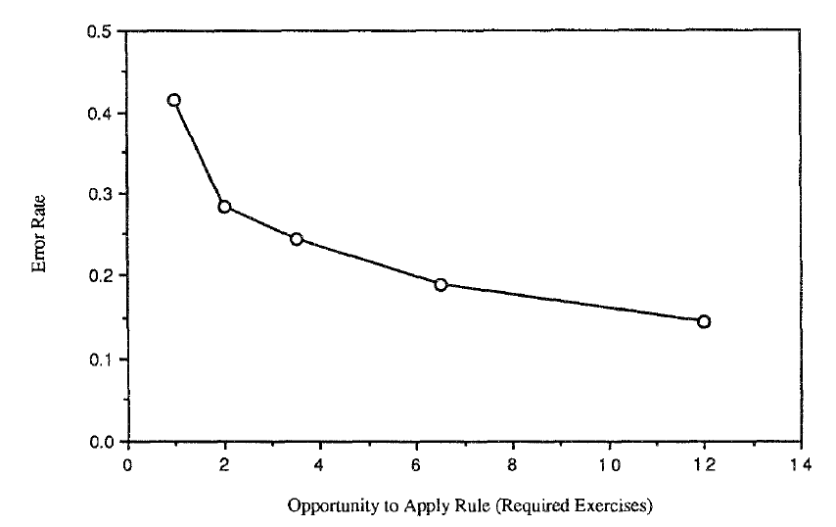
Learning LISP programming in the LISP Tutor (Corbett & Anderson, 1995)

Slide 8
Reflects a good Cognitive Model

Slide 9
A certain characteristic pattern

Slide 10
Power Law of Learning*

Slide 11
Power Law of Learning*
Performance (both speed and accuracy) improves with a power function

Slide 12
Power Law of Learning*
* -- may be an exponential function rather than a power function

Slide 13
Called Power Law
Because speed and accuracy both follow a power curve
Radical improvement at first which slows over time towards an asymptote
Passing the asymptote usually involves developing entirely new strategy

Slide 14
Real-world data
Are rarely perfectly smooth…
(At least not without hundreds of students or more)

Slide 15
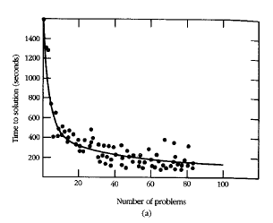
Learning in Cognitive Tutor Geometry (Ritter et al., 2007)

Slide 16
Making inference from learning curves
Via visual inspection of the curve form
Can tell many things
One of them is the quality of a skill model

Slide 17
“Normal learning”
Time
Opportunities to Practice Skill

Slide 18
What might this graph mean?
Time
Opportunities to Practice Skill

Slide 19
No learning going on
Time
Opportunities to Practice Skill

Slide 20
What could this imply about the skill model?
Time
Opportunities to Practice Skill

Slide 21
What might this graph mean?
Time
Opportunities to Practice Skill

Slide 22
Student has already learned skill for the most part
Time
Opportunities to Practice Skill

Slide 23
What might this graph mean?
Time
Opportunities to Practice Skill

Slide 24
Student learned a new strategy and “broke through” the asymptote
Time
Opportunities to Practice Skill

Slide 25
What could this imply about the skill model?
Time
Opportunities to Practice Skill

Slide 26
What might this graph mean?
Time
Opportunities to Practice Skill

Slide 27
Two skills treated as the same skill (Corbett & Anderson, 1995)
Time
Opportunities to Practice Skill

Slide 28
Manual Analysis
Questions? Comments?

Slide 29
Automated Model Discovery
Let’s go through Barnes, Bitzer, & Vouk’s (2005) pseudocode for fitting a Q-Matrix
Using the assignment code

Slide 30
Step 1
Create an item/skill matrix for one of the lessons
How many skills should we use?
(In the algorithm, you repeat for 1 skill, 2 skills, etc., until N+1 skills does not lead to a better model than N skills)

Slide 31
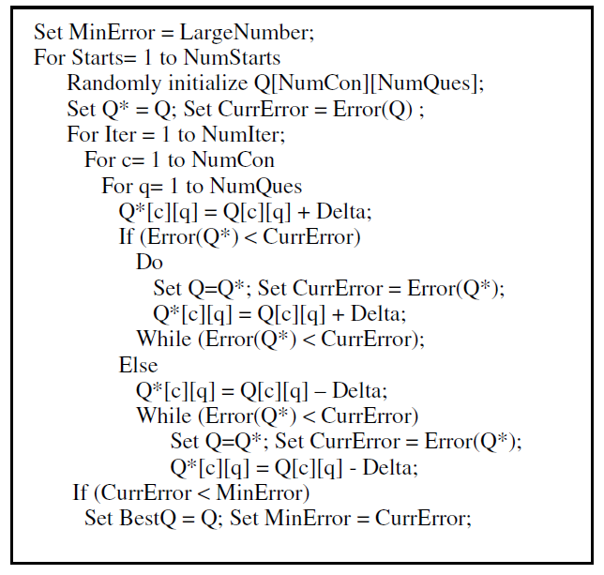
Step 2: Follow pseudocode

Slide 32
Q-Matrices
Questions? Comments?

Slide 33
Hybrid Approach
Learning Factors Analysis (Cen, Koedinger, & Junker, 2006)

Slide 34
Learning Factors Analysis
Take existing Q Matrix
Manually create a P Matrix
Where columns of Q matrix are skills
Columns of P matrix are “difficulty factors”

Slide 35
Example
Column from P-Matrix!
 | Add | Subtract | Multiply | Divide
7 + 3 + 2 | 1 | 0 | 0 | 0
7 + 3 - 2 | 1 | 1 | 0 | 0
(7 + 3) * 2 | 1 | 0 | 1 | 0
7 / 3 / 2 | 0 | 0 | 0 | 1
7 * 3 / 2 | 0 | 0 | 1 | 1
7 - 3 - 2 | 0 | 1 | 0 | 0
Order of Ops
0
0
1
1
1
0

Slide 36
Operations
Add a skill based on p-matrix
Split a skill based on p-matrix

Slide 37
Add skill
 | Add | Subtract | Multiply | Divide | Order of Ops
7 + 3 + 2 | 1 | 0 | 0 | 0 | 0
7 + 3 - 2 | 1 | 1 | 0 | 0 | 0
(7 + 3) * 2 | 1 | 0 | 1 | 0 | 1
7 / 3 / 2 | 0 | 0 | 0 | 1 | 1
7 * 3 / 2 | 0 | 0 | 1 | 1 | 1
7 - 3 - 2 | 0 | 1 | 0 | 0 | 0

Slide 38
Split skill
 | Add-no-Order-of-Ops | Subtract | Multiply | Divide | Add-Order-of-Ops
7 + 3 + 2 | 1 | 0 | 0 | 0 | 0
7 + 3 - 2 | 1 | 1 | 0 | 0 | 0
(7 + 3) * 2 | 0 | 0 | 1 | 0 | 1
7 / 3 / 2 | 0 | 0 | 0 | 1 | 0
7 * 3 / 2 | 0 | 0 | 1 | 1 | 0
7 - 3 - 2 | 0 | 1 | 0 | 0 | 0

Slide 39
LFA Model Search
Start from initial Q-matrix
Try all possible adds or splits
Evaluate adds and splits using BIC
If any modification is better than current version, take best modification and go to step 2

Slide 40
Alternate version
Two KC models can be combined and tested with LFA
One KC model treated as original Q matrix
Other KC model treated as P matrix

Slide 41
Alternate version
KC models models can be created from scratch with LFA
One KC model treats all items as having same skill
Other KC model treats all items as different skills

Slide 42
LFA
Implemented in PSLC DataShop

Slide 43
LFA
Questions? Comments?

Slide 44
POKS in brief
POKS – Partial Order Knowledge Structures (Desmarais et al., 1996, 2005)
Some skills are prerequisites to other skills
If skill A is prerequisite to skill B
You will never find a student who knows skill B but who does not know skill A

Slide 45
POKS models
Typically fit using automated discovery methods
Statistical search for whether making skill A prerequisite to skill B leads to statistically significantly better models
See Desmarais et al. (1996) for the math

Slide 46
Knowledge Structure
Questions?
Comments?

Slide 47
Next Class
Wednesday, February 8
3pm-5pm
AK232
Advanced BKT and Learning Decomposition
Beck, J.E., Chang, K-m., Mostow, J., Corbett, A. (2008) Does Help Help? Introducing the Bayesian Evaluation and Assessment Methodology. Proceedings of the International Conference on Intelligent Tutoring Systems.
Assignments Due: None

Slide 48
The End

