Slide 1
Big Data, Education, and Society
February 14, 2018

Slide 2
Teacher Reporting

Slide 3
We discussed a few systems last week

Slide 4
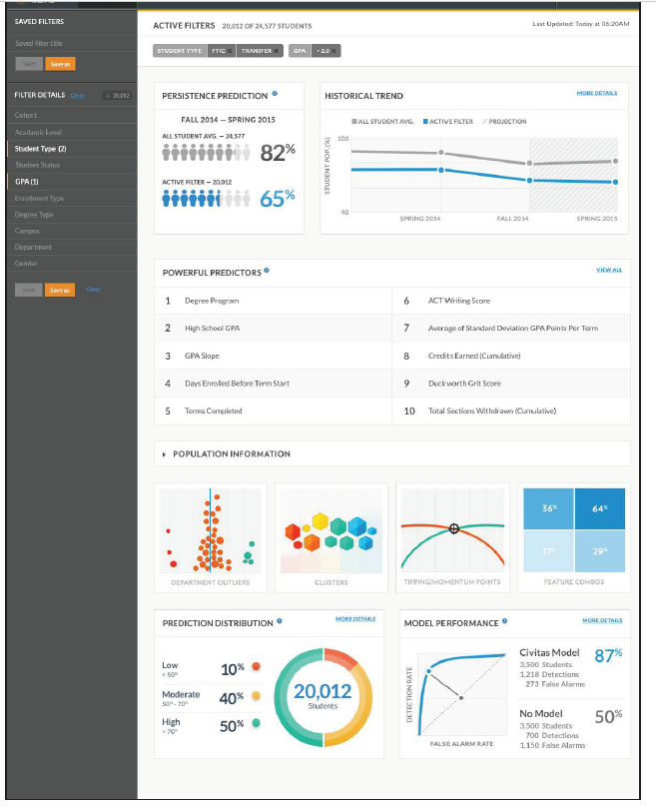

Slide 5
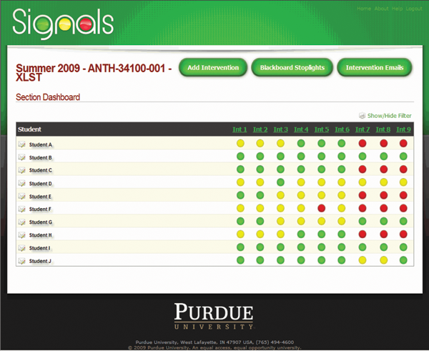

Slide 6
The readings discussed some additional systems

Slide 7
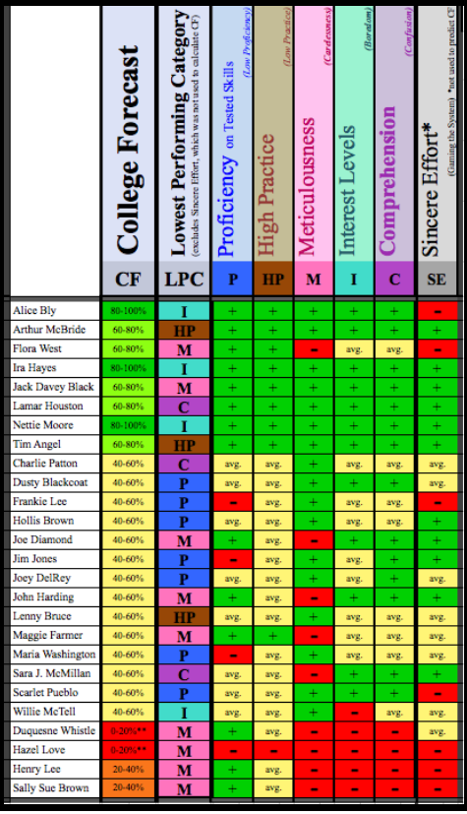
Ocumpaugh et al

Slide 8
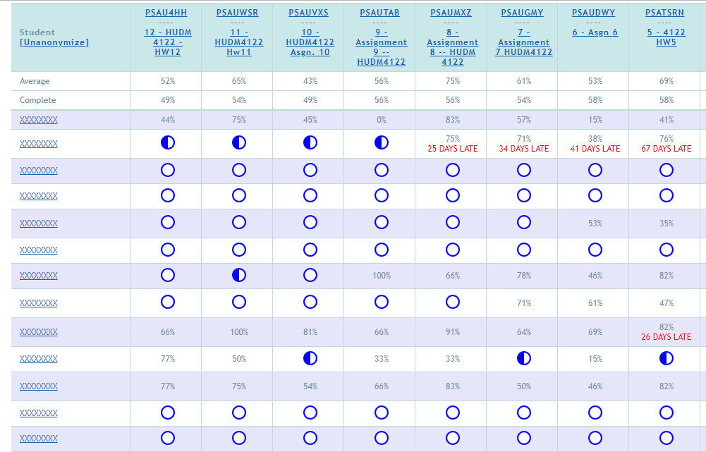
ASSISTments

Slide 9
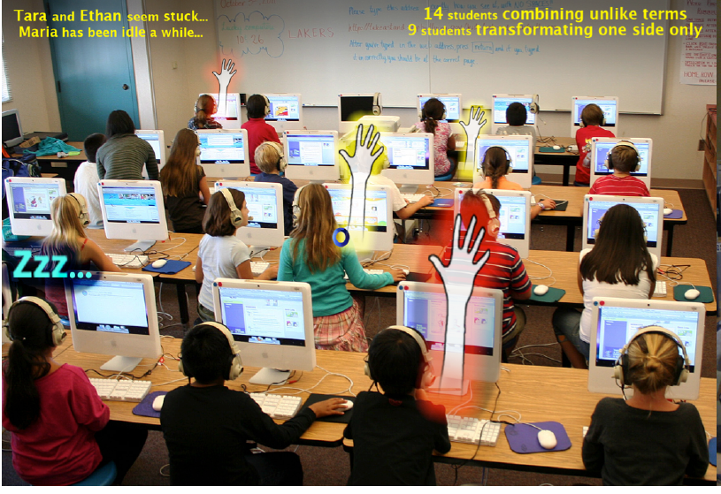
Holstein et al

Slide 10
How teachers use reports: example
https://www.youtube.com/watch?feature=player_embedded&v=Jb6Szy4fZ2w

Slide 11
How teachers use reports: example
“In this paper, we focus on proactive remediation, dynamically planned intervention by the teacher with one or more students. In a proactive remediation, the teacher decides to provide help to one or more students on a topic that they are not currently struggling with, based on evidence that the student(s) need to learn that topic. The teacher plans such interventions using formative assessment data provided by the tutoring system. Proactive remediation is different from the traditional view of on-task conversations in blended learning [10], where the student discusses the current material being presented in the tutor, with another student or the teacher.” (Miller et al., 2015)

Slide 12
How teachers use reports: example
Sending emails proposed by the learning system

Slide 13
Questions? Comments?

Slide 14
Discussion

Slide 15
What are the features of a good report?
Depends
Both whole-class & individual
Across all content/filtered by content
Progress reports that can be used immediately
Trending up/trending down
Summative/final report
Easy to read
Actionable
Diagnose problem areas
Customizable
Compare to performance to fair baseline
Communicate with parents, principals, etc.
Can look at individual students

Slide 16
What are the features of a good report?
Printable and works in grayscale
Exportable data/linkable to gradebook
Actually a dashboard – able to dig into closer detail
Accurate
Not misleading
Not things the teacher already knows
Should be iterated through pilots
Strong anonymization/privitization

Slide 17
What are the features of a good report?
Appropriate amount of details (customizable? Auto-detection?)
Track teachers’ actions based on report and results
Ability to take notes/flag
Compare to benchmark/goals
Interpretable/where does this assessment come from?/how is it calculated?
Useful to veteran/novice teachers

Slide 18
What are the features of a good report?
Up-to-date with new developments in analytics
Stable year-to-year

Slide 19
What are some things to avoid in designing a report?

Slide 20
How can reports support new (better) pedagogical practices?

Slide 21
How can reports reinforce bad pedagogical practices?

Slide 22
What should be different in reports for guidance counselors, principals…

Slide 23
Some tensions in report design (Duncan et al)
Detail versus big picture
Mastery versus progress
Benchmarking between students or with reference to a goal

Slide 24
Questions? Comments?

Slide 25
Please assemble into groups of 3-4
Then we will count off groups

Slide 26
Design a report
For teachers of students using an adaptive homework system for math
For teachers of students using an adaptive flash card system for a foreign language
For teachers of students using a blended learning system in math class
For teachers of students using a history game (such as Civilization) in class

Slide 27
Design a report
5. For teachers of students doing a computer-mediated programming project at home (group project in Scratch)
6. For teachers of students practicing the viola at home
7. For the sensei of students practicing tae kwon do in a dojo
8. For teachers of undergraduates doing a group creative writing project (in a system where drafts are instrumented)

Slide 28
Now send an ambassador to another group
And present/critique the designs

Slide 29
Questions? Comments?

Slide 30
Any questions or concerns regarding assignment?

Slide 31
Upcoming office hours
Tomorrow 9a-10a
2/21 930a-10a

