Slide 1
Big Data, Education, and Society
January 31, 2018

Slide 2
Questions? Concerns? Comments?

Slide 3
Who does not yet have a group, but wants a group?

Slide 4
Project Proposal
Questions? Concerns? Comments?

Slide 5
Let’s discuss the readings: Last week first

Slide 6
Let’s discuss the readings
Learning Analytics, Educational Data Mining
Can be treated as interchangeable for the purposes of this class

Slide 7
Let’s discuss the readings
What are the core methods of learning analytics/EDM, according to Baker & Siemens?

Slide 8
Many types of EDM/LA Method (Baker & Siemens, 2014; building off of Baker & Yacef, 2009)
Prediction
Structure Discovery
Relationship mining
Distillation of data for human judgment
Discovery with models

Slide 9
Prediction
Develop a model which can infer a single aspect of the data (predicted variable) from some combination of other aspects of the data (predictor variables)
Which students are bored?
Which students will fail the class?
Infer something that matters, so we can do something about it

Slide 10
Prediction
Classification
Regression
Density Estimation
Latent Knowledge Estimation

Slide 11
Structure Discovery
Find structure and patterns in the data that emerge “naturally”
No specific target or predictor variable
What problems map to the same skills?
Are there groups of students who approach the same curriculum differently?
Which students develop more social relationships in MOOCs?

Slide 12
Structure Discovery
Clustering
Factor Analysis (Exploratory)
Structural Equation Modeling (Exploratory)
Latent Class Analysis
Domain Structure Discovery

Slide 13
Relationship Mining
Discover relationships between variables in a data set with many variables
Are there trajectories through a curriculum that are more or less effective?
Which aspects of the design of educational software have implications for student engagement?

Slide 14
Relationship Mining
Correlation Mining
Causal Data Mining
Association Rule Mining
Sequential Pattern Mining
Network Analysis
MOTIF Analysis

Slide 15
Questions? Comments?

Slide 16
Let’s discuss the readings
What are some core applications of learning analytics/EDM, according to Baker & Siemens?

Slide 17
Some applications
Automated detection of learning, engagement, emotion, strategy, for better individualization (Jan 31)
Dropout/success prediction (Feb 7)
Better reporting for teachers, parents, and other stakeholders (Feb 14, 21)
Basic discovery in education

Slide 18
We will discuss
Examples of each of these and more
In future weeks

Slide 19
Automated Intervention

Slide 20
Examples of Use (at scale)
Cognitive Tutor – automated detectors of student knowledge used to drive mastery learning
Middle school and high school math

Slide 21
Examples of Use (at scale)
ALEKS – Models of prerequisite structure and knowledge used to select material for students
High school and college math and science

Slide 22
Examples of Use (scaling now through xPrize)
Project LISTEN – data mining used to determine which strategies work for which students, and to help select which stories to give students to read
Elementary school reading

Slide 23
Examples of Use (was at scale)
Knewton – enabled systems that decided what problem to give a student next
Many domains

Slide 24
Examples of Use (not yet at scale)
InqITS – automated detectors of student inquiry skill embedded in an automated agent that helps students learn how to conduct effective inquiry
Leading to inquiry skill that transfers to new scientific domains
Middle school science

Slide 25
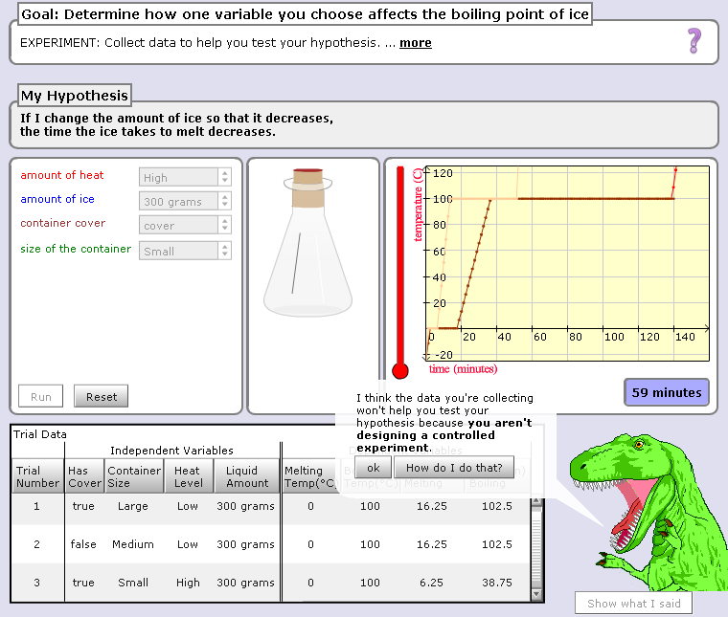

Slide 26
Hey, are you just playing with the buttons? Take your learning seriously or I will eat you!!!

Slide 27
Scooter video

Slide 28
AutoTutor

Slide 29
AutoTutor
Engages in knowledge-construction dialogues with learner
Adapts based on student emotion as well as student knowledge
Supportive versus shake-up dialogues

Slide 30
AutoTutor
https://www.youtube.com/watch?v=aPcoZPjL2G8
https://www.youtube.com/watch?v=jDNXG09vFqo
Apologies for those of you who have seen one of these videos before

Slide 31
Is anyone here familiar with any other examples?

Slide 32
What are the properties of a good automated intervention?
Engaging
Intervenes at appropriate times
Not too soon
Not too late
Good amount of hints/support – not just the answer
Accurately applied
Challenging/stimulates full potential
Sustainable
Reliable
Work for multiple different people/non-biased
Applies to both lower-level and higher-level knowledge

Slide 33
What are the properties of a good automated intervention?

Slide 34
What are some things to avoid in an automated intervention?
Not isolating people
Inappropriateness for students with disabilities
Bias or unequal effectiveness
Over-tracking
Giving factually inaccurate feedback
Archaic knowledge
Overly complicated UI
Doesn’t try to solve a solved problem

Slide 35
What are some things to avoid in an automated intervention?
Don’t oversimplify
Confounding means with ends
Distracting pedagogical agents or feedback
Over-optimizing small things
Over-scaffolding and supporting

Slide 36
What is the difference in benefits/risks
Obvious interventions
Stealth interventions

Slide 37
Questions? Comments?

Slide 38
Office hours next week 2/7
Will be held 930a-10a in my office

