Slide 1
Big Data, Education, and Society
February 26, 2020

Slide 2
Today’s Special Guest
Dr. Will (Zhenjun) Ma
Co-founder and Chief Data Scientist, Learnta
After-school (among other things) learning platform with substantial user base in China

Slide 3
First activity
Each group, please take a minute or two to tell everyone about your project idea
Will will give you brief feedback and ideas
Your classmates will provide feedback on the discussion forum (rather than out loud), if they have any
Reminder: your feedback to your classmates is due tonight
I will provide feedback on the discussion forum at the time of my eventual grading – I may ask clarification questions

Slide 4
Questions? Concerns? Comments?

Slide 5
Assignment 2
http://www.upenn.edu/learninganalytics/ryanbaker/BDES2020/BDES-2020-asgn2-v2.pdf

Slide 6
Presentation on Learnta

Slide 7
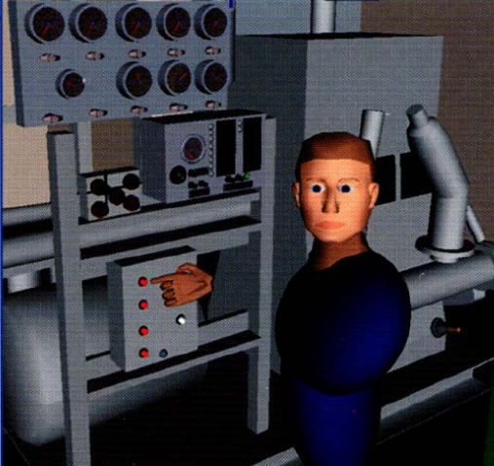
Automated Intervention
More broadly

Slide 8
Examples of Use (at scale)
Cognitive Tutor – automated detectors of student knowledge used to drive mastery learning
Middle school and high school math

Slide 9
Examples of Use (at scale)
ALEKS – Models of prerequisite structure and knowledge used to select material for students
High school and college math and science

Slide 10
Examples of Use (at scale)
InqITS – automated detectors of student inquiry skill embedded in an automated agent that helps students learn how to conduct effective inquiry
Leading to inquiry skill that transfers to new scientific domains
Middle school science

Slide 11
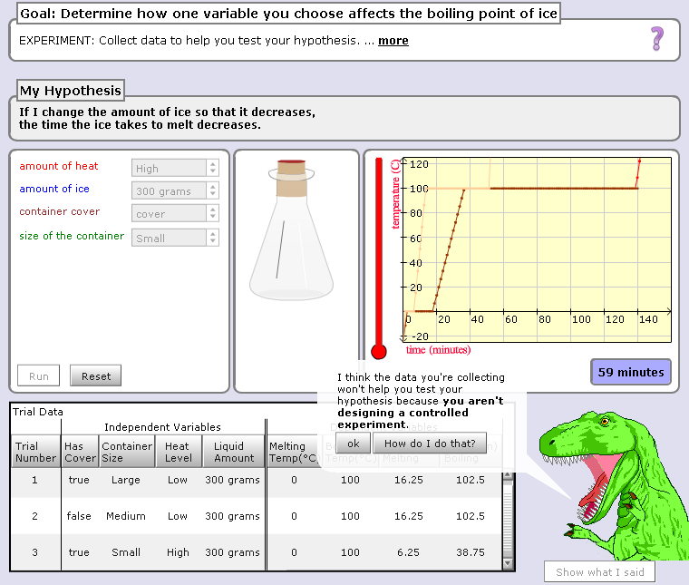

Slide 12
Hey, are you just playing with the buttons? Take your learning seriously or I will eat you!!!

Slide 13
Scooter video

Slide 14
AutoTutor

Slide 15
AutoTutor
Engages in knowledge-construction dialogues with learner
Adapts based on student emotion as well as student knowledge
Supportive versus shake-up dialogues

Slide 16
AutoTutor
https://www.youtube.com/watch?v=aPcoZPjL2G8
https://www.youtube.com/watch?v=jDNXG09vFqo

Slide 17
Is anyone here familiar with any other examples?

Slide 18
What are the properties of a good automated intervention?

Slide 19
What are some things to avoid in an automated intervention?

Slide 20
What is the difference in benefits/risks
Obvious interventions
Stealth interventions

Slide 21
Questions? Comments?

