Slide 1
Big Data, Education, and Society
April 15, 2020

Slide 2
Assignment 4
Any questions about assignment 4?

Slide 3
Discrimination and the Perpetuation of Bias

Slide 4
Algorithmic Bias (Garcia, 2016)
Nothing to do with the “bias-variance trade-off”, if you’ve ever heard of that
(And if you haven’t don’t worry about it)

Slide 5
Algorithmic Bias (Garcia, 2016)
When a prediction model implicitly discovers bias in existing decision-making and then perpetuates/systematicizes/extends it

Slide 6
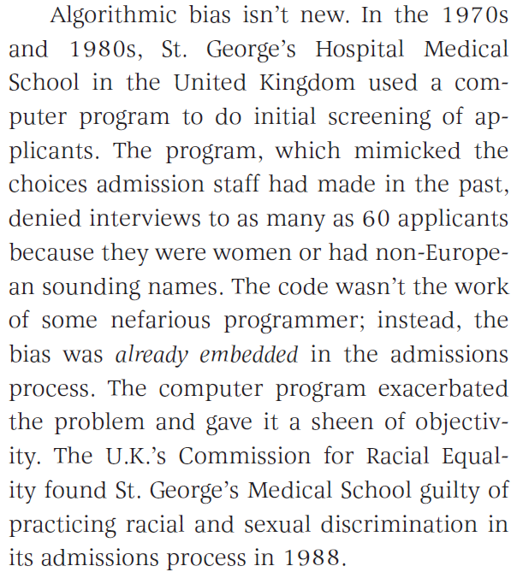
Example (Garcia, 2016)

Slide 7
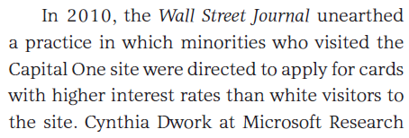
Example (Garcia, 2016)

Slide 8
Example (Corbett-Davies et al., 2017)
For example, when ProPublica examined computer-generated risk scores in Broward County, Fla., in 2016, it found that black defendants were substantially more likely than whites to be rated a high risk of committing a violent crime if released. Even among defendants who ultimately were not re-arrested, blacks were more likely than whites to be deemed risky. These results elicited a visceral sense of injustice and prompted a chorus of warnings about the dangers of artificial intelligence.

Slide 9
Comments? Questions?

Slide 10
Corbett-Davies et al. (2017) argument
Yet those results don’t prove the algorithm itself is biased against black defendants — a point we’ve made previously, including in peer-reviewed research. The Broward County classifications are based on recognized risk factors, like a documented history of violence. The classifications do not explicitly consider a defendant’s race.
Because of complex social and economic causes, black defendants in Broward County are in reality more likely than whites to be arrested in connection with a violent crime after release, and so classifications designed to predict such outcomes necessarily identify more black defendants as risky. This would be true regardless of whether the judgments were made by a computer or by a human decision maker.
It is not biased algorithms but broader societal inequalities that drive the troubling racial differences we see in Broward County and throughout the country. It is misleading and counterproductive to blame the algorithm for uncovering real statistical patterns. Ignoring these patterns would not resolve the underlying disparities.

Slide 11
What are your thoughts on this argument?

Slide 12
What could be solutions to preventing algorithmic bias?

Slide 13
What could be solutions to preventing algorithmic bias?
Avoid using demographic variables as predictors (GPDR)
Diversity in people developing models (Garcia, 2016)
Predict outcomes that are not biased – example given of predicting violent crime (less biased) instead of predicting all crime (more biased) (Corbett-Davies et al., 2017)

Slide 14
What could be solutions to preventing algorithmic bias?
“Right to explanation” (GPDR)
Inspect model outcomes for bias
Do visibly biased outcomes result? (Garcia, 2016)
Is the model more biased than its training data?
Openness as to model internals and predictions (Garcia, 2016)

Slide 15
Which of these solutions are practically feasible in learning analytics?
And which aren’t?
Why/why not?

Slide 16
Open University UK situation

Slide 17
Open University UK situation
How should they have addressed the problem?

Slide 18
Assemble into your *assignment* groups
Using your preferred communication mechanism – Hangout, Skype, Zoom, BlueJeans, teleconference

Slide 19
Assemble into your *assignment* groups
How could your proposed innovation become problematic or damaged due to algorithmic bias
Either actual or perceived?
What, if anything, could you do to mitigate that risk?

Slide 20
Be ready to present (briefly) to the class
What is your innovation?
What is the risk of algorithmic bias?
What steps could you take to address it?

Slide 21
Now present to the class
The class:
Do you think this is the biggest risk of algorithmic bias?
Do you have any concerns that their solution will not work?
After we complete critique in terms of these… Do you have other potential solutions?

Slide 22
Comments? Questions?

