Slide 1
Big Data, Education, and Society
October 8, 2021

Slide 2
Thank you for your assignment 1 handins
Great assignments
Great feedback to each other on the forums – thank you!
Vivian and I are processing your assignments, and will get you feedback ASAP
Some groups may get feedback from us earlier than others – don’t worry if you get feedback before or after others (there’s no specific order)

Slide 3
Assignment 2
https://www.upenn.edu/learninganalytics/ryanbaker/BDES2021/BDES-2021-asgn2-v1.pdf

Slide 4
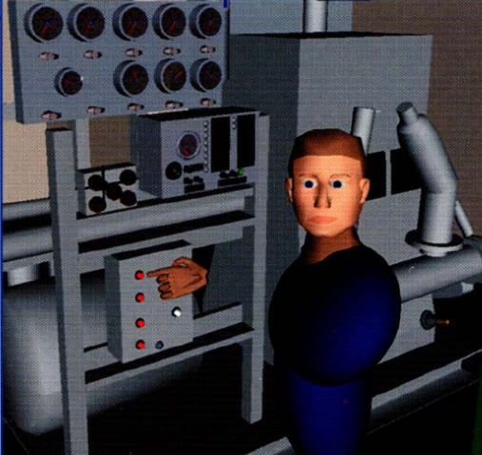
Automated Intervention

Slide 5
Examples of Use (at scale)
Cognitive Tutor/MATHia – automated detectors of student knowledge used to drive mastery learning
Middle school and high school and college math, USA

Slide 6
Examples of Use (at scale)
Alef – automated detectors of student knowledge used to select what material to give student next and provide reports to instructors
Entire (all subject) middle school curriculum, United Arab Emirates

Slide 7
Examples of Use (at scale)
ALEKS – Models of prerequisite structure and knowledge used to select material for students
High school and college math and science, USA

Slide 8
Examples of Use (was at scale at one point)
Project LISTEN – data mining used to determine which strategies work for which students, and to help select which stories to give students to read
Elementary school reading

Slide 9
Examples of Use (at scale)
Duolingo – automated detectors of student memory used to determine when a student needs to review something they already learned
Foreign language vocabulary, worldwide

Slide 10
Examples of Use (at scale)
Learnta – Models of prerequisite structure and knowledge used to select material for students, automated detectors of student knowledge used to drive mastery learning
English as a second language, China

Slide 11
Examples of Use (at scale)
InqITS – automated detectors of student inquiry skill embedded in an automated agent that helps students learn how to conduct effective inquiry
Leading to inquiry skill that transfers to new scientific domains
Middle school science, USA & China

Slide 12
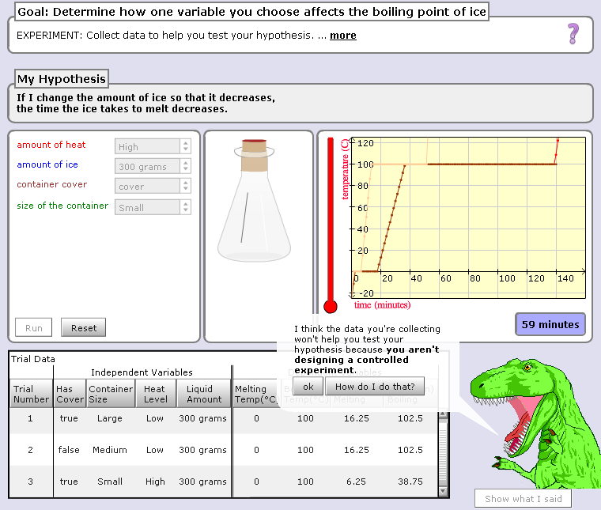

Slide 13
Hey, are you just playing with the buttons? Take your learning seriously or I will eat you!!!

Slide 14
Scooter video

Slide 15
AutoTutor

Slide 16
AutoTutor
Engages in knowledge-construction dialogues with learner
Adapts based on student emotion as well as student knowledge
Supportive versus shake-up dialogues

Slide 17
AutoTutor
https://www.youtube.com/watch?v=aPcoZPjL2G8
https://www.youtube.com/watch?v=jDNXG09vFqo

Slide 18
Is anyone here familiar with any other examples?

Slide 19
What are some situations where a system could intervene?

Slide 20
What are the properties of a good automated intervention?

Slide 21
What are some things to avoid in an automated intervention?

Slide 22
What is the difference in benefits/risks
Obvious interventions
Stealth interventions

Slide 23
Those of you who have learned from a system doing automated intervention
What system was it
What did it do
What was your reaction

Slide 24
Those of you who have taught using a system doing automated intervention
What system was it
What did it do
What was your reaction

Slide 25
Questions? Comments?

