Slide 1
Big Data, Education, and Society
November 4, 2021

Slide 2
Assignment 3
Any questions about assignment 3?

Slide 3
Discrimination and the Perpetuation of Bias

Slide 4
Algorithmic Bias (Garcia, 2016)
Nothing to do with the “bias-variance trade-off”, if you’ve ever heard of that
(And if you haven’t don’t worry about it)

Slide 5
What is algorithmic bias?

Slide 6
Definition in Garcia (2016)
When a prediction model implicitly discovers bias in existing decision-making and then perpetuates/systematicizes/extends it

Slide 7
Definition in Friedman & Nussbaum (1996)
Biased computer systems “systematically and unfairly discriminate against individuals or groups of individuals in favor of others.

Slide 8
Definition in Baker & Hawn (2021)
Cases where model performance is substantially better or worse across mutually exclusive groups, separated by non-malleable factors

Slide 9
Does anyone want to propose a different definition?
There are other definitions out there…

Slide 10
Key difference between definitions
If algorithms create a new bias or previously-unknown bias
Is it still algorithmic bias?
Baker & Hawn say yes
Friedman & Nussbaum say yes
Garcia says no

Slide 11
Is it a problem?
If algorithms are biased in ways that match well-known societal biases
Please post your thoughts in the chat

Slide 12
Is it a problem?
If algorithms are biased in ways that match poorly-understood societal biases
Please post your thoughts in the chat

Slide 13
Is it a problem?
If algorithms are biased in ways that don’t match societal biases
Please post your thoughts in the chat

Slide 14
Another differentiation
Algorithmic bias is found in automated decision-making
Friedman & Nussbaum
Garcia
Algorithmic bias is found in measurement
Baker & Hawn

Slide 15
Is it a problem?
An algorithm makes biased measurements, but the actual decision-making is left to humans
Please post your thoughts in the chat

Slide 16
Algorithmic Bias has a long history

Slide 17
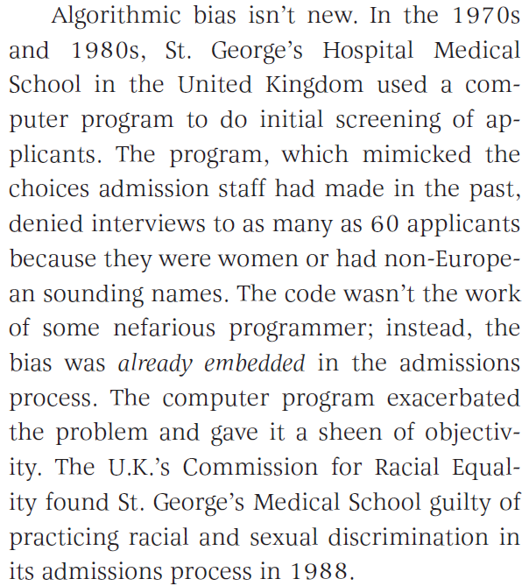
Example (Garcia, 2016)

Slide 18
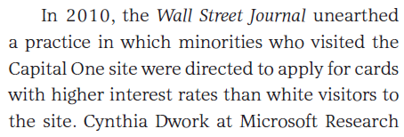
Example (Garcia, 2016)

Slide 19
Example (Corbett-Davies et al., 2017)
For example, when ProPublica examined computer-generated risk scores in Broward County, Fla., in 2016, it found that black defendants were substantially more likely than whites to be rated a high risk of committing a violent crime if released. Even among defendants who ultimately were not re-arrested, blacks were more likely than whites to be deemed risky. These results elicited a visceral sense of injustice and prompted a chorus of warnings about the dangers of artificial intelligence.

Slide 20
Comments? Questions?

Slide 21
Corbett-Davies et al. (2017) argument
Yet those results don’t prove the algorithm itself is biased against black defendants — a point we’ve made previously, including in peer-reviewed research. The Broward County classifications are based on recognized risk factors, like a documented history of violence. The classifications do not explicitly consider a defendant’s race.
Because of complex social and economic causes, black defendants in Broward County are in reality more likely than whites to be arrested in connection with a violent crime after release, and so classifications designed to predict such outcomes necessarily identify more black defendants as risky. This would be true regardless of whether the judgments were made by a computer or by a human decision maker.
It is not biased algorithms but broader societal inequalities that drive the troubling racial differences we see in Broward County and throughout the country. It is misleading and counterproductive to blame the algorithm for uncovering real statistical patterns. Ignoring these patterns would not resolve the underlying disparities.

Slide 22
What are your thoughts on this argument?

Slide 23
Where does algorithmic bias come from?
Action/ Deployment
Actual World
Machine Learning Lifecycle
Model Learning
The Task
Measurement/Data
(Barocas et al., 2019; Cramer et al., 2019; Kizilcec & Lee, 2020)
Notes:
In tracing the origins of bias, the main approach has been to describe the stages of a machine-learning lifecycle and then connect possible forms of bias to each of those stages.
Descriptions of the machine learning pipeline vary, but these are a some of the possible stages that we saw across a few different sources.
Developers creating an algorithmic solution move from the world as it is, to defining a task related to that world, to pulling together or creating a dataset, to defining, training, and testing a model; and finally to putting the model into practice in some manner, whether automated and behind the scenes or as a form of communication to decision-makers.
Throughout this cycle, there are multiple points of entry for bias and a lot of work in CS has attempted to map kinds of bias onto the places where they are most likely to occur in the pipeline.

Slide 24
Where does algorithmic bias come from?
Action/ Deployment
Actual World
Machine Learning Lifecycle
Model Learning
The Task
See review by Kizilcec & Lee (in press)
Measurement/Data
Notes:
Researchers have written extensively about the model learning stage of the lifecycle and how different metrics for fairness can be used to audit models for bias. Kizilcec and Lee have a great review that brings the broader research on modeling from computer science into the education context in a really useful, contextualized way.

Slide 25
Where does algorithmic bias come from?
Action/ Deployment
Actual World
Machine Learning Lifecycle
Model Learning
The Task
Measurement/Data
See review by Baker & Hawn (2021)
Notes:
As a complement, our focus here is more on the role of measurement and data collection as a source of bias, while also consolidating what we know about algorithmic bias in education as it impacts specific groups, and finally on suggesting some broad strategies for mitigating the bias that can arise in the measurement/data collection stage of the machine-learning pipeline.

Slide 26
Bias from Measurement/Data Collection
Representational Bias (Suresh & Guttag, 2020)
Model performs less well for group less represented in training data
Suburban middle-class students ≠ Urban lower-income students
Even a “complete” data set may not be enough if a group is rarely seen in the data set

Slide 27
Bias from Measurement/Data Collection
Measurement Bias (Suresh & Guttag, 2020)
Bias in Training Labels
Judgement by others
Judgement by self
Human coders

Slide 28
Taking a first step: What do we know? (Baker & Hawn, 2021)
Unknown Bias
Known
Bias
Fairness
Equity

Slide 29
What do we know about bias impacting learners in common demographic categories?
“[Industrial] Teams often struggled to anticipate which subpopulations and forms of unfairness they need to consider for specific kinds of ML applications.” (Holstein et al., 2019)
Most educational data mining research does not even mention learner demographics, much less research it (Paquette et al., 2020)

Slide 30
Race/Ethnicity
A range of algorithms predicting course failure performed worse for African-American students, but results differed across university courses. (Hu & Rangwala, 2020)
Algorithms predicting six-year college graduation had higher false positive rates for White students and higher false negative rates for Latino students. (Anderson et. al, 2019)
An algorithm for predicting course grades performed worse for students in underrepresented racial and ethnic groups than for White and Asian students (Lee & Kizilcec, 2020)
Algorithms predicting college dropout had lower true negative rates but better recall for students who are not White or Asian (Yu et al, 2021)
When race data was included in the model, students of several racial backgrounds were inaccurately predicted to perform worse than other students in undergraduate success. (Yu et al., 2020)

Slide 31
Nationality
On a test of foreign language proficiency, the E-Rater system inaccurately gave Chinese and Korean students higher scores than human essay raters. (Bridgeman et al., 2009, 2012)
Arabic and Hindi-speaking students were given lower scores [than human raters] on the same test. (Bridgeman et al., 2012)
Models built using data from learners in the Philippines, Costa Rica, and the United States were each more accurate on students from their own countries than for students from other countries. (Ogan et al., 2015)
Models predicting standardized examination scores trained on data from the USA were more accurate for students in economically developed countries than students in less economically developed countries (Li et al., 2021)

Slide 32
Gender
A range of algorithms predicting course failure performed worse for male students, but the result was inconsistent across university courses. (Hu & Rangwala, 2020)
Algorithms predicting six-year college graduation had higher false negative rates for male students. (Anderson et. al, 2019)
Algorithms predicting MOOC dropout performed worse for female students than male students. (Gardner et al., 2019)
An algorithm for predicting course grades performed worse for males than for female students. (Lee & Kizilcec, 2020)
Female students were inaccurately predicted to perform better for undergraduate success than male students. (Yu et al., 2020)
Algorithms predicting college dropout had lower true negative rates but better recall for male students (Yu et al, 2021)

Slide 33
Gender
While performance was good for both males and females, a JRip decision tree model predicting student retention performed well for males and females and more equitably than a J48 decision tree model. But, the JRip model still had moderately better performance for female students. (Kai et al., 2017).
Only small differences in performance between males and females were found predicting course outcomes and school dropout. (Christie et al., 2019; Riazy et al., 2020)

Slide 34
What do we know about bias impacting other groups?
Do we even know about all the groups that are impacted?

Slide 35
Native language and dialect
Algorithmic essay scoring developed on corpuses more relevant to native speakers than second-language speakers (Naismith et al., 2018)
No work on algorithmic bias in education in terms of learner dialect
Although there has been work to develop learning systems that are appropriate for speakers of non-traditional dialects (e.g. Finkelstein et al., 2013)

Slide 36
Disabilities
Accuracy of speech recognition system used in educational assessment much lower for students with speech impairment (Loukina et al., 2018)
Evidence of disparate impact in course outcome prediction for students who self-reported that they had some disability (Riazy et al., 2020)

Slide 37
Urbanicity
Detectors of student affect significantly less effective when transferred between urban, rural, and suburban students (Ocumpaugh et al., 2014)
Models of attributes of student questions not impacted by transfer between urban, rural, and suburban students (Samei et al., 2015)

Slide 38
Parental Educational Background
Model predicting college success more likely to inaccurately predict negative outcomes for first-generation college students if personal background included in model (Yu et al., 2020)
Model predicting retention in online program more accurate for first-generation college students (Kai et al., 2017)
Algorithms predicting college dropout had lower true negative rates but better recall for first-generation students (Yu et al, 2021)

Slide 39
Socioeconomic Status (SES)
Model predicting college success more likely to inaccurately predict negative outcomes for students from poorer families if personal background included in model (Yu et al., 2020)
Models predicting student success mildly less accurate if transferred between schools with different SES profiles (Yudelson et al., 2014)
Algorithms predicting college dropout had lower true negative rates but better recall for lower-SES students (Yu et al, 2021)

Slide 40
International Students
Model predicting college success more likely to inaccurately predict negative outcomes for international college students if personal background included in model (Yu et al., 2020)

Slide 41
Military-Connected Status
Model predicting high school dropout less accurate if developed for non-military connected students and applied to military-connected students, or vice-versa (Baker et al., 2020)

Slide 42
Strong evidence that bias impacts a wide range of groups
It’s likely that other groups -- not yet studied -- are also impacted.

Slide 43
Other takeaways from Baker & Hawn (2021)
Models trained on one group of learners generally perform more poorly for new groups.
Investigation of bias for many groups still missing, e.g. Indigenous learners, specific disabilities, religious minorities, non-binary and transgender learners.
Collecting and training on a diverse sample of students can help.
The super-majority of the empirical research on algorithmic bias in education was conducted by North America universities/organizations (but see Käser, 2014; Klingler et al., 2017; Riazy et al., 2019…)

Slide 44
What could be solutions to preventing algorithmic bias?
Your ideas?

Slide 45
What could be solutions to preventing algorithmic bias?
Actually look for it (Paquette et al., 2020)
Depends on collecting the necessary data (Baker & Hawn, 2021)

Slide 46
What could be solutions to preventing algorithmic bias?
Make sure data sets are actually representative

Slide 47
What could be solutions to preventing algorithmic bias?
Avoid using demographic variables as predictors (GPDR)
Broaden the community of people developing models (Garcia, 2016)
Predict outcomes that are not biased – example given of predicting violent crime (less biased) instead of predicting all crime (more biased) (Corbett-Davies et al., 2017)

Slide 48
What could be solutions to preventing algorithmic bias?
“Right to explanation” (GPDR)
Inspect model outcomes for bias
Do visibly biased outcomes result? (Garcia, 2016)
Is the model more biased than its training data?
Openness as to model internals and predictions (Garcia, 2016)

Slide 49
What could be solutions to preventing algorithmic bias?
Create guidelines for demonstrating a technology is not biased
During publication
Prior to use by school district

Slide 50
What could be solutions to preventing algorithmic bias?
Better tools for doing a “standard set” of analyses of algorithmic biases
Tools for conducting analyses on full data including demographics while preventing download of PII

Slide 51
Which of these solutions are practically feasible in learning analytics?
And which aren’t?
Why/why not?

Slide 52
Open University UK situation

Slide 53
Open University UK situation
How should they have addressed the problem?

Slide 54
Comments? Questions?
In a minute, we are going to switch to a group activity, and we’ll end the class with that
Are there any comments/questions before we do that?

Slide 55
Assemble into your *assignment* groups
Using your preferred communication mechanism – Hangout, Skype, Zoom, BlueJeans, teleconference
If you missed the email/post and didn’t set this up in advance, please self-organize quickly now

Slide 56
Assemble into your *assignment* groups
How could your proposed innovation become problematic or damaged due to algorithmic bias
Either actual or perceived?
What, if anything, could you do to mitigate that risk?

Slide 57
Yes
This can go into your assignment 3 handin

