Slide 1
Big Data, Education, and Society
November 24, 2021

Slide 2
Questions on the final presentation?

Slide 3
Explainable AI
AI where the reasons for a specific prediction can be explained to a human

Slide 4
Interpretable AI
AI where the process leading to predictions can be understood by a human

Slide 5
Explainable versus Interpretable
Explainable
I think Ryan will drop out of high school because he has a low GPA and keeps getting in fights
Interpretable
The model says that 0.1 lower GPA results in 3% higher chance of high school dropout
The model says that each disciplinary incident for fighting results in 6% higher chance of high school dropout

Slide 6
Explainable versus Interpretable
Explainable
I think Maria will get a correct answer on the next problem, because she has gotten 3 of the last 4 correct on problems involving the same mathematical skill
Interpretable
Each correct answer increases correctness probability 10% at first and then that benefit goes down over time
Each wrong answer decreases correctness probability 3%

Slide 7
Different challenges
Which one do you think is harder? Why?

Slide 8
Different affordances
With explainability, you can use any algorithm you want as long as you can explain a specific prediction afterwards
Some algorithms produce models that are just not interpretable even to experts

Slide 9
Be cautious
Although these are the standard definitions in AI more broadly
These terms are used fairly haphazardly/interchangeably in the EDM community
A lot of papers use “explainable” to refer to both of these
Also, “older papers” like Liu & Koedinger (2017) came about before these terms were widely used in these ways

Slide 10
Questions? Comments?

Slide 11
What makes a model interpretable (Liu & Koedinger, 2017)
Note: they call it “explanatory”

Slide 12
What makes a model interpretable (Liu & Koedinger, 2017)
Need to understand how the model works
Need to understand why the model is better than (simpler) alternatives
Understanding of this why should either
advance our understanding of how learners learn the relevant material
or have clear implications for instructional improvements
or both

Slide 13
What makes a model interpretable (Liu & Koedinger, 2017)
Facilitated by interpretable and meaningful predictors
Facilitated by designing predictors based on theory
Facilitated by predicting a variable that is well-defined

Slide 14
What makes a model interpretable (Liu & Koedinger, 2017)
Interpretable models tend to be relatively parsimonious

Slide 15
Comments? Questions?

Slide 16
Let’s compare these to uninterpretable models
Can’t understand how the model works
Can’t explain why the model is better than (simpler) alternatives
Doesn’t
advance our understanding of how learners learn the relevant material
or have clear implications for instructional improvements
It just predicts better

Slide 17
Let’s compare these to uninterpretable models
Less likely to have interpretable and meaningful predictors
But could also be combining these interpretable and meaningful predictors in uninterpretable ways
More likely to be predicting a variable that is itself hard to interpret
Less likely to be parsimonious

Slide 18
Comments? Questions?

Slide 19
How can we tell if a predictor is “interpretable and meaningful”?
What are some strategies?

Slide 20
How can we tell if a predictor is “interpretable and meaningful”?
Just-so stories

Slide 21
Let’s create some just-so stories
Please volunteer & say your just-so story out loud
Predicting student correctness in learning system by time previously taken to answer

Slide 22
Let’s create some just-so stories
Please volunteer & say your just-so story out loud
Predicting college dropout by average course grade (in courses passed)

Slide 23
Let’s create some just-so stories
Please volunteer & say your just-so story out loud
Predicting school violence from dress code violations

Slide 24
Let’s create some just-so stories
Please volunteer & say your just-so story out loud
Predicting student frustration from standard deviation in amount of time taken to respond across last five responses

Slide 25
Comments? Questions?

Slide 26
The creation of explainables (Howley et al., 2020)
Tools for supporting understanding of a model and interpreting how it works

Slide 27
Let’s go into random breakout groups
Please go through these explainables together
Don’t do the post-tests
Be ready for a little bit of confusion/frustration
https://tongyuzhou.com/bkt-explorable/
http://www.cs.williams.edu/~iris/res/bkt-esperanto/index.html

Slide 28
What did you think of the alchemy explainable?

Slide 29
What did you think of the esperanto explainable?

Slide 30
The alchemy explainable didn’t work!
In (Howley et al., 2020) it didn’t lead to better ability to answer questions about BKT
Caveat: the sample was Mechanical Turk, not real teachers

Slide 31
Do you feel like you understand BKT now?

Slide 32
Do you feel like you understand BKT now?
BKT is one of the simplest algorithms used in adaptive learning systems today

Slide 33
What might be…
Some properties of an effective tutorial for how a model/algorithm works?

Slide 34
Comments? Questions?

Slide 35
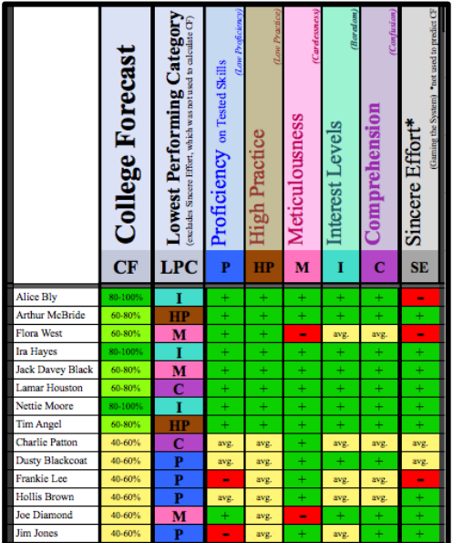
Explanations of specific predictions
Common in outcome prediction systems, as we’ve discussed in past weeks

Slide 36
What might be some attributes
Of an effective design of an explanation for a specific prediction?

Slide 37
What makes a model interpretable: reprise (Liu & Koedinger, 2017)
Facilitated by interpretable and meaningful predictors
Facilitated by designing predictors based on theory
Seems relevant to explaining a prediction too, right?

Slide 38
AI Methods for Explainable AI
Recent work has attempted to explain modern AI models such as deep neural networks (Samek et al., 2018)

Slide 39
AI Methods for Explainable AI
Sensitivity analysis
If we change each of the predictors, which predictor changes most impact the prediction?

Slide 40
AI Methods for Explainable AI
Layer-wise relevance propagation
Which specific predictors/values can maintain the current prediction even if all the other predictors change?

Slide 41
Comments? Questions?

Slide 42
Final note: transparency
The idea that the factors/reasoning underlying the decisions made by algorithms should be inspectable by the people impacted by those algorithms

Slide 43
How closely connected are:
Transparency
Interpretability/Explanability
Can you have transparency without interpretability/explainability?

Slide 44
How transparent is good enough?
Understandable to a machine learning expert/statistician?
Understandable to a teacher or school leader?
Understandable to an 8-year old?

Slide 45
Overall comments or questions?

