Slide 1
Big Data, Education, and Society
September 24, 2021

Slide 2
Reports for School Personnel

Slide 3
We discussed a few systems last week
BrightBytes
Course Signals

Slide 4
Some additional systems

Slide 5
iReady

Slide 6
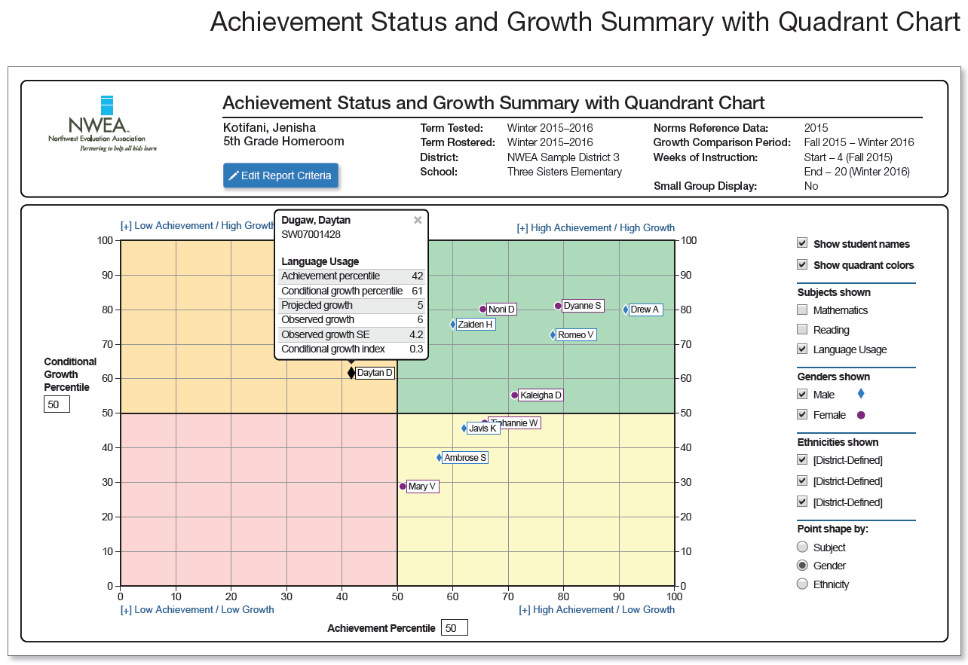
NWEA MAP

Slide 7
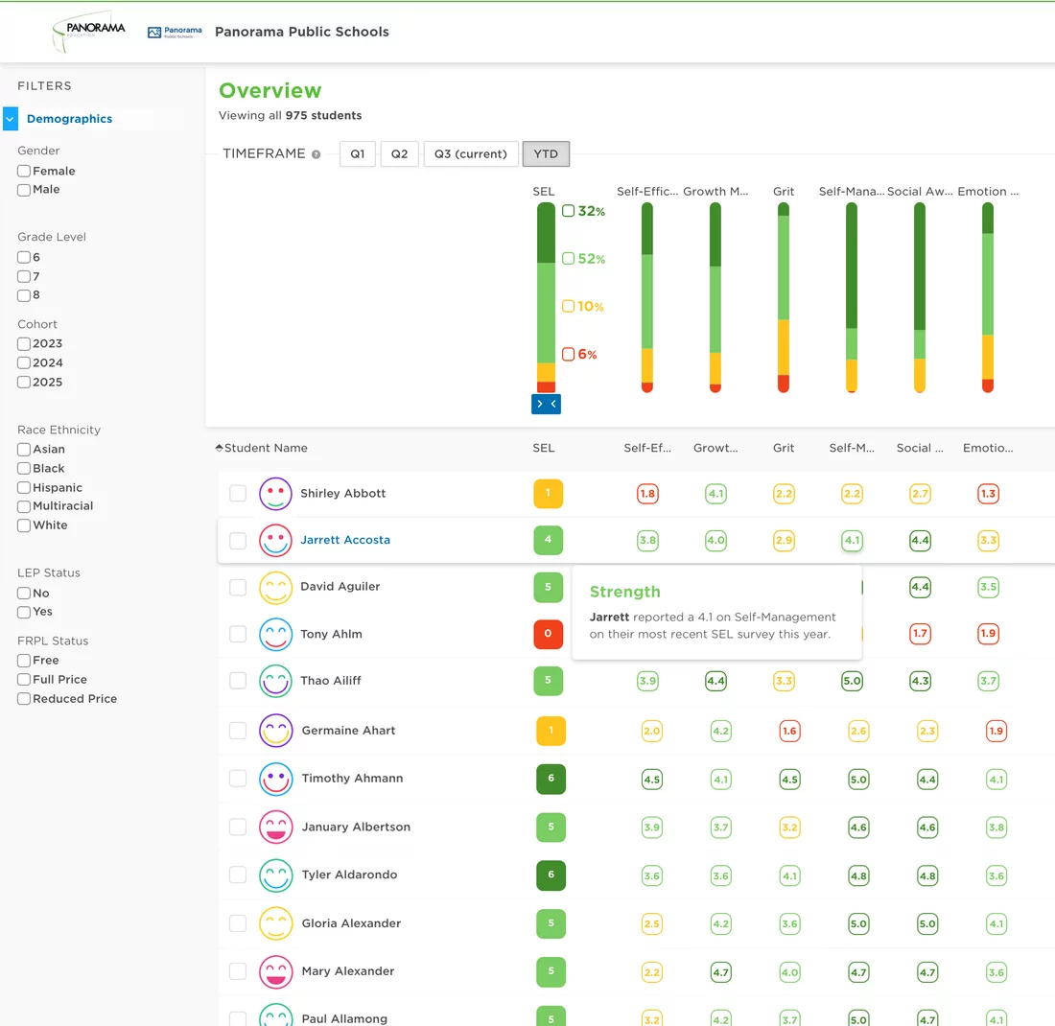
Panorama Education

Slide 8
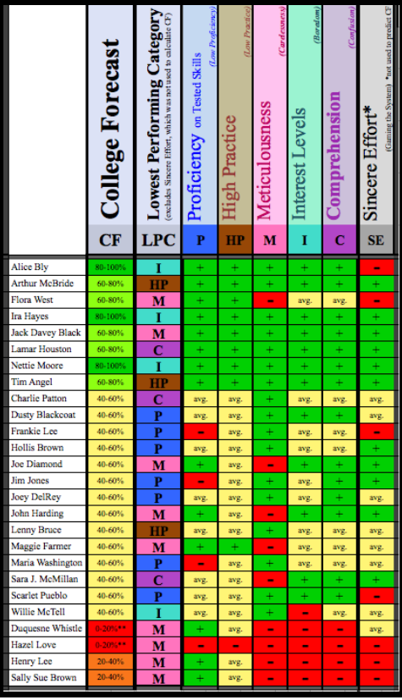
Ocumpaugh et al

Slide 9
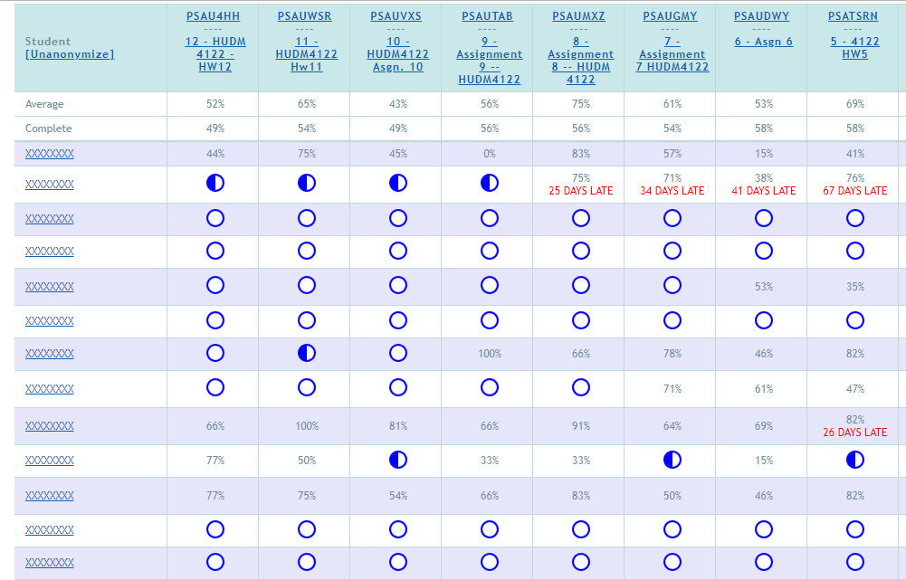
ASSISTments

Slide 10
ASSISTments

Slide 11
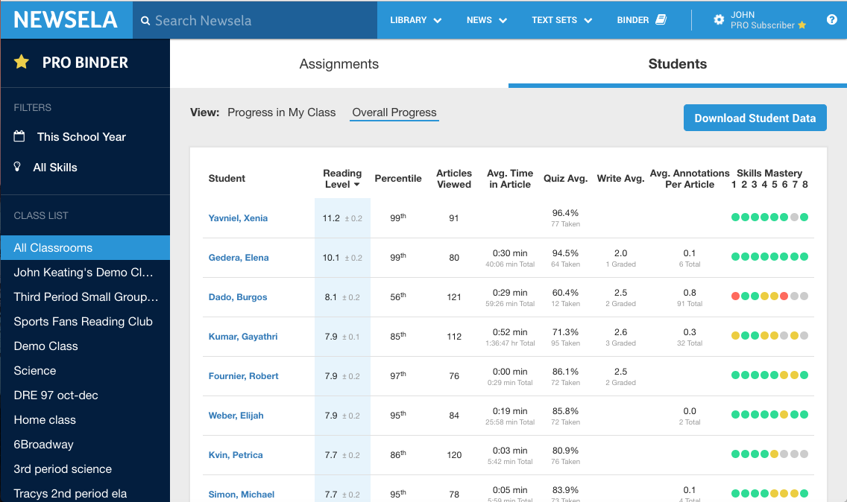
Newsela

Slide 12
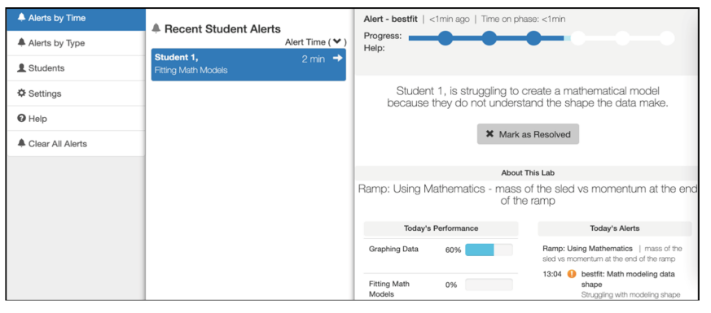
Inq-Blotter

Slide 13
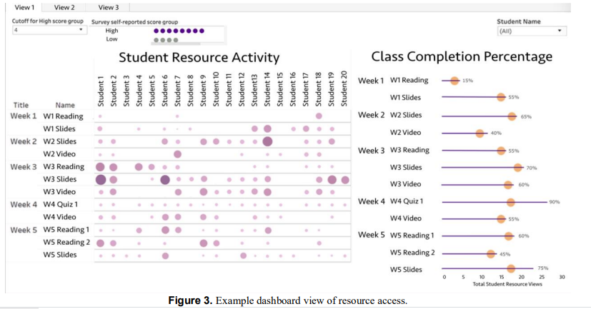
Wise & Jung

Slide 14
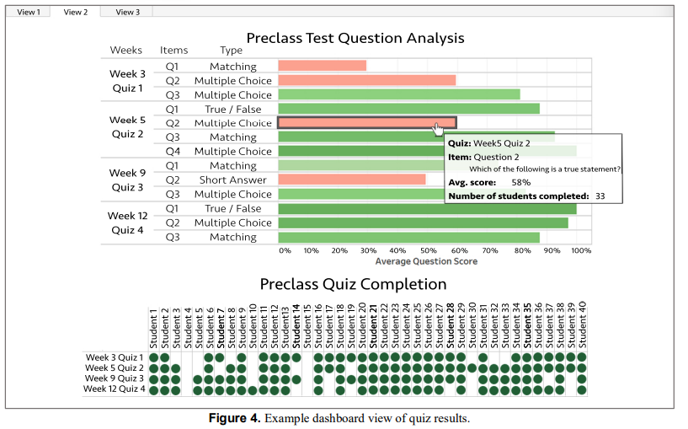
Wise & Jung

Slide 15
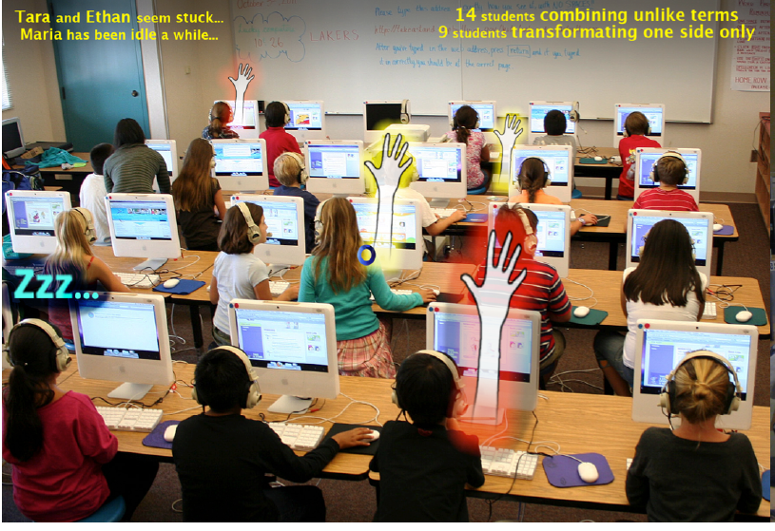
Holstein et al

Slide 16
How teachers use reports: example
https://www.youtube.com/watch?v=kGxQsN0DBUU

Slide 17
How teachers use reports: example
“In this paper, we focus on proactive remediation, dynamically planned intervention by the teacher with one or more students. In a proactive remediation, the teacher decides to provide help to one or more students on a topic that they are not currently struggling with, based on evidence that the student(s) need to learn that topic. The teacher plans such interventions using formative assessment data provided by the tutoring system. Proactive remediation is different from the traditional view of on-task conversations in blended learning [10], where the student discusses the current material being presented in the tutor, with another student or the teacher.” (Miller et al., 2015)

Slide 18
How teachers use reports: example Wise & Jung
Whole-class scaffolding, devoting more attention to explaining specific concepts that were difficult for students: “I [could] even adjust sometimes on the fly during the semester if it seems like students are not learning what they are hoping to learn in the class, or not learning what I think I want them to be learning in the course”
Targeted scaffolding, focusing attention on particular students… who seemed to be disengaged or struggling: “I intervened with them a bit earlier than I might have otherwise as they hadn’t missed so many classes”
Revising the course elements: “There may be an option to get the quizzes out of being a separate activity or to have them be part of the video to make it more engaging”, “It tells us we might need to look at a question again. For example, ‘is this written well?’ or ‘do we need to change the question?’”

Slide 19
How teachers use reports: example Wise & Jung
“Across all three kinds of actions, there was a tendency to take a deficit perspective, taking action based on students not engaging with the materials or materials not receiving attention.”

Slide 20
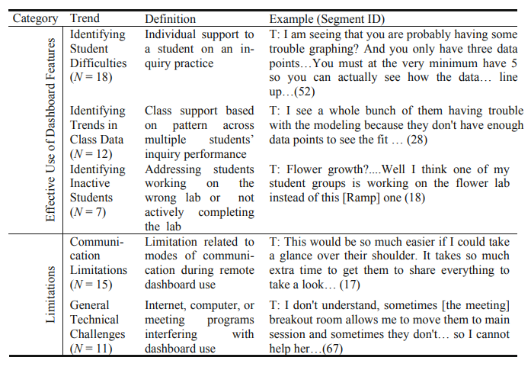
How teachers use reports: example (Dickler et al., 2021)

Slide 21
How teachers use reports: example
Sending emails proposed by the learning system
Sometimes modified
Often sent as-is

Slide 22
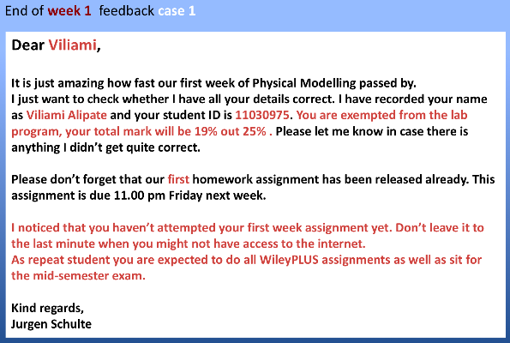
OnTask Learning

Slide 23
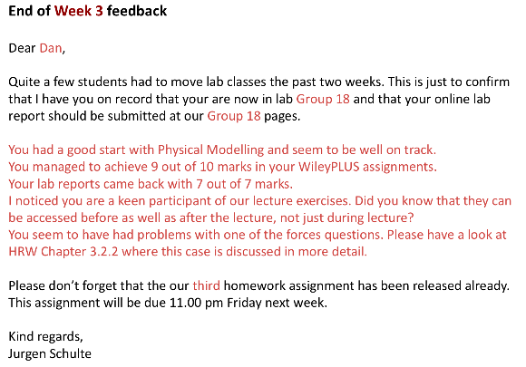
OnTask Learning

Slide 24
Questions? Comments?

Slide 25
Discussion

Slide 26
What are the features of a good report?

Slide 27
What are some things to avoid in designing a report?

Slide 28
How can we support new (better) pedagogical practices using reports?

Slide 29
How could reports reinforce bad pedagogical practices?

Slide 30
What should be different in reports for guidance counselors, principals…
How can we better support stakeholders beyond teachers?

Slide 31
Some tensions in report design (Duncan et al)
Detail versus big picture
Mastery versus progress
Benchmarking between students or with reference to a goal

Slide 32
Questions? Comments?

Slide 33
In a minute, we will go to randomly selected breakout rooms
If there’s time

Slide 34
Design a report
Draw it in powerpoint or google slides or paint or whatever program you want

Slide 35
Group report tasks
For teachers of students using an adaptive homework system for math
For teachers of students using an adaptive flash card system for a foreign language
For teachers of students using a blended learning system in math class
For teachers of students using a history game (such as Civilization) in class

Slide 36
Group report tasks
5. For teachers of students doing a computer-mediated programming project at home (group project in Scratch)
6. For teachers of students practicing the viola at home
7. For the sensei of students practicing tae kwon do in a dojo
8. For teachers of undergraduates doing a group creative writing project (in a system where drafts are instrumented)

Slide 37
Now post your report designs to piazza
No need to write explanations of the report
Just write the context (i.e. the descriptions on the previous two slides)
And post your file or link
Everyone please go to at least one other group’s presentation, take a look, and write comments
If we run out of time to do it in class, just do it in the next session

Slide 38
Questions? Comments?

Slide 39
Assignment 1 is due October 4
Any questions or concerns regarding assignment?

