Slide 1
Big Data, Education, and Society
March 28, 2024

Slide 2
Assignment 3: Risks and Challenges
Any questions on assignment?

Slide 3
Discrimination and the Perpetuation of Bias

Slide 4
Algorithmic Bias (Garcia, 2016)
Nothing to do with the “bias-variance trade-off”, if you’ve ever heard of that
(And if you haven’t don’t worry about it)

Slide 5
What is algorithmic bias?

Slide 6
Definition in Garcia (2016)
When a prediction model implicitly discovers bias in existing decision-making and then perpetuates/systematicizes/extends it

Slide 7
Definition in Friedman & Nussbaum (1996)
Biased computer systems “systematically and unfairly discriminate against individuals or groups of individuals in favor of others.

Slide 8
Definition in Baker & Hawn (2022)
Cases where model performance is substantially better or worse across mutually exclusive groups, separated by non-malleable factors

Slide 9
Comments? Questions?

Slide 10
Key difference between definitions
If algorithms create a new bias or previously-unknown bias
Is it still algorithmic bias?
Baker & Hawn say yes
Friedman & Nussbaum say yes
Garcia says no

Slide 11
Is it a problem?
If algorithms are biased in ways that match well-known societal biases
Anyone disagree with this one?

Slide 12
Is it a problem?
If algorithms are biased in ways that match existing but poorly-understood societal biases
Thoughts?

Slide 13
Is it a problem?
If algorithms are biased in ways that don’t match societal biases
Thoughts?

Slide 14
Another differentiation
Algorithmic bias is found in automated decision-making
Friedman & Nussbaum
Garcia
Algorithmic bias is found in measurement
Baker & Hawn

Slide 15
Is it a problem?
An algorithm makes biased measurements, but the actual decision-making is left to humans
Thoughts?

Slide 16
Algorithmic Bias has a long history

Slide 17
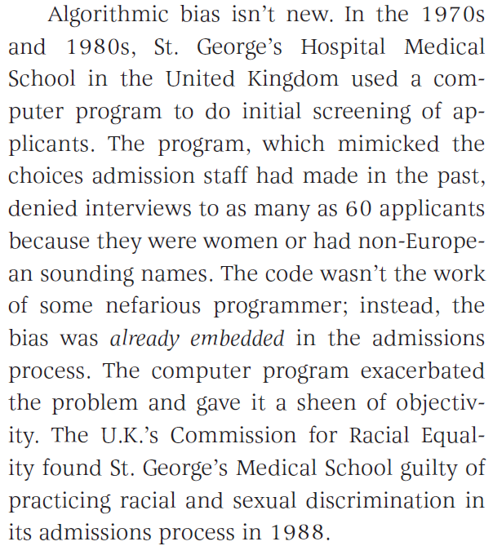
Example (Garcia, 2016)

Slide 18
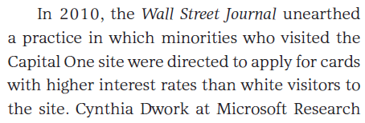
Example (Garcia, 2016)

Slide 19
Example (Corbett-Davies et al., 2017)
For example, when ProPublica examined computer-generated risk scores in Broward County, Fla., in 2016, it found that black defendants were substantially more likely than whites to be rated a high risk of committing a violent crime if released. Even among defendants who ultimately were not re-arrested, blacks were more likely than whites to be deemed risky. These results elicited a visceral sense of injustice and prompted a chorus of warnings about the dangers of artificial intelligence.

Slide 20
Comments? Questions?

Slide 21
Corbett-Davies et al. (2017) argument
Yet those results don’t prove the algorithm itself is biased against black defendants — a point we’ve made previously, including in peer-reviewed research. The Broward County classifications are based on recognized risk factors, like a documented history of violence. The classifications do not explicitly consider a defendant’s race.
Because of complex social and economic causes, black defendants in Broward County are in reality more likely than whites to be arrested in connection with a violent crime after release, and so classifications designed to predict such outcomes necessarily identify more black defendants as risky. This would be true regardless of whether the judgments were made by a computer or by a human decision maker.
It is not biased algorithms but broader societal inequalities that drive the troubling racial differences we see in Broward County and throughout the country. It is misleading and counterproductive to blame the algorithm for uncovering real statistical patterns. Ignoring these patterns would not resolve the underlying disparities.

Slide 22
What are your thoughts on this argument?

Slide 23
Where does algorithmic bias come from?
Action/ Deployment
Actual World
Machine Learning Lifecycle
Model Learning
The Task
Measurement/Data
(Barocas et al., 2019; Cramer et al., 2019; Kizilcec & Lee, 2020)
Notes:
In tracing the origins of bias, the main approach has been to describe the stages of a machine-learning lifecycle and then connect possible forms of bias to each of those stages.
Descriptions of the machine learning pipeline vary, but these are a some of the possible stages that we saw across a few different sources.
Developers creating an algorithmic solution move from the world as it is, to defining a task related to that world, to pulling together or creating a dataset, to defining, training, and testing a model; and finally to putting the model into practice in some manner, whether automated and behind the scenes or as a form of communication to decision-makers.
Throughout this cycle, there are multiple points of entry for bias and a lot of work in CS has attempted to map kinds of bias onto the places where they are most likely to occur in the pipeline.

Slide 24
Where does algorithmic bias come from?
Action/ Deployment
Actual World
Machine Learning Lifecycle
Model Learning
The Task
See review by Kizilcec & Lee (2021)
Measurement/Data
Notes:
Researchers have written extensively about the model learning stage of the lifecycle and how different metrics for fairness can be used to audit models for bias. Kizilcec and Lee have a great review that brings the broader research on modeling from computer science into the education context in a really useful, contextualized way.

Slide 25
Where does algorithmic bias come from?
Action/ Deployment
Actual World
Machine Learning Lifecycle
Model Learning
The Task
Measurement/Data
See review by Baker & Hawn (2022)
Notes:
As a complement, our focus here is more on the role of measurement and data collection as a source of bias, while also consolidating what we know about algorithmic bias in education as it impacts specific groups, and finally on suggesting some broad strategies for mitigating the bias that can arise in the measurement/data collection stage of the machine-learning pipeline.

Slide 26
Bias from Measurement/Data Collection
Representational Bias (Suresh & Guttag, 2020)
Model performs less well for group less represented in training data
Suburban middle-class students ≠ Urban lower-income students
Even a “complete” data set may not be enough if a group is rarely seen in the data set

Slide 27
Bias from Measurement/Data Collection
Measurement Bias (Suresh & Guttag, 2020)
Bias in Training Labels
Judgement by others
Judgement by self
Human coders

Slide 28
Taking a first step: What do we know? (Baker & Hawn, 2022)
Unknown Bias
Known
Bias
Fairness
Equity

Slide 29
What do we know about bias impacting learners in common demographic categories?
“[Industrial] Teams often struggled to anticipate which subpopulations and forms of unfairness they need to consider for specific kinds of ML applications.” (Holstein et al., 2019)
Most educational data mining research does not even mention learner demographics, much less research it (Paquette et al., 2020)

Slide 30
Up-to-date summary
https://www.pcla.wiki/index.php/Algorithmic_Bias_in_Education

Slide 31
Race/ethnicity
Several papers show that educational prediction algorithms perform worse for African-American students and Latino students (Hu & Rangwala, 2020; Anderson et al., 2019; Lee & Kizilcec, 2020)
Including prediction of grades, course failure, graduation, dropout
However, automated essay scoring and self-regulated learning detection found to be largely unbiased (Litman et al., 2021; Zhang et al., 2022)
Almost never enough data to test for biases impacting Native American learners (but see Christie et al., 2019)

Slide 32
Race/ethnicity
Important note: many argue for predicting explicitly based on race, but doing so:
Can actually make model less accurate (Yu et al., 2020, 2021)
Can replicate bias in decisions being made by instructors (i.e. Wolff et al., 2017) – we’ll talk about this example a bit later
Can lead to blatantly discriminatory algorithms that make prediction almost entirely based on race (Feathers, 2022)
For an (unbalanced) in-depth discussion of issue, see (Baker, Esbensahade, Vitale, & Karumbaiah, 2023)

Slide 33
Additional Note
Not including demographic variables as predictors is sometimes referred to as fairness through unawareness
However, other variables can secretly act as proxies for demographic variables
So fairness through unawareness is by itself insufficient

Slide 34
Gender
Mixed complicated results for gender – has been studied several times
But sometimes models seem to be biased against female students (Gardner et al., 2019; Yu et al., 2020, 2021; Verdugo et al., 2022)
And sometimes models seem to be biased against male students (Hu & Rangwala, 2020; Anderson et al., 2019; Lee & Kizilcec, 2020; Yu et al., 2021)

Slide 35
Nationality
On a test of foreign language proficiency, one system inaccurately gave Arabic and Hindi-speaking students lower scores than human essay raters. (Bridgeman et al., 2012)
Models of help-seeking built using data from learners in the Philippines, Costa Rica, and the United States were each more accurate on students from their own countries than for students from other countries. (Ogan et al., 2015)
Models predicting standardized examination scores trained on data from the USA were more accurate for students in economically developed countries than students in less economically developed countries (Li et al., 2021)

Slide 36
Also evidence for algorithmic bias in education in terms of
Socioeconomic status (Yudelson et al., 2014; Yu et al., 2020)
Native language (Naismith et al., 2018; Sha et al., 2021)
Disabilities (Loukina et al., 2018; Riazy et al., 2020)
Urbanicity (Ocumpaugh et al., 2014)
Parental Educational Background (Kai et al., 2017)
Parent in military (Baker et al., 2020)

Slide 37
What do we know about bias impacting other groups?
Insufficient research -- there needs to be more
Do we even know about all the groups that are impacted?

Slide 38
What do we know about bias impacting other groups?
Insufficient research -- there needs to be more
Do we even know about all the groups that are impacted?
Majority of empirical evidence for algorithmic bias in education published by researchers in USA (Baker, Hawn, & Lee, 2023)
We need to learn more about algorithmic bias worldwide

Slide 39
Other takeaways
Models trained on one group of learners generally perform more poorly for new groups.
Investigation of bias for many groups still needed, e.g. indigenous learners, non-standard dialects, specific disabilities, non-binary and transgender learners, religious minorities.
Collecting and training on a diverse sample of students can help.

Slide 40
Thoughts? Questions?

Slide 41
Steps towards preventing algorithmic bias
Actually look for it (Paquette et al., 2020)
Depends on collecting the necessary data (Baker & Hawn, 2022)

Slide 42
Steps towards preventing algorithmic bias
Make sure data sets are actually representative

Slide 43
Steps towards preventing algorithmic bias
Avoid using demographic variables as predictors (GPDR)
Broaden the community of people developing models (Garcia, 2016)
Predict outcomes that are not biased – example given of predicting violent crime (less biased) instead of predicting all crime (more biased) (Corbett-Davies et al., 2017)

Slide 44
Steps towards preventing algorithmic bias
“Right to explanation” (GPDR)
Inspect model outcomes for bias
Do visibly biased outcomes result? (Garcia, 2016)
Is the model more biased than its training data?
Openness as to model internals and predictions (Garcia, 2016)

Slide 45
Steps towards preventing algorithmic bias
Create guidelines for demonstrating a technology is not biased
During publication
Prior to use by school district

Slide 46
Steps towards preventing algorithmic bias
Tools for conducting analyses on full data including demographics while preventing download of PII

Slide 47
Steps towards preventing algorithmic bias
If the data is present, and the willingness is present
The technical aspects of fixing algorithmic bias actually aren’t that difficult – lots of good technical methods (Kizilcec & Lee, 2021; Yu et al., 2024)

Slide 48
Which of these steps are practically feasible in learning analytics?
And which aren’t?
Why/why not?

Slide 49
Open University UK situation

Slide 50
Open University UK situation
How should they have addressed the problem?

Slide 51
Comments? Questions?
In a minute, we are going to switch to a group activity, and we’ll end the class with that
Are there any comments/questions before we do that?

Slide 52
Assemble into pairs from different project groups
Ten minutes per project
Briefly remind your conversation partner of your semester project
Discuss how could your proposed innovation become problematic or damaged due to algorithmic bias
Either actual or perceived?
What, if anything, could you do to mitigate that risk?

Slide 53
Upcoming sessions
Apr 4 Implementation Fidelity
Apr 5 Project Assignment 3 first draft due
Apr 8 VIVI-SD 4 due
Apr 11 Student Privacy
Apr 12 Project Assignment 3 final version due
Apr 15 VIVI-SD 5 due
Apr 18 Interpretability (both sections virtual)
Apr 22 VIVI-SD 6 due
Apr 25 Beneficence

