Slide 1
Big Data, Education, and Society
February 1, 2024

Slide 2
Vivi-SD
Now that hopefully we’ve sorted out groups a little better
How did it work for you?
Next Vivi-SD: different groups but hopefully less chaos?
Thanks for your patience

Slide 3
Project Proposal
Does anybody not have a group yet?

Slide 4
Project Proposal
Other questions? Concerns?

Slide 5
At-Risk Predictions

Slide 6
Examples of Use (at scale)
Civitas, Course Signals, Zogotech – At-risk prediction models used to provide actionable information to instructors and academic advisors
Who is likely to fail a course or drop out, and why
College

Slide 7
Examples of Use (at scale)
Google (BrightBytes), Clever, Infinite Campus, Chicago School Consortium – At-risk prediction models used to predict which students will drop out instead of graduate, to inform interventions by teachers and guidance counselors
High School

Slide 8
BrightBytes

Slide 9
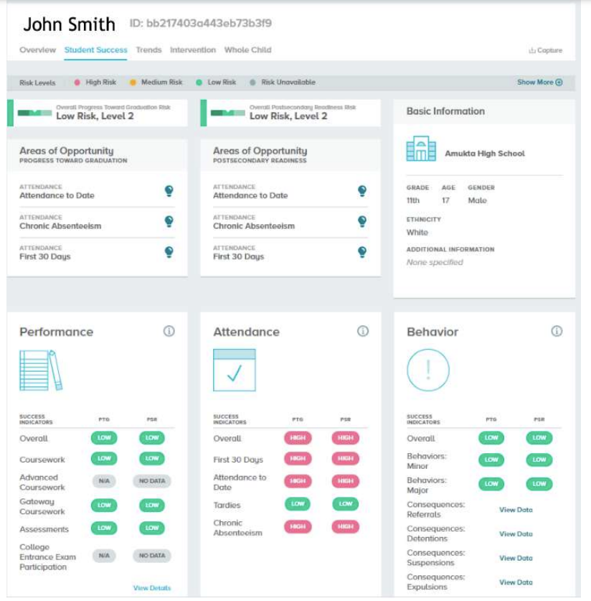
BrightBytes

Slide 10
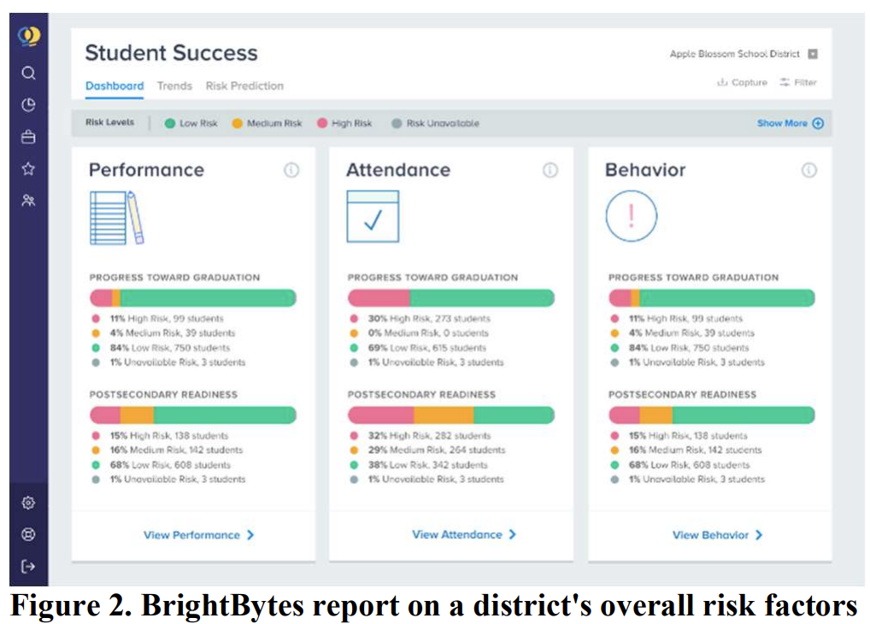

Slide 11
Civitas Learning

Slide 12
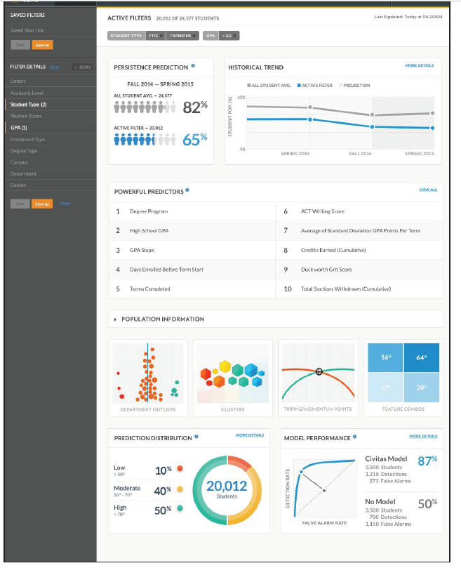

Slide 13
Purdue->Ellucian Course Signals

Slide 14
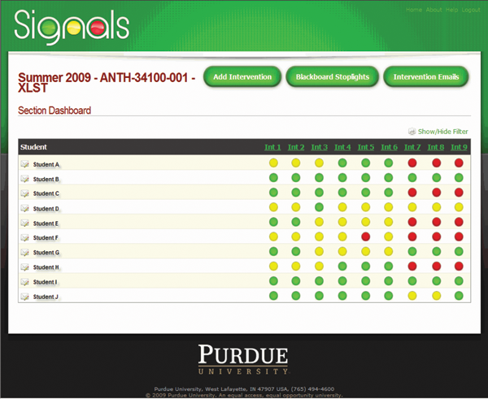

Slide 15
Evidence for reduced rate of failure/dropout
(Arnold, 2010; Arnold & Pistilli, 2012)
Some debate on this (e.g. Essa, 2013)
(Milliron et al., 2014)
(Hlosta et al., 2021)
Often depends on how you look at the data and what variables are controlled for (Dawson et al., 2017)
Review argues that more rigorous and large-scale evidence needed (Ifenthaler & Yau, 2020)

Slide 16
Real-world use
Relatively sophisticated machine learning algorithms used in the real world (Christie et al., 2019; Coleman et al., 2019; Coleman, 2021)

Slide 17
Recent work
Increased attention to whether there is presence of algorithmic bias – algorithms that are less effective for historically underrepresented learners (Christie et al., 2019; Coleman, 2021)
We will discuss this issue in detail on Mar. 28
Using demographic variables as predictors can worsen algorithmic bias (Baker et al., 2023)

Slide 18
What are some potential predictors that a student is at-risk? (K-12 or college)

Slide 19
Let’s review these indicators

Slide 20
Which of these indicators are creepy?

Slide 21
Which of these indicators are actionable?

Slide 22
Which of these indicators are readily feasible to obtain?

Slide 23
More broadly…

Slide 24
What are some ways we could use an at-risk prediction?

Slide 25
What are some other types of risk in education that we could predict?

Slide 26
Let’s get into groups of ~3
For 10 minutes
What are the benefits and risks of using at-risk prediction?

Slide 27
Any thoughts you’d like to bubble up to the full group?
From your discussion

Slide 28
Other Questions? Comments? Further thoughts?

Slide 29
Any comments or questions about the readings?

Slide 30
Final thoughts or questions?

Slide 31
Upcoming sessions
Feb 8 VIRTUAL. Reports for School Personnel
Feb 12 VIVI-SD 2 Due
Feb 15. Reports for Parents
Feb 16 Project Assignment 1 due
Feb 19 Project Assignment 1 posts due
Feb 22 VIRTUAL. Automated Intervention
Feb 26 VIVI-SD 3 Due
Feb 29 Validity
Mar 7 NO CLASS SPRING BREAK

