Slide 1
Big Data, Education, and Society
April 11, 2024

Slide 2
Assignment 3:
Risks and Challenges
Any questions on assignment?

Slide 3
Privacy and the
Perception of Malevolence

Slide 4

Privacy and the
Perception of Malevolence

Slide 5
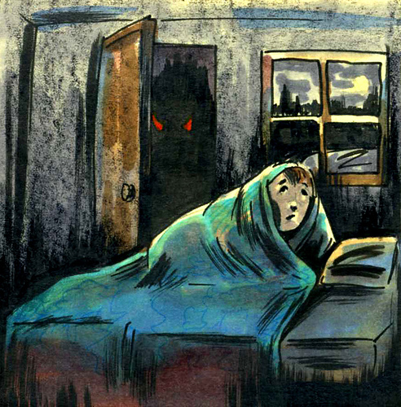
Privacy and the
Perception of Malevolence

Slide 6
Let’s start with
A couple of controversies
Getting to be a bit back in time
But a key early influence on how things still are today

Slide 7
2012
Prof. Shaundra Daily, at Clemson University, did a research trial of Galvanic Skin Response bracelets in Alabama classrooms
A 1-paragraph blurb was placed on the Gates Foundation website

Slide 8
The Paragraph
“Purpose: to work with members of the Measuring Effective Teachers (MET) team to measure engagement physiologically with Galvanic Skin Response (GSR) bracelets which will determine the feasibility and utility of using such devices regularly in schools with students and teachers”
A basic research project studying whether engagement can be detected with GSR bracelets in schools

Slide 9
The Response (1)
“Gates Foundation: one more step into the dystopian future with electronic bracelets for students & teachers…
Put a Galvanic Skin Response (GSR) bracelet on every kid in the class and you can measure teacher effectiveness in keeping their attention.
Maybe the next step is for the bracelet to zap them with electric current when their attention wanders.
And then the next generation will be the Galvanic Skin Response bracelet on every teacher–to zap her when she veers from the Common Core curriculum. Then. . . bring on the drones to eliminate such teachers.”
– Leonie Haimson, NYC blogger and non-profit director

Slide 10
The Response (2)
“What can I say? Shades of Brave New World.
Which district will be first to put the bracelets on their students and teachers? Will charter school students have to wear them, or only children in public schools? Who will pay for them? Will schools raise money by selling the data to Amazon and Google and other data-mining corporations? Have we lost all common sense?” –
Diane Ravitch, Former U.S. Assistant Secretary of Education

Slide 11
The Response (3)
“Let’s see now. The teacher who keeps the class in a state of high anxiety gets points on the “effectiveness” scale. The teacher whose students are feeling at ease in the classroom will get a low rating.
If this reader saw through this flaw, why did no one at the Gates Foundation?”
“I personally object to the Big Brother aspect of the project, as well as to the suggestion that “learning” can be measured by physiological reactions rather than by that yet-unmeasurable thing called understanding.”
“This is getting to sound more like “1984″ every time someone steps up to defend this unethical invasion of children’s bodies.”
-- Diane Ravitch, Former U.S. Assistant Secretary of Education

Slide 12
The Response (3):
Comments on Ravitch Blog post
“Bill and Melinda Gates are engaging in all kinds of “scientific” experiments on the “little folk” through their malanthropic foundation.”
“Those criminals – the Gates – portray themselves as the super heroes we were waiting for to save our education system. They seem to like authoritarianism sadistic cruel environment in which people obey and fulfill their function as submissive parts in the crony capitalistic machine the Gates are running. ”
“I could see it bundled with a lithium powered cattle prod, and you’ve got it. Call it the I-Prod.”
“Let’s hope it also is provides indisputable proof of the danger which undisciplined megalomaniacs like Gates pose to the evolution of mankind and highly principled civilized society.”
“This research should be deemed immoral and illegal not handsomely rewarded. Melinda and Bill should go to jail for funding it.”

Slide 13
The Response (4):
Video segment on Glenn Beck show
“Is Big Data Big Brother?”
[video segment no longer available online]

Slide 14
The Response (5):
Additional commentary and response
Right-wing politicians
White nationalist groups

Slide 15
Notes
Not a “left” or “right” political issue
Seen across the traditional political spectrum

Slide 16
Thoughts? Questions? Comments?

Slide 17
The failure of InBloom
Timeline
Abbreviated from https://www.studentprivacymatters.org/inbloom-timeline/
  Not exactly a neutral source, but relatively factual on dates

Slide 18
Timeline
May 2011 – NYS approves no-bid contract with Wireless Generation for state educational data system, shortly after NYC school chancellor moves to WG – media becomes interested
July 2011 – Political campaign – led by Democratic and left-leaning bloggers including Leonie Haimson -- against WG contract due to Rupert Murdoch/News Corp ties and ongoing News Corp phone-hacking scandal in UK
August 2011 – NYS Comptroller vetoes WG contract due to News Corp ties
August 2011 – Gates Foundation announces “Shared Learning Collaborative”, a system that will recommend learning resources to students and support transmission of student data between U.S. states – when a student moves to a new state for instance
December 2011 – NYS approves new state educational data system to be paid for by Gates Foundation; shortly after, announcement by Gates Foundation that WG will build this state data system

Slide 19
Timeline
October 2012 – Leonie Haimson holds press conference in NYC demanding details of contract, public hearing, and consent by each parent for data storage
October 2012 – Gates Foundation announces that parental opt-out will be allowed by platform
November 2012 – SLC name changes to InBloom
December 2012 – Gates Foundation states that each school district should decide if parents are allowed to opt-out
January 2013 – Louisiana, Kentucky, Georgia, North Carolina, Delaware, Illinois, Colorado, Massachusetts join InBloom

Slide 20
Timeline
February 2013 – Bloggers and activists, including Diane Ravitch, generally become interested in InBloom
March 2013 – Gigantic expensive party at SXSW announcing InBloom
March 2013 – First mainstream media coverage of InBloom

Slide 21
Timeline
March 2013 – Introduction of legislation in NY state against sharing educational data without explicit parental consent; weaker legislation allowing opt-out later approved
April 2013 – Louisiana withdraws from InBloom
May 2014 – Georgia, Delaware, Kentucky withdraw from InBloom
August 2013 – North Carolina withdraws from InBloom
October 2013 – Several NY school districts refuse state and federal funding in order to withdraw from InBloom; demand their data be deleted
November 2013 – InBloom client school board in Colorado lose election; Illinois and Colorado withdraw from InBloom

Slide 22
Timeline
February 2014 – New York State announces it will still share data with InBloom
March 2014 – NYS legislature adds amendment to state budget bill banning state from providing educational data to any company that will use data in educational dashboard
April 2014 – NYS withdraws from InBloom
April 2014 – InBloom folds after several tens of millions spent

Slide 23
Timeline
February 2014 – New York State announces it will still share data with InBloom
March 2014 – NYS legislature adds amendment to state budget bill banning state from providing educational data to any company that will use data in educational dashboard
April 2014 – NYS withdraws from InBloom
April 2014 – InBloom folds after several tens of millions spent
The US hasn’t really seen a national school data initiative since

Slide 24
Today
Different states have different data systems – many states offload data storage responsibility to individual districts and provide data standards which are broadly ignored, leading to highly inconsistent data between districts
Schools use data dashboards in NY State, but at a district-by-district level

Slide 25
Thoughts? Questions? Comments?

Slide 26
Should parental opt-out be part of school data systems?
What are the arguments for/against?

Slide 27
Educational Data Breaches have happened
(review in Klose et al., 2020)
Edmodo breach of all data – malevolent use of emails and passwords
Breach of Naviance data in one county by a student – no known malevolent use of data
Three breaches of student registration platforms in China used for identity theft
So far no stories about interaction log data being misused

Slide 28
What do students think about privacy in learning applications?
(Arnold & Sclater, 2017)
Focus on higher ed

Slide 29
What do students think about privacy in learning applications?
(Arnold & Sclater, 2017)
i) Would you be happy for data on your learning activities
to be used if it kept you from dropping out or helped you
get personalized interventions?
ii) Would you be happy for your data to be used if it helped
improve your grades?
iii) Would you be happy to have your data visualized
through an app where you can look to compare with
your classmates?

Slide 30
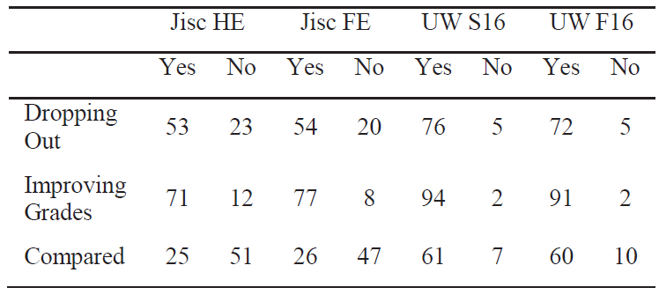
What do students think about privacy in learning applications?

Slide 31
Note
The first item was not very well-designed
But still…
Should we be withholding effective interventions from students who do not think they are worth the privacy cost?
Is it ethical to provide interventions in these cases, even very gentle ones?
Is it ethical to not provide interventions in these cases?

Slide 32
Questions? Comments?

Slide 33
Baker (2023)
Notes that demographic data is needed to find and fix algorithmic bias
So there is a clear trade-off between privacy and fixing algorithmic bias

Slide 34
Thoughts? Comments?

Slide 35
Is deidentification a solution for research?
(Khalil & Barnes, 2016)
The goal of deidentification is to make it impossible to link a student back to their individual data

Slide 36
Is deidentification truly possible?
ASSISTments twitter example
Research demonstration of re-identification of class using newspaper article about field trip (Yacobson et al., 2019)

Slide 37
Some approaches
Anonymization: removing all identifying information (but did we successfully remove it all?)
De-identification: switching identifying information to a code (so the same student can still be linked within data)
K-anonymization: at least K individuals must share set of pre-defined attributes for data to be released
Blurring: reducing data precision or quality to minimize identification risk
  Changing values to range subcategories
  Adding noise to values
  Adding random data to proportion of fields

Slide 38
“Strictly guarded key”
(Draschler & Geller, 2016)
If there is legitimate value to being able to re-link educational data
For example, to allow longitudinal follow-up on the effectiveness of an intervention
Or to understand how student behavior now (or other variables) correlates to long-term outcomes
Perhaps the solution is to provide the re-identification key to a trusted intermediary, with strict rules for when data can be linked
This is the PSLC DataShop’s approach (Koedinger et al, 2010)

Slide 39
Ban all linkage of data sets
On the other side
Yacobsen et al. (2019) call for banning all linkage between data sets, to avoid reidentification
  For example, (Almeda & Baker, 2020) linked interaction data from ASSISTments to LinkedIn data
  To determine which forms of disengagement have longitudinal impact on student achievement (job)

Slide 40
Minimize all additional information (Klose et al., 2020)
To reduce any possible risk of re-identification attacks
How do we decide in advance which information creates too high a risk, and what information is potentially useful?

Slide 41
Thoughts? Comments? Questions?

Slide 42
Trade-offs
There is a clear trade-off here, which we will return to in our discussion of beneficence
Many steps to increase data security and protect privacy…
reduce potential benefit for students in terms of research and intervention
Where is the right trade-off?
  Different policy and social conventions around this in different societies and for different age groups

Slide 43
Questions? Comments?

Slide 44
Upcoming sessions
Apr 5 Project Assignment 3 first draft due
Apr 8 VIVI-SD 4 due
Apr 11 Student Privacy
Apr 12 Project Assignment 3 final version due
Apr 15 VIVI-SD 5 due
Apr 18 Interpretability (both sections virtual)
Apr 22 VIVI-SD 6 due
Apr 25 Beneficence
May 2 Big Data, Big Science, and Longitudinal Follow-up
May 9 Final Project Presentations

