Slide 1
Big Data, Education, and Society
February 8, 2024

Slide 2
Reports for School Personnel

Slide 3
We discussed a few systems last week
BrightBytes
Course Signals

Slide 4
Some additional systems with reports for school personnel

Slide 5
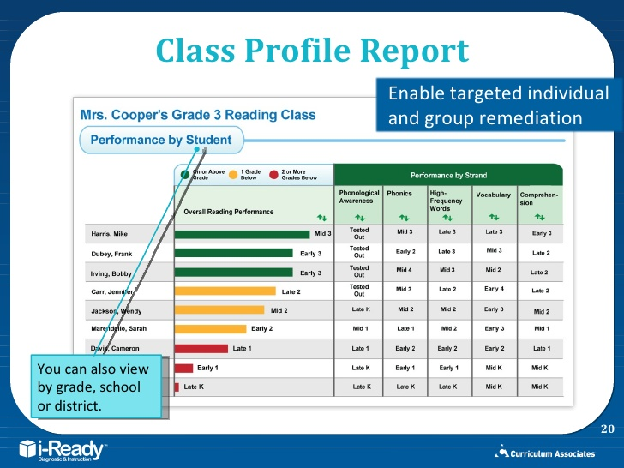
iReady

Slide 6
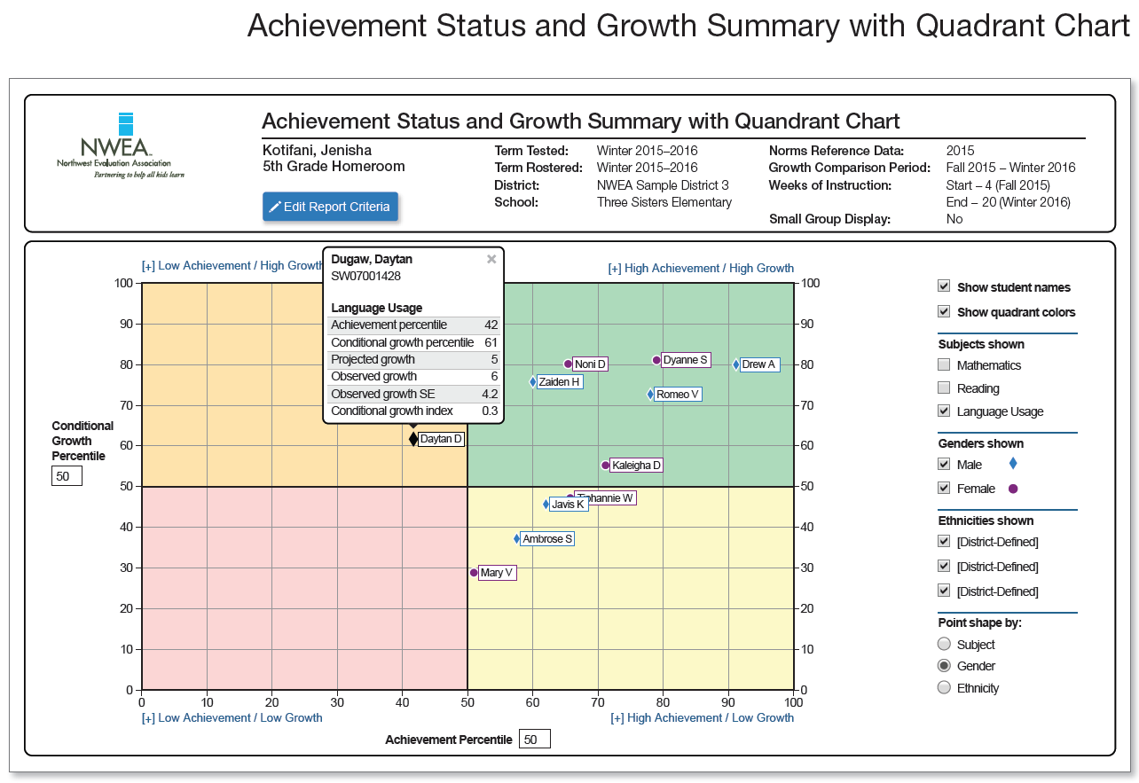
NWEA MAP

Slide 7
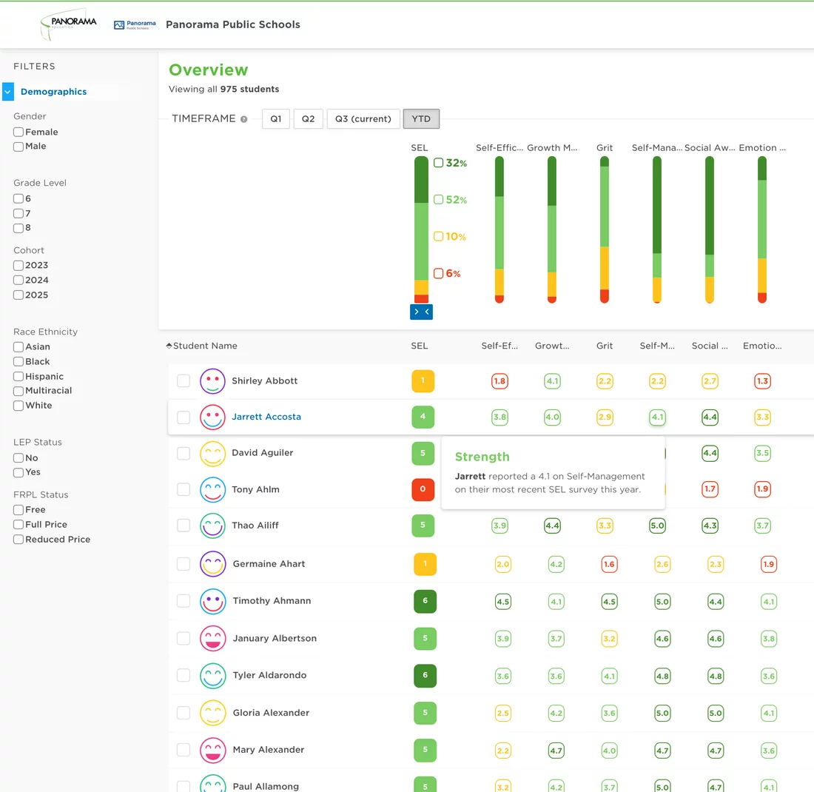
Panorama Education

Slide 8
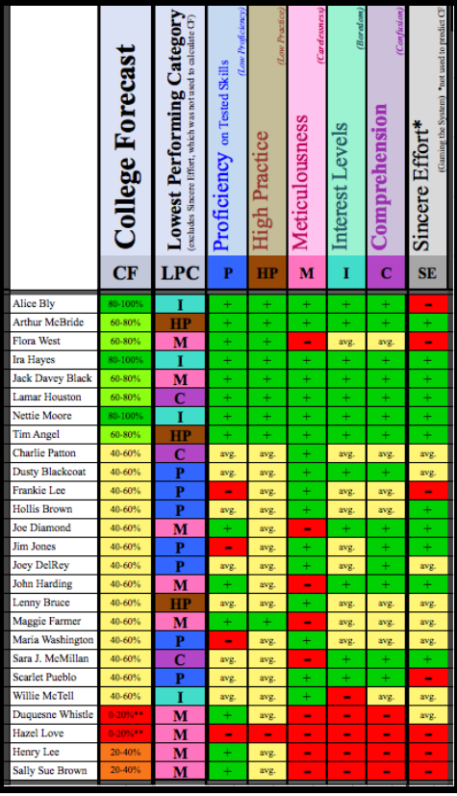
Ocumpaugh et al

Slide 9
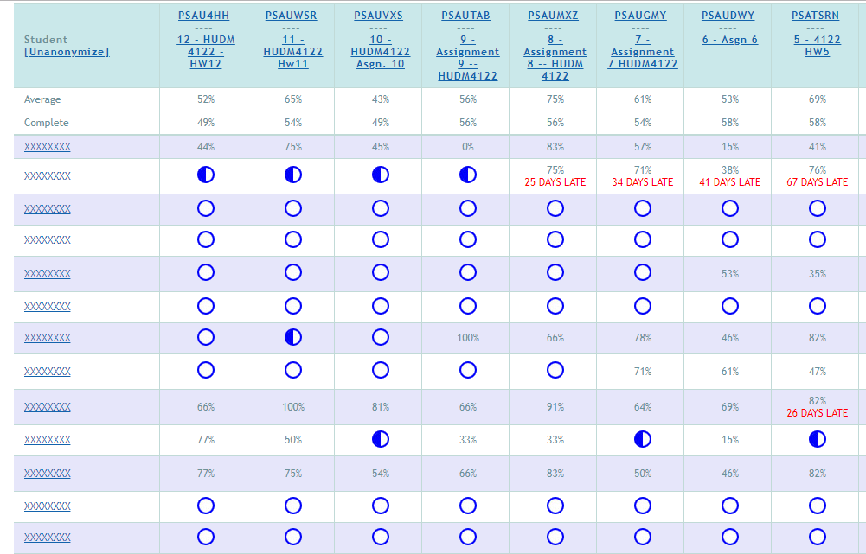
ASSISTments

Slide 10
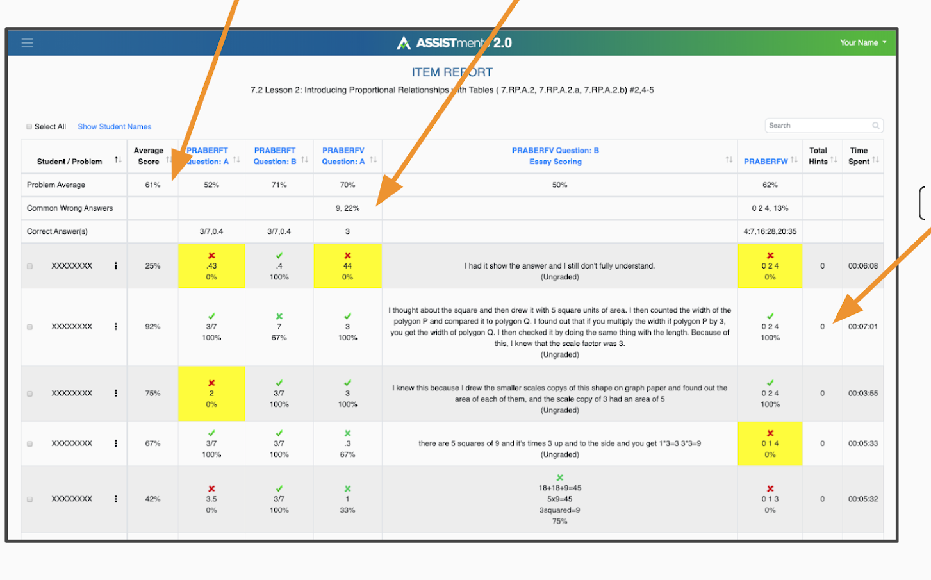
ASSISTments

Slide 11
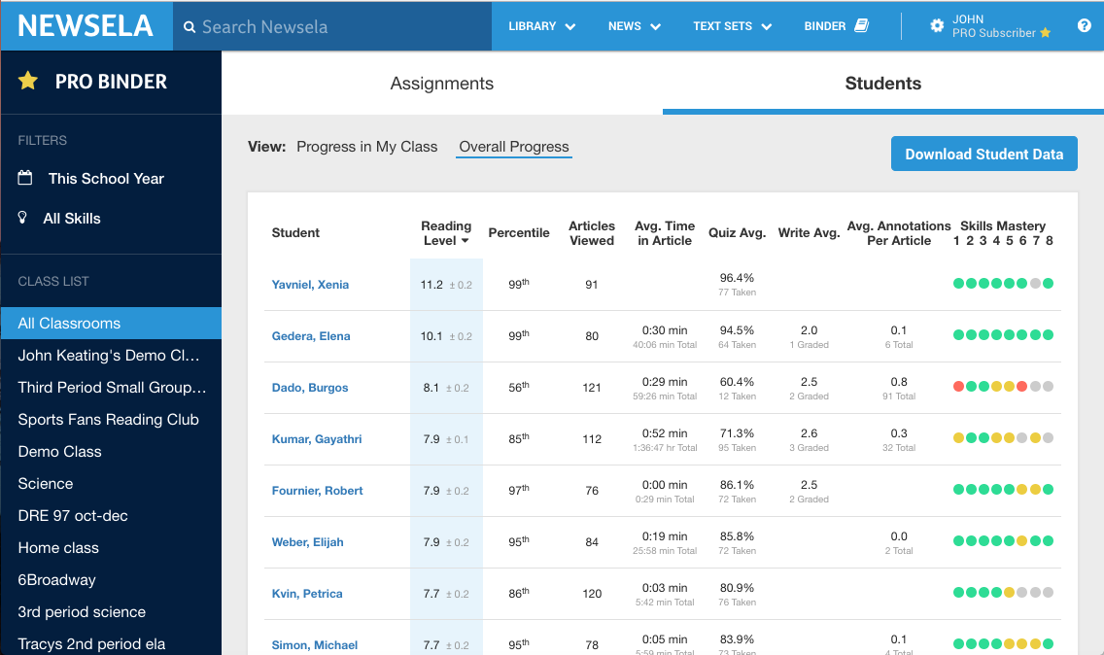
Newsela

Slide 12
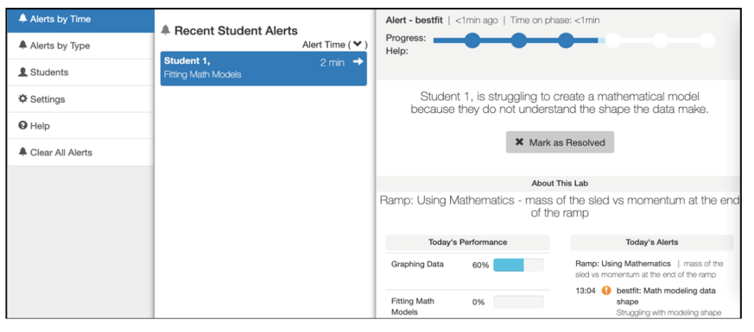
Inq-Blotter

Slide 13
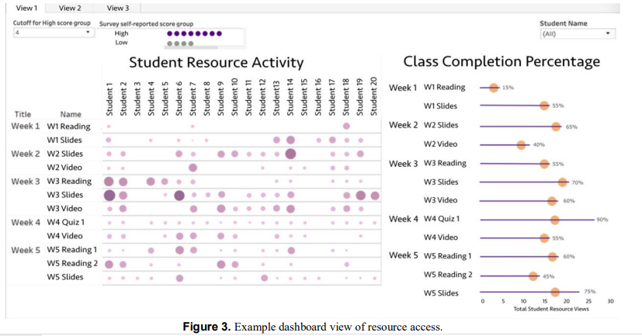
Wise & Jung

Slide 14
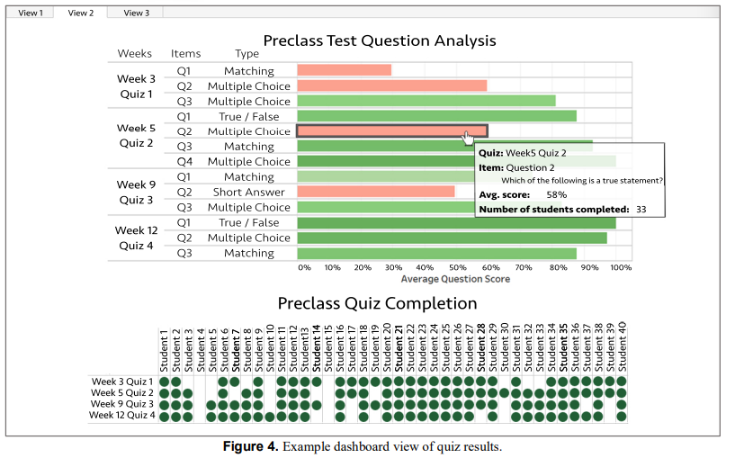
Wise & Jung

Slide 15
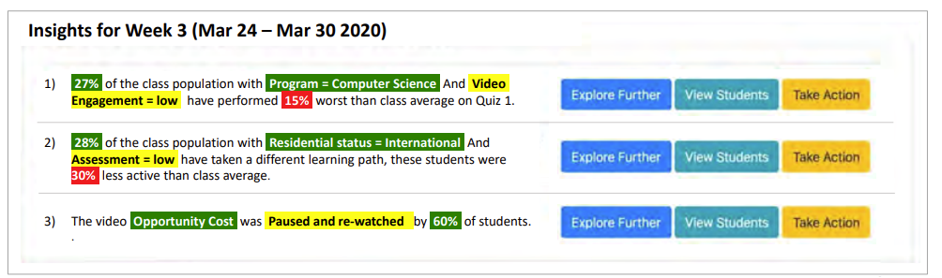
Khosravi et al. 2021
Discover groups of students with biggest difference in behavior or performance from rest of class
Scaffold instructor in understanding why and/or taking action

Slide 16
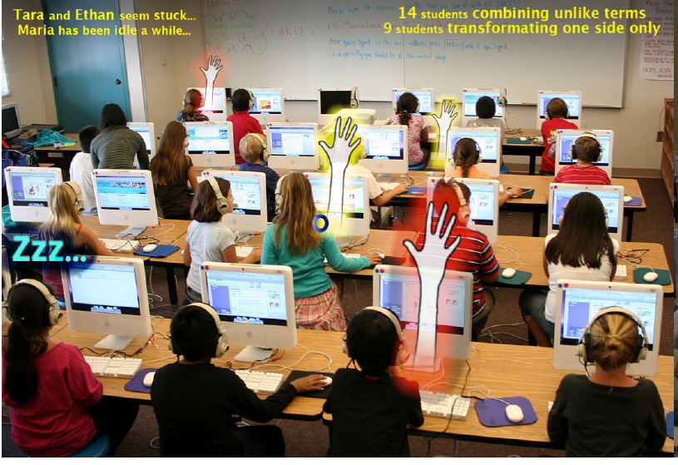
Holstein et al

Slide 17
How teachers use reports: example
https://www.youtube.com/watch?v=kGxQsN0DBUU

Slide 18
How teachers use reports: example
“In this paper, we focus on proactive remediation, dynamically planned intervention by the teacher with one or more students. In a proactive remediation, the teacher decides to provide help to one or more students on a topic that they are not currently struggling with, based on evidence that the student(s) need to learn that topic. The teacher plans such interventions using formative assessment data provided by the tutoring system. Proactive remediation is different from the traditional view of on-task conversations in blended learning [10], where the student discusses the current material being presented in the tutor, with another student or the teacher.” (Miller et al., 2015)

Slide 19
How teachers use reports: example
Wise & Jung
Whole-class scaffolding, devoting more attention to explaining specific concepts that were difficult for students: “I [could] even adjust sometimes on the fly during the semester if it seems like students are not learning what they are hoping to learn in the class, or not learning what I think I want them to be learning in the course”
Targeted scaffolding, focusing attention on particular students… who seemed to be disengaged or struggling: “I intervened with them a bit earlier than I might have otherwise as they hadn’t missed so many classes”
Revising the course elements: “There may be an option to get the quizzes out of being a separate activity or to have them be part of the video to make it more engaging”, “It tells us we might need to look at a question again. For example, ‘is this written well?’ or ‘do we need to change the question?’”

Slide 20
How teachers use reports: example
Wise & Jung
“Across all three kinds of actions, there was a tendency to take a deficit perspective, taking action based on students not engaging with the materials or materials not receiving attention.”

Slide 21
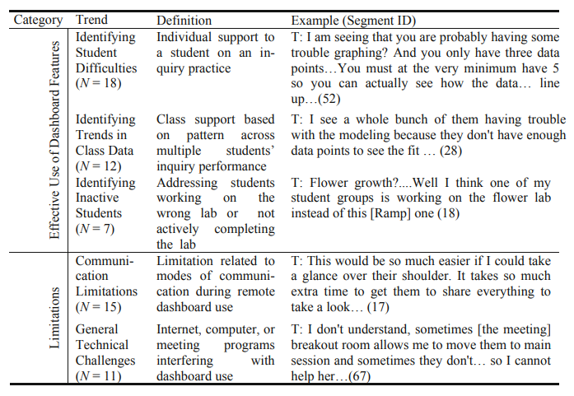
How teachers use reports: example
(Dickler et al., 2021)

Slide 22
How teachers use reports: example
Sending emails proposed by the learning system
  Sometimes modified
  Often sent as-is

Slide 23
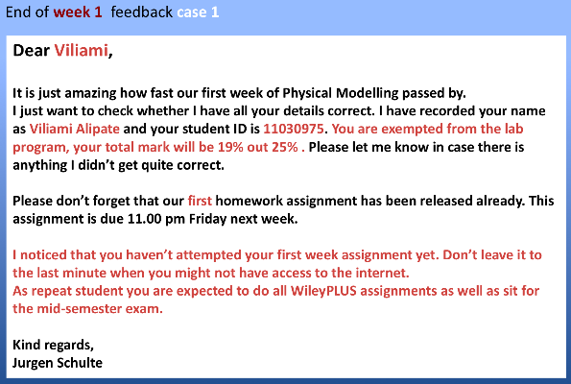
OnTask Learning

Slide 24
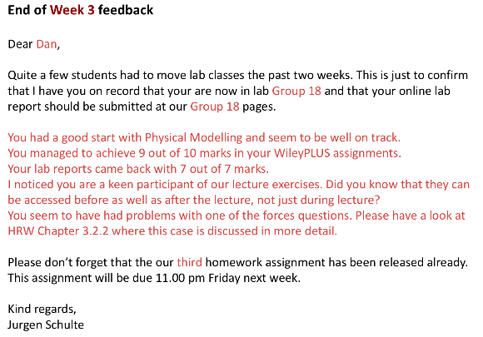
OnTask Learning

Slide 25
Questions? Comments?

Slide 26
Discussion

Slide 27
What are the features of a good report?

Slide 28
What are some things to avoid in designing a report?

Slide 29
How can we support new (better) pedagogical practices using reports?

Slide 30
How could reports reinforce bad pedagogical practices?

Slide 31
What should be different in reports for guidance counselors, principals…
How can we better support stakeholders beyond teachers?

Slide 32
Some tensions in report design
(Duncan et al)
Detail versus big picture
Mastery versus progress
Benchmarking between students or with reference to a goal

Slide 33
Questions? Comments?

Slide 34
Upcoming sessions
Feb 12 VIVI-SD 2 Due
Feb 15. Reports for Parents
Feb 16 Project Assignment 1 due
Feb 19 Project Assignment 1 posts due
Feb 22 VIRTUAL. Automated Intervention
Feb 26 VIVI-SD 3 Due
Feb 29 Validity
Mar 7 NO CLASS SPRING BREAK
Mar 14 Rational Modeling and Model Validity
Mar 15 Project Assignment 2 first draft due

