Slide 1
Big Data, Education, and Society
February 15, 2024

Slide 2
Questions about assignment?
Due *tomorrow*
Post on discussion forum
Do not forget to post in response to your classmates

Slide 3
Quick vote
Would you like to now pick your VIVI-SD groups for rest of semester? (starting asgn 4)
Or stay with current system?
I will aggregate vote across both sections and let you know results

Slide 4
Parent reporting

Slide 5
Parent reporting
What do parents usually get from schools?

Slide 6
Parent reporting
Subject-level grades
Percentile scores for subjects overall
Uninterpretable competencies with 1-3 scores
Your child was absent
Your child is behind on school work

Slide 7
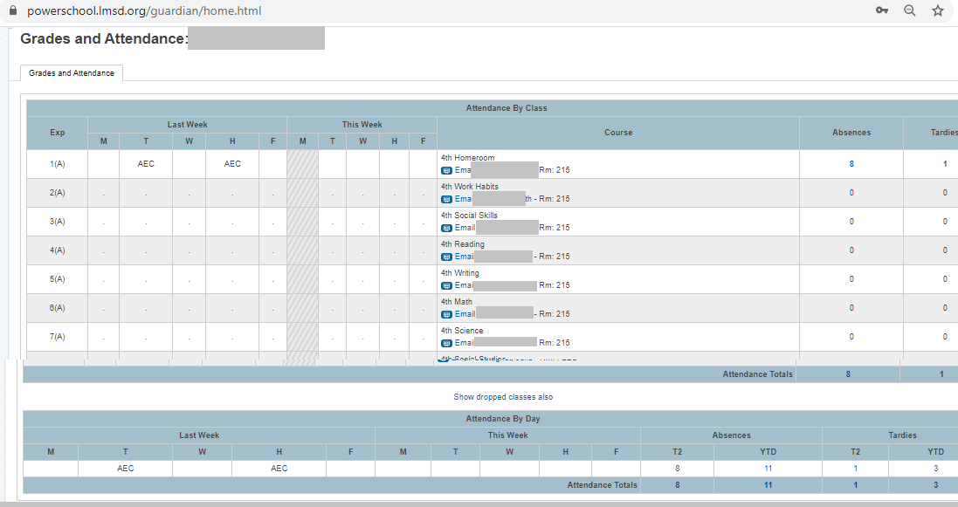
PowerSchool

Slide 8
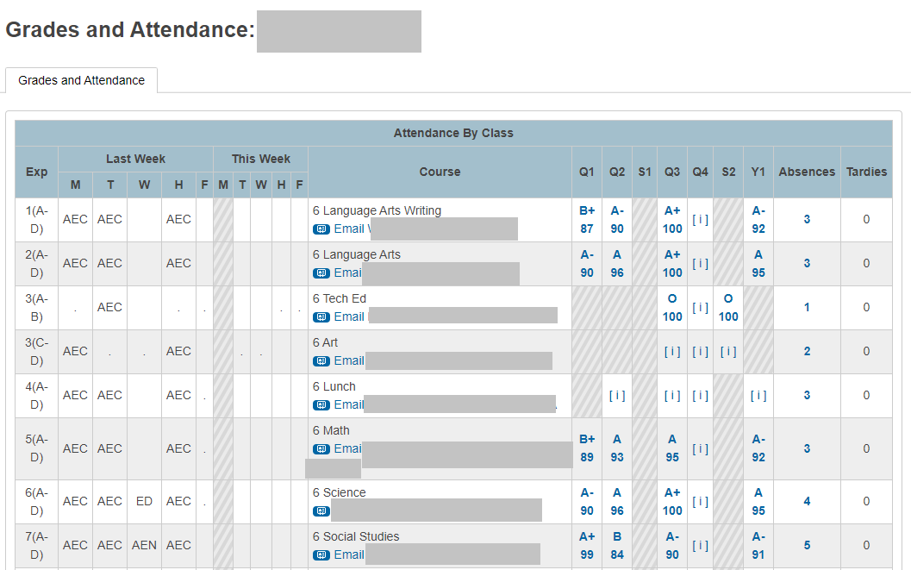
PowerSchool

Slide 9
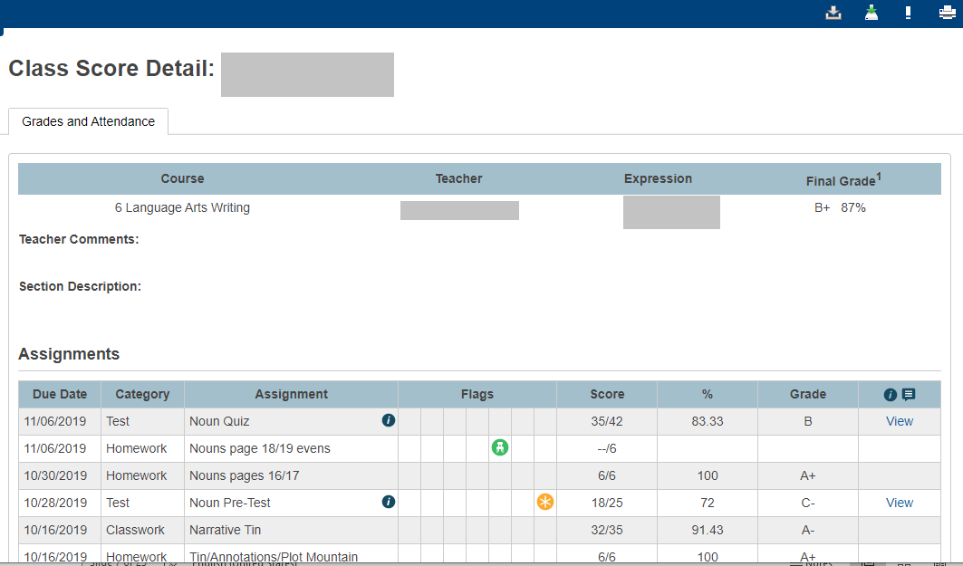
PowerSchool

Slide 10
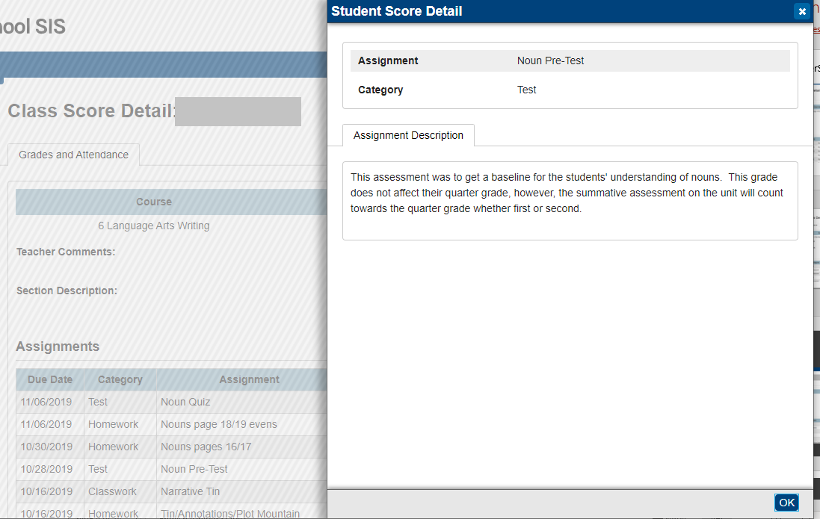
PowerSchool

Slide 11
What’s a parent to do?
With this information

Slide 12
What’s a parent to do?
With this information
Little Fnordkin got a C- on the test, but what options do the parents have?

Slide 13
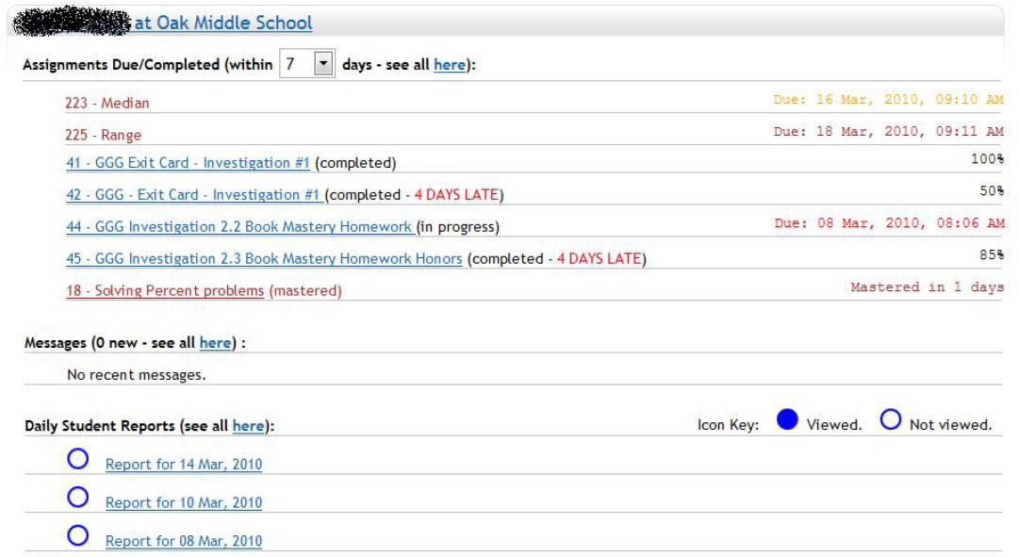
Parent reporting (Broderick et al.)

Slide 14
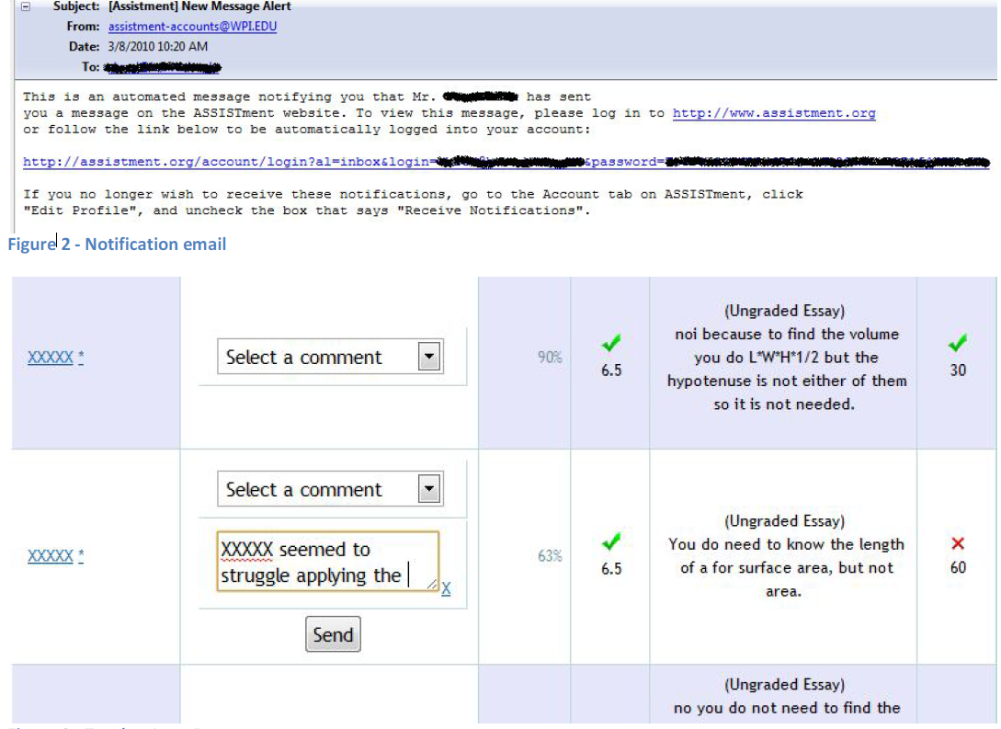

Slide 15
Parent reporting (Broderick et al.)
Explicitly designed at teacher request not to allow parent to communicate through reports, to reduce parent communication to them

Slide 16
Parent reporting (Broderick et al.)
Explicitly designed at teacher request not to allow parent to communicate through reports, to reduce parent communication to them
What are your opinions of this decision?

Slide 17
Parent reporting (Broderick et al.)
Limited use by parents
Mildly positive responses on parent survey
  More parents felt like they understood what was being covered in math class, and how their student was performing

Slide 18
Questions? Comments?

Slide 19
Parent reporting (Bergman)
Emails and text messages to parents informing them when assignment not handed in
Significant though small positive impact on student GPA

Slide 20
Questions? Comments?

Slide 21
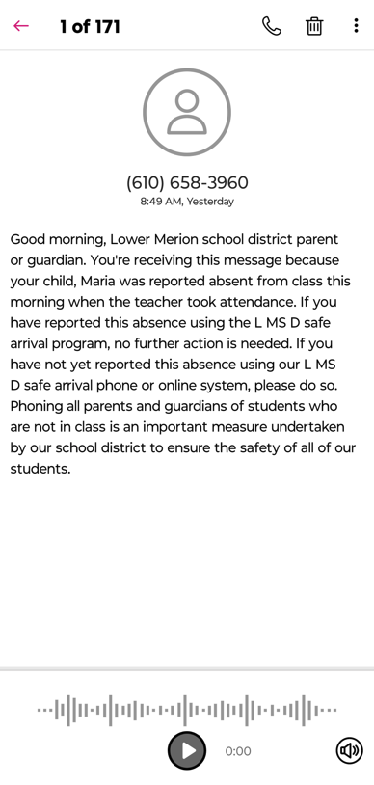
Parent reporting (absenteeism)

Slide 22
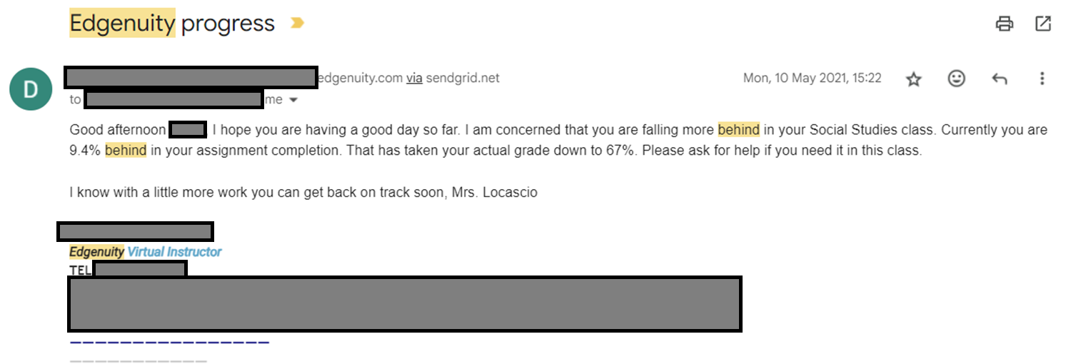
Parent reporting (progress)

Slide 23
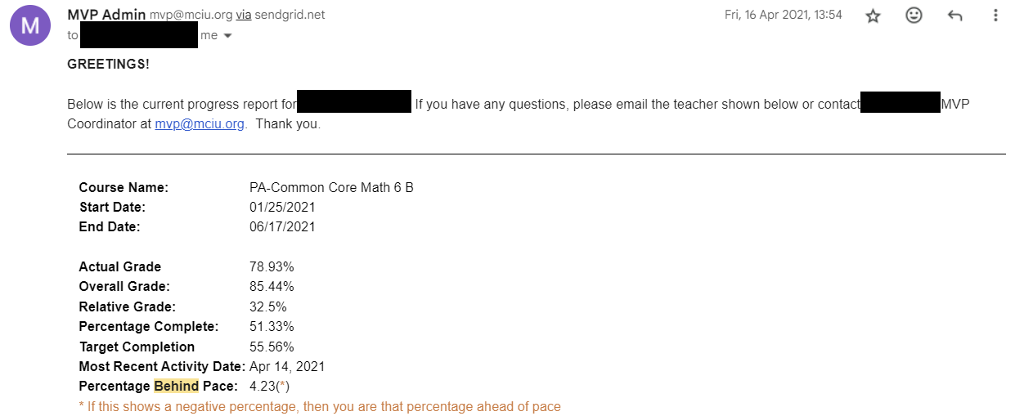
Parent reporting (progress)

Slide 24
Questions? Comments?

Slide 25
What are the features of a good parent report?

Slide 26
What other parenting reporting systems have you seen?

Slide 27
What are some things to avoid in designing a parent report?

Slide 28
Assemble into random breakout groups
Not your assignment or VIVI-SD groups

Slide 29
Design a report
(reminder: these slides are on course webpage)
1 & 2. Teachers of students using an adaptive homework system for math
3 & 4. For teachers of students using an adaptive flash card system for a foreign language
5 & 6. For parents of students using a blended learning system in math class
7 & 8. For teachers of students using a history game (such as Civilization) in class

Slide 30
Design a report
(reminder: these slides are on course webpage)
9&10. For parents of students at an alternative school for children with behavioral problems
11 & 12. For teachers of students doing a computer-mediated programming project at home (group project in Scratch)
13 & 14. For the parents of students practicing tae kwon do in a dojo
15 & 16. For teachers of undergraduates doing a group creative writing project (in a system where drafts are instrumented)

Slide 31
Any publicly available location is fine
You might find aggie.io useful
Please make sure to write your goal at the top and your team email addresses

Slide 32
Draw for N minutes
I will come around between groups and harvest your links
Then I will redistribute your link to another group who will send you critique and feedback, cc’ing me
Any questions before we start?

Slide 33
Reminder
Email your feedback to the group, cc me and Vivian

Slide 34
Questions? Comments?

Slide 35
Further comments/discussion?

Slide 36
Upcoming sessions
Feb 16 Project Assignment 1 due
Feb 19 Project Assignment 1 posts due
Feb 22 VIRTUAL. Automated Intervention
Feb 26 VIVI-SD 3 Due
Feb 29 Validity
Mar 7 NO CLASS SPRING BREAK
Mar 14 Rational Modeling and Model Validity
Mar 15 Project Assignment 2 first draft due
Mar 21 Generalizability
  Both Sections Virtual, 9a (45min early) and 7p (1 hr late)
Mar 22 Project Assignment 2 final version due

