Slide 1
Big Data, Education, and Society
February 20, 2025

Slide 2
Thank you for your assignment 1 handins
Great assignments
Great feedback to each other on the forums so far – thank you!
You still have time to enter your feedback until tonight
We are processing your assignments, and will get you feedback ASAP
Some groups may get feedback from me earlier than others – don’t worry if you get:
Feedback before or after others (there’s no specific order)
Relatively brief feedback from me and Chelsea (we might just agree with JeepyTA)

Slide 3
Assignment 2: Needs Assessment
Let’s go over it together
Any questions?

Slide 4
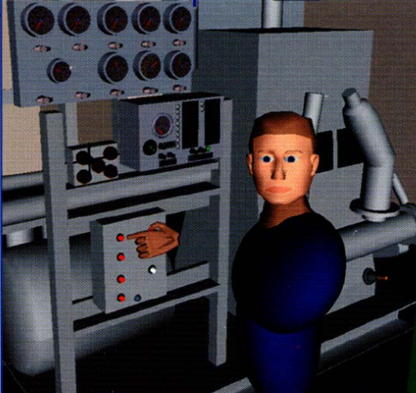
Automated Intervention

Slide 5
Examples of Use (at scale)
Cognitive Tutor/MATHia – automated detectors of student knowledge used to drive mastery learning
Middle school and high school and college math, USA

Slide 6
Examples of Use (at scale)
Alef NextGen – automated detectors of student knowledge used to select what material to give student next and provide reports to instructors
Entire (all subject) middle school curriculum, United Arab Emirates

Slide 7
Examples of Use (at scale)
ALEKS – Models of prerequisite structure and knowledge used to select material for students
High school and college math and science, USA

Slide 8
Examples of Use (at scale)
Project LISTEN/Amira – data mining used to determine which strategies work for which students, and to help select which stories to give students to read
Elementary school reading, USA

Slide 9
Examples of Use (at scale)
Duolingo – automated detectors of student memory used to determine when a student needs to review something they already learned
Foreign language vocabulary, worldwide

Slide 10
Examples of Use (formerly at scale)
Learnta – Models of prerequisite structure and knowledge used to select material for students, automated detectors of student knowledge used to drive mastery learning
English as a second language and math, China

Slide 11
Examples of Use (at scale)
InqITS – automated detectors of student inquiry skill embedded in an automated agent that helps students learn how to conduct effective inquiry
Leading to inquiry skill that transfers to new scientific domains
Middle school science, USA, formerly China

Slide 12
Comments? Questions?

Slide 13
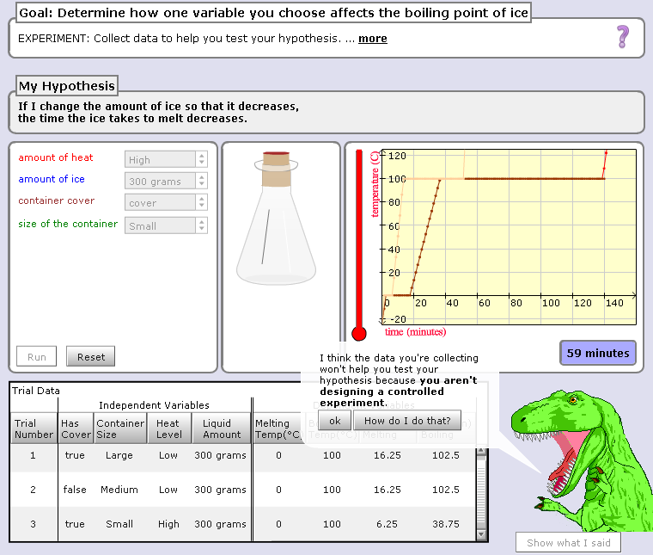

Slide 14
Hey, are you just playing with the buttons? Take your learning seriously or I will eat you!!!

Slide 15
Comments? Questions?

Slide 16
Scooter video
ldcwdmcmscm

Slide 17
Comments? Questions?

Slide 18
AutoTutor

Slide 19
AutoTutor
Engages in knowledge-construction dialogues with learner
Adapts based on student emotion as well as student knowledge
Supportive versus shake-up dialogues

Slide 20
AutoTutor
https://www.youtube.com/watch?v=aPcoZPjL2G8
https://www.youtube.com/watch?v=jDNXG09vFqo

Slide 21
Comments? Questions?

Slide 22
Those of you who have learned from a system doing automated intervention
What system was it
What did it do
What was your reaction

Slide 23
Those of you who have taught using a system doing automated intervention
What system was it
What did it do
What was your reaction

Slide 24
Is anyone here familiar with any other examples?

Slide 25
What are some situations when a system could intervene?

Slide 26
What are the properties of a good automated intervention?

Slide 27
What are some things to avoid in an automated intervention?

Slide 28
What is the difference in benefits/risks
Visible interventions
More subtle interventions, such as changing next problem difficulty

Slide 29
Further comments/discussion?

Slide 30
Upcoming sessions
Feb 20. Project Assignment 1 response posts due
Feb 24. VIVI-SD 3 Due
Feb 27. Validity.
Mar 6. Generalizability. Guest Lecturer: Andres Zambrano.
Mar 13. NO CLASS SPRING BREAK
Mar 14. Project Assignment 2 first draft due
Mar 20. Rational Modeling and Model Validity
Mar 21. Project Assignment 2 second draft due
Mar 27. Discrimination and the Perception of Bias. Guest Lecturer: Stefan Slater.

