Slide 1
Big Data, Education, and Society
January 16, 2025

Slide 2
Welcome to EDUC 6123: Big Data, Education, and Society
Where we’ll discuss… Big Data, Education, and Society

Slide 3
Your instructor
Ryan Baker

Slide 4
Your course assistant
Chelsea Porter

Slide 5
Course goals
The growth of learning analytics and educational data mining has been met with both optimism and concern. Excitement about the possibilities of individualized, personalized, adaptive learning have emerged. But concerns that student privacy will be jeopardized, and that student futures will be forever shaped by data from long ago – or warped by an errant prediction about the student years into the future – have emerged as well.
In this class, we will discuss what learning analytics can do, what it has the potential to do for good, and what the potential is for harm. We will discuss multiple uses and applications of analytics, where simple steps can mitigate risk, the relationship between validity and risk, and where risk mitigation will do more harm than good. We will do so in the context of real-world educational systems, challenges, problems, and with reference to original sources as much as possible

Slide 6
Format
Reading
Lecture
Discussions
Projects
Commentary on Projects

Slide 7
How this class is going to work
Read the readings
Participate in the discussion forums
Attend class and discuss the topics
Participate in the virtual small-group discussion sessions in VIVI-SD (more in a sec)
Do the assignments, and comment on other students’ assignments when required
Post to the forum when you have questions or comments
You are also welcome at my office hours

Slide 8
Two sections
You can attend either section, it’s up to you
Tuesdays 930am-1120am in-person
With hybrid simulcast
Will be virtual a few times during semester, will be announced well in advance
https://upenn.zoom.us/j/98421857018
Tuesdays 615pm-805pm fully virtual
https://upenn.zoom.us/j/99858903156

Slide 9
Three office hours
Mondays 6am-7am fully virtual
Thursdays 3pm-4pm in-person
No hybrid simulcast sorry
Friday 4pm-5pm fully virtual
Same link
https://upenn.zoom.us/j/93923377036

Slide 10
Three office hours
Mondays 6am-7am fully virtual
Starts Feb 3
Thursdays 3pm-4pm in-person
Starts Jan 23
Friday 4pm-5pm fully virtual
Starts Jan 24
Will occasionally be cancelled or rescheduled; will be posted on JeepyTA

Slide 11
Administrative Stuff
Is everyone signed up for class?
If not, and you want to receive credit, please send me an email
If you ARE signed up for this class, and have NOT gotten email from me yet, also please send me an email

Slide 12
Course Prerequisites
None
Some prior experience with statistics or data mining recommended
More so that you’re familiar with these methods can do – we will not actually conduct data mining or statistical analysis in this class

Slide 13
Course website
www.upenn.edu/learninganalytics/ryanbaker/BDES2025/index.html

Slide 14
Class Schedule

Slide 15
Class Schedule
Updated versions will be available on the course webpage

Slide 16
Class Schedule
If any schedule changes happen due to unforeseen circumstances
Online schedule will be kept up-to-date

Slide 17
Course Discussion Forum (Shared by both sections)
https://educ6123-s25.jeepyta.net/
This semester, we will be joined by our LLM-powered TA, JeepyTA
JeepyTA will answer some of your questions when we aren’t available, and will answer them faster than we can
My colleagues will be conducting a study on JeepyTA, which they will invite you to join

Slide 18
Course Discussion Forum
Key communication tool for this class
Hand in some assignments there
Comment on other students’ assignments there
Discuss the readings there

Slide 19
VIVI-SD Discussions
This semester we’ll be trying something new
This class is too big to have good “full class” discussions for some topics, even with two sections
Zoom breakout rooms (and in-class small groups) mean that I don’t really get to support your conversations

Slide 20
VIVI-SD: A new tool
In VIVI-SD, you will have discussions with a small number of your classmates, guided and scaffolded by Virtual Ryan
You will have until the due date to schedule and conduct these discussions

Slide 21
Assignments
This class will have one primary project with multiple sub-assignments
In this project, you will propose a learning analytics application
You should conduct this project in groups of 3
You need to pick your group for the first assignment – you will keep this group for the rest of the semester

Slide 22
Assignments
Project Proposal 17%
Needs Assessment 17%
Risks and Challenges 17%
Final Project 17%
Class Participation (including the forum) 11%
VIVI-SD Discussions 21%

Slide 23
Participation Grade
Includes JeepyTA forum and in class participation
Just showing up to class and sitting silently and doing nothing else does not count as class participation
Does NOT include VIVI-SD, that’s separate
No specific guidelines on how many posts you should make, or word length
If you have a question for me that is not completely specific (e.g. why did I get a B?), please post it to the forum
I get hundreds of real emails a day, I will read the forum first

Slide 24
Required Books
None

Slide 25
Readings
Available at https://drive.google.com/file/d/1UZthaRPpjhBfClc6-b5RyTXcIGeXtoXN/view?usp=sharing

Slide 26
Questions about Syllabus?

Slide 27
Project Proposal
Let’s go to the course webpage to look at it
Questions? Concerns? Comments?

Slide 28
Accommodations for Students with Disabilities
Please email me to set up a meeting so we can best accommodate you

Slide 29
Ways to get in touch with me
Post to the forum
Strongly preferred for all questions that could be of interest to other students; fastest response by me and Chelsea and JeepyTA
Come to office hours
When this needs to be rescheduled or shortened, I will post to JeepyTA
Set up a meeting penn.learninganalytics@gmail.com
Hand in your work on JeepyTA
Questions on grades, being late, or missing class ryanshaunbaker@gmail.com
Use the right approach, get a much faster response

Slide 30
Plagiarism and Cheating: Boilerplate Slide
Don’t do it
If you have any questions about what it is, talk to me before you turn in an assignment that involves either of these
University regulations will be followed to the letter

Slide 31
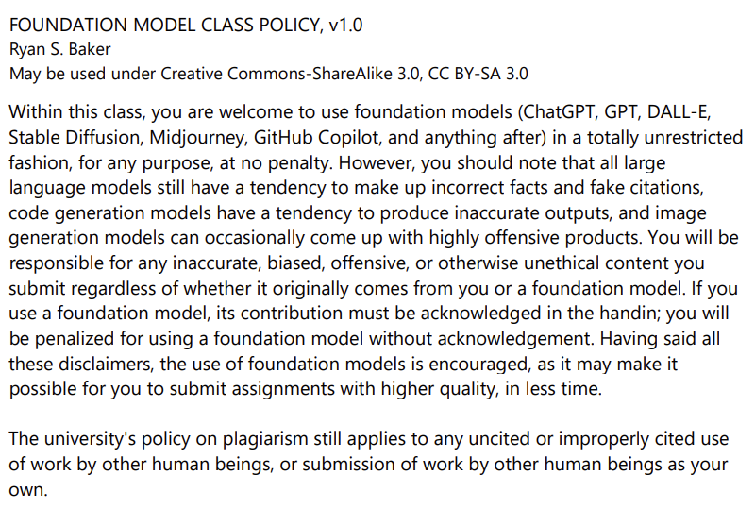

Slide 32
Questions? Concerns? Comments?
Any questions on the syllabus, schedule, or administrative topics?

Slide 33
Introductions
Please introduce yourselves!
Your name
Your pronouns (completely optional)
What program you’re studying in
What your current job is (if you have one)
Why (if) you think the course subject is interesting
What you hope to be doing in 5 years

Slide 34
Let’s get started with some discussion

Slide 35
How is education different than it was 30 years ago?

Slide 36
What might education be like in 30 years?

Slide 37
How is non-school learning different than it was 30 years ago?

Slide 38
How might non-school learning be different in 30 years?

Slide 39
How was data used in education 30 years ago?

Slide 40
How is data being used in education today?

Slide 41
How might data be used in education in 30 years?

Slide 42
What is big data?
Your thoughts?

Slide 43
What makes big data different than the data we had in education 50 years ago?
Your thoughts?

Slide 44
These are the issues we will talk about this semester
How society and technology are changing
How these changes create great opportunities for learning
How these changes may create risks for learners
And how we can make good decisions in order to reduce these risks

Slide 45
National differences
We will also try to discuss how national differences in both culture and policy may impact both opportunities and risks
Huge differences in policies between different countries in terms of educational technology regulations

Slide 46
Questions? Comments?

Slide 47
For next class
Read the project proposal assignment
Start thinking about project ideas
In next week’s class, I’ll ask you to be prepared to:
Say *one sentence* about a project idea (have that sentence ready!)
Speak for about two minutes about the project idea in smaller groups
This does not need to be your eventual project idea; it is just an idea

Slide 48
You can also…
You are also welcome to use the discussion forum to look for project partners
Not required -- we will have an activity next week to also help you find teams

Slide 49
Thank you!
I look forward to learning from all of you over the course of this semester!

Slide 50
Upcoming sessions
Jan 23. Learning Analytics: The Big Picture
Jan 30. At-Risk Prediction. Both sections VIRTUAL.
Feb 3. (But Jan 27 better) VIVI-SD 1 Due
Feb 6. Reports for School Personnel
Feb 10. VIVI-SD 2 Due
Feb 13. Reports for Parents
Feb 17 Project Assignment 1 due
Feb 20. Project Assignment 1 response posts due
Feb 20. Automated Intervention. Both sections VIRTUAL.

