Slide 1
Big Data, Education, and Society
February 13, 2025

Slide 2
Questions about assignment?
Due in 3 days
Post on discussion forum
Do not forget to post in response to your classmates
  Post as a project group

Slide 3
Parent reporting

Slide 4
Parent reporting
What do parents usually get from schools?

Slide 5
Parent reporting
Subject-level grades
Percentile scores for subjects overall
Uninterpretable competencies with 1-3 scores
Your child was absent
Your child is behind on school work

Slide 6
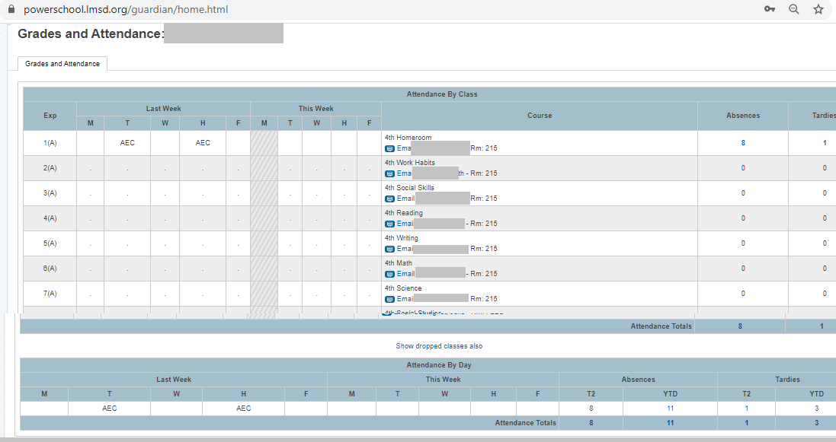
PowerSchool

Slide 7
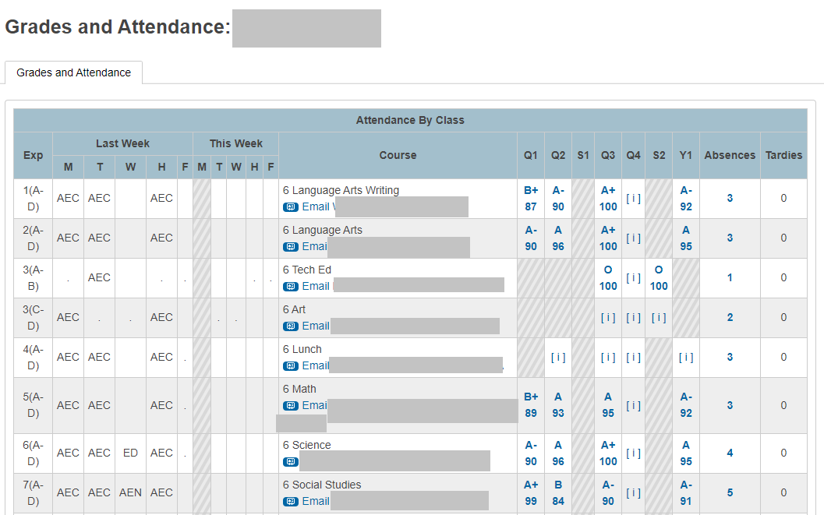
PowerSchool

Slide 8
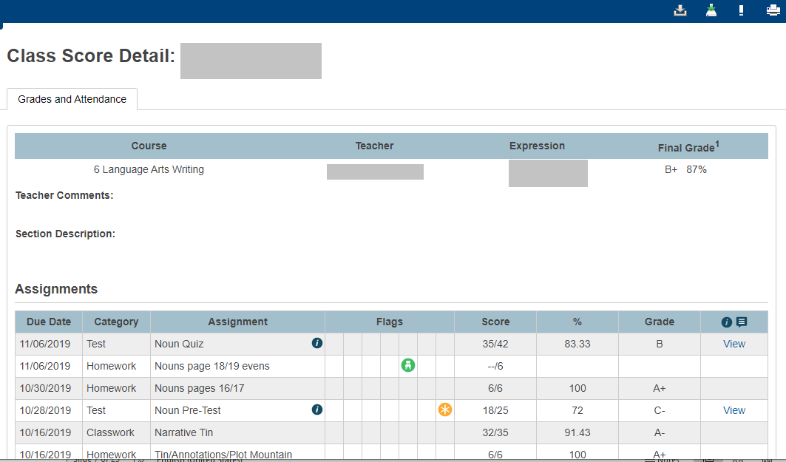
PowerSchool

Slide 9
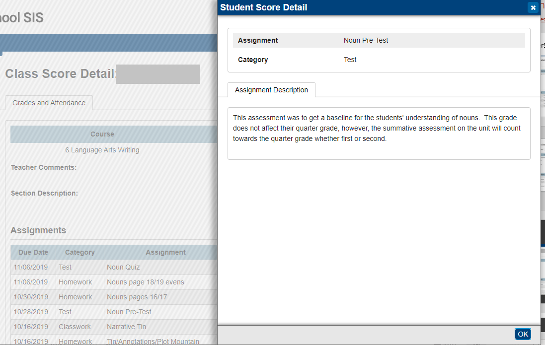
PowerSchool

Slide 10
What’s a parent to do?
With this information

Slide 11
What’s a parent to do?
With this information
Little Fnordkin got a C- on the test, but what options do the parents have?

Slide 12
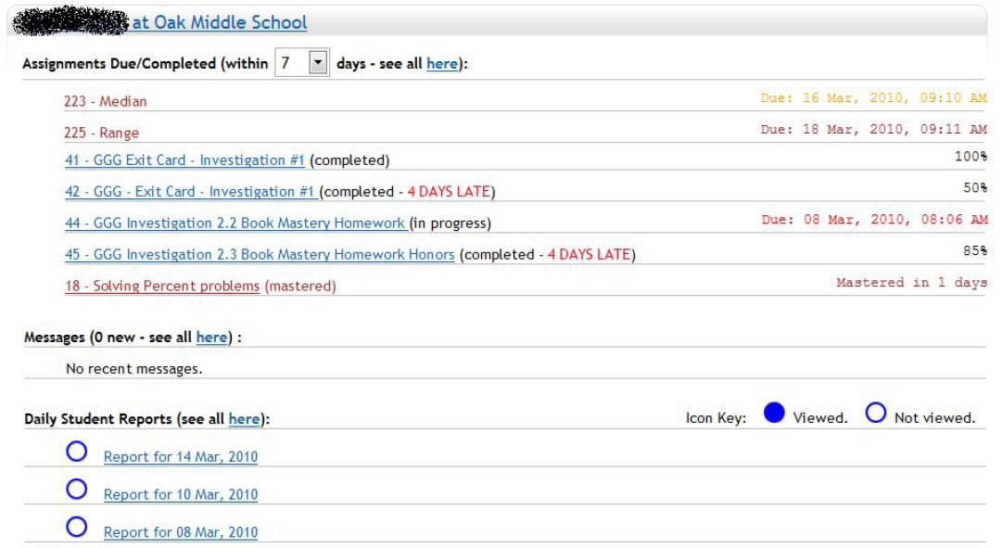
Parent reporting (Broderick et al.)

Slide 13
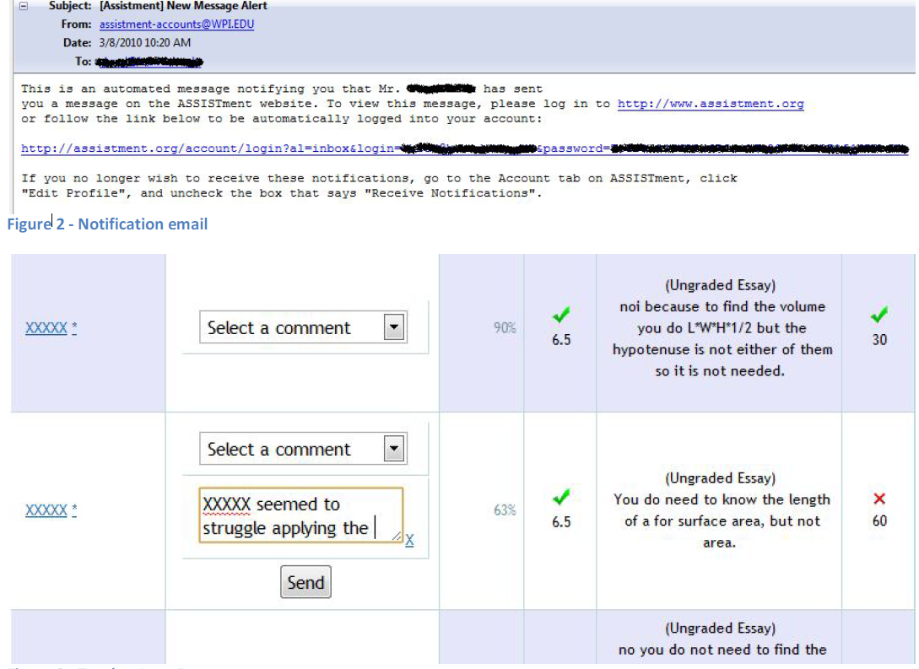

Slide 14
Parent reporting (Broderick et al.)
Explicitly designed at teacher request not to allow parent to communicate through reports, to reduce parent communication to them

Slide 15
Parent reporting (Broderick et al.)
Explicitly designed at teacher request not to allow parent to communicate through reports, to reduce parent communication to them
What are your opinions of this decision?

Slide 16
Parent reporting (Broderick et al.)
Limited use by parents
Mildly positive responses on parent survey
  More parents felt like they understood what was being covered in math class, and how their student was performing

Slide 17
Questions? Comments?

Slide 18
Parent reporting (Bergman)
Emails and text messages to parents informing them when assignment not handed in
Significant though small positive impact on student GPA

Slide 19
Questions? Comments?

Slide 20
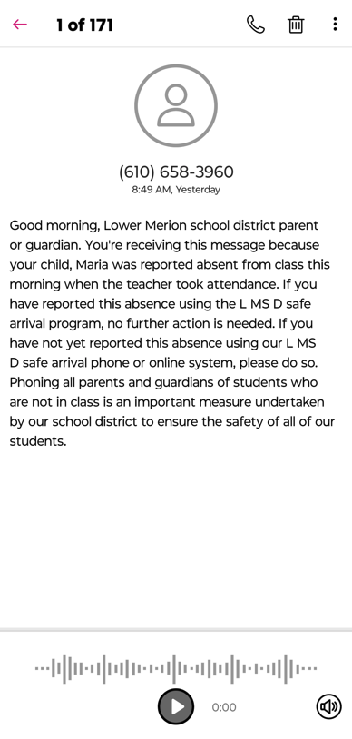
Parent reporting (absenteeism)

Slide 21
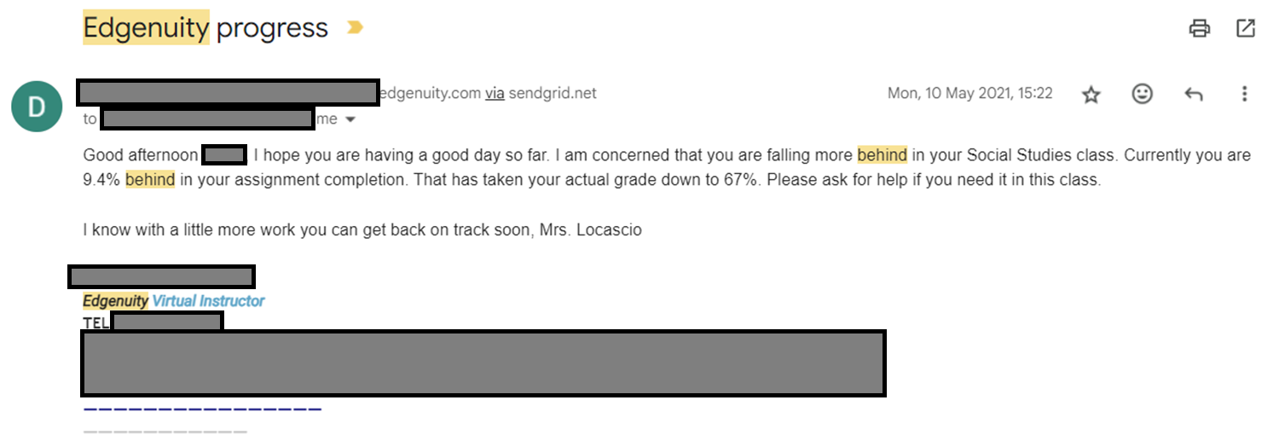
Parent reporting (progress)

Slide 22
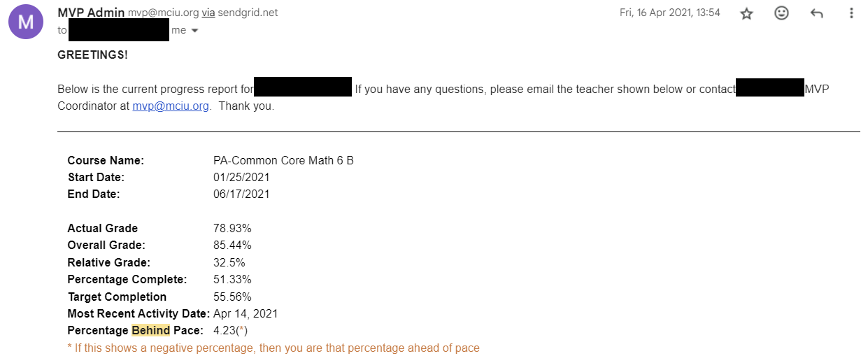
Parent reporting (progress)

Slide 23
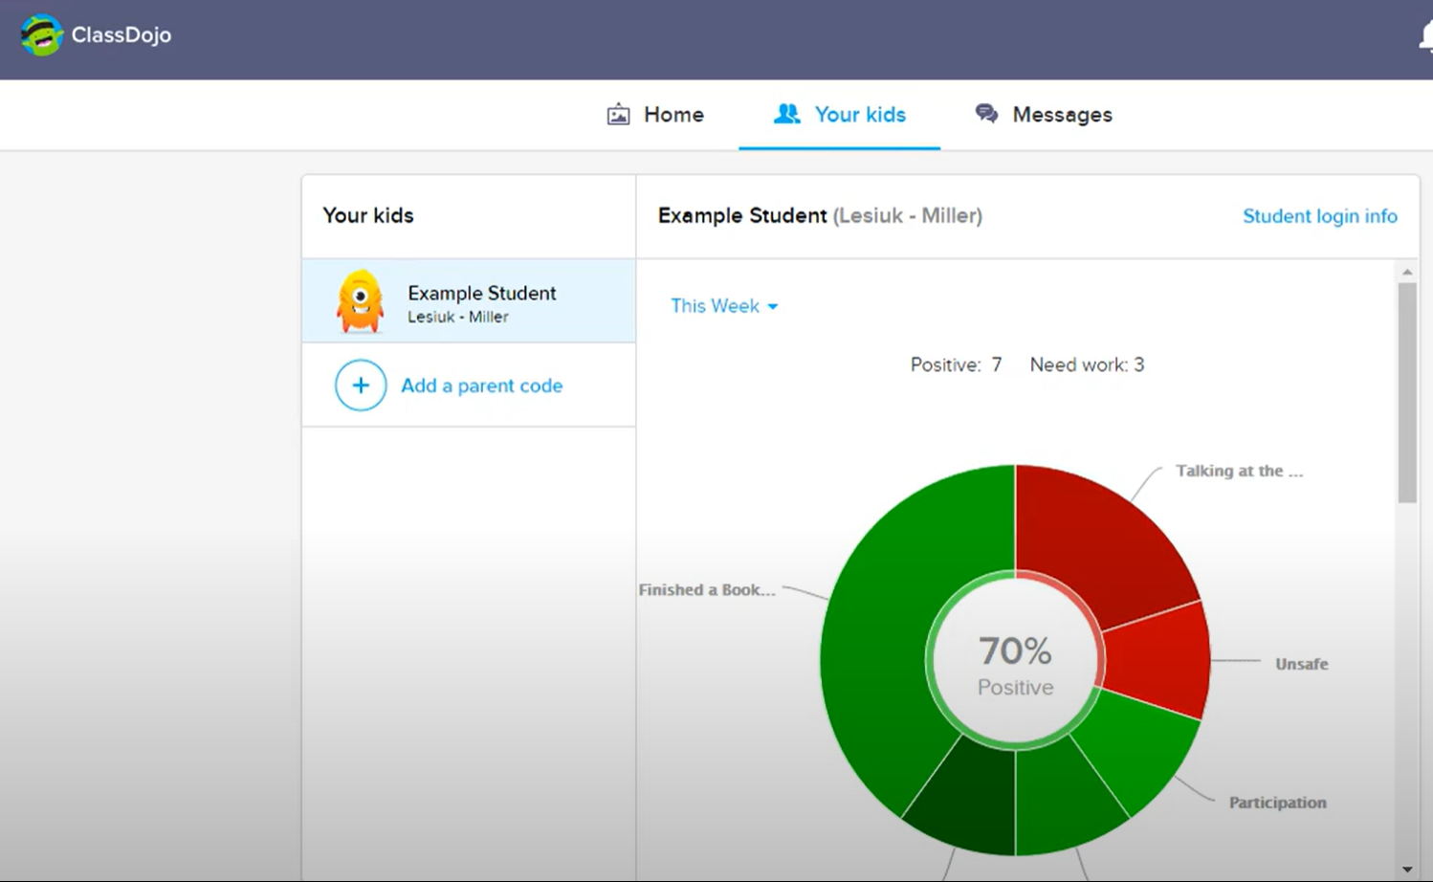
Parent reporting (behavior)

Slide 24
Questions? Comments?

Slide 25
What are the features of a good parent report?

Slide 26
What other parenting reporting systems have you seen?

Slide 27
What are some things to avoid in designing a parent report?

Slide 28
Assemble into groups
Not your assignment or VIVI-SD groups

Slide 29
Design a report
1 & 2. Teachers of students using an adaptive homework system for math
3 & 4. For teachers of students using an adaptive flash card system for a foreign language
5 & 6. For parents of students using a blended learning system in math class
7 & 8. For teachers of students using a history game (such as Civilization) in class

Slide 30
Design a report
9&10. For parents of students at an alternative school for children with behavioral problems
11 & 12. For teachers of students doing a computer-mediated programming project at home (group project in Scratch)
13 & 14. For the parents of students practicing tae kwon do in a dojo
15 & 16. For teachers of undergraduates doing a group creative writing project (in a system where drafts are instrumented)

Slide 31
Any publicly available location is fine
You might find magma.com useful (I think it’s still free?)
Please make sure to write your goal at the top and your team email addresses

Slide 32
Draw for N minutes
I will come around between groups and harvest your links
Then I will redistribute your link to another group who will give you critique and feedback by email, cc’ing me
Any questions before we start?

Slide 33
Reminder
Email your feedback to the group, cc me

Slide 34
Questions? Comments?

Slide 35
Further comments/discussion?

Slide 36
Upcoming sessions
Feb 17 Project Assignment 1 due
Feb 20. Project Assignment 1 response posts due
Feb 20. Automated Intervention. Both sections VIRTUAL.
Feb 24. VIVI-SD 3 Due
Feb 27. Validity.
Mar 6. Generalizability.
Mar 13. NO CLASS SPRING BREAK
Mar 14. Project Assignment 2 first draft due
Mar 20. Rational Modeling and Model Validity
Mar 21. Project Assignment 2 second draft due

