Slide 1
Big Data, Education, and Society
February 6, 2025

Slide 2
Reports for School Personnel

Slide 3
We looked at Infinite Campus last week

Slide 4
Some additional systems with reports for school personnel (historical and contemporary)

Slide 5
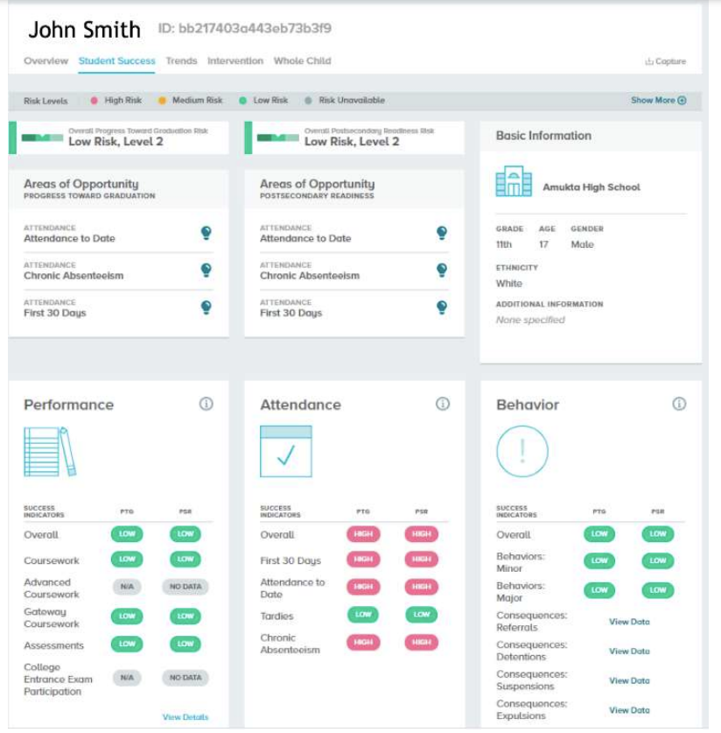
BrightBytes

Slide 6
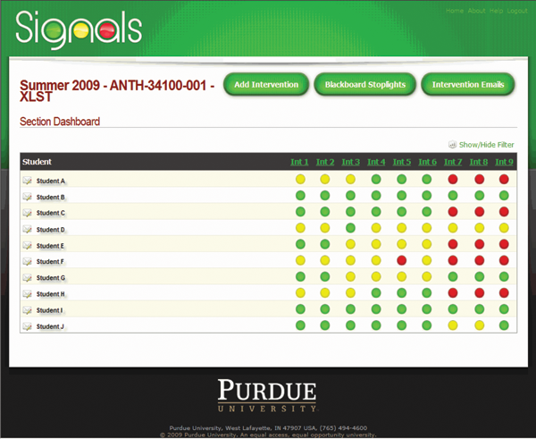
Course Signals

Slide 7
iReady

Slide 8
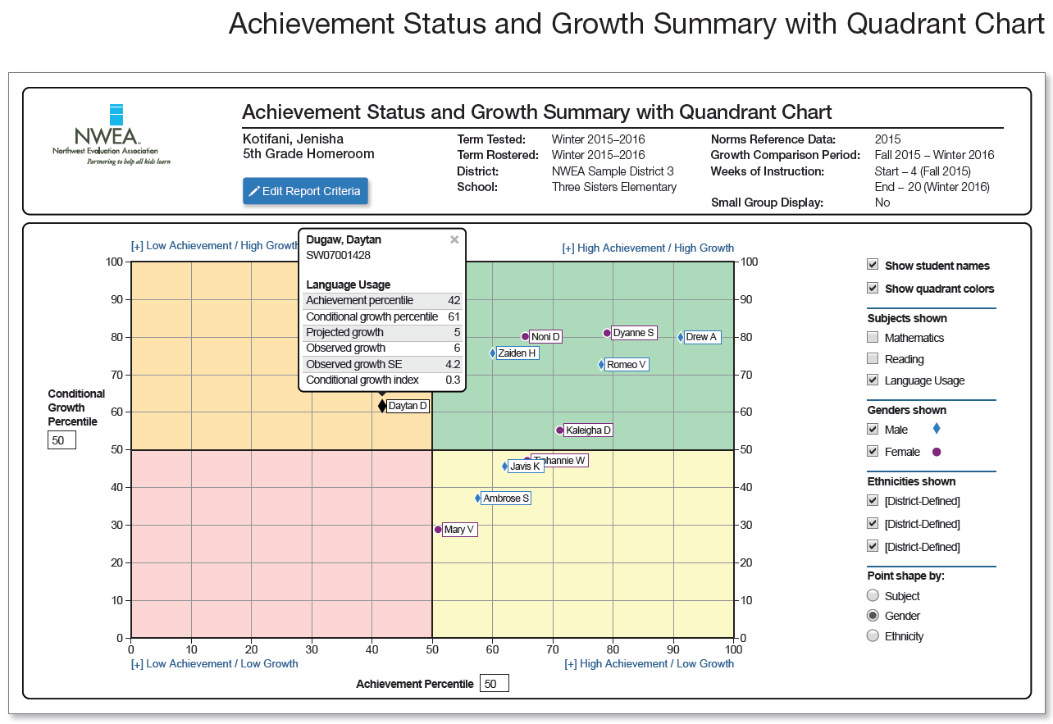
NWEA MAP

Slide 9
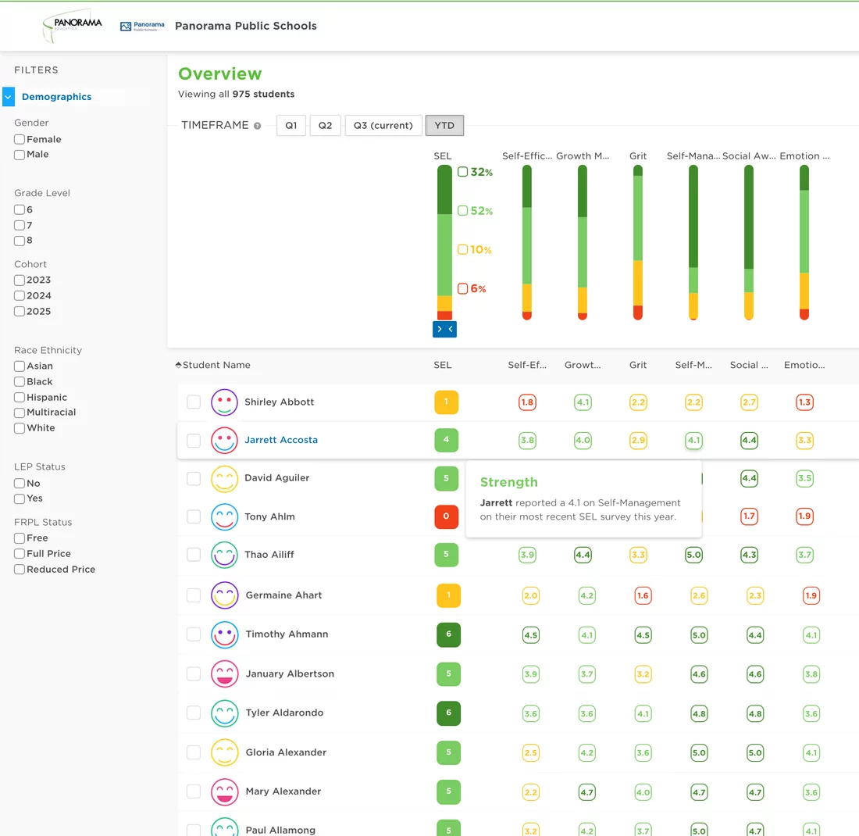
Panorama Education

Slide 10
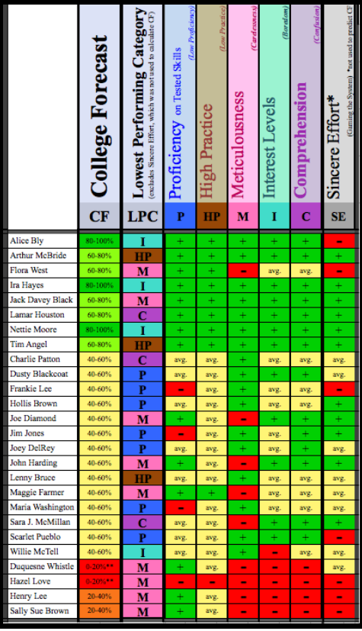
Ocumpaugh et al

Slide 11
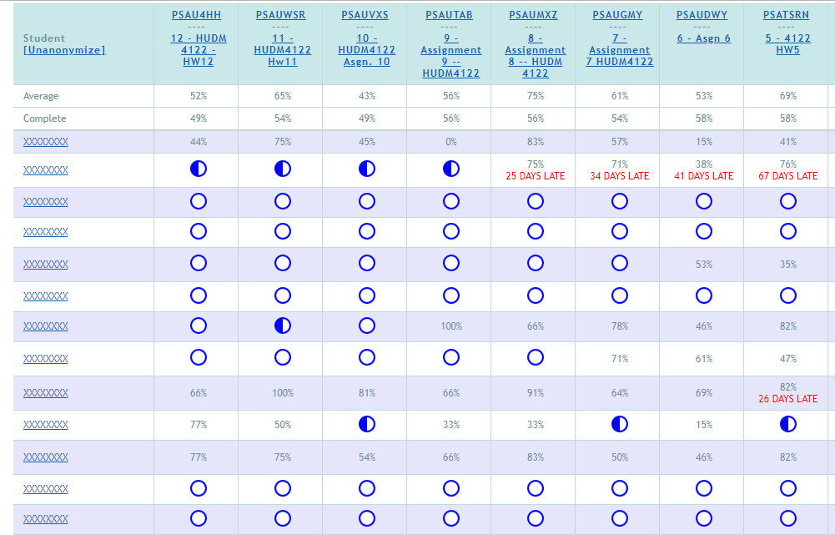
ASSISTments

Slide 12
ASSISTments

Slide 13
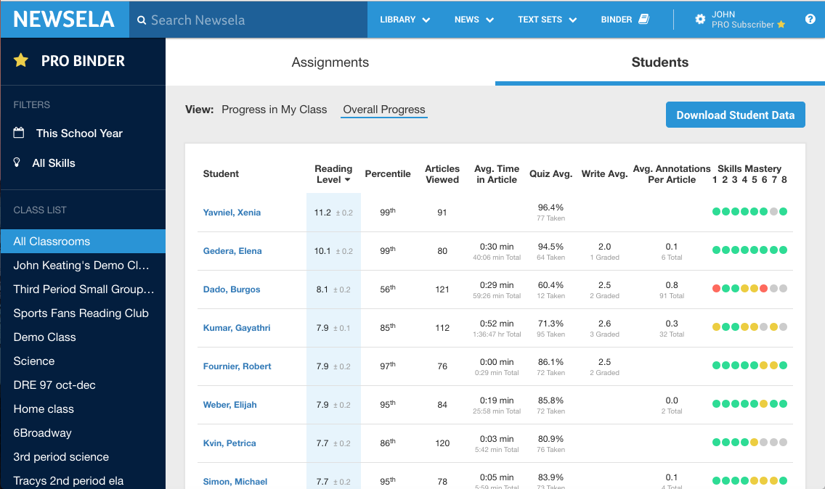
Newsela

Slide 14
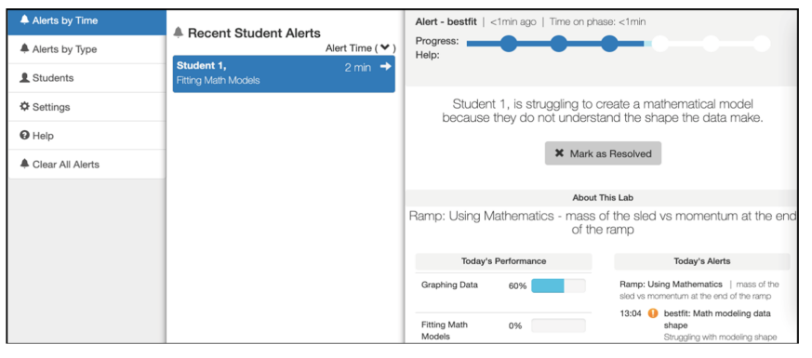
Inq-Blotter

Slide 15
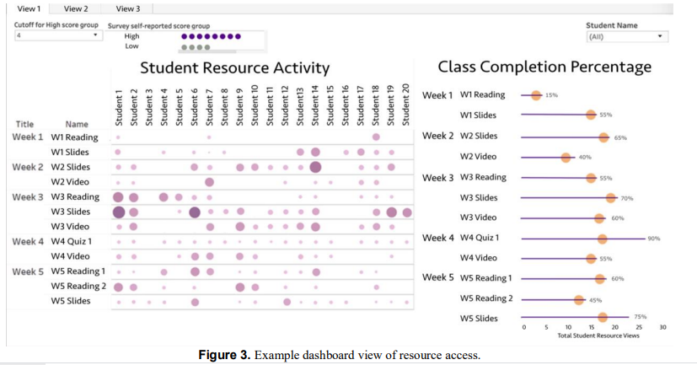
Wise & Jung

Slide 16
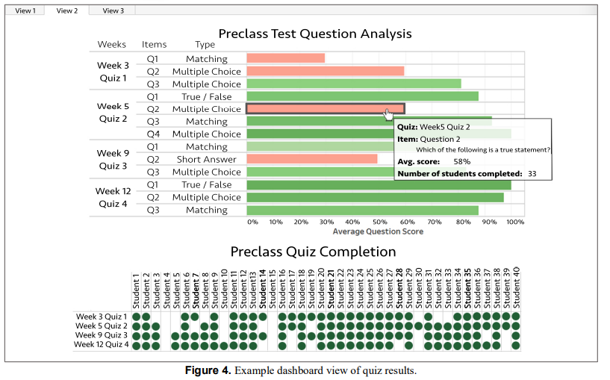
Wise & Jung

Slide 17
Khosravi et al. 2021
Discover groups of students with biggest difference in behavior or performance from rest of class
Scaffold instructor in understanding why and/or taking action

Slide 18
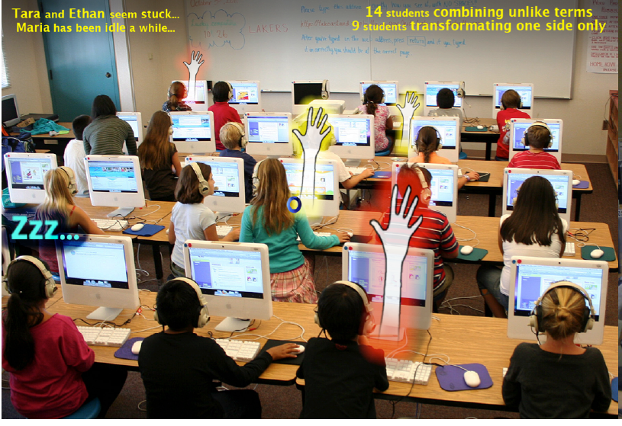
Holstein et al., 2018

Slide 19
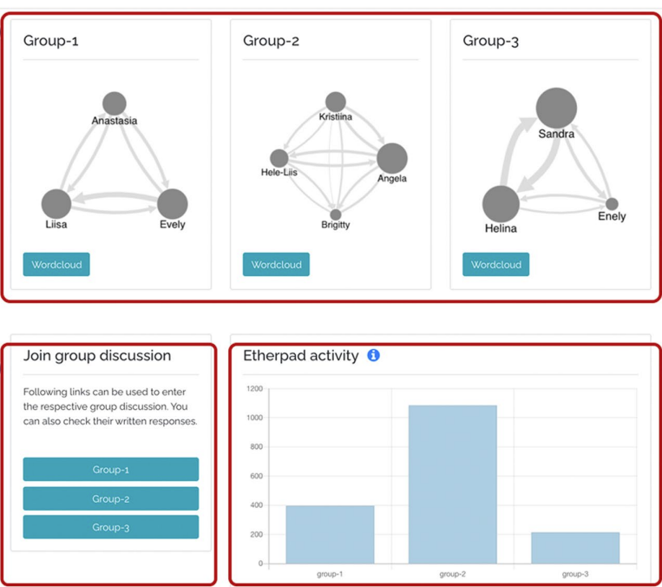
Kasepalu et al., 2023

Slide 20
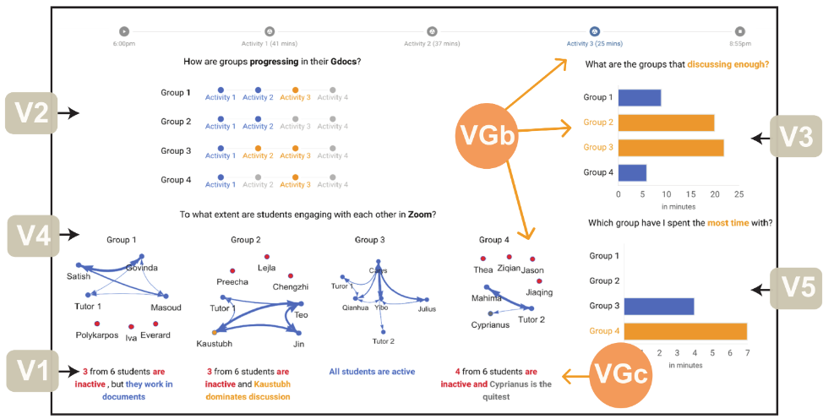
Pozdniakov et al., 2025

Slide 21
How teachers use reports: example
https://www.youtube.com/watch?v=kGxQsN0DBUU

Slide 22
How teachers use reports: example
“In this paper, we focus on proactive remediation, dynamically planned intervention by the teacher with one or more students. In a proactive remediation, the teacher decides to provide help to one or more students on a topic that they are not currently struggling with, based on evidence that the student(s) need to learn that topic. The teacher plans such interventions using formative assessment data provided by the tutoring system. Proactive remediation is different from the traditional view of on-task conversations in blended learning [10], where the student discusses the current material being presented in the tutor, with another student or the teacher.” (Miller et al., 2015)

Slide 23
How teachers use reports: example Wise & Jung
Whole-class scaffolding, devoting more attention to explaining specific concepts that were difficult for students: “I [could] even adjust sometimes on the fly during the semester if it seems like students are not learning what they are hoping to learn in the class, or not learning what I think I want them to be learning in the course”
Targeted scaffolding, focusing attention on particular students… who seemed to be disengaged or struggling: “I intervened with them a bit earlier than I might have otherwise as they hadn’t missed so many classes”
Revising the course elements: “There may be an option to get the quizzes out of being a separate activity or to have them be part of the video to make it more engaging”, “It tells us we might need to look at a question again. For example, ‘is this written well?’ or ‘do we need to change the question?’”

Slide 24
How teachers use reports: example Wise & Jung
“Across all three kinds of actions, there was a tendency to take a deficit perspective, taking action based on students not engaging with the materials or materials not receiving attention.”

Slide 25
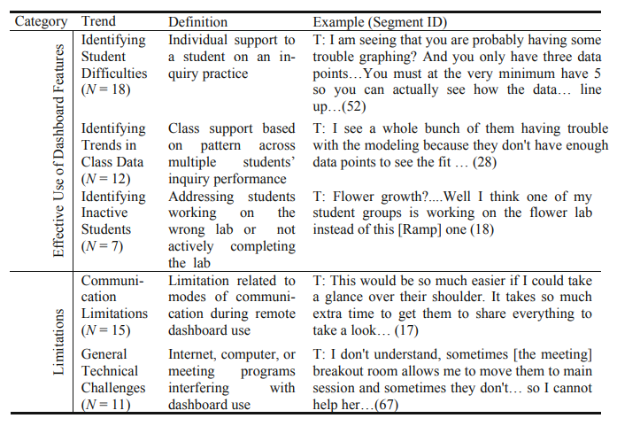
How teachers use reports: example (Dickler et al., 2021)

Slide 26
How teachers use reports: example
Sending emails proposed by the learning system
Sometimes modified
Often sent as-is

Slide 27
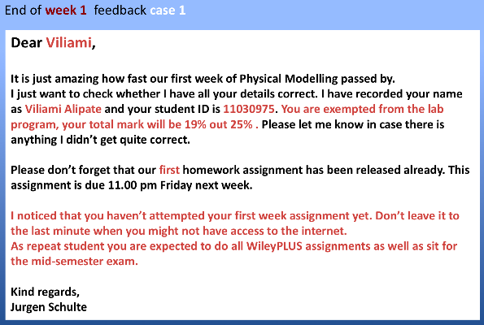
OnTask Learning

Slide 28
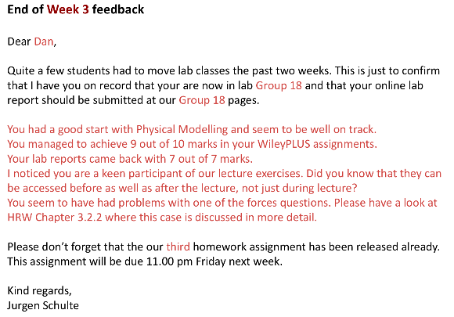
OnTask Learning

Slide 29
Questions? Comments?

Slide 30
Discussion

Slide 31
What are the features of a good report?

Slide 32
What are some things to avoid in designing a report?

Slide 33
How can we support new (better) pedagogical practices using reports?

Slide 34
How could reports reinforce bad pedagogical practices?

Slide 35
What should be different in reports for guidance counselors, principals…
How can we better support stakeholders beyond teachers?

Slide 36
Some tensions in report design (Duncan et al)
Detail versus big picture
Mastery versus progress
Benchmarking between students or with reference to a goal

Slide 37
Questions? Comments?

Slide 38
Upcoming sessions
Feb 3. VIVI-SD 1 Due
Feb 6. Reports for School Personnel
Feb 10. VIVI-SD 2 Due
Feb 13. Reports for Parents
Feb 17 Project Assignment 1 due
Feb 20. Project Assignment 1 response posts due
Feb 20. Automated Intervention. Both sections VIRTUAL.
Feb 24. VIVI-SD 3 Due
Feb 27. Validity.
Mar 6. Generalizability.

