Slide 1
Special Topics in Educational Data Mining
HUDK5199 Spring term, 2013
February 2-, 2013

Slide 2
Today’s Class
Behavior Detection
And then some discussion of features in Excel between end of class and 5pm
We will start today, and continue in future classes as needed

Slide 3
Behavior Detection
Inferring key aspects of a student’s behavior

Slide 4
Behaviors people have detected

Slide 5
Disengaged Behaviors
Gaming the System (Baker et al., 2004, 2008, 2010; Cheng & Vassileva, 2005; Walonoski & Heffernan, 2006; Beal, Qu, & Lee, 2007)
Off-Task Behavior (Baker, 2007; Cetintas et al., 2010)
Carelessness (San Pedro et al., 2011; Hershkovitz et al., 2011)
WTF Behavior (Rowe et al., 2009; Wixon et al., UMAP2012)

Slide 6
Meta-Cognitive Behaviors
Help Avoidance (Aleven et al., 2004, 2006)
Unscaffolded Self-Explanation (Shih et al., 2008; Baker, Gowda, & Corbett, 2011)
Exploration Behaviors (Amershi & Conati, 2009)

Slide 7
Building off of Classification
In terms of data mining algorithms, Behavior Detection is pretty much just Classification
So why does it need a lecture to itself?

Slide 8
Because There’s So Much More…
Than just what algorithm you use

Slide 9
But before we get going
Homework 4 solutions
Wanjia Li
Huacheng Li
Kara Carpenter

Slide 10
Awesome…

Slide 11
Things you need to think about…
When you’re doing behavior detection

Slide 12
Where did the labels come from?
Self-report?
Field observations?
Text replays?

Slide 13
Self-report
Fairly common for constructs like affect and self-efficacy
Not as common for labeling behavior

Slide 14
Are you gaming the system right now?
Yes
No

Slide 15
Was recommended to me by CMU IRB compliance officer in 2003
Are you gaming the system right now?
Yes
No

Slide 16
Field Observations
One or more observers watch students and take systematic notes on student behavior
Takes some training to do right (Ocumpaugh et al., 2012)
Free Android App developed by my group (Baker et al., 2011)

Slide 17
Text replays
Pretty-prints of student interaction behavior from the logs

Slide 18
Examples

Slide 19
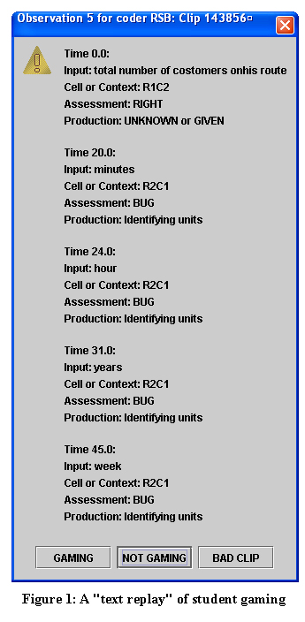

Slide 21
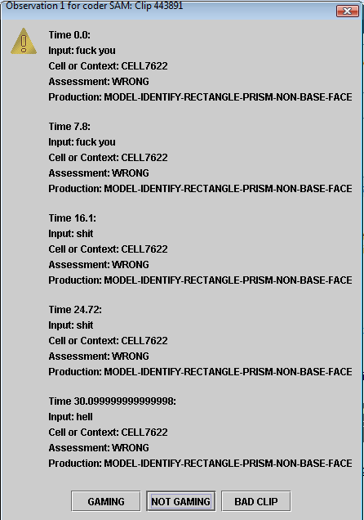

Slide 22
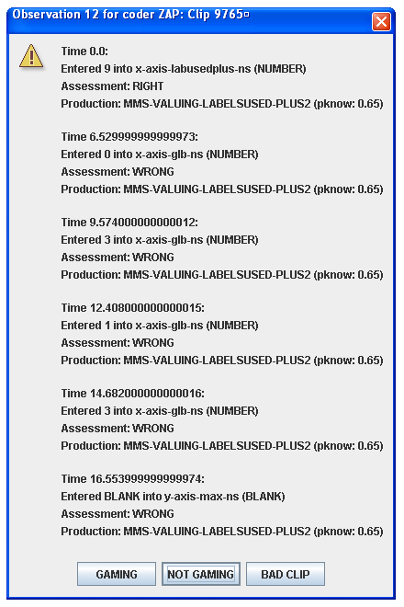

Slide 23
Major Advantages
Blazing fast to conduct
8 to 40 seconds per observation

Slide 24
Notes
Decent inter-rater reliability is possible
Agree with other measures of constructs
Can be used to train behavior detectors

Slide 25
Major Limitations
Limited range of constructs you can code
Gaming the System – yes
Collaboration in online chat – yes (Prata et al, 2008)
Frustration, Boredom – sometimes
Off-Task Behavior outside of software – no
Collaborative Behavior outside of software – no

Slide 26
Major Limitations
Lower precision (because lower bandwidth of observation)

Slide 27
Another Labeling Issue

Slide 28
How good are the labels?
You shouldn’t expect your detectors to do better than the inter-rater reliability of human at coding the same construct

Slide 29
How good are the labels?
You shouldn’t expect your detectors to do better than the inter-rater reliability of human at coding the same construct
In fact, what does it mean if
human kappa = 0.60
your detector’s kappa = 0.94

Slide 30
Some Validity Questions

Slide 31
For what uses is my model valid?
For what users will it work?
For what contexts will it work?
Is it valid for moment-to-moment assessment?
Is it valid for overall assessment?
If I intervene based on this model, will it still work?

Slide 32
Multi-level cross-validation
When you cross-validate, software tools like RapidMiner allow you to choose the batch (level) that you cross-validate on
What levels might be useful to cross-validate on?

Slide 33
Multi-level cross-validation
Action
Student
Lesson
School
Demographic
Software Package

Slide 34
What people actually do (2013)
Action
Student
Lesson
School
Demographic
Software Package

Slide 35
Lack of testing across populations is a real problem!

Slide 36
Why?

Slide 37
Medicine
Medical drug testing has had a history of testing only on white males (Dresser, 1992; Shavers-Hornaday, 1997; Shields et al., 2005)
Leading to medicines being used by women and members of other races despite lack of evidence for efficacy

Slide 38
We…
Are in danger, as a field, of replicating the same mistakes!

Slide 39
Settings
A lot of student modeling research is conducted in
suburban schools (mostly white and Asian populations, higher SES)
elite universities (mostly white and Asian populations, higher SES)
In wealthy countries…

Slide 40
Settings
Some research is conducted in
urban schools in wealthy countries (mostly minority groups, lower SES)

Slide 41
Settings
Almost no research is conducted in
rural schools in wealthy countries (mostly white populations in the US, lower SES)
community colleges and HBCUs/HHSCUs/TCUs (mostly African-American and Latino and indigenous populations, lower SES)
developing countries (there are notable exceptions, including Didith Rodrigo’s group in the Philippines)

Slide 42
Why not?

Slide 43
Challenges
There are often significant challenges in conducting research in these settings
Uncooperative city school IRBs
Parents and community leaders who do not support research – partly out of legitimate historically-driven cynicism about the motives and honesty of University researchers (Tuhiwai Smith, 1999)
Inconvenient locations
Outdated computer equipment
Physical danger for researchers

Slide 44
However
If we ignore these populations
Our research may serve to perpetuate and actually increase inequalities

Slide 45
However
If we ignore these populations
Our research may serve to perpetuate and actually increase inequalities
Effective educational technology for everyone?
Effective educational technology for a few?
Or effective educational technology for a few, and unexpectedly ineffective educational technology for everyone else?

Slide 46
Another validation question
Are there ever situations where it makes sense to test your model on the original data set where it was developed?

Slide 47
Another validation question
Are there ever situations where it makes sense to test your model on the original data set where it was developed?
Computing complexity-based goodness metrics such as BiC
Determine maximum possible performance of modeling approach

Slide 48
Moment-to-Moment and Overall Assessment
It’s often a good idea to study how well a detector works
For determining when a behavior is occurring
For determining how much a behavior occurs
For determining who engages in a behavior
Really depends on how you want to use a detector

Slide 49
If I intervene based on this model, will it still work?
Not studied very much
If you intervene, the behaviors you’ve been making inference on may develop a different meaning
Students in the Philippines intentionally) game the system to receive interventions based on a gaming detector (Rodrigo et al., 2012)
Does gaming the system have the same semantics?

Slide 50
If I intervene based on this model, will it still work?
What if students figure out how your detector works, and then game the system to fool it?
If your off-task detector is
IF THE STUDENT IS IDLE MORE THAN 80 SECONDS, OFF-TASK
It’s easy for the student to just hit enter or somesuch every minute or so

Slide 51
Leveraging Detector Confidence
A lot of detectors are better at relative confidence than at being right about whether a student is above or below 50% confidence
E.g. A’ is substantially higher than Kappa
If a student is 48% likely to be off-task, treat them differently if they are 3% likely or 98% likely
Strong interventions near 100%
“Fail-soft interventions” near 50%
No intervention near 0%

Slide 52
Leveraging Detector Confidence
In using detectors in discovery with models analyses (which we’ll discuss later in the semester)
Always use detector confidence
Why throw out information?

Slide 53
Comments or Questions
About Assignment 4?

Slide 54
Next Class
Monday, February 25
Feature Engineering and Distillation – WHAT
Assignment Due: 3. None

Slide 55
Excel
Plan is to go as far as we can by 5pm
We will continue after next class session
Vote on which topics you most want to hear about

Slide 56
Topics
Using average, count, sum, stdev (asgn. 4 data set)
Relative and absolute referencing (made up data)
Copy and paste values only (made up data)
Using sort, filter (asgn. 4 data set)
Making pivot table (asgn. 4 data set)
Using vlookup (Jan. 28 class data set)
Using countif (asgn. 4 data set)
Making scatterplot (Jan. 28 class data set)
Making histogram (asgn. 4 data set)
Equation Solver (Jan. 28 class data set)
Z-test (made up data)
2-sample t-test (made up data)
Other topics?

Slide 57
The End

