Slide 1
Special Topics in Educational Data Mining
HUDK5199 Spring term, 2013
March 4, 2013

Slide 2
Today’s Class
Reinforcement Learning and Partially Observable Markov Decision Processes
Some slides inspired by slides by Gillian Hayes, U. Edinburgh A full, free online course on reinforcement learning! http://www.inf.ed.ac.uk/teaching/courses/rl/slides
Images used according to Fair Use

Slide 3
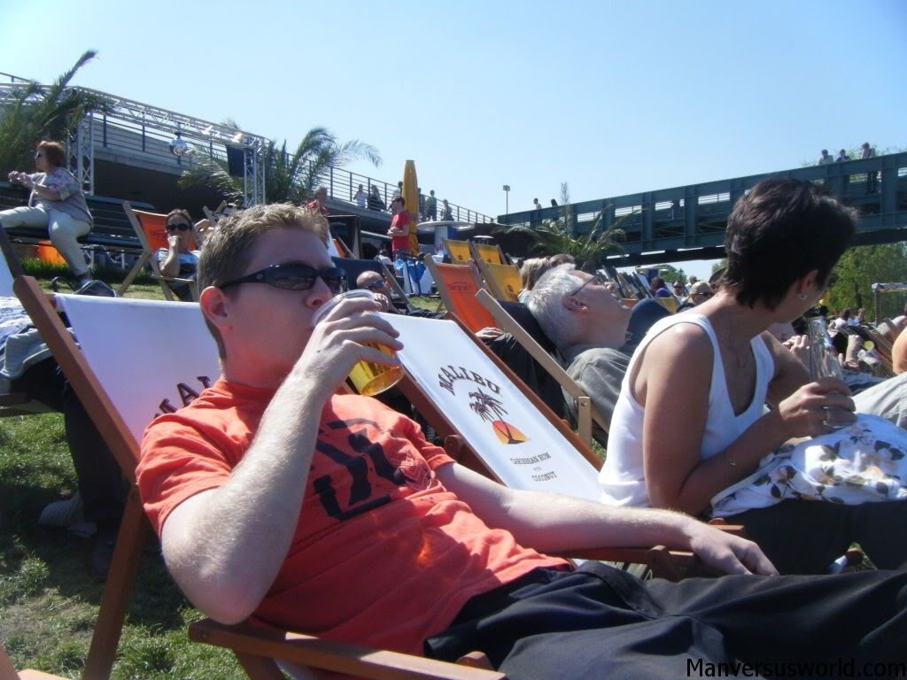
A relaxing break from prediction modeling

Slide 4
Reinforcement Learning in Psychology

Slide 5
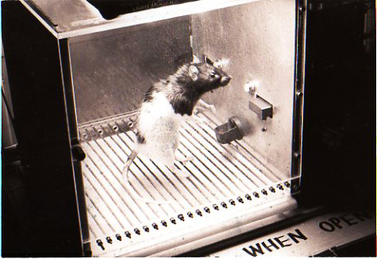
Reinforcement Learning in Psychology

Slide 6
Reinforcement Learning in CS
Totally different

Slide 7
Reinforcement Learning in CS
Totally different
Undergraduate receiving pellets rather than rat

Slide 8
Reinforcement Learning in CS (Really)
Learning from feedback
The computer program has actions it can take
The computer program gets feedback as to the success of those actions

Slide 9
Reinforcement Learning
Try to automatically learn a mapping from situations to actions
So that feedback is as positive as possible
Through trying actions and seeing the results

Slide 10
Example
I need 4 volunteers

Slide 11
Volunteer 1
You are a used glortz salesman
Your goal is to sell your greeble clients the most expensive possible used glortz
You have the following options
Offer more expensive glortz
Offer less expensive glortz
Discuss merits of current glortz
Demand they buy current glortz

Slide 12
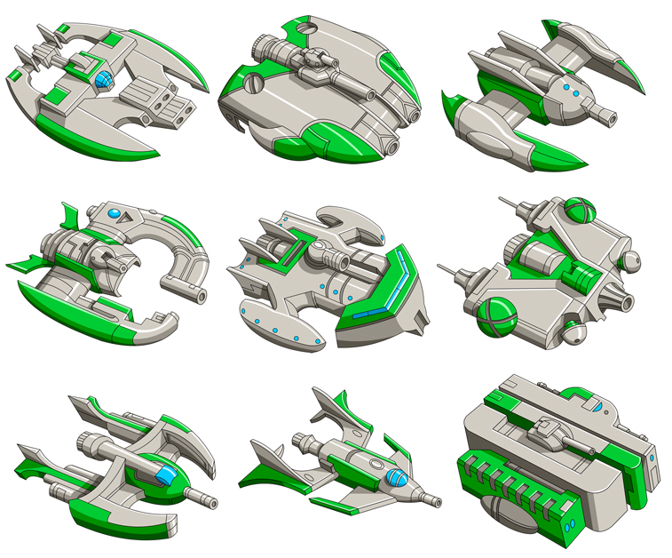
Glortzes (prices in Greldaks)
800
100
270
2500
1000
1270
5000
7000
19,000

Slide 13
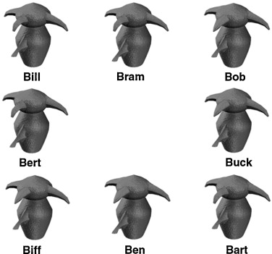

Slide 21
How much?
How much did glortz dealer 1 make in sales?

Slide 22
Volunteer 2
You are also a glortz salesman, at the glortz dealer next door

Slide 31
How much?
How did glortz dealer 2 do?

Slide 32
Volunteer 3
You are also a glortz salesman, at the glortz dealer down the street

Slide 41
How much?
How did glortz dealer 3 do?

Slide 42
Volunteer 4
You are also a glortz salesman, at the annual glortz trade show

Slide 51
How much?
How did glortz dealer 4 do?

Slide 52
This is Reinforcement Learning
Learning a mapping from situations to actions
What have we learned about our friends?

Slide 53
What are the meaningful features?

Slide 54
What do blue circles mean?

Slide 55
What do purple circles mean?

Slide 56
What do green squares mean?

Slide 57
Is every greeble with the same appearance the same?

Slide 58
How does it work in an automated fashion?
Try out actions to learn which produces highest rewards
At first, trial and error
Later, biased search

Slide 59
How does it work in an automated fashion?
Situations, Actions, Goals
Infer the situation
Choose the action
To achieve the goal

Slide 60
Exploration or Exploitation?
Exploitation – You can get the highest immediate rewards from trying the answer that is most likely to work
Exploration – But at least at first, this is unlikely to always be the right answer
And settling too early may prevent you from finding the best answer
Local minima problem

Slide 61
Deterministic or Stochastic?
Most real-world problems have some noise
Another reason to keep exploring early on in learning how to respond to a problem
And to try same solution to (seemingly) same case multiple times
Not all greebles that look the same are the same

Slide 62
Immediate reward or long-term reward?
The goal of method should be to infer greatest long-term reward, rather than immediate reward
Not obvious for Greldak salesman problem
Consider learning, though

Slide 63
Immediate reward or long-term reward?
For an intelligent tutor,
Different policies will lead to
Better short-term performance
Current problem
Better long-term performance
Next problem, next week

Slide 64
Example
Let’s say a tutor has the following actions every problem
Let student try to answer
Give hint
Give scaffolding
Give answer
If the reward in RL is “performance on current problem”
Then the best strategy is always “Give answer”
Probably not best for long-term performance

Slide 65
Policy computation
π(A_{n},S)= Prob(A_{n} |S)
S = current situation
A_{n} = action n is best (and should be chosen)
Through computing
Q(A_{n},S) = TotalReward(A_{n} |S)

Slide 66
Policy computation
TotalReward(A_{n} |S) = Reward_{now} + Reward_{now+1} + Reward_{now+2} + Reward_{now+3} + Reward_{end}
However, future rewards may be less certain than immediate rewards
d = time discount function between 0 and 1
TotalReward(A_{n} |S) = d* Reward_{now} + d²* Reward_{now+1} + d³* Reward_{now+2} + d⁴* Reward_{now+3} + d^{t} * Reward_{end}

Slide 67
Simplest Version
“Bandit Problem”
Just one situation
Determine which action generally has highest reward, regardless of situation

Slide 68
I need 2 volunteers

Slide 69
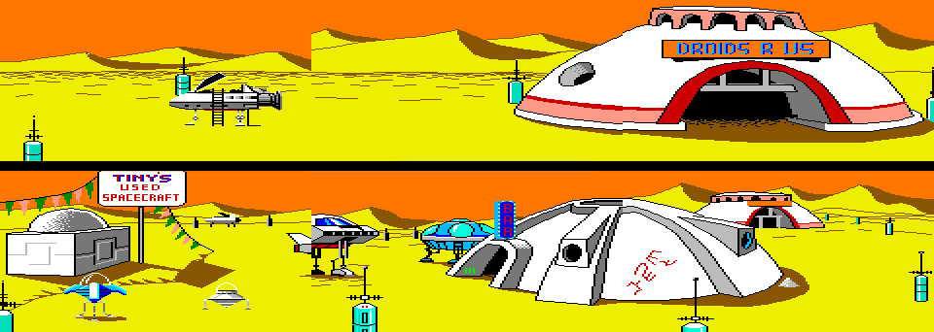
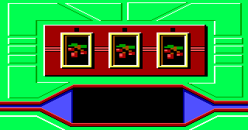
Volunteer 1: You are in the fabled casino in Ulence Flats

Slide 70
You can choose between three levers
Green lever
Red lever
Yellurple lever
(Don’t start yet)

Slide 71
Volunteer 2
Write down the results each time
One column for Red
One column for Green
One column for Yellurple
(Volunteer 1: you can’t look)

Slide 72
Volunteer 1
Play 100 times
Your goal is to make as much money as possible

Slide 73
Volunteer 2
What are the mean and SD for each option?

Slide 74
True values
RED: M = +2, SD= ~6
GREEN: M = + 40, SD = ~57
YELLURPLE: M = - 20, SD = ~57
What should the values be for:
π(A_{n},S)= Prob(A_{n} |S) Q(A_{n},S) = TotalReward(A_{n} |S)

Slide 75
True values
RED: M = +2, SD= ~6
GREEN: M = + 40, SD = ~57
YELLURPLE: M = - 20, SD = ~57
If this involved real money, what would you do?

Slide 76
Exploitation versus Exploration
Multiple strategies:
Greedy – always pick the action with highest Q
ε-Greedy – select random action ε percent of the time, else pick the action with highest Q

Slide 77
Exploitation versus Exploration
Softmax Algorithm
Tau influences aggressiveness
For Tau close to 0, model uses reward information strongly
For Tau close to infinity, model uses reward information very little

Slide 78
Becomes more complex…
When situation is taken into account
Model needs to figure out mapping from situation to reward
And which aspects of situation (e.g. features) matter

Slide 79
Becomes more complex…
When considering possibility that agent actions may actually change state of the world
E.g. reward function changes based on situation, and your actions change situation

Slide 80
Lots of algorithms
When situation is taken into account
Model needs to figure out mapping from situation to reward
And which aspects of situation (e.g. features) matter (e.g. lead to a significant difference in rewards)

Slide 81
POMDP
Partially observable markov decision process
Adds observations as well as rewards to RL
E.g. your actions change the situation, but you don’t know exactly how
All you know is what the agent can observe

Slide 82
Example of RL in EDM

Slide 83
Chi et al. (2011)
Goal: Choose strategy in Physics tutoring by expert human tutors
Situation
Range of features of past tutor behavior, past student behavior, and difficulty of current step
Action –
Elicit, Tell crossed with
Justify, Skip-Justify
Reward – Student’s Final Learning Gain from Pre-test to Post-test
Separate model developed for each of 8 KCs

Slide 84
Most commonly used selection features in final policies (final models not given in paper)
StepSimplicityPS: percentage of answers across all students that were correct for a step in training data
TuConceptsToWordsPS: ratio of physics concepts to words in the tutor's dialogue.
tellsSinceElicitA: the number of tells the student has received since the last elicit.
durationKCBetweenDecisionT: time since the last tutorial decision was made on the current KC.

Slide 85
Results
Using policy with new group of students led to better student learning than random policy
Also, using pre-post learning gain as reward function led to better student learning than using immediate performance

Slide 86
Questions? Comments?

Slide 87
Next Class
Monday, March 6
Advanced Detector Evaluation and Validation
Assignment Due: None

Slide 88
The End

