Slide 1
Special Topics in
Educational Data Mining
HUDK5199
Spring term, 2013
March 7, 2013

Slide 2
Today’s Class
Regression in Prediction

Slide 3
Regression in Prediction
There is something you want to predict (“the label”)
The thing you want to predict is numerical
  Number of hints student requests
  How long student takes to answer
  What will the student’s test score be

Slide 4
Regression in Prediction
A model that predicts a number is called a regressor in data mining
The overall task is called regression

Slide 5
Regression
Associated with each label are a set of “features”, which maybe you can use to predict the label
Skill pknow time totalactions numhints
ENTERINGGIVEN 0.704 9 1 0
ENTERINGGIVEN 0.502 10 2 0
USEDIFFNUM 0.049 6 1 3
ENTERINGGIVEN 0.967 7 3 0
REMOVECOEFF 0.792 16 1 1
REMOVECOEFF 0.792 13 2 0
USEDIFFNUM 0.073 5 2 0
….

Slide 6
Regression
The basic idea of regression is to determine which features, in which combination, can predict the label’s value
Skill pknow time totalactions numhints
ENTERINGGIVEN 0.704 9 1 0
ENTERINGGIVEN 0.502 10 2 0
USEDIFFNUM 0.049 6 1 3
ENTERINGGIVEN 0.967 7 3 0
REMOVECOEFF 0.792 16 1 1
REMOVECOEFF 0.792 13 2 0
USEDIFFNUM 0.073 5 2 0
….

Slide 7
Linear Regression
The most classic form of regression is linear regression
There are courses called “regression” at a lot of universities that don’t go beyond linear regression

Slide 8
Linear Regression
The most classic form of regression is linear regression
Numhints = 0.12*Pknow + 0.932*Time –
0.11*Totalactions
Skill pknow time totalactions numhints
COMPUTESLOPE 0.544 9 1 ?

Slide 9
Linear Regression
Linear regression only fits linear functions (except when you apply transforms to the input variables, which most statistics and data mining packages can do for you…)

Slide 10
Non-linear inputs
What kind of functions could you fit with
Y = X²
Y = X³
Y = sqrt(X)
Y = 1/x
Y = sin X
Y = ln X

Slide 11
Linear Regression
However…
It is blazing fast
It is often more accurate than more complex models, particularly once you cross-validate
  Caruana & Niculescu-Mizil (2006)
It is feasible to understand your model
(with the caveat that the second feature in your model is in the context of the first feature, and so on)

Slide 12
Example of Caveat
Let’s study a classic example

Slide 13
Example of Caveat
Let’s study a classic example
Drinking too much prune nog at a party, and having to make an emergency trip to the Little Researcher’s Room

Slide 14
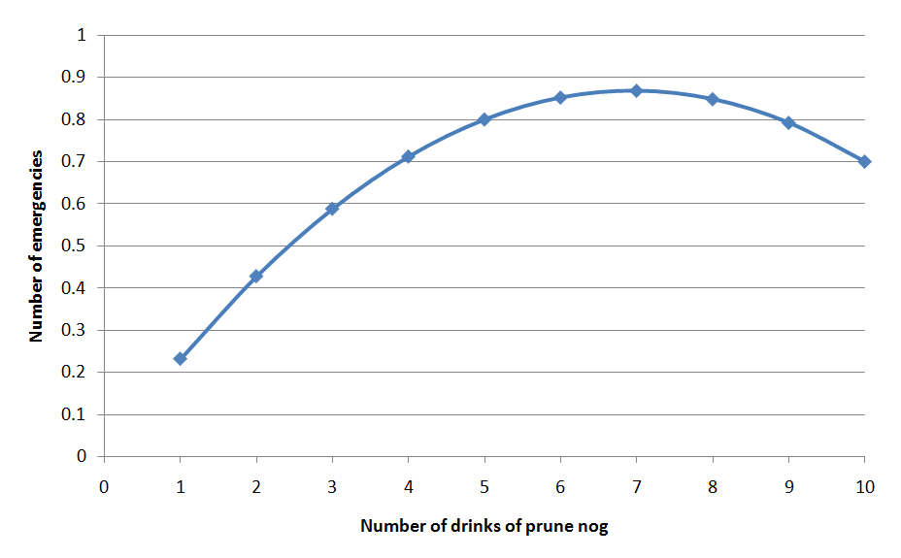
Data

Slide 15
Data
Some people are resistent to the deletrious effects of prunes and can safely enjoy high quantities of prune nog!

Slide 16
Learned Function
Probability of “emergency”=
0.25 * # Drinks of nog last 3 hours
- 0.018 * (Drinks of nog last 3 hours)²
But does that actually mean that
(Drinks of nog last 3 hours)² is associated with less “emergencies”?

Slide 17
Learned Function
Probability of “emergency”=
0.25 * # Drinks of nog last 3 hours
- 0.018 * (Drinks of nog last 3 hours)²
But does that actually mean that
(Drinks of nog last 3 hours)² is associated with less “emergencies”?
No!

Slide 18
Example of Caveat
(Drinks of nog last 3 hours)² is actually positively correlated with emergencies!
  r=0.59

Slide 19
Example of Caveat
The relationship is only in the negative direction when (Drinks of nog last 3 hours) is already in the model…

Slide 20
Example of Caveat
So be careful when interpreting linear regression models (or almost any other type of model)

Slide 21
Comments? Questions?

Slide 22
Regression Trees

Slide 23
Regression Trees
(non-linear; RepTree)
If X>3
  Y = 2
  else If X<-7
    Y = 4
    Else Y = 3

Slide 24
Linear Regression Trees
(linear; M5’)
If X>3
  Y = 2A + 3B
  else If X< -7
    Y = 2A – 3B
    Else Y = 2A + 0.5B + C

Slide 25
Create a Linear Regression Tree to
Predict Emergencies

Slide 26
Model Selection in
Linear Regression
Greedy
M5’
None

Slide 27
Neural Networks
Another popular form of regression is neural networks
(also called
Multilayer
Perceptron)
This image courtesy of Andrew W. Moore, Google
http://www.cs.cmu.edu/~awm/tutorials

Slide 28
Neural Networks
Neural networks can fit more complex functions than linear regression
It is usually near-to-impossible to understand what the heck is going on inside one

Slide 29
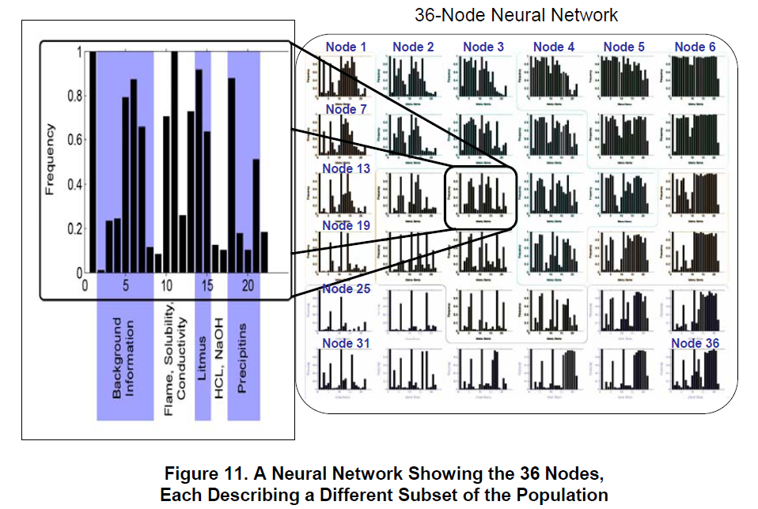
Soller & Stevens (2007)

Slide 30
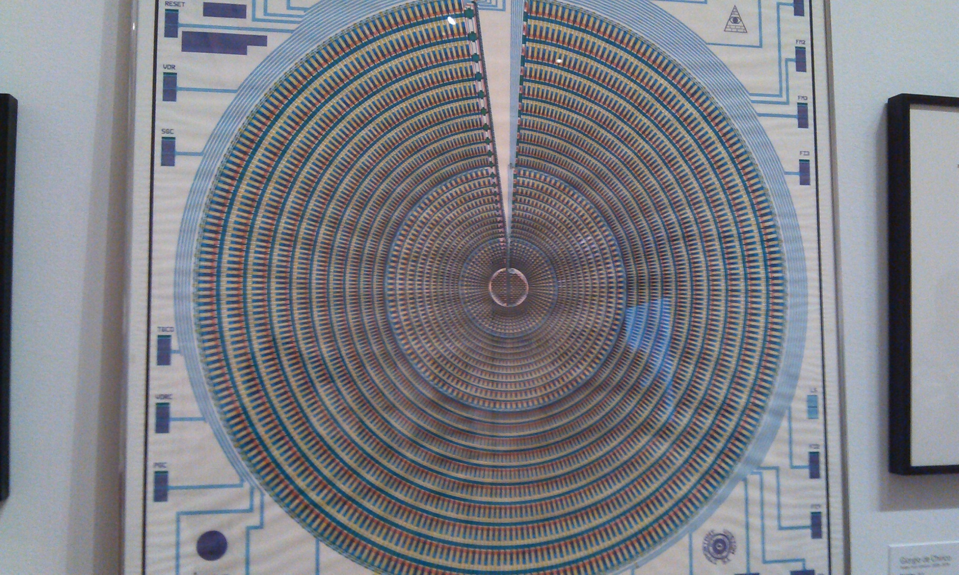
Neural Network at the MOMA

Slide 31
In fact
The difficulty of interpreting non-linear models is so well known, that they put up a sign about it on the Belt Parkway

Slide 32
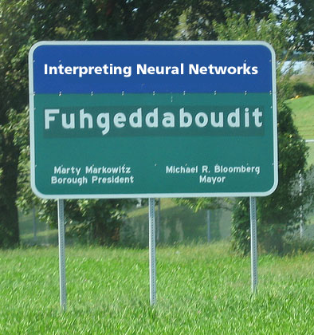

Slide 33
And of course…
There are lots of fancy regressors in Data Mining packages like RapidMiner
Support Vector Machine
Poisson Regression
LOESS Regression (“Locally weighted scatterplot smoothing”)
Regularization-based Regression
(forces parameters towards zero)
  Lasso Regression (“Least absolute shrinkage and selection operator”)
  Ridge Regression

Slide 34
Assignment 5
Let’s discuss your solutions to assignment 5

Slide 35
How can you tell if a regression model is any good?

Slide 36
How can you tell if a regression model is any good?
Correlation/r²
RMSE/MAD
What are the advantages/disadvantages of each?

Slide 37
Cross-validation concerns
The same as classifiers

Slide 38
Statistical Significance Testing
F test/t test
But make sure to take non-independence into account!
  Using a student term

Slide 39
Statistical Significance Testing
F test/t test
But make sure to take non-independence into account!
  Using a student term
  (but note, your regressor itself should not predict using student as a variable… unless you want it to only work in your original population)

Slide 40
As before…
You want to make sure to account for the non-independence between students when you test significance
An F test is fine, just include a student term
(but note, your regressor itself should not predict using student as a variable… unless you want it to only work in your original population)

Slide 41
Alternatives
Bayesian Information Criterion
Akaike Information Criterion
Makes trade-off between goodness of fit and flexibility of fit (number of parameters)
Said to be statistically equivalent to cross-validation
  May be preferable for some audiences

Slide 42
Questions? Comments?

Slide 43
Asgn. 7

Slide 44
Next Class
Wednesday, March 13
Imputation in Prediction
Readings
Schafer, J.L., Graham, J.W. (2002) Missing Data: Our View of the State of the Art. Psychological Methods, 7 (2), 147-177
Assignments Due: None

Slide 45
The End

