Slide 1
Special Topics in Educational Data Mining
HUDK50199 Spring term, 2013
April 1, 2012

Slide 2
Today’s Class
Discovery with Models

Slide 3
Discovery with Models: The Big Idea
A model of a phenomenon is developed
Via
Prediction
Clustering
Knowledge Engineering
This model is then used as a component in another analysis

Slide 4
Can be used in Prediction
The created model’s predictions are used as predictor variables in predicting a new variable
E.g. Classification, Regression

Slide 5
Can be used in Relationship Mining
The relationships between the created model’s predictions and additional variables are studied
This can enable a researcher to study the relationship between a complex latent construct and a wide variety of observable constructs
E.g. Correlation mining, Association Rule Mining

Slide 6
“Increasingly Important…”
Baker & Yacef (2009) argued that Discovery with Models is a key emerging area of EDM
I think that’s still true, although it has been a bit slower to become prominent than I might have expected

Slide 7
First paper focused on discovery with models as a method (in EDM)
Hershkovitz, A., Baker, R.S.J.d., Gobert, J., Wixon, M., Sao Pedro, M. (in press) Discovery with Models: A Case Study on Carelessness in Computer-based Science Inquiry. To appear in American Behavioral Scientist.

Slide 8
Some prominent recent DWM analyses
Muldner, K., Burleson, W., Van de Sande, B., & VanLehn, K. (2011). An analysis of students’ gaming behaviors in an intelligent tutoring system: predictors and impacts. User Modeling and User-Adapted Interaction, 21(1), 99-135. [Winner of James Chen Best UMUAI Paper Award]
Baker, R.S.J.d., Gowda, S., Corbett, A., Ocumpaugh, J. (2012) Towards Automatically Detecting Whether Student Learning is Shallow. Proceedings of the International Conference on Intelligent Tutoring Systems, 444-453. [ITS2012 Best Paper]
Pardos, Z.A., Baker, R.S.J.d., San Pedro, M.O.C.Z., Gowda, S.M., Gowda, S.M. (in press) Affective states and state tests: Investigating how affect throughout the school year predicts end of year learning outcomes. To appear in Proceedings of the 3rd International Conference on Learning Analytics and Knowledge.
Fancsali, S. (2012) Variable Construction and Causal Discovery for Cognitive Tutor Log Data: Initial Results. Proceedings of EDM2012, 238-239.

Slide 9
Some prominent recent DWM analyses
Dawson, S., Macfadyen, L., Lockyer, L., & Mazzochi-Jones, D. (2011). Using social network metrics to assess the effectiveness of broad-based admission practices. Australasian Journal of Educational Technology, 27(1), 16-27.
Obsivac, T., Popelinsky, L., Bayer, J., Geryk, J., Bydzovska, H. Predicting drop-out from social behaviour of students. Proceedings of EDM2012, 103-109.
Kinnebrew, J. S., Biswas, G., & Sulcer, B. (2010). Modeling and measuring self-regulated learning in teachable agent environments. Journal of e-Learning and Knowledge Society, 7(2), 19-35.
Yoo, J., Kim, J. (2012) Predicting Learner’s Project Performance with Dialogue Features in Online Q&A Discussions. Proceedings of ITS2012, 570-575.

Slide 10
Advantages of DWM

Slide 11
Advantages of DWM
Possible to Analyze Phenomena at Scale
Even for constructs that are
latent
expensive to label by hand

Slide 12
Advantages of DWM
Possible to Analyze Phenomena at Scale
At scales that are infeasible even for constructs that are quick & easy to label by hand
Scales easily from hundreds to millions of students
Entire years or (eventually) entire courses of schooling
Predicting Nobel Prize winners from kindergarten iPad drawings?

Slide 13
Advantages of DWM
Supports inspecting and reconsidering coding later
Leaves clear data trails
Can substitute imperfect model with a better model later and re-run
Promotes replicability, discussion, debate, and scientific progress

Slide 14
Disadvantages of DWM
Easy to Do Wrong!

Slide 15
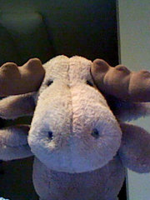
Discovery with Models: Here There Be Monsters

Slide 16
Discovery with Models: Here There Be Monsters
“Rar.”

Slide 17
Discovery with Models: Here There Be Monsters
It’s really easy to do something badly wrong, for some types of “Discovery with Models” analyses
No warnings when you do

Slide 18
Think Validity
Validity is always important for model creation
Doubly-important for discovery with models
Discovery with Models almost always involves applying model to new data
How confident are you that your model will apply to the new data?

Slide 19
Challenges to Valid Application
What are some challenges to valid application of a model within a discovery with models analysis?

Slide 20
Challenges to Valid Application
Is model valid for population?
Is model valid for all tutor lessons? (or other differences)
Is model valid for setting of use? (classroom versus homework?)
Is the model valid in the first place? (especially important for knowledge engineered models)

Slide 21
Example
Baker & Gowda (2010) take detectors of

Slide 22
Off-task behavior
Baker’s (2007) Latent Response Model machine-learned detector of off-task behavior
Trained using data from students using a Cognitive Tutor for Middle School Mathematics in several suburban schools
Validated to generalize to new students and across Cognitive Tutor lessons

Slide 23
Gaming the System
Baker & de Carvalho’s (2008) Latent Response Model machine-learned detector of gaming the system
Trained using data from population of students using Algebra Cognitive Tutor in suburban schools
Approach validated to generalize between students and between Cognitive Tutor lessons (Baker, Corbett, Roll, & Koedinger, 2008)
Predicts robust learning in college Genetics (Baker, Gowda, & Corbett, 2011)

Slide 24
Carelessness
Baker, Cobett, & Aleven’s (2008) machine-learned detector of carelessness
Trained and cross-validated using data from year-long use of Geometry Cognitive Tutor in suburban schools
Detectors transfer from USA to Philippines and vice-versa (San Pedro et al., 2011)

Slide 25
And Apply Detectors To
3 high schools in Southwestern Pennsylvania
Urban
Rural
Suburban
Using Cognitive Tutor Geometry

Slide 26
Results

Slide 27
% Off-Task
 | Urban school | Suburban school | Rural school
 | 34.1% (18.0%) | 15.4% (20.7%) | 20.4% (13.3%)
All differences in color statistically significant at p<0.05, using Tukey’s HSD

Slide 28
% Gaming the System
 | Urban school | Suburban school | Rural school
 | 7.4% (2.2%) | 6.9% (3.1%) | 6.6% (1.7%)
All differences in color statistically significant at p<0.05, using Tukey’s HSD

Slide 29
Carelessness Probability
 | Urban school | Suburban school | Rural school
 | 0.50 (0.07) | 0.32 (0.11) | 0.27 (0.13)
All differences in color statistically significant at p<0.05, using Tukey’s HSD

Slide 30
Valid?
These detectors were validated as thoroughly as any detectors (except student knowledge) in educational software had been in 2010
But were they validated enough to trust when they predicted differences between schools?
Your thoughts?

Slide 31
Trade-off
Part of the point of discovery with models is to conduct analyses that would simply be impossible without the model, which typically means generalizing beyond original samples
Many types of measures are used outside the context where they were tested
Questionnaires in particular
The key is to find a balance between paralysis and validity
And be honest about what you did so that others can replicate and disagree

Slide 32
How much does it matter?

Slide 33
The Great Gaming Squabble

Slide 34
The Great Gaming Squabble
Baker (2007) used a machine-learned detector of gaming the system to determine whether gaming the system is better predicted by student or tutor lesson
Using data from an entire year of students at one school using Cognitive Tutor Algebra

Slide 35
The Great Gaming Squabble
Muldner, Burleson, van de Sande, & Van Lehn (2011) developed a knowledge-engineered detector of gaming the system
They applied it first to their own data, then to the same data Baker used
Already a victory for Discovery with Models

Slide 36
Validation
Baker’s gaming detector
Detector was validated for a different population than the research population (middle school versus high school)
Detector was validated for new lessons in 4 cases
Muldner et al.’s gaming detector
Detector was not formally validated, but was inspected for face validity

Slide 37
The Great Gaming Squabble
Baker (2007) found that gaming better predicted by lesson
Muldner et al. (2011) found that gaming better predicted by student
Which one should we trust?

Slide 38
The Great Gaming Squabble
Recent unpublished research by the two groups working together (cf. Hershkovitz et al., in preparation)
For a certain definition of working together
E.g. van de Sande & Van Lehn involved, but not Muldner
Found that a human coder’s labeling of clips where the two detectors disagree…
Achieved K=0.17 with the ML detector
And K= -0.17 with the KE detector

Slide 39
The Great Gaming Squabble
Which one should we trust?
(Neither?)

Slide 40
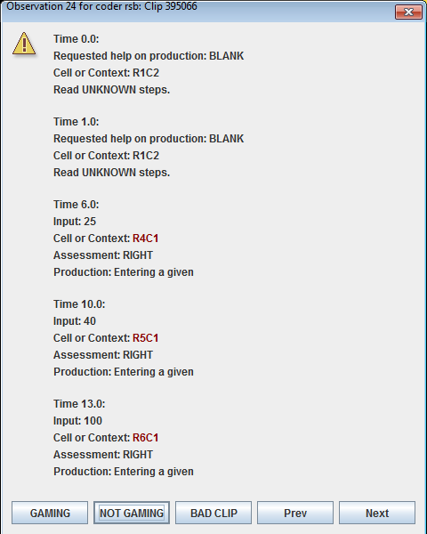
Misidentification of Gaming (Muldner et al.’s detector)
This was seen as gaming, because quick response after hint

Slide 41
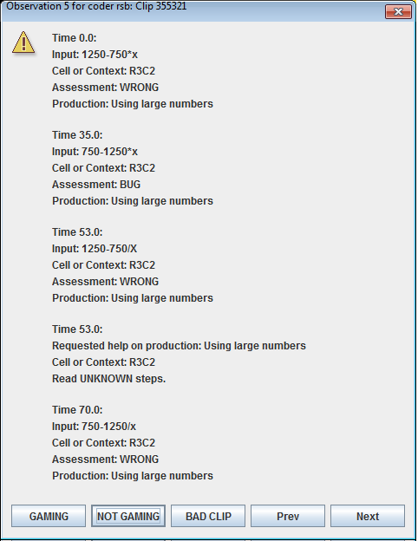
Misidentification of Non-Gaming (Muldner et al.’s detector)

Slide 42
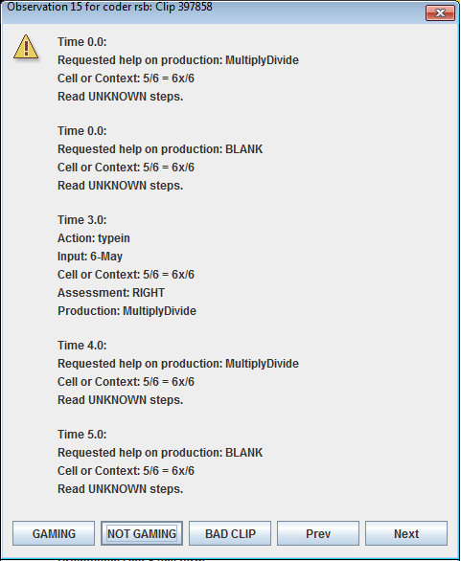
Misidentification of Non-Gaming (Baker et al.’s detector)

Slide 43
ML and KE don’t always disagree
In Baker et al. (2008)
Baker and colleagues conducted two studies correlating ML detectors of gaming to learner characteristics questionnaires
Walonoski and Heffernan conducted one study correlating KE detector of gaming to learner characteristics questionnaires
Very similar overall results!

Slide 44
Converging evidence increases our trust in the finding…

Slide 45
Models on top of Models

Slide 46
Models on top of Models
Another area of Discovery with Models is composing models out of other models
Examples:
Models of Gaming the System and Help-Seeking use Bayesian Knowledge-Tracing models as components (Baker et al., 2004, 2008a, 2008b; Aleven et al., 2004, 2006)
Models of Preparation for Future Learning use models of Gaming the System as components (Baker et al., 2011)
Models of Affect use models of Off-Task Behavior as components (Baker et al., 2012)
Models predicting college attendance use models of Affect and Off-Task Behavior as components (Pardos et al., in press)

Slide 47
Models on top of Models
When I talk about this, people often worry about building a model on top of imperfect models
Will the error “pile up”?

Slide 48
Models on top of Models
But is this really a risk?
If the final model successfully predicts the final construct, do we care if the model it uses internally is imperfect?
What would be the dangers?

Slide 49
The Power of Models-upon-Models

Slide 50
The Power of Models-upon-Models
Pardos et al. (in press) use models of affective states to predict state standardized exam scores
Can be used to understand broader impacts of affect on learning
San Pedro et al. (under review) use models of affective states and learning to predict who will go to college, using data from middle school
Can be used to determine which students are at-risk and why a specific student is at-risk

Slide 51
Comments? Questions?

Slide 52
Comparing Risks
Which is more dangerous?

Slide 53
Monsters or Dragons?

Slide 54
Monsters or Dragons?
“Rar.”

Slide 55
Asgn. 7
Questions?
Comments?

Slide 56
Next Class
Wednesday, April 3
Factor Analysis
Readings
Alpaydin, E. (2004) Introduction to Machine Learning. pp. 116-120.
Assignments Due: NONE

Slide 57
The End

