Slide 1
HUDK5199: Special Topics in Educational Data Mining
February 13, 2013

Slide 2
Special Session on Excel
We couldn’t find a time that worked for a majority of you guys and worked for me
So instead, we will start using the time between 4:40pm-5pm to go through Excel, RapidMiner, etc., tips and methods
Starting next class
I will also try to cover more of this in class (I started last time)
We’ll end promptly at 5pm, since I know some of you have 5:10pm classes

Slide 3
Today’s Class
Knowledge Structure

Slide 4
Q-Matrix (Tatsuoka, 1983; Barnes, 2005)
 | Skill1 | Skill2 | Skill3 | Skill4
Item1 | 1 | 0 | 0 | 0
Item2 | 1 | 1 | 0 | 0
Item3 | 1 | 0 | 1 | 0
Item4 | 0 | 0 | 0 | 1
Item5 | 0 | 0 | 1 | 1
Item6 | 0 | 1 | 0 | 0

Slide 5
Example
 | Add | Subtract | Multiply | Divide
7 + 3 + 2 | 1 | 0 | 0 | 0
7 + 3 - 2 | 1 | 1 | 0 | 0
(7 + 3) * 2 | 1 | 0 | 1 | 0
7 / 3 / 2 | 0 | 0 | 0 | 1
7 * 3 / 2 | 0 | 0 | 1 | 1
7 - 3 - 2 | 0 | 1 | 0 | 0

Slide 6
How do we create a Q-Matrix?
Hand-development and refinement
Learning curves, as discussed by John
Automatic model discovery
Barnes’s approach; other approaches
Hybrid approaches
LFA, as discussed by John

Slide 7
Examples from Homework
Let’s look at some examples of how you did this in the homework
After that, I will go over Barnes’s Q-Matrix discovery algorithm in more detail
As well as more complex models of domain knowledge structure

Slide 8
Solutions
Factor Analysis (most common solution) – Huacheng Li, Diego Luna Bazaldua
Correlation Matrix to Q-Matrix – Madeline Weiss
Fitting Q-Matrix – Cameron White

Slide 9
“True” Q-Matrix (It is Simulated Data)
 | 1 | 2 | 3 | 4
1 | 1 | 0 | 0 | 0
2 | 0 | 1 | 0 | 0
3 | 0 | 0 | 1 | 0
4 | 0 | 0 | 0 | 1
5 | 1 | 0 | 1 | 0
6 | 0 | 1 | 0 | 1
7 | 0 | 0 | 1 | 0
8 | 0 | 0 | 1 | 0

Slide 10
Perfect match to Madeline & Huacheng
 | 1 | 2 | 3 | 4
1 | 1 | 0 | 0 | 0
2 | 0 | 1 | 0 | 0
3 | 0 | 0 | 1 | 0
4 | 0 | 0 | 0 | 1
5 | 1 | 0 | 1 | 0
6 | 0 | 1 | 0 | 1
7 | 0 | 0 | 1 | 0
8 | 0 | 0 | 1 | 0

Slide 11
Hand Development and Refinement
John Stamper showed examples of how learning curves and other DataShop tools can be used to do hand development and refinement of knowledge structures

Slide 12
Hybrid Approaches
John Stamper discussed the LFA algorithm in class

Slide 13
Automated Model Discovery
Let’s go through Barnes, Bitzer, & Vouk’s (2005) pseudocode for fitting a Q-Matrix

Slide 14
Step 1
Create an item/skill matrix
How many skills should we use?
(In the algorithm, you repeat for 1 skill, 2 skills, etc., until N+1 skills does not lead to a better model than N skills)

Slide 15
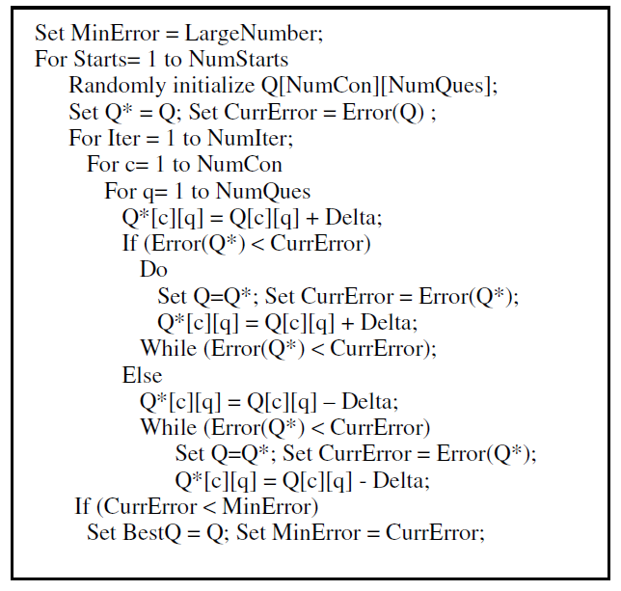
Step 2: Follow pseudocode

Slide 16
Q-Matrices
Questions? Comments?

Slide 17
Q-Matrix Discovery
Let’s fit a Q-Matrix
For Feb. 13 class data set
Using algorithm from Barnes, Bitzer, & Vouk

Slide 18
More complex approaches
Other Q-matrix approaches
Non-negative matrix factorization
Other knowledge structures
Partial Order Knowledge Structures
Bayesian Networks

Slide 19
Non-negative matrix factorization (Desmarais et al., 2012)
Approach similar to principal component analysis or factor analysis
Reduces dimensionality of data by finding groups of items associated with each other
Involves Linear Algebra; we won’t go into the mathematics today

Slide 20
Partial Order Knowledge Structures (Desmarais et al., 1996, 2006)
Postulate relationships between items
Mastery of one item is prerequisite to mastery of another item

Slide 21
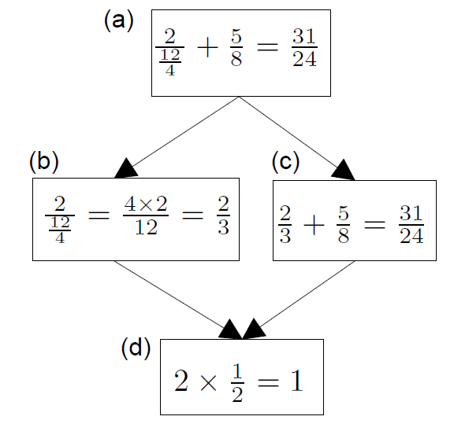
Example (Desmarais et al., 2006)
B does not inform us about C
If student succeeds at C, they will succeed at D;
D is prerequisite to C

Slide 22
Extension to skills
POKS can be extended rather easily to use skills (interchangeable items) rather than items

Slide 23
Bayesian Networks
Less restricted set of models that also infer relationships between skills and items, and between skills
Can infer more complicated relationships between material than the very restricted set of relationships modeled in POKS
Can infer {skill-skill, item-item, skill-item} relationships at the same time
Can integrate very diverse types of information
That extra flexibility can lead to over-fitting (cf. Desmarais et al., 2006)

Slide 24
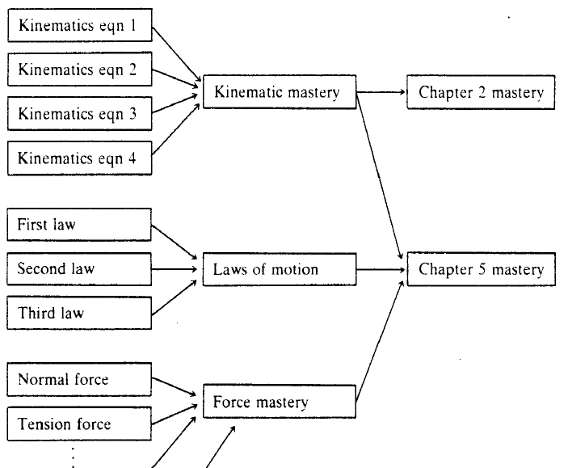
Martin & VanLehn (1995)

Slide 25
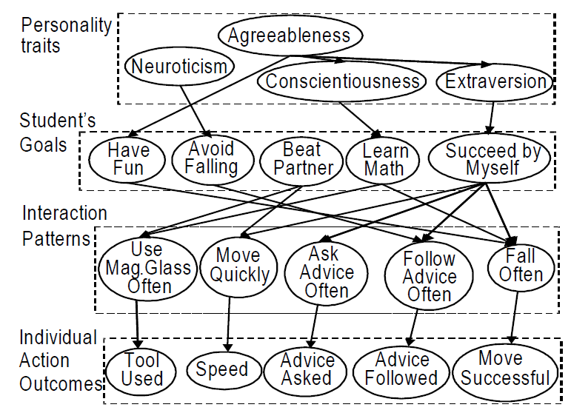
Conati et al., 2009

Slide 26
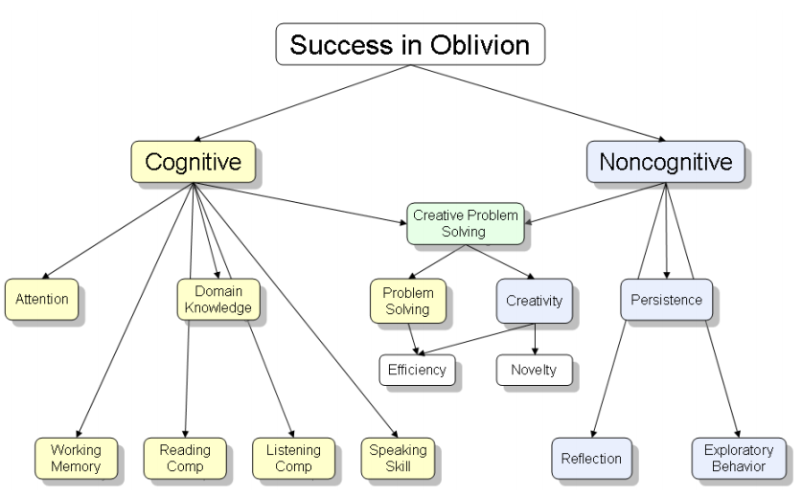
Shute et al., 2009

Slide 27
Next Class
Wednesday, February 20
Classification Algorithms
Witten, I.H., Frank, E. (2011) Data Mining: Practical Machine Learning Tools and Techniques. Ch. 4.7, 6.1, 6.2, 6.5, 6.7
Assignments Due: None

Slide 28
The End

